Slide 1

Midterm Project – Reproducing Published Results
CS 8803: Reinforcement Learning
21 Feb 2016

Slide 2
Implementation Details
BURLAP used to replicate experiment
TD(λ) algorithm built in
Easily implement graph defined MDP
Difficulties
Updating state values (weights) when using static training sets
Used planFromState() method instead
This negatively affected ability to reproduce results
Consistency
Accuracy
Notes:
I used burlap because of all the built in libraries. However, I did have some problems that made reproducing Sutton’s results difficult. Namely, I was unable to successfully replay the training sets with the TD lambda algorithm. Instead, I had to use planfrom state which did not permit specifying the state action next state tuples. I know these negatively affected my results.

Slide 3
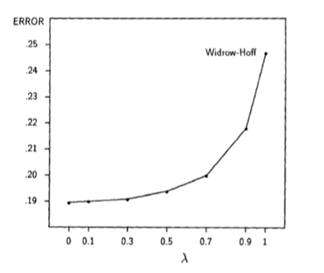
Results – Experiment 1
Similarities
TD(1) is worst
TD(0) is best
Differences
Shape
Absolute error
Discount factor and learning rate are not specified because they affect rate of convergence, not actual convergence value
Notes:
Here are the results from the first experiment. Sutton’s results are on the left while mine are on the right. There are a few similarities. We see that TD(1) has the worst error while TD(0) has the best. We see that the general trend of the graph is the same, but the shape is not. We also see that the errors that Sutton had are significantly lower than what I experienced.

Slide 4
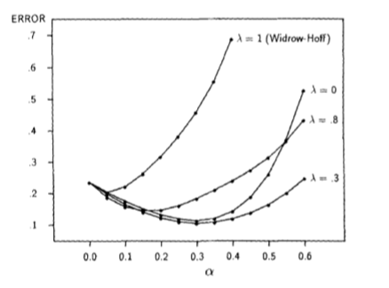
Results – Experiment 2
Similarities
General trend
Start, dip, sharp increase
Differences
Best learning rate is not ~0.3
Some values of lambda behave significantly different
Notes:
Here are the results from the second experiment. Again, Sutton’s results are on the left while mine are on the right. Similarities here were harder to find but still present. The general trend is still there from mid range error to lowest error to highest error. However, we see that some values of lambda have significantly different behavior. We also see that the best learning in my experiments was around 0.05 while for Sutton is was around 0.3

Slide 5
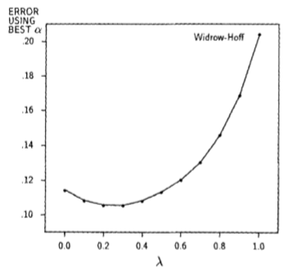
Results – Experiment 2
Similarities
TD(1) is worst
Error decreases for a time
TD(0.3) has one of the lowest errors
Differences
TD(0) still has best estimate
The reproduced results look very similar to those from Experiment 1. This implementation must propagate information faster than in Sutton.
Notes:
These are the results of experiment 2 presented in a slightly different manner – taking the best learning rate and plotting those errors versus lambda. Again we see that TD(1) has the most error in both cases and that TD(0.3) has one of the lowest. However Sutton specifically points out that TD(0) did not have the lowest error in his experiment where in mine it does. This is probably due to an implementation difference where my TD lambda propagates back faster than in his case.

Slide 6
Conclusion
Confirmed some results
TD(0) had best estimate of state values
TD(1) had worst, even with the best learning rate
Result differences
Best learning rate: 0.05 vs 0.3
TD(0) had best estimate even with single presentation vs TD(0.3)
Future work
Implement experiments using actual training sets rather than randomly generating sequences each time
Perhaps use a different tool
MDPToobox for Python
Notes:
In conclusion I was able to confirm some of Sutton’s results but not all. TD(0) had the best state estimates while TD(1) had the worst. However, there were a number of differences that should be explored further, namely the differences in learning rates and why TD(0) still produced the best estimate even with a single presentation of a training set. Future work should include successfully implementing training sets either using BURLAP or with another tool such as the MDPToolbox for Python

