Slide 1
Final Project Multi-Agent Games
CS8803: Reinforcement Learning
17 April 2016
Notes:
Hello, my name is Jacob Kilver and this is my presentation on my final project for Reinforcement Learning

Slide 2
Implementation Details
BURLAP was used to replicate results
Correlated Q, Friend Q, Foe Q implemented in BURLAP
Framework for stochastic grid games
Challenge was constructing the soccer game environment
Created new classes for GridGame and GridGameMechanics in addition to some smaller classes
Specialized them for use with the soccer grid game environment
Used the Q learning algorithms already in BURLAP
Correlated Q
Friend Q
Foe Q
For traditional Q learning
Notes:
I am assuming you are familiar with the experiments being done here so I will go straight to how I went about reproducing them. I used BURLAP for this project because it already had a framework for stochastic grid games and many of the more complicated Q learning algorithms were already implemented.
The challenge then was to construct the soccer grid game environment in BURLAP. I ended up creating some new classes based off of BURLAP’s GridGame and GridGameMechanics classes and specialized them for this particular soccer grid game.
I used the correlated Q, Friend Q, and Foe Q algorithms built into BURLAP. For the traditional Q learning

Slide 3
Results
Able to show that Correlated Q, Foe Q, and Friend Q converged
Learning did not converge as in Greenwald and Hall
Smoother
Faster
Could be due to differences in
Discount factor
Initial Q values
Learning rates
Construction of graphs – removed zero values for cleaner look
Learning rates
Constant
Exponential decay
Notes:
In the charts to follow, I was able to show that correlated Q, Foe Q, and Friend Q all converge just as in Greenwald and Hall. However, I was not able to produce charts that were similar to Greenwald and Hall in the way they converged. In short, the various Q learners converged smoother and faster than in the Greenwald and Hall paper. This could be the result of differences in discount factors, initial Q values, and learning rates. I also removed zero values from the graphs to make them look cleaner since most of the data were zeros.
Just a little note on the learning rates. The charts to follow show results using a constant learning rate and with an exponential decay learning rate because the Greenwald paper was not clear which was used.

Slide 4
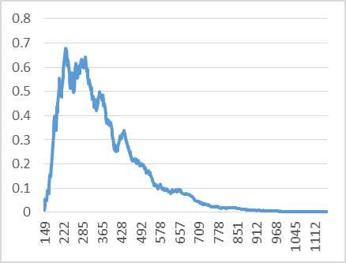
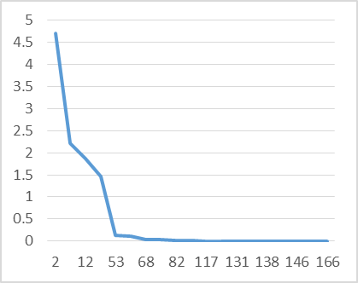
Results – Correlated Q
Constant learning rate
Exponential decay learning rate
Constant learning rate looks most similar to results of Greenwald and Hall
Exponential decay looks more like Friend Q
Notes:
Of all the Q learners that converge, the correlated Q with constant learning rate looks the most similar to that of Greenwald and Hall. The exponential decay plot looks more like the Friend Q chart from Greenwald and Hall

Slide 5
Results – Foe Q
Constant learning rate
Exponential decay learning rate
Looks more like Friend Q in Greenwald and Hall
Notes:
The results for Foe Q in both cases look more like that of Friend Q in Greenwald and Hall

Slide 6
Results – Friend Q
Constant learning rate
Exponential decay learning rate
Exponential decay does not look too different from Greenwald and Hall
Notes:
For Friend Q, the exponential decay results do not look dissimilar to those from Greenwald and Hall, especially if the scale from Greenwald and Hall were used here.

Slide 7
Results – Naïve Q
Constant learning rate
Exponential decay learning rate
Results strongly agree with Greenwald and Hall
Q values never converge
Decay on right only seen because of learning rate decay
Exponential decay much faster than in Greenwald and Hall
Notes:
The naïve Q results strongly agree with those from Greenwald and Hall. The Q values never converge. For the constant learning rate there is no decay, while with decayed learning rate learner decays only due to the learning rate. This decay is still much faster than in Greenwald and Hall.

Slide 8
Conclusion
Results from Greenwald and Hall were confirmed
Correlated Q, Foe Q, and Friend Q converge
Traditional Q learning does not
Better reproduce plots
Experiment more widely with variations in
Learning rate
Initial Q values
Discount factor
Epsilon – Probability a random action is performed
Create visualization of learning for better debugging/understanding
Notes:
The major results from Greenwald and Hall were confirmed. Correlated Q, Foe Q, and Friend Q all have Q values that converge while traditional Q learning does not.
For future work, the results from Greenwald and Hall should be attempted to be matched more closely. More variations in learning rates, initial Q values, discount factors, and epsilon. Additionally, a way to visualize the soccer game being played and how Q values are updated would aid in understanding and in finding problems.

