Slide 1
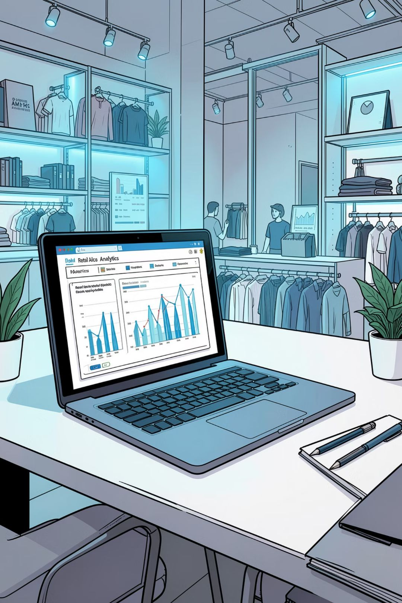
Customer Shopping Behavior Analysis
Analysis of 3,900 purchases to uncover spending patterns, segments, product preferences, and subscription behavior to inform strategy.

Slide 2
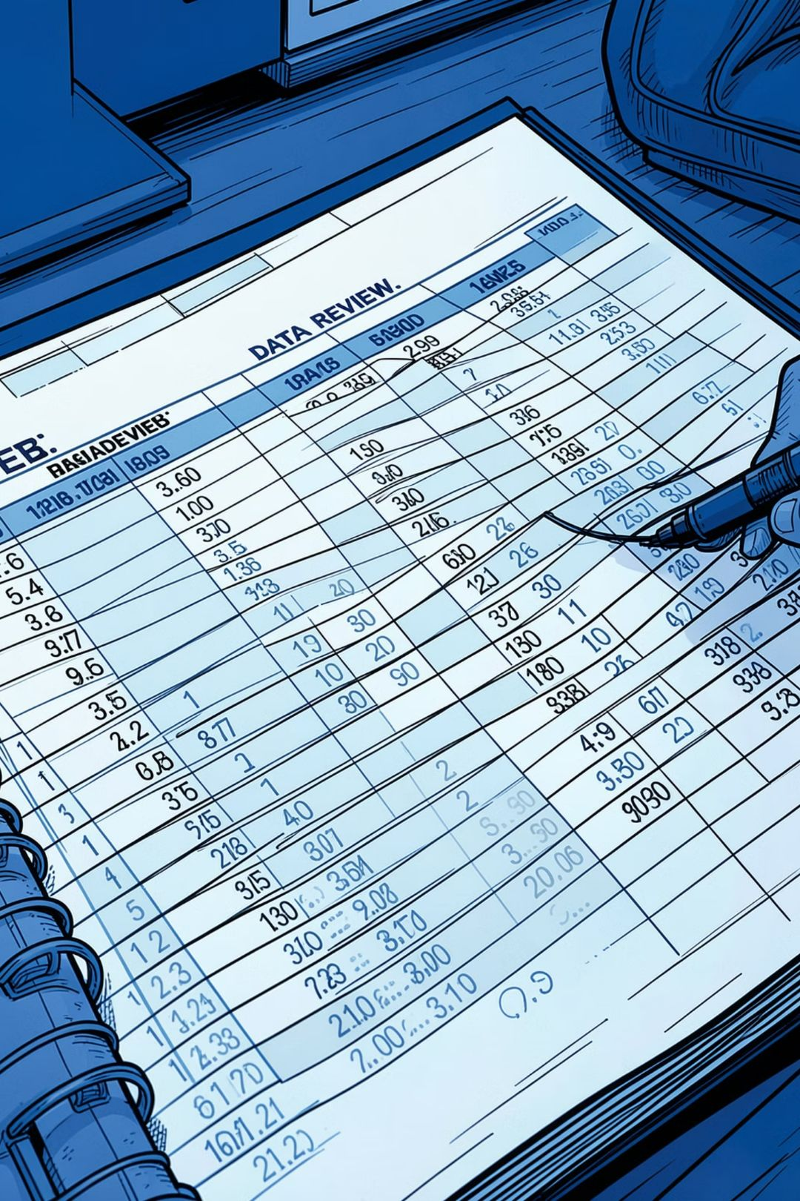
Dataset Snapshot
Rows & Columns
Key Features
3,900 rows · 18 columns
Demographics, purchase details, behavior, and shipping
Missing Data
37 nulls in Review Rating

Slide 3

Data Preparation (Python)
Loaded with pandas, inspected with df.info() and .describe(). Imputed Review Rating nulls using category medians. Renamed columns to snake_case and engineered age_group and purchase_frequency_days. Dropped promo_code_used after checking redundancy with discount_applied.

Slide 4

Database Integration & SQL Workflow
01
Load
Push cleaned DataFrame to MySQL
02
Query
Run aggregated analyses for business questions
03
Export
Feed results to reporting tools (Power BI)

Slide 5
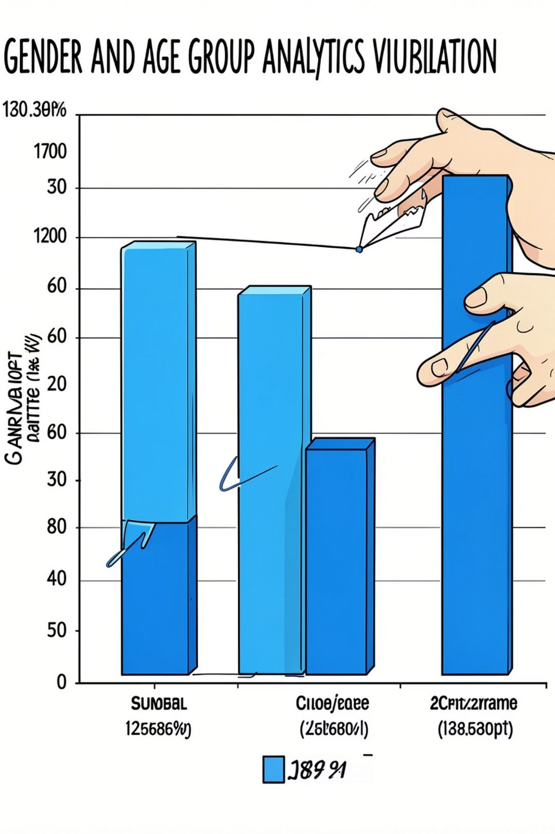
Revenue & Demographics (SQL Results)
Female
Total revenue: 75,191
Male
Total revenue: 157,890
Revenue by Age Group
Young Adult 62,143 · Middle-aged 59,197 · Adult 55,978 · Senior 55,763

Slide 6

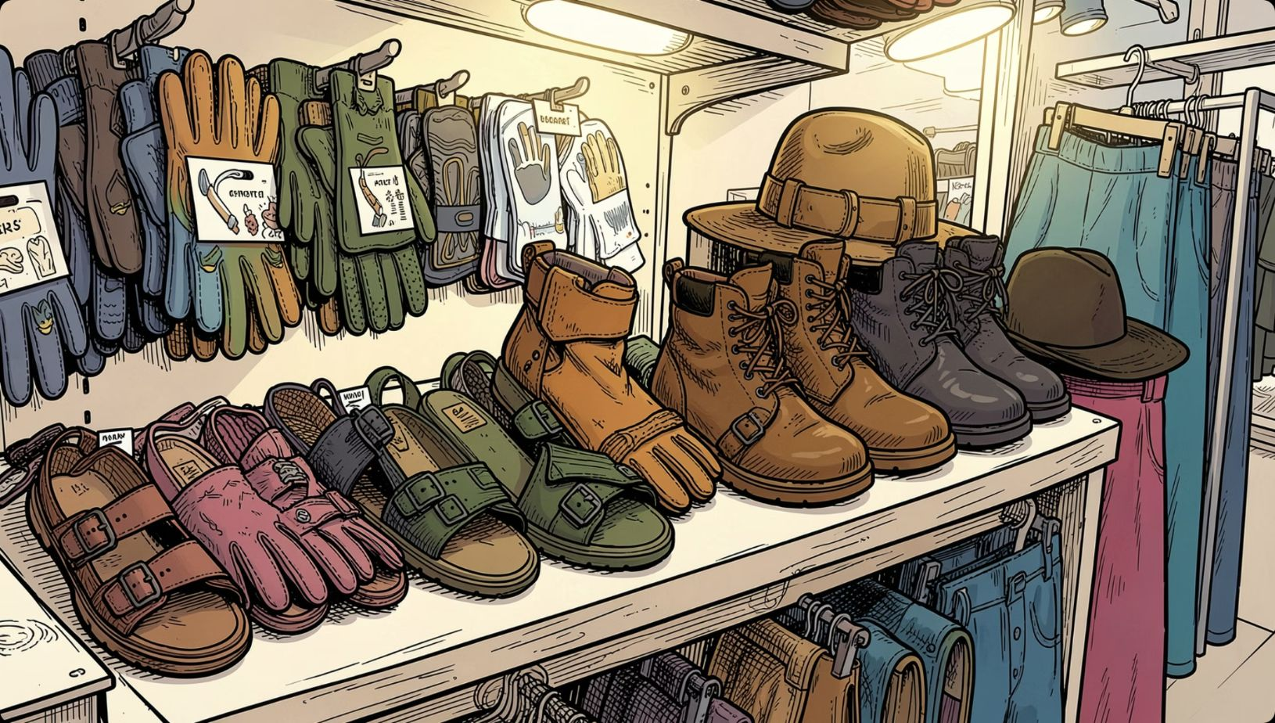
Product & Rating Insights
Top Rated Items
Gloves 3.86 · Sandals 3.84 · Boots 3.82 · Hat 3.80 · Skirt 3.78
Top Sellers by Category
Accessories: Jewelry, Sunglasses, Belt · Clothing: Blouse, Pants, Shirt · Footwear: Sandals, Shoes, Sneakers · Outerwear: Jacket, Coat

Slide 7
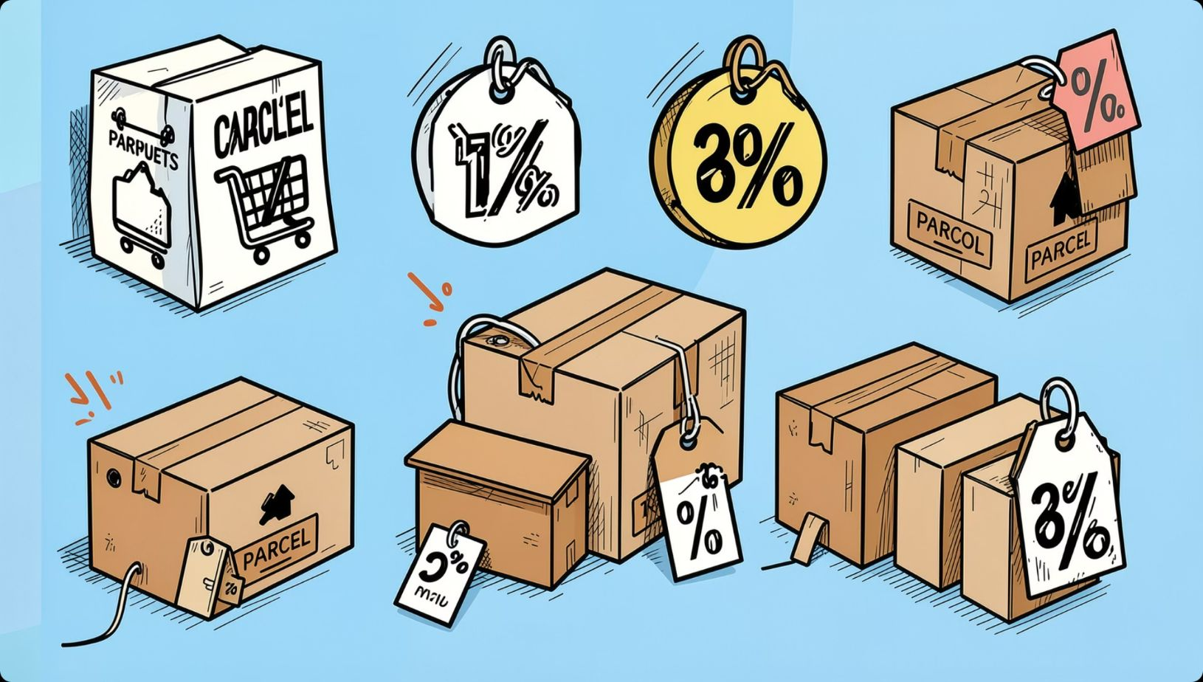
Discounts, Shipping & Subscription Patterns
- Discount-dependent products: Hat 50.00%, Sneakers 49.66%, Coat 49.07%, Sweater 48.17%, Pants 47.37.
- Shipping: Average purchase — Standard $58.46, Express $60.48.
- Subscribers: 1,053 customers, avg spend $59.49, total revenue $62,645. Non-subscribers: 2,847 customers, avg spend $59.87, total revenue $170,436.

Slide 8
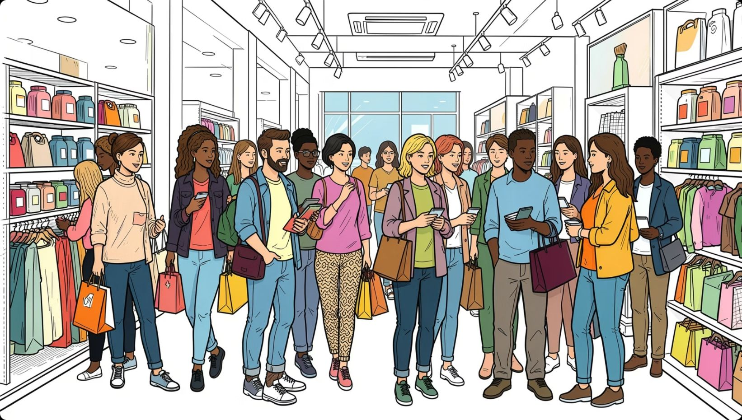
Customer Segmentation & Behavior
Repeat buyers (>5 purchases): 958 subscribers vs. 2,518 non-subscribers — used to evaluate subscription propensity.
Loyal
3,116 customers
Returning
701 customers
New
83 customers

Slide 9
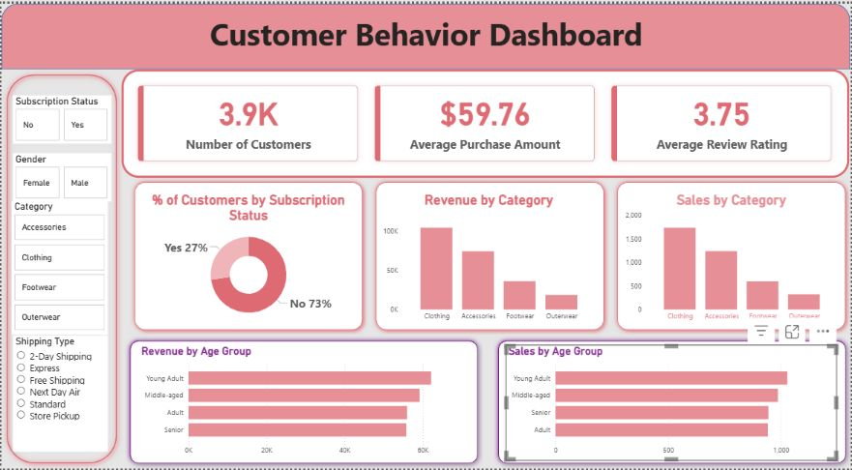
Dashboard Highlights (Power BI)
Key metrics: 3.9K customers · $59.76 average purchase · 3.75 avg review rating. Donut: Subscriptions Yes 27% / No 73%. Visuals for revenue & sales by category and by age group; filters for subscription, gender, category, shipping.

Slide 10
Business Recommendations
Boost Subscriptions
Loyalty Programs
Review Discount Policy
Product Positioning
Reward repeat buyers to move them into the Loyal segment.
Promote exclusive benefits to increase subscriber base and recurring revenue.
Balance short-term sales with margin control; target high-discount items strategically.
Highlight top-rated and best-selling products in campaigns.
Targeted Marketing
Focus on high-revenue age groups and express-shipping users for tailored offers.

