Slide 1
DATA ANALYSIS USING PYTHON
POKÉMON DATA ANALYSIS
SHASHANK S V(AF0476293)
VEERESH K G(AF0475403)

Slide 2
Introduction
Pokémon has been a globally recognized franchise for decades, capturing the hearts of fans with its diverse creatures, strategic battles, and ever-evolving game mechanics. In this analysis, we will dive deep into a dataset containing information on 1,025 Pokémon, covering various key attributes that define them.
This dataset includes details such as:
Pokémon types (Primary and Secondary)
Base stats (HP, Attack, Defense, Special Attack, Special Defense, and Speed)
Generational classification (From Gen 1 to the latest releases)
First appearances in different game versions

Slide 3
Objectives
Data Cleaning & Preparation – Handle missing values, duplicates, and ensure data integrity.
Pokémon Type Distribution – Analyze the frequency of primary and secondary types.
Statistical Analysis of Base Stats – Identify the strongest, fastest, and most defensive Pokémon.
Legendary vs. Regular Pokémon – Compare base stats and characteristics.
Speed & Strength Analysis – Find Pokémon with the highest Attack, Defense, and Speed.
First Appearance Trends – Study how Pokémon were introduced in different game versions.
Visualizations & Insights – Use charts and graphs to uncover meaningful patterns.

Slide 4
Scope of work
Data Collection & Cleaning – Load, inspect, and preprocess the dataset.
Exploratory Data Analysis (EDA) – Analyze Pokémon types, generations, and stats.
Statistical Analysis – Compare base stats, strengths, and weaknesses.
Visualization – Use charts and graphs for insights.
Conclusion & Insights – Summarize key findings and trends.

Slide 5
Tools and technologies
🔹 Programming Language (Python): A versatile, high-level language used for web development, automation, AI, and data analysis. 🔹 Data Manipulation (Pandas, NumPy): Pandas is used for working with structured data, while NumPy provides powerful numerical operations on arrays. 🔹 Data Visualization (Matplotlib, Seaborn): Matplotlib creates static plots, and Seaborn offers high-level interfaces for beautiful statistical visualizations.

Slide 6
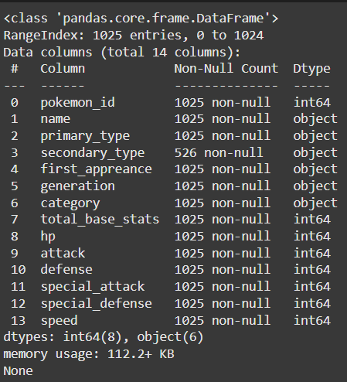
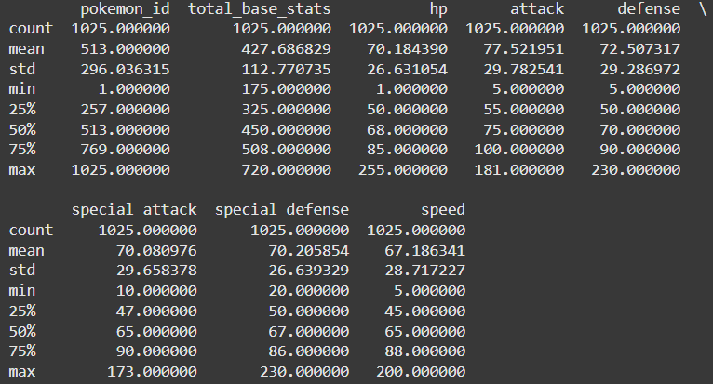
Data preprocessing
df.info() df.describe()

Slide 7
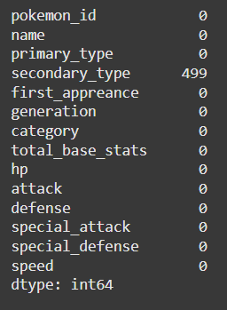
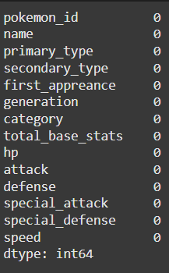
Data preprocessing
df.isnull.sum() df.isnull.sum()

Slide 8
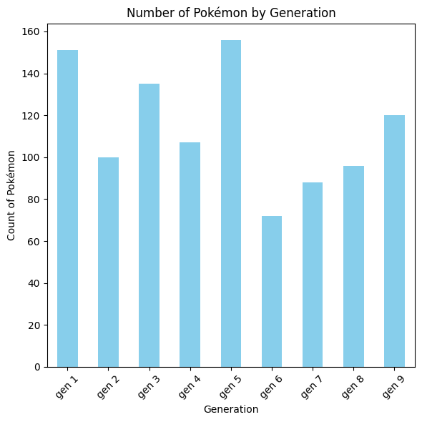
Visualization Using Graphs
This bar graph show us that how many Pokémon are there in each generation

Slide 9
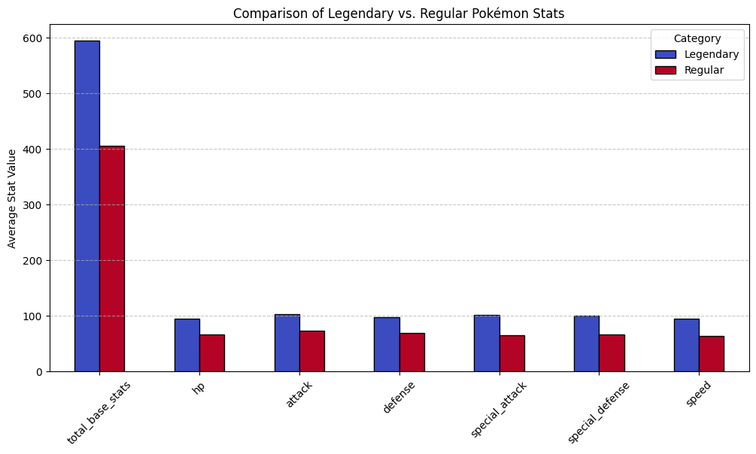
Visualization Using Graphs
This graph show us comparisons between legendary and regular Pokémon based on their average stats

Slide 10
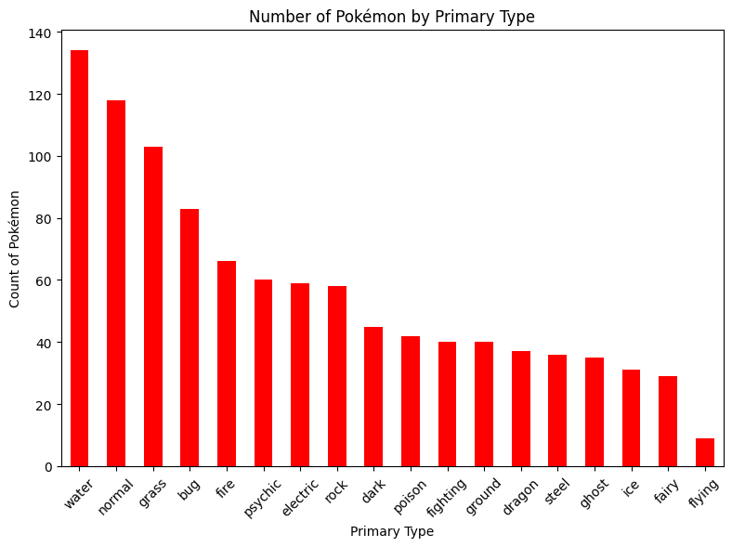
Visualization Using Graphs
This bar graph show us that how many primary Pokémon are there

Slide 11
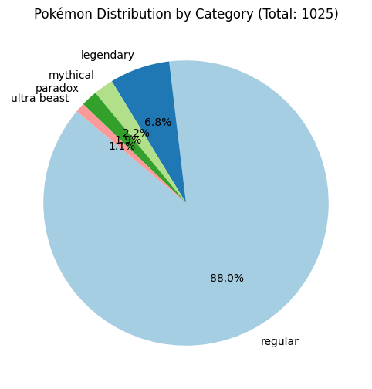
Visualization Using Graphs
This pie chart show us that percentage of Pokémon based on their category

Slide 12
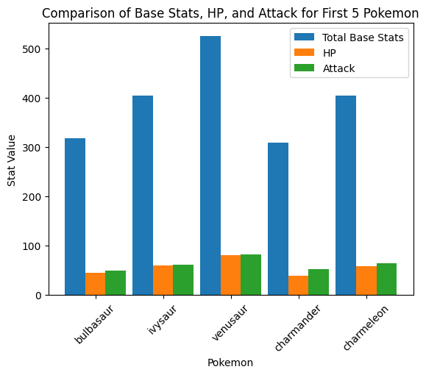
Visualization Using Graphs
This graph show us first 5 Pokémon based on their base stats,HP,attack

Slide 13
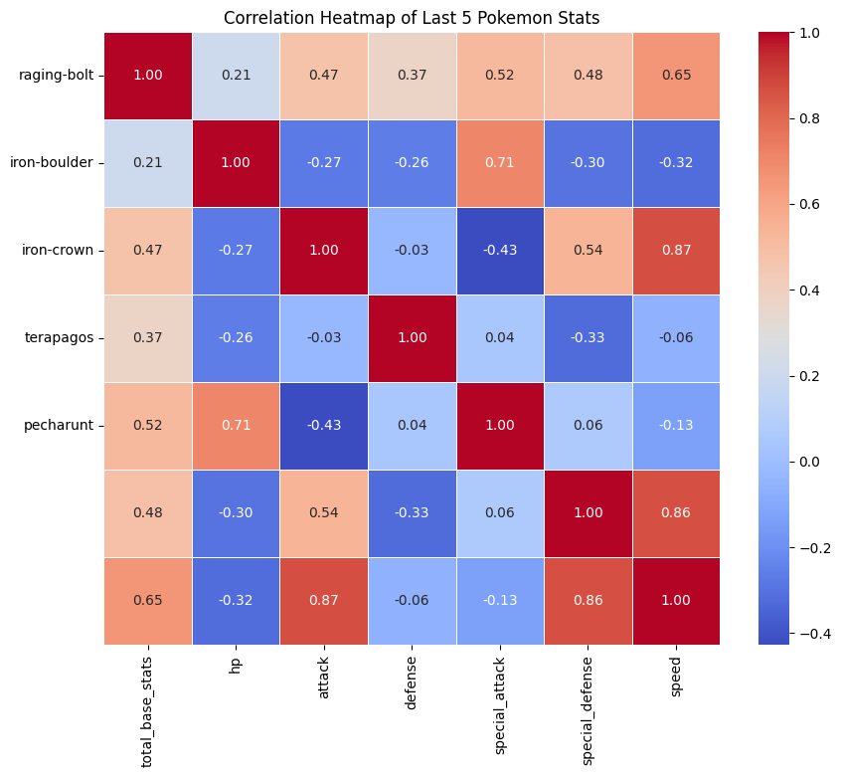
Visualization Using Graphs
This heatmap show us last 5 Pokémon based on their stats

Slide 14
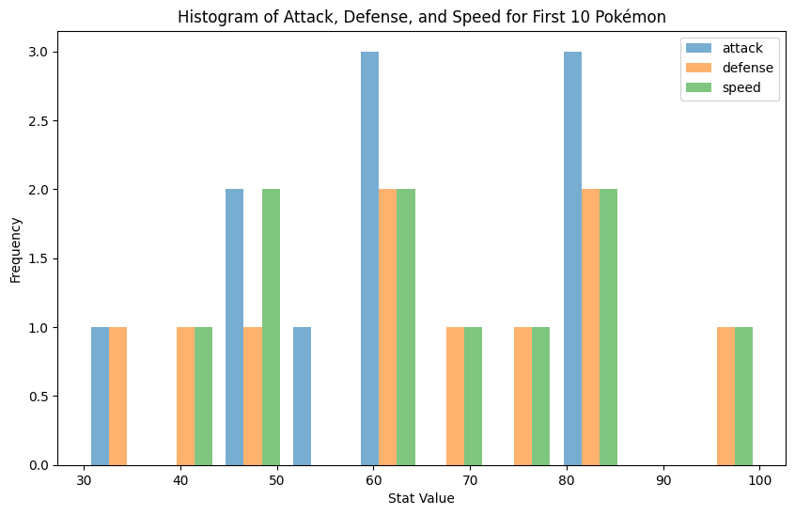
Visualization Using Graphs
This graph show us first 10 Pokémon based on their attack,defense,speed

Slide 15
Conclusion
Type-Based Insights:
Water-type Pokémon have the highest average HP, making them more durable in battles.
Fire-type Pokémon are generally stronger in Attack, suggesting offensive advantages.
Psychic-type Pokémon tend to have balanced stats, excelling in both offense and defense.
Stat Analysis:
Pokémon with higher CP (Combat Power) tend to have stronger Attack and Defense stats.
There’s a noticeable correlation between Attack and Defense in many Pokémon, with some exceptions in rare or legendary ones.
Generation-Based Insights:
Generation 1 Pokémon exhibit a wide range of stats, with many classics having strong abilities.
Later generations seem to have a more balanced distribution of stats across types

