Slide 1
Renewable Energy Powered IoT System for Plant Water Stress Monitoring
Project Guide:
Mr. S. Bhargav
assistant professor, Dept. of EIE
VNRVJIET
Presented by:
Shasheendra (22071A1073)
Arnav (22071A1083)
Anand (22071A10B2)

Slide 2
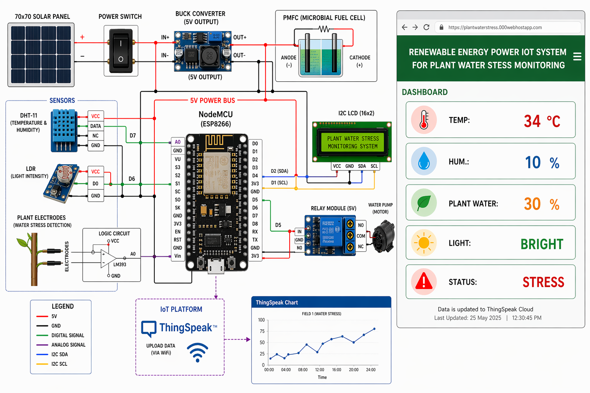
Circuit Diagram

Slide 3
Presentation Outline
Introduction
Literature Survey
Problem Identification
Methodology
Block Diagram
Flow Chart
Circuit Diagram
Development and Implementation
Results and Discussion
Conclusion and Future Scope
References

Slide 4
Introduction
Agriculture today demands efficient water management due to rising climate change impacts and freshwater scarcity.
Conventional irrigation systems rely on manual or indirect soil measurements, often leading to overwatering or under-watering.
The proposed system directly monitors plant water stress using IoT technology to ensure precise irrigation control.
The entire setup is powered by renewable energy sources like solar panels and plant microbial fuel cells (PMFCs) for sustainable operation.
Sensor data is sent to a microcontroller and IoT platform for real-time monitoring and decision-making.
This project aims to create a self-sustaining, eco-friendly, and automated system that promotes smart agriculture and resource conservation.

Slide 5
Literature Survey
 | Title of the paper | Author Name & Journal | Methodology | Limitations
1. | A Plant-Wearable System for Its Health Monitoring by Intra- and Interplant Communication | Umberto Garlando, Stefano Calvo, Mattia Barezzi, , Alessandro Sanginario, Paolo Motto Ros, and Danilo Demarchi IEEE Transactions on Agrifood Electronics, Vol. 1, No. 2, December 2023 | Developed a plant-wearable sensor that measures stem electrical frequency to monitor water stress. Used an LMC555 oscillator embedded in the stem loop. The system was powered by solar and plant microbial fuel cells (PMFCs). Communication between plants occurred via LoRa low-power networking. Designed for long-term field monitoring with minimal energy usage. | Since the experiments were done mainly on tobacco plants, the findings may not apply to other crops. Signal transmission can vary with soil type, moisture, and conductivity, reducing accuracy in different environments. The system also requires fixed electrodes, which may not suit all plant structures or remain stable as plants grow. The PMFC power source may degrade over time or perform differently with changing soil microbes.
2. | Development of Sustainable Hybrid Microbial Fuel Cell (MFC) System from Living Plants for Low-Power Field Electronic Devices | Matthew Lo 2023 IEEE Green Technologies Conference | Designed a hybrid microbial fuel cell integrating soil-MFC and plant-MFC systems. Tested multiple soils and plants including Lemongrass, Tomato, and Spider Plant. Used copper spiral and zinc mesh electrodes to improve conductivity. Monitored voltage, current, and microbial activity across configurations. Evaluated performance stability under environmental fluctuations. | The system faces key limitations. Its performance depended heavily on soil type, with river soil generating the lowest power and reducing broad applicability. Output was highly sensitive to environmental changes such as temperature and fertilizer, leading to inconsistent results. Despite performance improvements, the overall power density remained in the µW/cm² range.

Slide 6
Literature Survey
 | Title of the paper | Author Name & Journal | Methodology | Limitations
3. | Plant Microbial Fuel Cells: A Comprehensive Review of Influential Factors, Innovative Configurations, Diverse Applications, Persistent Challenges, and Promising Prospects | Peng Lean Chong, Joon Huang Chuah, Chee-Onn Chow, and Poh Kiat Ng Elsevier – Journal of Cleaner Production / Renewable Energy Review | Provided a detailed review of PMFC design, operation, and influencing factors. Compared tubular, flat-plate, and wetland configurations. Analyzed the effect of plant species, soil types, and microbial ecosystems. Emphasized performance improvement through material optimization. Discussed challenges like scalability and power density limits. | The reported power outputs vary greatly as the 679 mW/m² maximum which depend on specific setups and may not be achievable in real field conditions. Scalability challenges are discussed, no practical engineering solutions are proposed for PMFC deployment. Much of the referenced data comes from controlled laboratory conditions rather than agricultural soils, limiting real-world relevance.
4. | Plant Microbial Fuel Cells: A Promising Biosystems Engineering | Rachnarin Nitisoravut and Roshan Regmi Renewable and Sustainable Energy Reviews (Elsevier) Volume 76, | Explored PMFCs as biosystems combining plants, microbes, and soil for bioelectricity. Investigated rhizodeposition and electron transfer mechanisms. Compared C3, C4, and CAM plants for energy efficiency. Studied plant–microbe interactions and root exudate influence. Evaluated PMFC’s role in energy and biosensing. | The studies it compares lack experimental uniformity, using different substrates, plant ages, electrode materials, and environmental conditions, which makes direct performance comparison difficult. Research on economically important crops like vegetables and fruits is limited because of their short life cycles and stress sensitivity, reducing practical agricultural relevance.

Slide 7
Problem Identification
Excessive water usage in agriculture: Farmers often rely on manual or time-based irrigation systems, leading to overwatering or under-watering, which wastes water and reduces crop yield.
Lack of direct plant-based stress monitoring: Most existing systems measure soil moisture or air humidity, but these do not accurately represent the plant’s actual physiological stress level.
Dependence on non-renewable power sources: Current IoT-based monitoring setups use batteries or mains electricity, which increase maintenance costs and cause environmental waste from frequent replacements.
Limited energy availability for remote sensing: Rural or field-deployed systems lack continuous, self-sustaining energy sources, making it difficult to power sensors and transmit data reliably.
Inadequate integration of IoT and renewable bioenergy: There is a gap in combining Plant Microbial Fuel Cells (PMFCs) or solar power with IoT platforms for autonomous and long-term monitoring of plant health.
Delayed detection of plant water stress: Traditional visual methods detect stress after damage occurs, whereas bioelectrical and impedance-based monitoring can offer early, real-time detection — but are not yet widely implemented in low-cost field systems.

Slide 8
Methodology
To design a low-power IoT device that monitors plant water stress directly from the plant’s stem using bioelectrical signals.
The system must be self-powered using renewable energy sources and operate without batteries.
The plant itself becomes part of an electronic circuit that detects water stress.
A relaxation oscillator generates a square-wave signal, where the plant stem’s impedance determines the output frequency.
As the plant experiences water stress, its internal water content and electrical properties change, which alters the measured frequency.
The frequency is correlated to soil water potential, if frequency increases or decreases beyond a threshold, the plant is stressed.
The data is transmitted wirelessly to a monitoring system, where it can be viewed on an IoT dashboard.

Slide 9
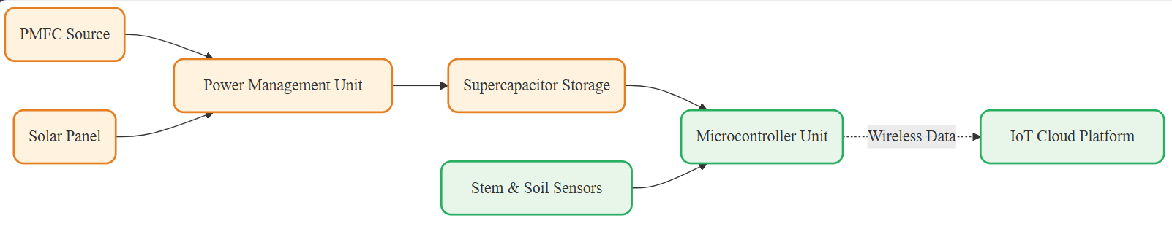
Block Diagram

Slide 10
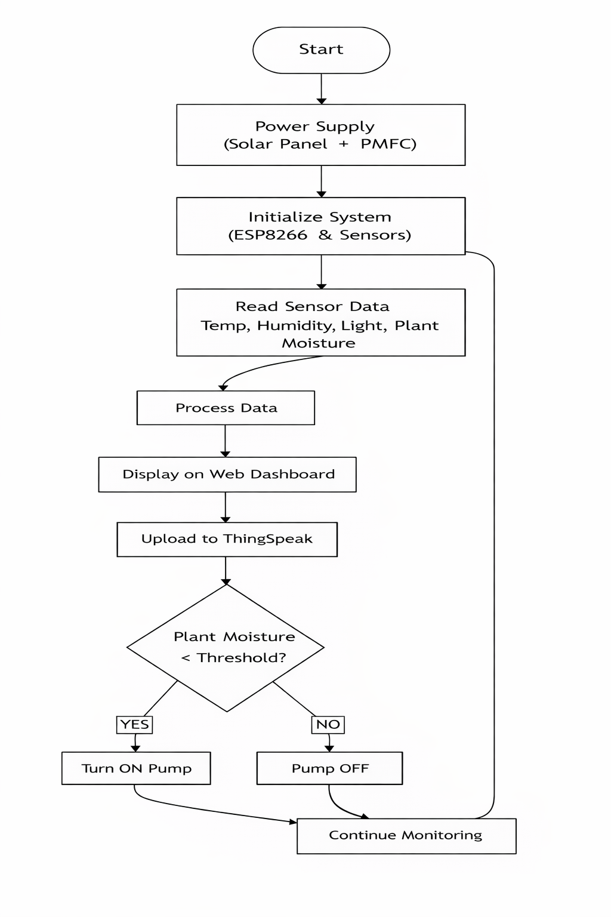
Flow Chart

Slide 11
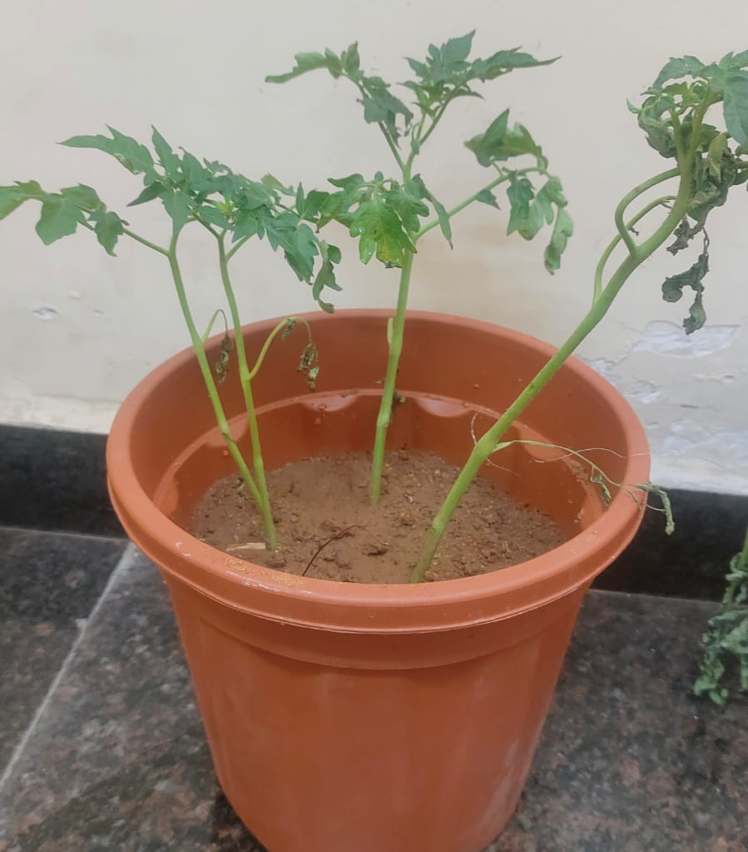
Development and Implementation
System Overview
A complete prototype of the renewable energy powered IoT-based plant water stress monitoring system has been successfully developed and tested under real-time conditions.
Hardware Implementation
PMFC Prototype: Developed using a tomato plant with zinc (anode) and copper (cathode) electrodes.
Renewable Energy Integration: Solar panel integrated with PMFC to form a hybrid energy system, supported by a DC–DC converter and energy storage unit for stable power supply.
Figure 1: Plant Microbial Fuel Cell (PMFC) Setup

Slide 12
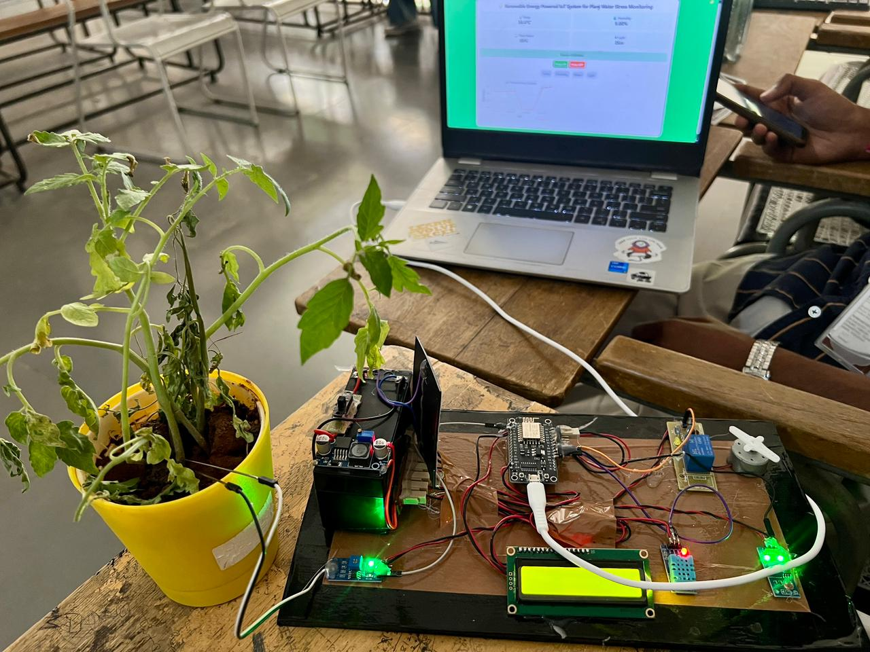
Development and Implementation
Plant-Based Sensing System
Plant Moisture measured using electrode sensors
Environmental Monitoring
Temperature and humidity sensor
Light intensity sensor (LDR)
Control & IoT Implementation
Microcontroller: ESP8266
Real-time data transmitted to ThingSpeak cloud platform
Automation Feature
Relay-controlled automatic water pump
Activated when plant stress crosses threshold value
Figure 2: Experimental Setup of the System

Slide 13
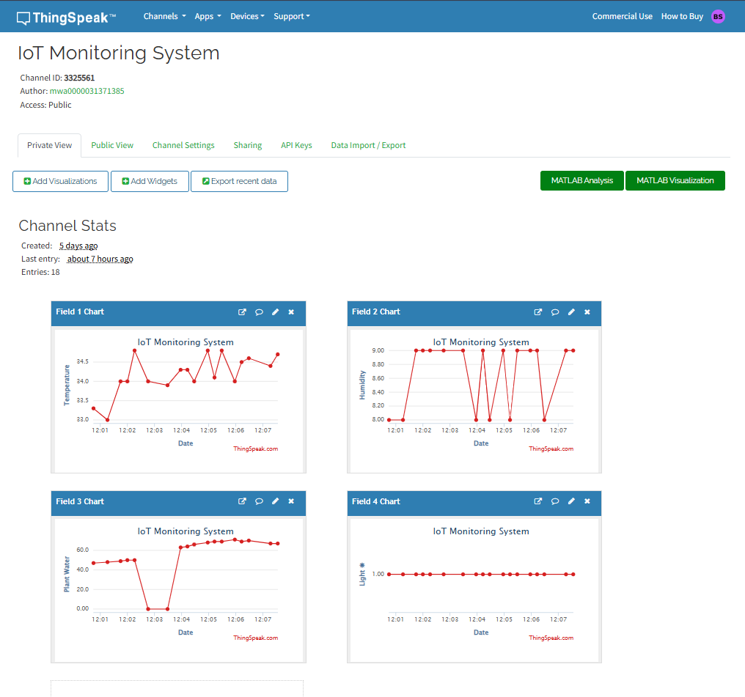
Results and Discussion
Experimental Results
The PMFC prototype validating bioelectricity generation from plant–soil interaction.
The stem impedance-based sensing system successfully detected variations in plant water content.
Environmental parameters such as temperature, humidity, and light intensity were continuously monitored.
Real-time data was transmitted to the ThingSpeak IoT platform, enabling live visualization of system parameters.
The automatic irrigation system was activated when plant stress exceeded the predefined threshold.
Figure 3: ThingSpeak Graphs

Slide 14
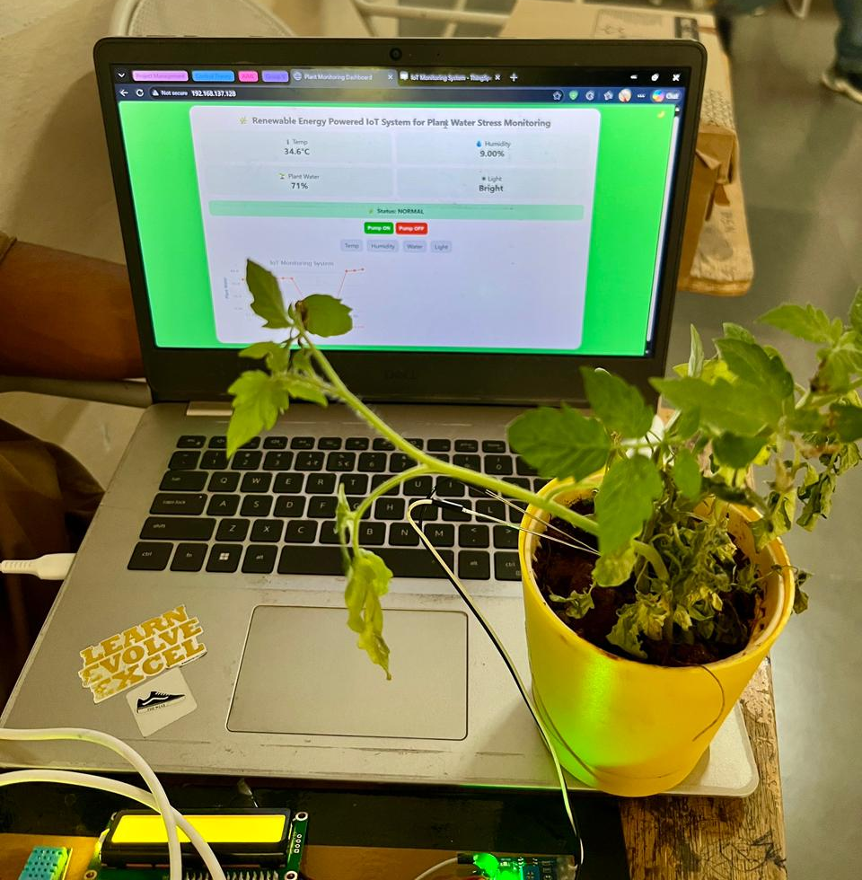
Results and Discussion
System Performance Analysis
The system demonstrated stable operation using hybrid renewable energy (Solar + PMFC).
Real-time monitoring was successfully achieved with minimal delay.
The sensing mechanism provided early indication of plant water stress compared to visual observation.
The IoT dashboard enabled continuous tracking and analysis of plant and environmental conditions.
Discussion
The integration of plant-based sensing with IoT proved effective for smart agriculture applications.
The use of PMFC as a supplementary power source enhances sustainability, although output is low.
Variations in environmental conditions slightly influenced readings, indicating the need for calibration.
The system successfully demonstrates a low-cost, eco-friendly, and automated irrigation solution.
Figure 4: Plant-Based Sensing

Slide 15
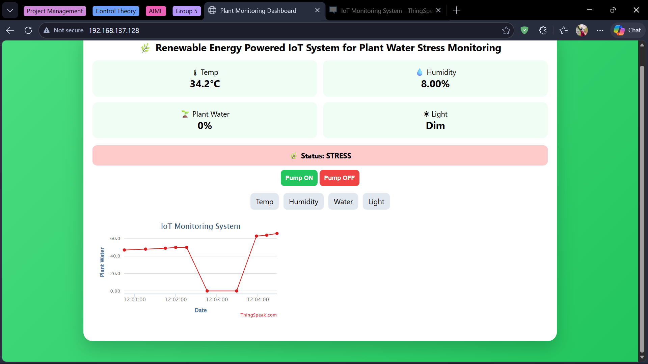
Conclusion and Future Scope
Conclusion
A renewable energy powered IoT system for plant water stress monitoring was successfully designed and implemented.
The system uses plant stem impedance sensing to directly measure plant water stress in real time.
A hybrid energy system (Solar + PMFC) was developed to ensure sustainable and battery-free operation.
Integration of ESP8266 and ThingSpeak enabled real-time data monitoring and visualization.
The system demonstrated automatic irrigation control, improving water efficiency.
Overall, the project provides a low-cost, eco-friendly, and smart solution for precision agriculture.
Figure 5: Web-Based Monitoring Interface

Slide 16
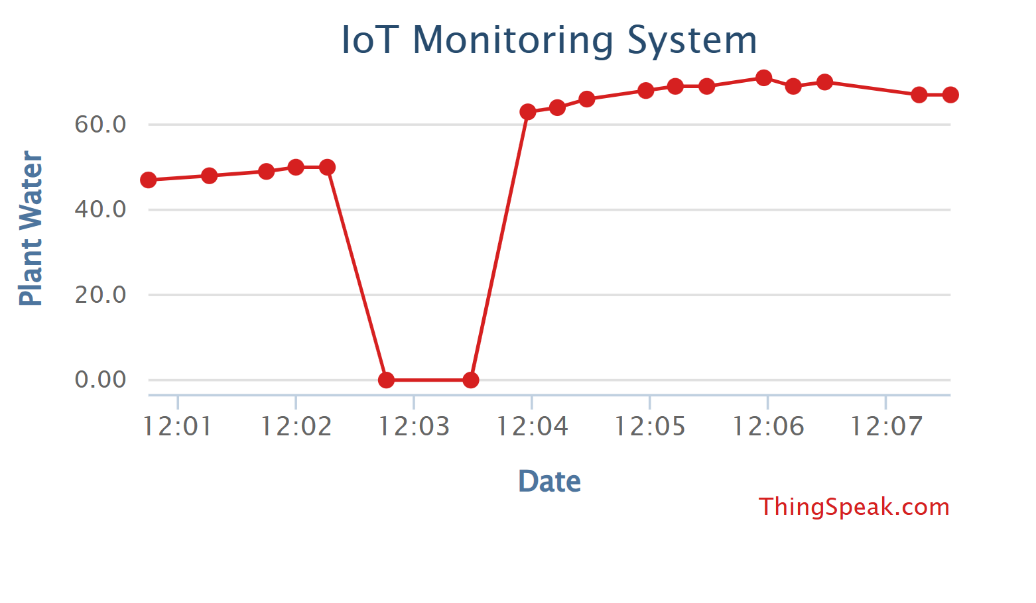
Conclusion and Future Scope
Future Scope
Integration of Machine Learning models for predictive water stress analysis.
Development of a mobile application for user-friendly monitoring and control.
Enhancement of PMFC efficiency using advanced electrode materials (carbon-based / nano-materials).
Expansion to large-scale farm deployment using long-range communication (LoRa/5G).
Addition of more sensors (soil nutrients, pH, CO₂) for comprehensive plant health monitoring.
Implementation of fully automated irrigation systems with intelligent decision-making.
Figure 6: Plant Moisture Graph

Slide 17
References
Garlando, U., Calvo, S., Barezzi, M., Sanginario, A., Ros, P. M., & Demarchi, D. (2023). A “plant-wearable system” for its health monitoring by intra-and interplant communication. IEEE Transactions on AgriFood Electronics, 1(2), 60-70. [link]
Lo, M. (2023, April). Development of Sustainable Hybrid Microbial Fuel Cell (MFC) System from Living Plants for Low-power Field Electronic Devices. In 2023 IEEE Green Technologies Conference (GreenTech) (pp. 154-159). IEEE. [link]
Chong, P. L., Chuah, J. H., Chow, C. O., & Ng, P. K. (2025). Plant microbial fuel cells: A comprehensive review of influential factors, innovative configurations, diverse applications, persistent challenges, and promising prospects. International Journal of Green Energy, 22(3), 599-648. [link]
Nitisoravut, R., & Regmi, R. (2017). Plant microbial fuel cells: A promising biosystems engineering. Renewable and Sustainable Energy Reviews, 76, 81-89.[link]
Angelini, F. (2021). Development of an autonomous plant monitoring system based on Plant Microbial Fuel Cells (Doctoral dissertation, Politecnico di Torino).[link]
Cum, F., Calvo, S., Sanginario, A., & Garlando, U. (2024). Evaluation of Machine Learning Models for Water Stress Detection Using Stem Impedance. IEEE Transactions on AgriFood Electronics.[link]
Brunelli, D., Tosato, P., & Rossi, M. (2016). Flora health wireless monitoring with plant-microbial fuel cell. Procedia Engineering, 168, 1646-1650.[link]
Hess, D., González, A., Briones, A., Navarro, J., Groen, D., Roccotiello, E., & Conserva, A. (2025, July). Indoor Plant Health Monitoring System using NDVI Imaging, PMFC Sensing and Soil Moisture Data. In 2025 IEEE International Workshop on Metrology for Industry 4.0 & IoT (MetroInd4. 0 & IoT) (pp. 190-195). IEEE.[link]

Slide 18
References
Cum, F., Calvo, S., Demarchi, D., & Garlando, U. (2023, September). Machine learning models comparison for water stress detection based on stem electrical impedance measurements. In 2023 IEEE Conference on AgriFood Electronics (CAFE) (pp. 108-112). IEEE.[link]
Ballestas, E. R., Bortoluzzi, E. C., Minervino, A. H. H., Palma, H. H., Neckel, A., Ramos, C. G., & Moreno-Ríos, A. L. (2024). Power generation potential of plant microbial fuel cells as a renewable energy source. Renewable Energy, 221, 119799.[link]
Martinez, R. D. R., & Bermudez, M. E. A. (2023). Production of electrical energy from living plants in microbial fuel cells. Clean Energy, 7(2), 408-416.[link]
Reynolds, J., Taggart, M., Martin, D., Lobaton, E., Cardoso, A., Daniele, M., & Bozkurt, A. (2023). Rapid drought stress detection in plants using bioimpedance measurements and analysis. IEEE Transactions on AgriFood Electronics, 1(2), 135-144.[link]
Ferré, D., Briones, A., Zaballos, A., Carpaneto, A., Roccotiello, E., Groen, D., ... & Brunelli, D. (2025, July). Stand-Alone Green Twin for Plant Microbial Fuel Cell (PMFC) Monitoring and Optimization. In 2025 IEEE International Workshop on Metrology for Industry 4.0 & IoT (MetroInd4. 0 & IoT) (pp. 196-201). IEEE.[link]
Latif, M., Tiy, P. A., Muharam, M., & Luthfi, A. (2023). The Study of Plant Microbial Fuel Cell for Alternative Energy Source. Jurnal Nasional Teknik Elektro.[link]
Castillo-Atoche, A., Vázquez-Castillo, J., Osorio-De-La-Rosa, E., Heredia-Lozano, J. C., Viñas, J. A., Cetina, R. Q., & Estrada-López, J. J. (2021). An energy-saving data statistics-driven management technique for bio-powered indoor wireless sensor nodes. IEEE Transactions on Instrumentation and Measurement, 70, 1-10.[link]
Lu, Z., Yin, D., Chen, P., Wang, H., Yang, Y., Huang, G., ... & Zhang, L. (2020). Power-generating trees: Direct bioelectricity production from plants with microbial fuel cells. Applied Energy, 268, 115040.[link]

