Slide 1


Bank of Baroda Hackathon - 2022
Technology Partner
Your Team Name :The Best of The Best
Your team bio :Shasianand T
Nandhini J
Sandhya M
Mugila S P
Date :20.09.2022

Slide 2
Problem Statement?
As ALTERNATE AUTHENTICATION is familiar to us we choose it. We had already presented a project on “Advanced Security in ATM “using Retinal Scanning. So,We are usual to this topic.
Now we are interested to provide the best solution for the ALTERNATE AUTHNTICATION in banking services.

Slide 3
User Segment & Pain Points
Which user /advertiser segment would be early adopter of your product & why?
Many new technologies are advancing now-a-days for visually impaired people.Till now ,Banking Sectors are not have the technology especially for blind people.
Voice Signature technology is more efficient in the situations like COVID pandamic and blind people may use the banking service without much difficulty.

Slide 4
Pre-Requisite
IRIS RECOGNITION is one of the alternatives solution for this problem
It is an automated method of biometric identification
Uses mathematical pattern recognition.
It uses Infrared radiations to store video image of IRIS.
Algorithms-mathematical and statistical.
It is used in high security areas
If the iris changes due to eye defect it is difficult to scan our eyes which is a drawback in this technique so we are switch over to the Voice Signature mechanism.

Slide 5
Azure tools or resources
SPEECH STUDIO is a set of UI-based tools for building and integrating features from Azure Cognitive Services Speech service in applications. Speech Studio by using a no-code approach, and then reference those assets in applications by using the Speech SDK, the Speech CLI, or the REST APIs.

Slide 6
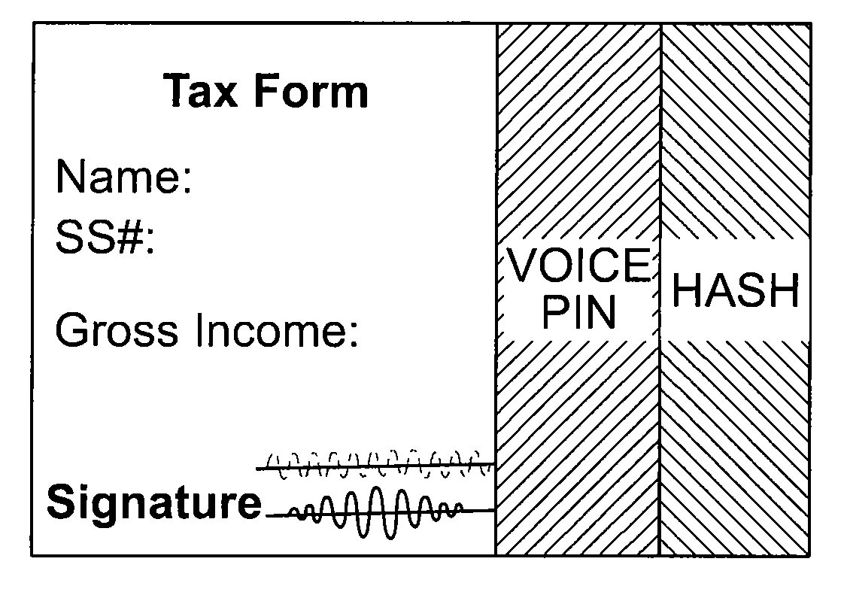
Any Supporting Functional Documents
The signer speaks a personal identification number (PIN) to generate a voice PIN and the signer also speaks at least the signer's name. The voice PIN and voice signature are appended to the document and the voice PIN is encrypted using the public key to create an encrypted voice PIN. A polynomial hash is generated based on the document, the voice signature and the encrypted voice PIN and this hash is itself encrypted based on the PIN to generate an encrypted hash. Finally, the voice signature, the encrypted voice PIN and the encrypted hash are sent to the intended recipient.

Slide 7
Key Differentitors
There is an urgent need for improving security in banking region. With the advent of ATM through banking became a lot easier it even became a lot vulnerable.
The chances of misuse of this much hyped 'insecure' baby product (ATM) happens due to criminals.
HACKERS – they are trying to hack the accounts in each and every country with the help of ATM cards.
The present invention utilizes a combination of public key encryption, symmetric key encryption, and voice recognition and verification technology, the ATM are able to verify that once a signature has been bound to the account.

Slide 8
ADOPTION PLAN
1.receiving a spoken personal identification number (PIN) and generating a voice PIN from the spoken PIN;
2.receiving a spoken intention to execute a document and generating a voice signature from the spoken intention to execute;
3.encrypting the voice PIN using the public key;
4.generating a polynomial hash based on the document, the voice signature and the encrypted voice PIN, wherein the polynomial hash varies with changes in at least the voice signature and the encrypted voice PIN;
5.encrypting the hash using the PIN as an input to said encryption of the hash; and
sending the document, the voice signature, the encrypted voice PIN, and the encrypted hash to a second computing device, the second computing device being of an intended recipient of the document,
whereby the encrypted voice PIN is provided to the second computing device to allow, by the second computing device,
generation, using the PIN resulting from a decryption of the encrypted voice PIN, of a comparative encrypted hash of the document, the voice signature, and the encrypted voice PIN for comparison with the encrypted hash
tored authentication data is necessary at the location of authentication.

Slide 9
GitHub Repository Link & supporting diagrams, screenshots, if any
How far it can go?
https://github.com/SHASIANAND/The-Best-of-The-Best.git

Slide 10
Thank You
Team member names
Shasianand T
Nandhini J
Sandhya M
Mugila S P

