Slide 1
BLOCKCHAIN
Subtopics:
Introduction
Consensus algorithms
NFTs
Smart Contracts
Applications and Domains

Slide 2
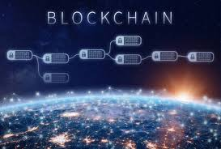
A blockchain is essentially a digital ledger of transactions that is duplicated and distributed across the entire network of computer systems. It is a decentralised mechanism of recording information that is dfficult to hack the system

Slide 3
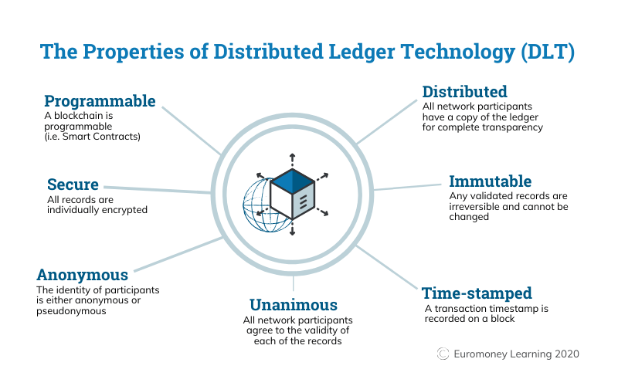

Slide 4
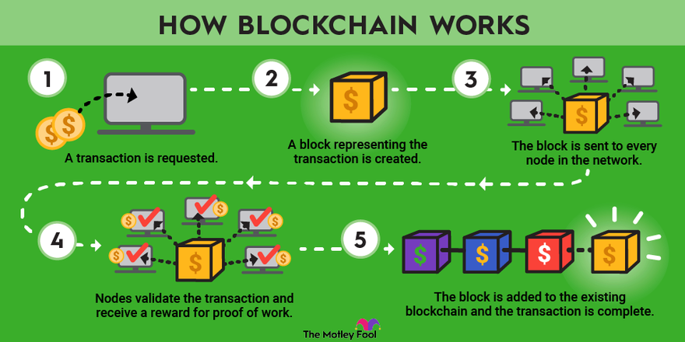

Slide 5
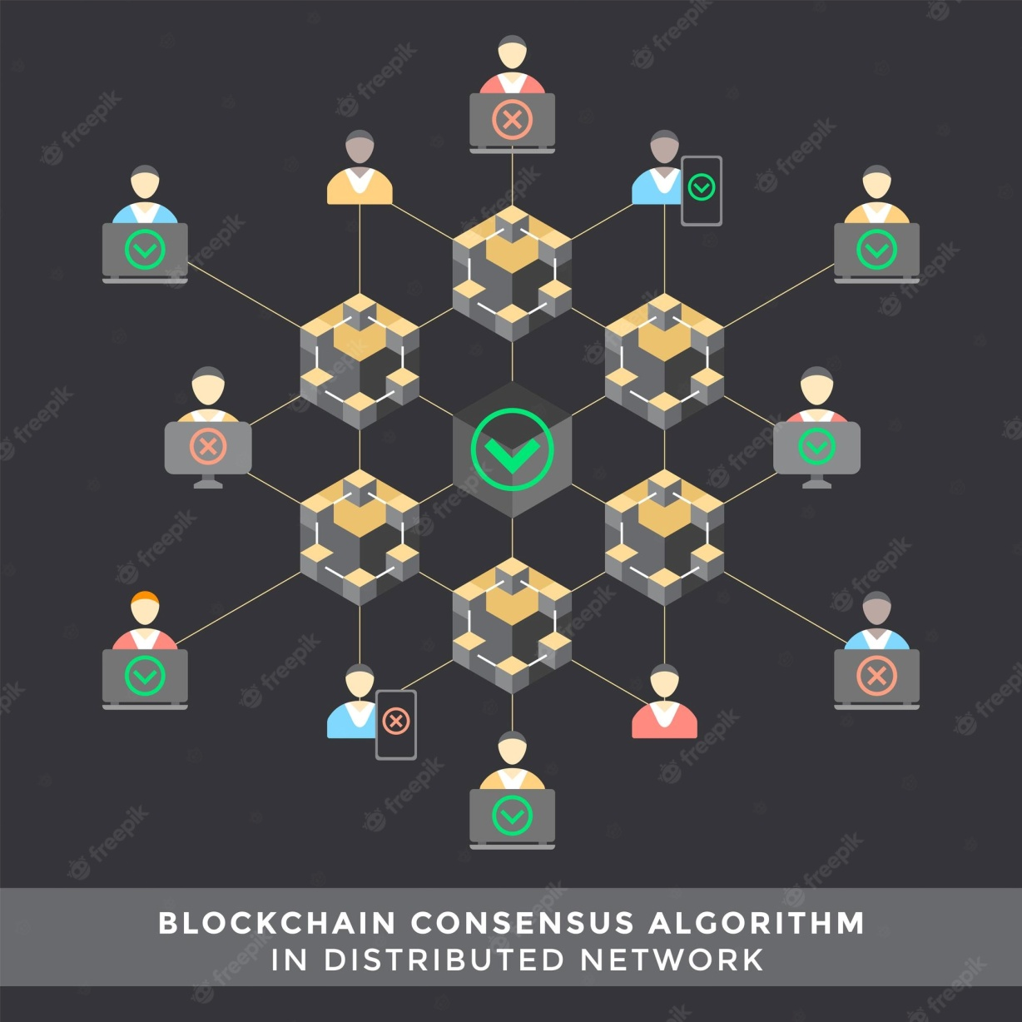
CONSENSUS ALGORITHMS
Consensus is the process by which a group of peers – or nodes – on a network determine which blockchain transactions are valid and which are not. Consensus mechanisms are the methodologies used to achieve this agreement. It’s the sets of rules that help to protect networks from malicious behaviour and hacking attacks.

Slide 6
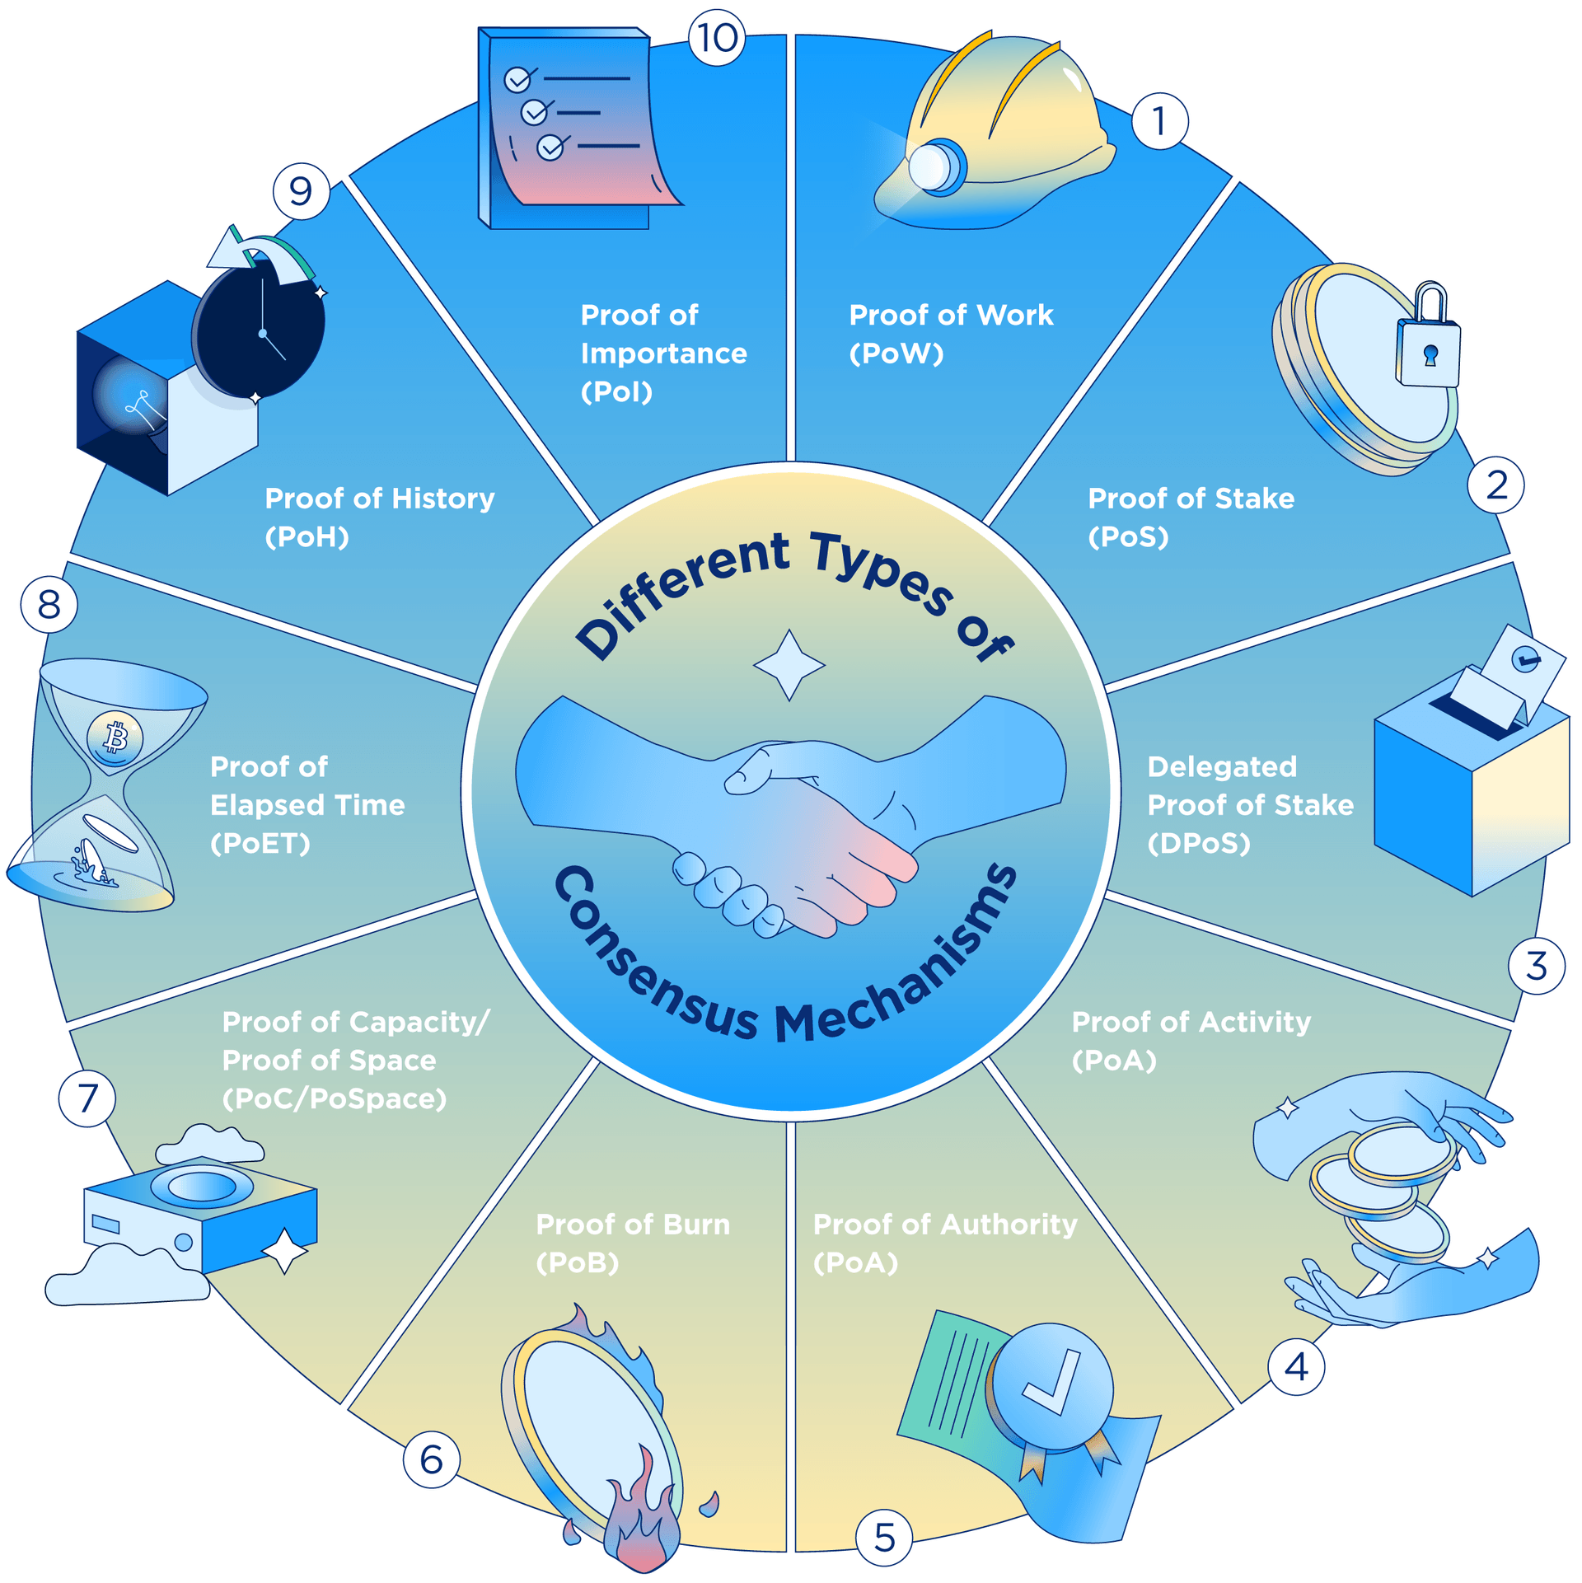
TYPES OF CONCONSENSUS ALGORITHMS

Slide 7
NFTs
An NFT is a unit of data, stored on a type of digital ledger called a blockchain, which can be sold and traded.
The NFT can be associated with a particular digital or physical asset such as images, art, music, and sport highlights^{[8]} and may confer licensing rights to use the asset for a specified purpose.
NFTs function like cryptographic tokens, but unlike cryptocurrencies such as Bitcoin or Ethereum, NFTs are not mutually interchangeable, and so are not fungible.
An NFT solely represents a proof of ownership of a blockchain record, and does not necessarily imply that the owner possesses intellectual property rights to that digital asset.
According to legal scholar Rebecca Tushnet, "In one sense, the purchaser acquires whatever the art world thinks they have acquired. They definitely do not own the copyright to the underlying work unless it is explicitly transferred."

Slide 8
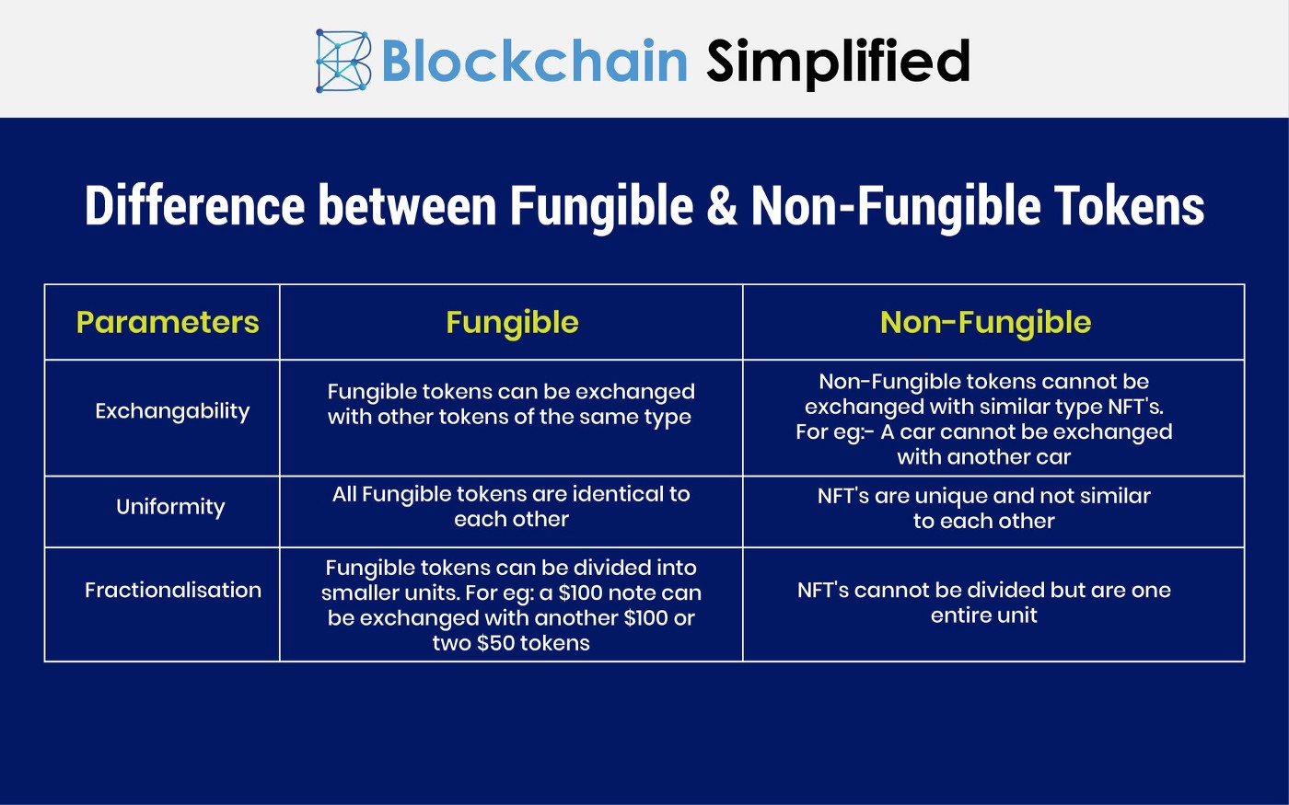

Slide 9
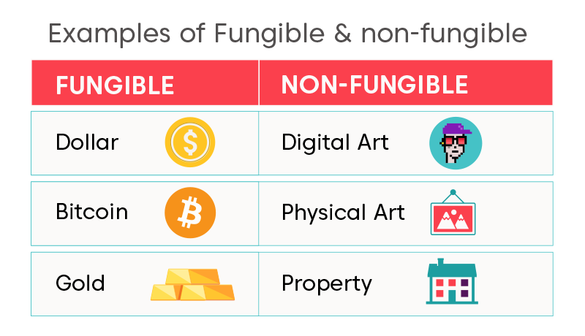
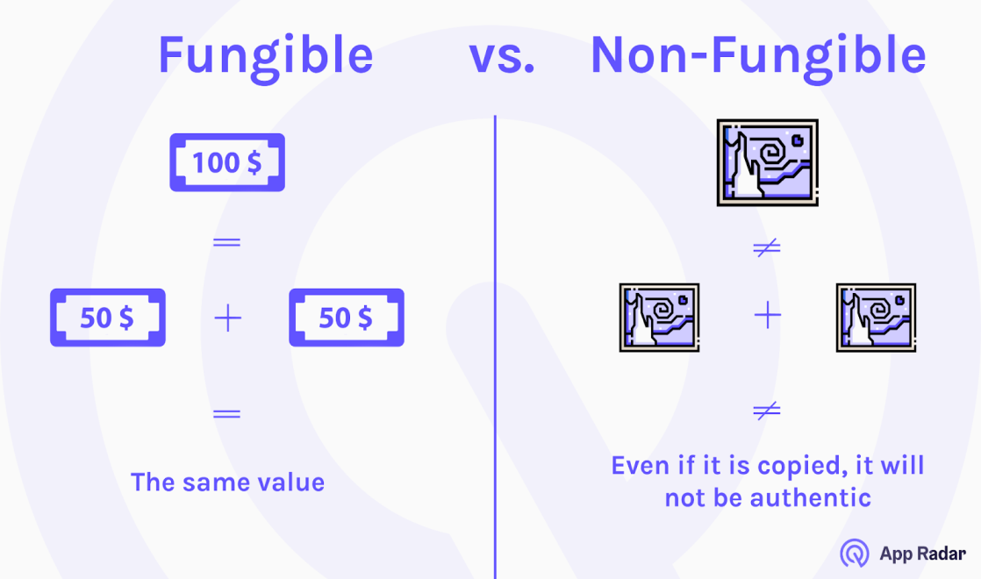
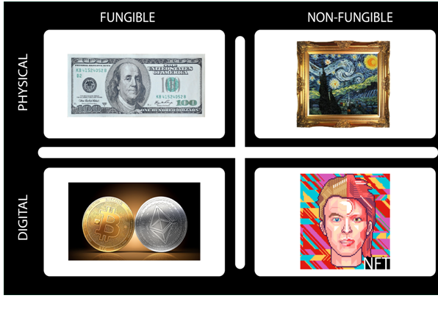

Slide 10
SMART CONTRACTS
A smart contract is a computerized transaction protocol that executes the terms of a contract. The general objectives of smart contract design are to satisfy common contractual conditions (such as payment terms, liens, confidentiality, and even enforcement), minimize exceptions both malicious and accidental, and minimize the need for trusted intermediaries. Related economic goals include lowering fraud loss, arbitration and enforcement costs, and other transaction costs.
Smart contracts are essentially automated agreements between the contract creator and the recipient. Written in code, this agreement is baked into the blockchain, making it immutable as well as irreversible. They're usually used to automate the execution of an agreement so that all parties can be sure of the conclusion right away, without the need for any intermediaries.

Slide 11
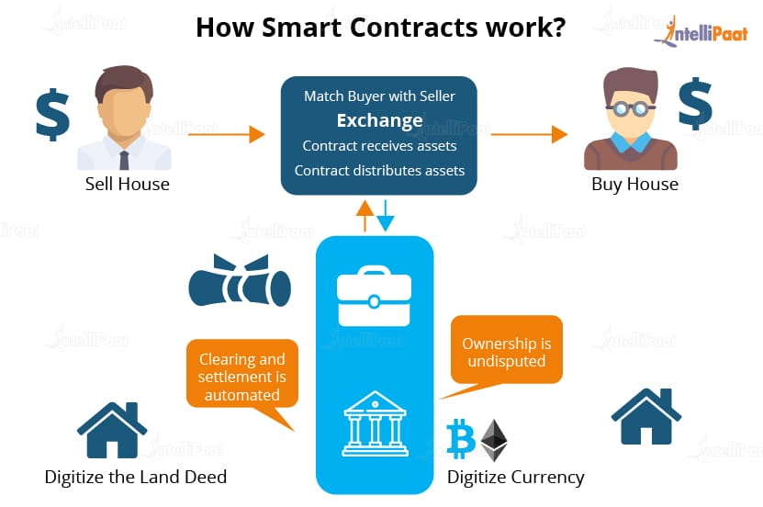

Slide 12
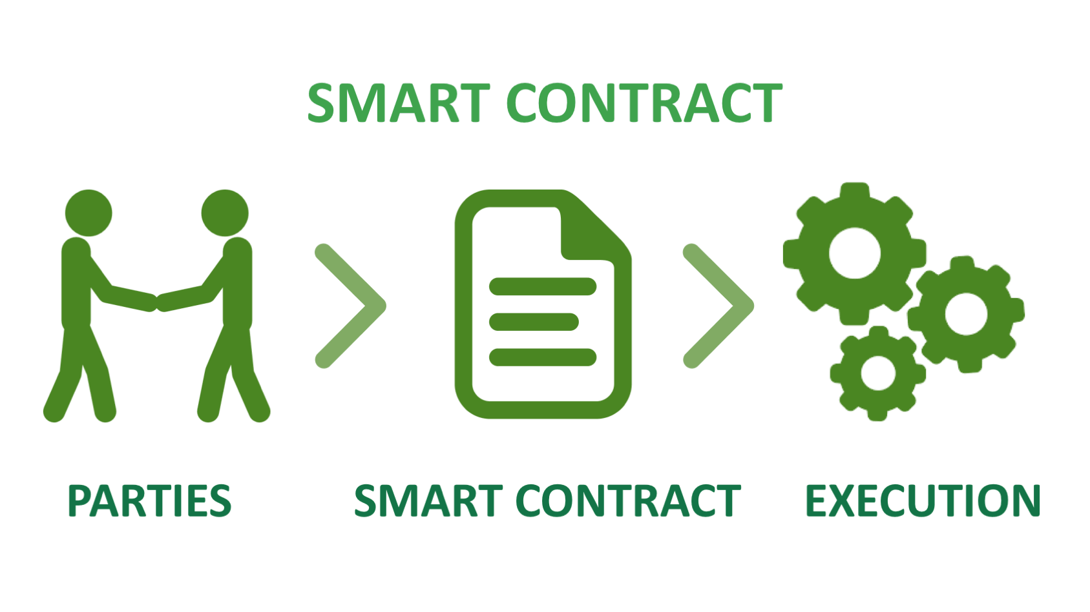
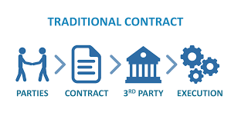

Slide 13
FINANCE
BANKING
INSURANCE
BLOCKCHAIN
USE CASES
HEAVY INDUSTRIES AND MANUFACTURING
MEDIA
E - COMMERCE
SPORTS
REAL ESTATE

Slide 14

Internet is programmable information and Blockchain is programmable Security.
By – Balaji Srinivasan.

