Slide 1
Git COMMANDS
NAME: SHATHRI G
UID : 166724
DATE : 03/03/2021
TRAINER : VENKAT

Slide 2
INSTALLING & CONFIGURATION COMMANDS
git --version : prints the git version.
git --help : prints list of all commonly used commands
git --C <path> : run as if git is started in <path>.
git -add : add files to the index.
git commit : record changes to repository.

Slide 3
Git BRANCHES
git checkout -b <branch_name> : to create a new branch
git checkout master : to checkout from branch directly to master.
git branch : gives list of all branches.
git checkout <branch_name> : switch work to a different branch.
git branch -m <old name> <new name> : to change the name of the branch.
git branch -d <branch_name> : to delete the branch.
git branch -D <branch_name> : force delete the branch.

Slide 4
MERGE BRANCHES
git checkout <target_branch>
git merge <source_branch>
For example :
To merge branch1 to the master,
git checkout master
git merge branch1

Slide 5
FETCH, PULL & PUSH
git fetch : download objects and refs from another repository
git pull : Fetch from and integrate with another repository or a local branch
git push : Update remote refs along with associated objects

Slide 6
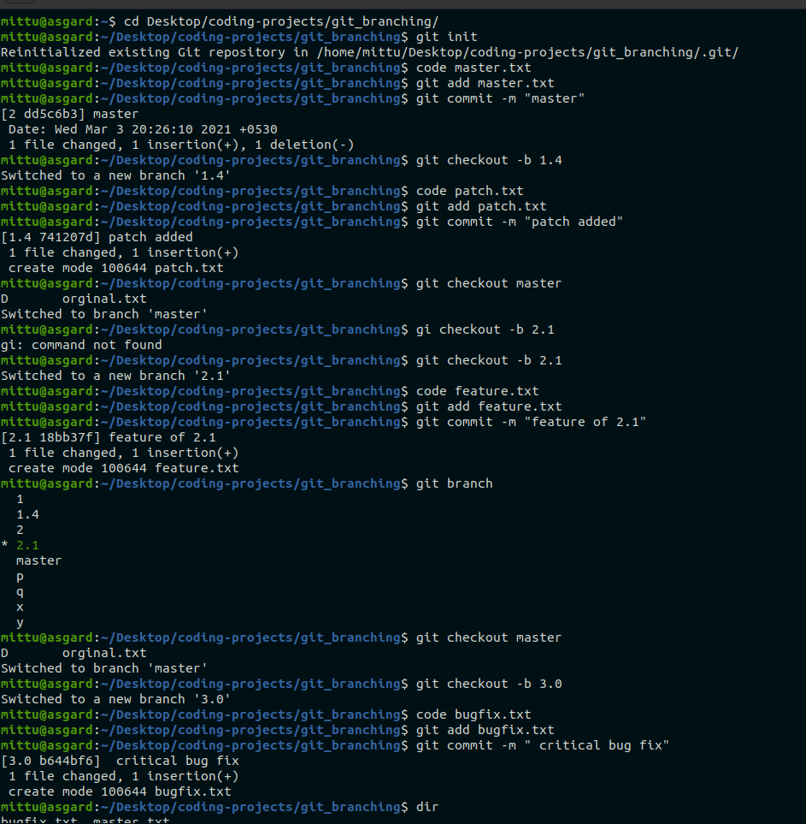
Example programme
741207d

Slide 7
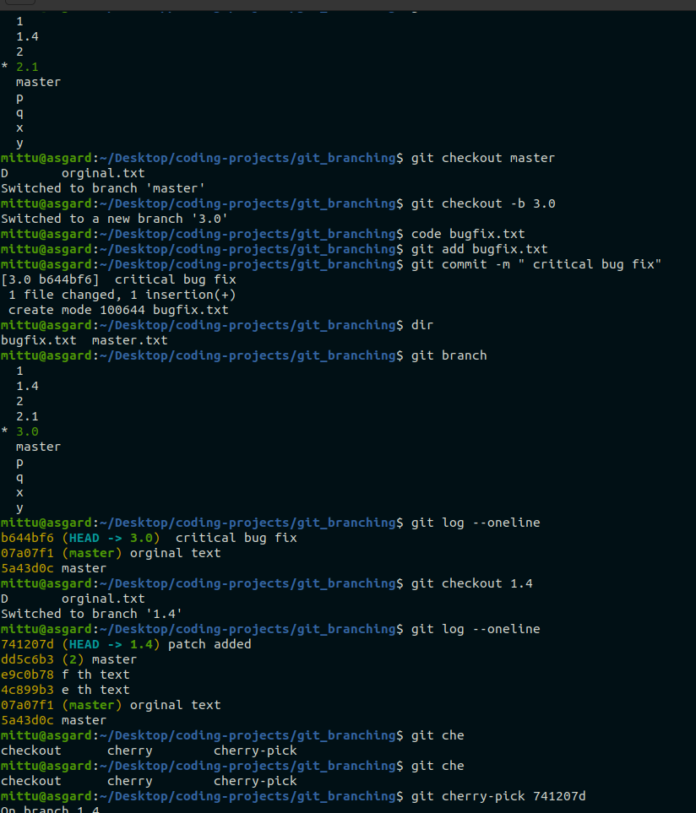

Slide 8
THANKYOU

