Slide 1
SHELL SCRIPTING- BASIC PROGRAMMING
NAME: SHATHRI G
166724
DEVOPS TRAINING
TRAINER: VENKAT
DAY 4, FEB 12

Slide 2
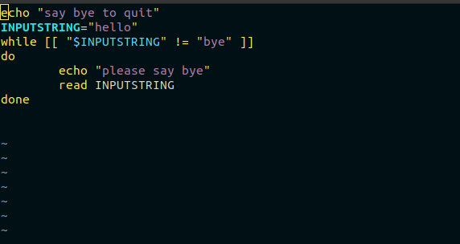
WHILE LOOP

Slide 3
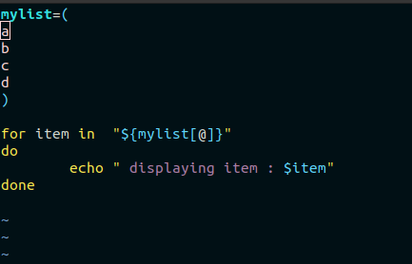
ARRAYS

Slide 4
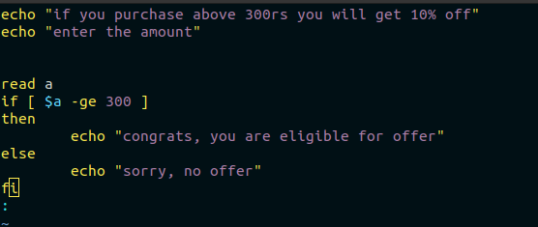
IF ELSE

Slide 5
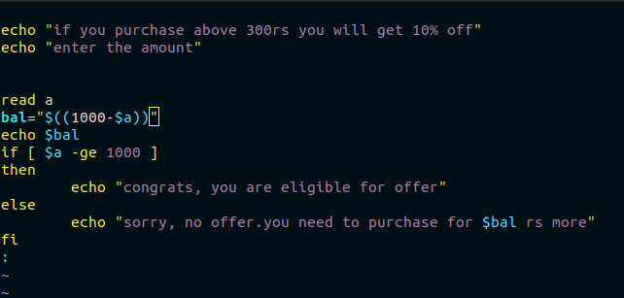
IF ELSE

Slide 6
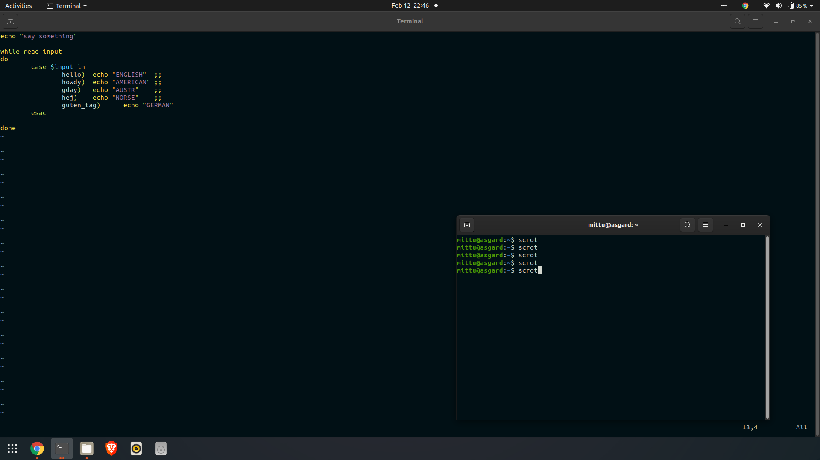
SWITCHING

Slide 7
THANKYOU

