Slide 1
NAME : Shathri G ,
166724 DEVOPS TRAINING
TRAINER : VENKAT
DAY 2 , FEB 10
LINUX COMMANDS

Slide 2
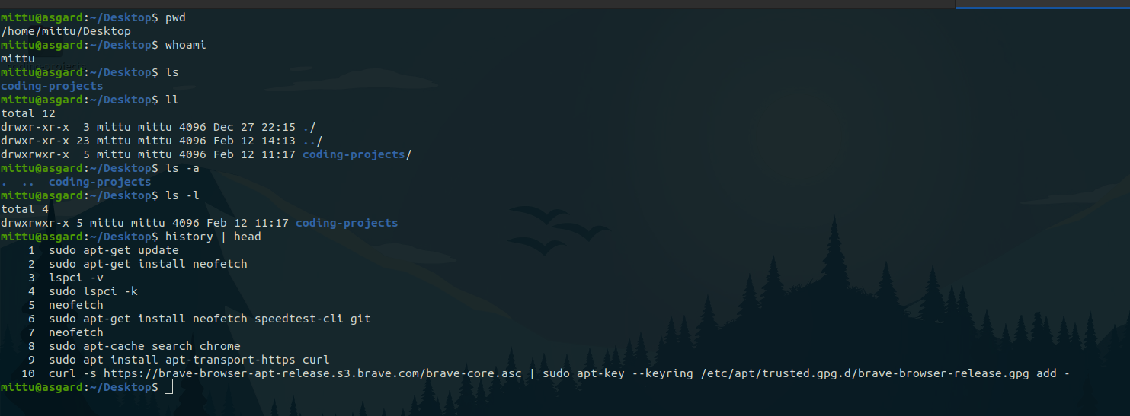
COMMANDS
pwd - print current working directory
whoami - print current user
ls - list items in a directory
ll - List information about the FILEs
ls -l - List files with permission and other metsdata
ls -a - List of all files including hidden files
history - Print bash terminal history

Slide 3
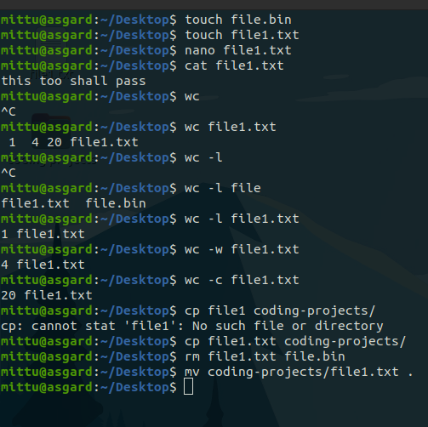
COMMANDS
touch - create a new file
nano - text editor
cat - concatenate two files
wc - Print newline, word, and byte count of file
wc -l - print line count
wc -w - print word count
cp - copy
rm - remove file
mv - move file

Slide 4
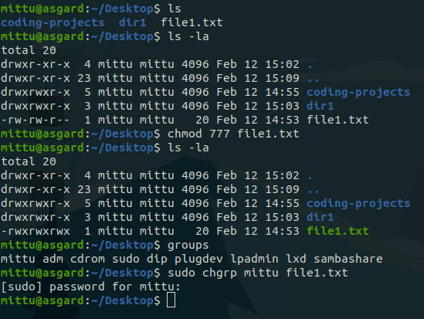
COMMANDS
chmod - change permission modes
chgrp - change group
chown - change ownership

Slide 5
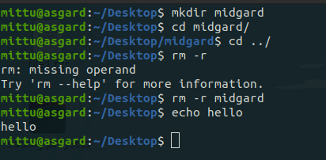
COMMANDS
mkdir - make directory
cd - change directory
cd ../ - navigate to previous directory
rm -r - remove directory
echo - echo back the input

Slide 6
THANK YOU

