Slide 1
LINUX COMMANDS
NAME: SHATHRI G
166724
DEVOPS TRAINING
TRAINER: VENKAT
DAY 3, FEB 11

Slide 2
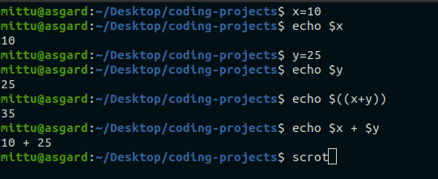
LINUX COMMANDS
￼
￼
￼
VARIABLE CREATION
SET AND UNSET VARIABLES

Slide 3
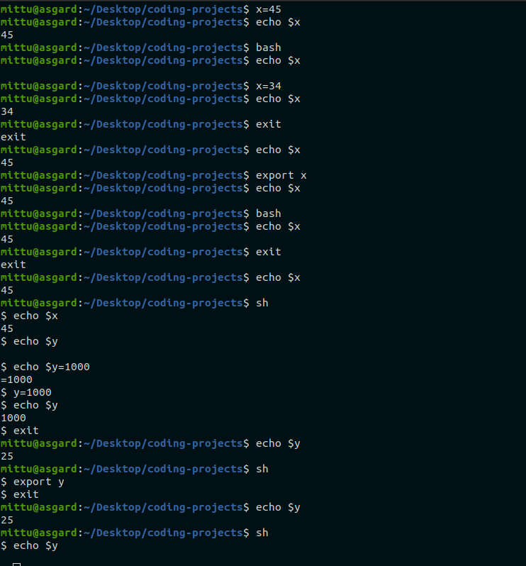
LINUX COMMANDS

Slide 4
BASIC COMMANDS IN VI EDITOR
K - To move cursor upwards
J - To move cursor downwards
:q! - to come out of the editor
i - to insert text
yy - copy a single line
p - to paste
dd - delete a single line
cc - cut a single line
/word - search for that word

Slide 5
BASIC COMMANDS IN VI EDITOR
I - Insert at the beginning of current line
a - insert after the current cursor
A - insert text at the end of the current line
o - create new line below current cursor location
O - create new line above cursor location
x - delete the charecters under cursor location
X - delete charecter before cursor location
dw - next word

Slide 6
VARIABLES IN SHELL SCRIPT
Local variables
Environment variables
Shell variables
$o - file name of current script
$# - no. of argument supplied to the script
$* - all arguments which are double quoted
$@ - all arguments which are individually double quoted
$? - the exit status of last command executed
$$ - the process no. of current shell
$! - process no. of last backdround commands

Slide 7
THANK YOU

