Slide 1


Cryptanalysis of Side-Channel Vulnerabilities
Timing Attack on RSA and Mitigation via Cryptographic Blinding
Course: Cryptography

Slide 2


Hypothesis & Threat Model
Hypothesis
Threat Model
Execution time of RSA's Square-and-Multiply correlates with private key bits.
▹
Attacker: Access to a decryption oracle (e.g., a server).
▹
Bit 1: Includes extra multiplication $\rightarrow$ Slower.
▹
Observation: Measures precise timing of decryption operations.
▹
Bit 0: Only performs squaring $\rightarrow$ Faster.
▹
Method: Deduces private key bits via statistical analysis of timing variances.
▹

Slide 3

The Vulnerability: Square-and-Multiply
M = C
^{d}
mod N
for bit in d: x = x * x mod N // Square (Always) if bit == 1: x = x * C mod N // Multiply (Conditional)
The Timing Leak: Extra multiplications create measurable timing differences, exposing the sequence of private key bits.

Slide 4
The Fix: RSA Blinding
Blinding decouples the decryption timing from the actual ciphertext C by introducing a random factor.
1
Generate Random Factor
2
Blind the Ciphertext
Pick a random r
C' = (C · r
^{e}
) mod N
3
Decrypt Blinded Text
4
Unblind the Result
M' = (C')
^{d}
mod N
M = (M' · r
⁻¹
) mod N

Slide 5
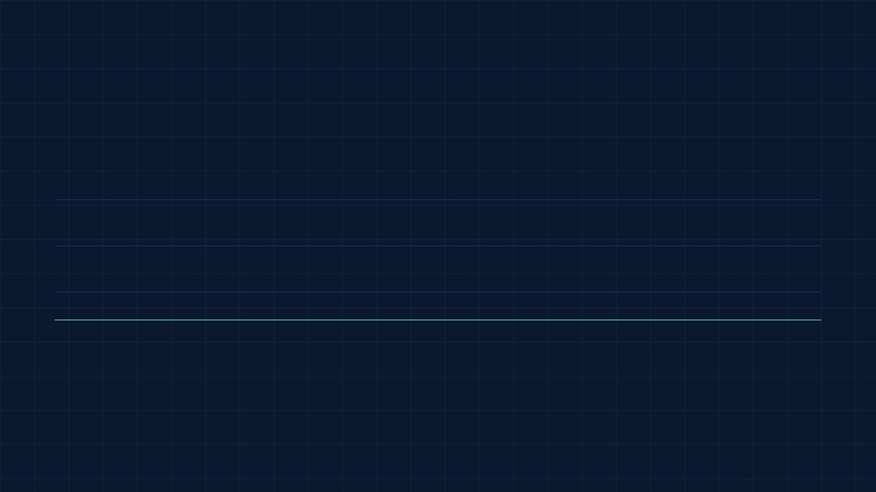


Experimental Results & Performance
Metric
Vulnerable RSA
Fixed (Blinded) RSA
Average Execution Time
17.78 ms
22.14 ms
Timing Variance
24.46
30.55
Performance Overhead
Base
~24.5%
Security Gain: Blinding effectively decorrelates execution timing from the secret ciphertext.
Resource Impact: Throughput and memory overhead remain negligible for modern systems.

Slide 6

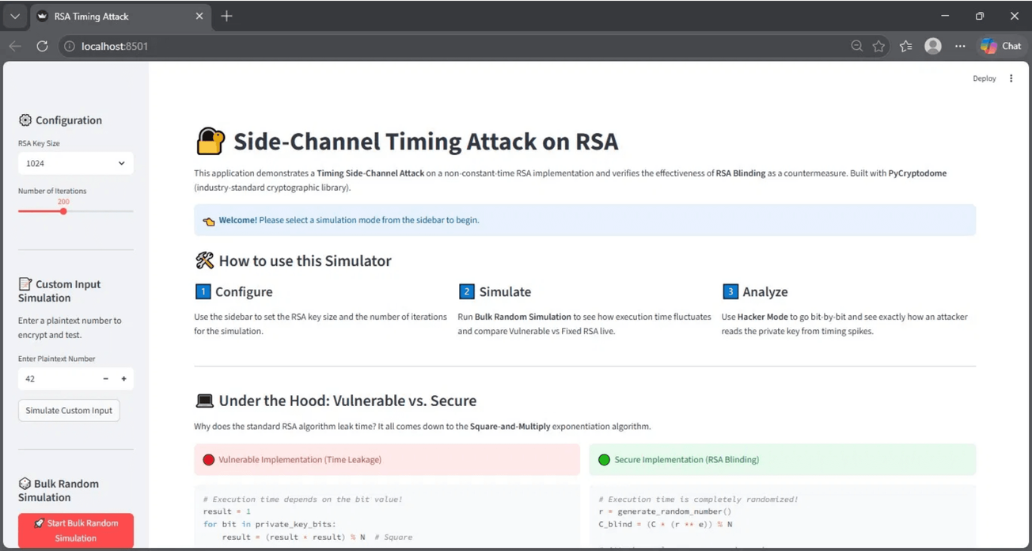



Simulation Dashboard: Timing Attack on RSA
Interactive Configuration
Allows users to set RSA key sizes (e.g., 1024-bit) and adjust the number of iterations for statistical significance.
Bulk Simulation
Runs automated tests to compare execution times between Vulnerable and Secure (Blinded) implementations live.
Hacker Mode
Enables bit-by-bit analysis to visualize exactly how an attacker reads the private key from timing spikes.
Logic Verification
Verifies the effectiveness of RSA Blinding as a robust countermeasure against real-world timing leaks.

Slide 7


Security Analysis & Limitations
Core Recommendation: Implement true constant-time arithmetic libraries for comprehensive side-channel protection.
Blinding Strengths
Remaining Risks
Effectively neutralizes remote timing attacks.
▹
Micro-architectural: Cache-timing (L1/L2) leaks still possible.
▹
Prevents leakage from chosen ciphertext inputs.
▹
Physical Access: Differential Power Analysis (DPA/SPA).
▹
Low computational overhead (~24.5%) for high security gain.
▹
Electromagnetic: EM emission side-channels.
▹

Slide 8



Conclusion
Security Integrity
A system is only as strong as its weakest link. Mathematical security does not guarantee implementation security.
Practical Defense
Cryptographic blinding is a low-cost, highly effective countermeasure against standard remote timing attacks.
Holistic Approach
Developers must account for the physical execution environment and micro-architectural leaks to ensure robust security.
Thank You! Questions?

