Slide 1
Last-Level Cache Side-Channel Attacks are Practical
Fangfei Liu, Yuval Yarom, Qian Ge, Gernot Heiser, Ruby B. Lee Appeared in S&P'15
Presented by Baltasar Dinis and Rem Yang

Slide 2


Side-channel attacks are hard to deploy
DRAM
The L1i, L1d (and L2) caches are:
Fast and small → high timing resolution → easier to attack
Core-private, thus unlikely to be shared among cloud clients
Cloud providers disable page sharing between VMs
This thwarts both FLUSH+RELOAD and EVICT+RELOAD attacks
LLC
L1
L1

Slide 3
Prime + Probe
Attacker
Victim
Ways
Sets

Slide 4
Prime + Probe
Prime a cache set
Attacker
Victim
Ways
Sets

Slide 5
Prime + Probe
Prime a cache set
Wait for some time
Attacker
Victim
Ways
Sets

Slide 6

Prime + Probe
Prime a cache set
Wait for some time
Probe cache set
Attacker
Victim
Ways
Sets

Slide 7
Prime + Probe
Victim did not access cache set
Attacker probe is fast
Attacker
Victim
Ways
Sets

Slide 8
Prime + Probe
Victim did access cache set
Attacker probe is slow
Attacker
Victim
Ways
Sets
Evict

Slide 9
Solving the "easy" challenges
Q: If the secret data is in the L1, how can we observe data accesses in the LLC?
A: Leverage the fact that the LLC is inclusive → evicting data in the LLC forces an eviction in the victim L1
Q: How to target specific cache sets in the LLC if it is physically indexed?
A: By using huge pages in the attacker code, all the set index bits are in the page offset (constant under address translation)
DRAM
LLC
L1
L1

Slide 10
Prerequisite for PRIME+PROBE
Ways
DRAM
Sets
LLC
L1
L1
Attacker needs to know which memory accesses map to the same cache set (the eviction set)

Slide 11
The LLC is sliced, and that's complicated
DRAM
Each core is connected to a local slice of the LLC, use a ring bus to handle remote accesses
Slice ID is computed from a hash of the address
The access latency varies with which slice we are targeting → we need to PRIME+PROBE within the same slice to get consistent time readings
LLC₀
LLC₁
L1
L1

Slide 12
PRIME+PROBE on the sliced LLC is hard
Slice 0
Attacker needs to know which memory accesses map to the same cache set and cache slice
Slice 1
Slice 2

Slide 13
Constructing the Eviction Set
lines
Goal: partition lines (in the same set) into per-slice eviction sets
For illustration, assume LLC has 2 ways and 2 slices
eviction_set_0
eviction_set_1

Slide 14
Constructing the Eviction Set
lines
conflict_group
Construct the minimal group of lines that span the entire set across all slices
For each candidate in lines:
If not conflicts with conflict_group:
Move to conflict_group
eviction_set_0
eviction_set_1

Slide 15
Constructing the Eviction Set
Partition the conflict_group by slice
For each candidate left in lines:
Use it to distinguish members of the conflict_group; if they conflict, they belong to the same slice
lines
conflict_group
eviction_set_0
eviction_set_1

Slide 16
Attacking Square + Multiply Exponentiation
// compute b^e % mod
// e is secret
func sq_mul(b, mod, e):
r = 1
for i in len(e):
r = square(r) % mod
// secret dependent
if e_i == 1:
r = r * b % mod
return r
Used in both RSA and ElGamal decryptions
Repeatedly PRIME+PROBE the LLC
Observe intervals between cache accesses made by the square operation
Temporal pattern differs due to secret-dependent memory accesses
Corresponds to bits in exponent

Slide 17
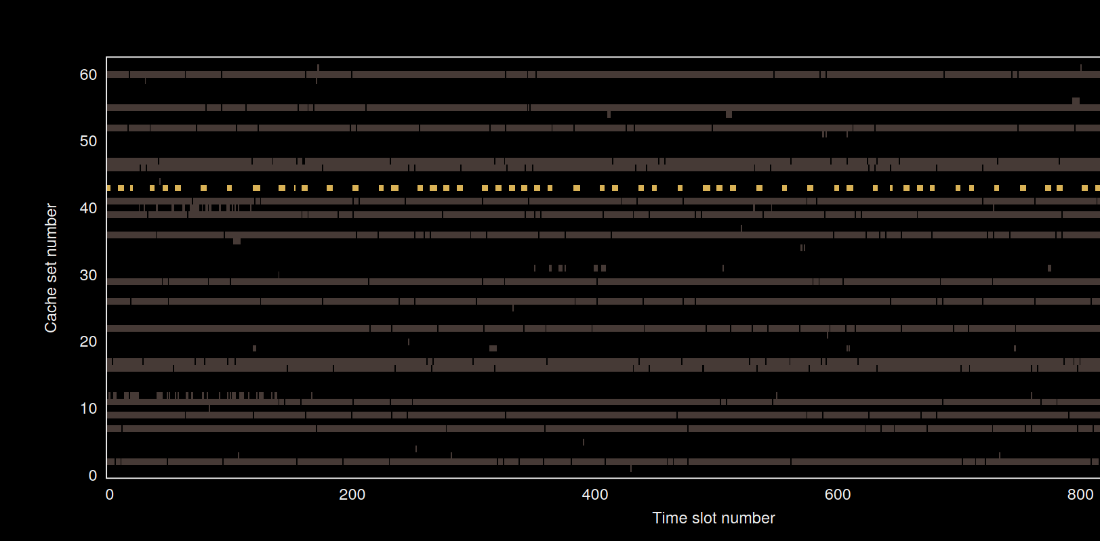
0

Slide 18
00

Slide 19
001

Slide 20
0011....

Slide 21


The Good, The Bad...
The attack is practical, even with:
Non-collocated cores
No knowledge of any page table mappings (victim and attacker)
No page-sharing between victim and attacker
No need to reverse the sliced cache hash function
Higher bandwidth than prior work (1.2Mb/s vs 190Kb/s)
In a real system, it is non-trivial to figure out what cache set maps to a particular part of the code
Requires information about the software artifact the victim is using
Experiments were run in isolation: real cloud will be noisier and harder to figure out

Slide 22

... and The Future (work)
Explore how the attack could extend to NUMA architectures
Sounds hard: how to prime remote memory?
Automatic detection of secret-dependent accesses
Sample from a lot of known crypto libraries
Train a model
Attach a model to the attacker code, PRIME+PROBE the collocated clients continuously
With such an automatic side-channel detection build an automated tool for exploiting collocated clients
Identify web services by measuring latency from inside the datacenter
Extract keys from TLS negotiation
(scare everyone in the process?)

