Slide 1
GPTC PALAKKAD
Gov.Polytechnic College Palakkad
Email:gptcpalakkad@gmail.com
Ph:9876543210
Kodumbu PO ,
Palakkad, Kerala India
PIN ; 678551

Slide 2
DEPARTMENTS
MECHANICAL ENGINEERING
CIVIL ENGINEERING
COMPUTER HARDWARE ENGINEERING
INSTRUMENTATION ENGINEERING
ELECTRONICS AND ELECTRICAL ENGINEERING
ELECTRONICS ENGINEERING

Slide 3
Vision
To Be A Centre Of Excellence In Engineering Education For Providing Valuable Resources To Industry And Society
Mission
Providing Quality Education In Engineering And Technology
Involving In The Development Of Society Through Technology Transfer, Entrepreneurship And Industry Interaction
To Inculcate Social Responsibility And Ethical Values Among

Slide 4
MECHANICAL ENGINEERING
Impart knowledge with strong foundation in mechanical engineering that helps the students to solve practical problems.
Create a passion in the field of mechanical engineering to implement efficient mechanical engineering practices throughout their professional career.
Develop innovative mind and entrepreneurial skills that enable students to address various challenges in the society.
Inculcate students with good management practices, interpersonal skills with strong adherence to ethics and values.
PROGRAM SPECIFIC OUTCOMES (PSOs)
Students completed diploma in mechanical engineering program will be able to:
Apply their knowledge in the domains of production, fluid power and thermal engineering to solve engineering problems.
Apply the acquired technical skills in the field of engineering design, advanced machine tools, industrial maintenance and servicing
Update their knowledge in the field of industrial automation and CAD/CAM to cope up with the industrial requirements.

Slide 5
COMPUTER HARDWARE ENGINEERING
Programme Educational Objectives (PEOs)
Our computer hardware diploma engineer will have sufficient understanding of the field of computer hardware and networking Technologies
They will be able to advance in career and move on with updating technology.
They will have the ability to understand the context and broader impacts of Technology
They will be aware of complying with ethical, cultural, legal, environmental and economical aspects of doing a job or Technology business

Slide 6
CIVIL ENGINEERING
Programme Educational Objectives (PEOs)
1. Develop competent civil engineering technicians with professional skills, knowledge, abilities & attitude for wage employment and/or to become entrepreneur.
2. Provide opportunities and develop competence to work as a leader, manager or team member in multidisciplinary civil engineering works and projects.
3. Develop effective communication skills - Verbal, Written and Graphical, to justify technical solutions for diverse targets associated with civil engineering works.

Slide 7
INSTRUMENTATION ENGINEERING
Programme Educational Objectives (PEOs)
Impart knowledge with strong foundation in mechanical engineering that helps the students to solve practical problems.
Create a passion in the field of mechanical engineering to implement efficient mechanical engineering practices throughout their professional career.
Develop innovative mind and entrepreneurial skills that enable students to address various challenges in the society.

Slide 8
ELECTRICAL AND ELECTRONICS ENGINEERING
Programme Educational Objectives(PEO’S)
Our diploma engineer will be able to apply their technical knowledge and skills to serve the industry and society through employment and entrepreneurship.
They will be in a position to find a prospectful advance in professional knowledge and career by acquiring higher education.
They will be ready to take up responsibilities based on the comprehensive knowledge and skill acquired, for a better society

Slide 9
ELECTRONICS ENGINEERING
ROGRAM EDUCATIONAL OBJECTIVES (PEOs)
Our Electronics diploma professional can take up the middle level responsibilities in manufacturing and advanced technology industries with his acquired knowledge and skills.
Our Electronics diploma engineers will be able to apply their professional and personal excellence to help support social development.
They will be able to expand the knowledge base through higher studies and update on technology leading to career growth.

Slide 10
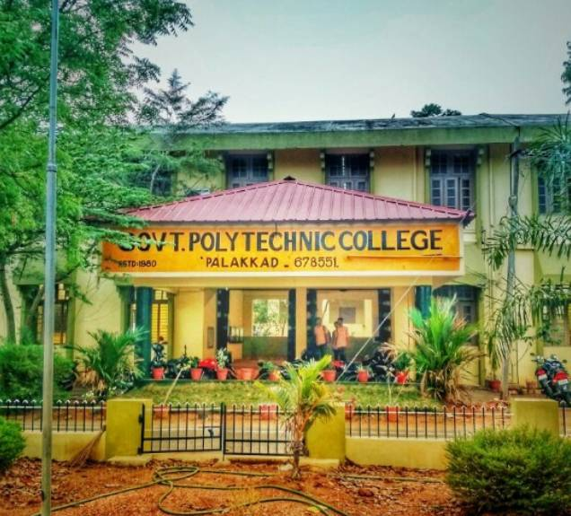
THANK YOU

