Slide 1
Chat bot deployment
BY:
SHENBAGAPRIYA A

Slide 2
CONTENT
Idea of Our Project
Architecture diagram
Use Cases
Technology Stack
Conclusion

Slide 3
Idea of Our Project
Our project utilizes IBM Cloud Watson Assistant to create a interactive chat bot acting as a virtual guide on popular messaging platforms like Facebook Messenger and Slack.
The main goal is to provide valuable information, answer FAQs, and provide a friendly, engaging conversational experience.

Slide 4
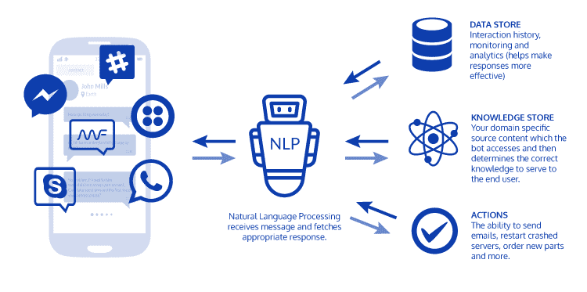
Architecture diagram

Slide 5
Use Cases
Information Retrieval:
Chat bot delivers specific topic information in response to user query.
FAQ Handling:
User's FAQ addressed promptly with clear, informative response from chat bot.
User Guidance:
User seeks guidance on a process or task, and the chat bot guides them through the steps.
Error Handling:
User input is unclear or falls outside the chat bot's capabilities, and the chat bot gracefully handles the situation.

Slide 6
Technology Stack
React (Frontend)
Django (Backend)
MongoDB (Database)
BotPress Framework
IBM Cloud Watson Assistant

Slide 7
Conclusion
The idea creates an intelligent and user-friendly virtual guide.
Focused on natural language processing and dynamic dialog management, it provides effective guidance on messaging platforms .
The robust tech stack guarantees scalability, helpful, and user-friendly interactions, paving the way for ongoing enhancements and reshaping how information is accessed in the conversational AI era.

