Slide 1

SPM [Sustainable Project Management]
GRADUATION PROJECT
Shereen Eltayeb
Hossam Gamal
Ahmed Nagy
Abdelrahman Mohamed
PROJECT MANAGEMENT PIONEER TEAM
MINISTRY OF COMMUNICATION
TELECOMEGYPT

Slide 2


SPM [Sustainable project Management]
Table of Contents
SPM [Sustainable project Management]
Our project & team
Intro
Situation Statement
Fishbone Diagram
SWOT Analysis
SMART Objectives
Project Charter [initiation]
RACI Chart
Stakeholder Analysis & Power Grid
Project Plan
Work Breakdown Structure” WBS”
Precedence Diagram
Gantt Chart
Budget plan
Statement Of Work “SOW”
Risk plan
Communication plan
Project Plan

Slide 3
SPM [Sustainable project Management]
Our Team
2 | Project Team
Shereen Eltayeb |  | Team Leader | 01555344546 | shereenallaa@gmail.com
Hossam Gamal |  | Team Member | 01125311565 | 7uccam@gmail.com
Ahmed Nagy |  | Team Member | ‪01024490449 | Email
Abdelrahman Mohamed |  | Team Member | 01017133879 | abdo.m.mohamm@gmail.com

Slide 4
SPM [Sustainable Project Management]
Intro
Global and Industry Alignment: The 2030 Agenda for Sustainable Development and the submarine networks industry emphasize clean energy and sustainable innovations, aligning with Sustainable Development Goals #7,8(affordable and clean energy, decent work ).
Sustainability Responsibility: It involves taking responsibility for the impact of activities on stakeholders (customers, employees, communities, environment) across all operations.
Core Aspects: Encompasses human rights, labor practices, environmental protection, fair operating practices, consumer issues, and community engagement.
Evolving Project Management: Success now extends beyond time, cost, and scope, aiming for a positive environmental, social, and economic impact throughout a project's lifecycle.

Slide 5
SPM [Sustainable project Management]
Situation Statement
The Statement (Opportunity)
Telecom Egypt is the only telecom operator investing in Subsea cables in Egypt and as the global world is attentive to sustainable development goals and policies which affect several aspects environmental, social and economic. Added to that, the subsea industry is always targeting international customers. It would be promising opportunity to embrace the values of Sustainable Project Management at Telecom Egypt’s Projects , especially projects related to submarine cable industry(For example, clean sources energy, curbing power consumption, inducing CO2 footprint and effective project management).
Effect:
How seizing this opportunity is affecting Telecom Egypt (International customers)
Lower in-service costs in long-term
Saving taxes when applying carbon credit rules
Customers will experience value Alignment
Lower pollution and environmental risks that affects customers’ health
Wide range of telecommunications services with No ethical concerns
Impact:
The value being gained to Telecom Egypt in case seizing opportunity
International projects and investments are smoothly carried out
Coping with the advancement in developed world
Compliance with future international regulations in the industry
Increase in Telecom Egypt’s Regional market share
Increase number of Pro-sustainability customers
Gain in Long-term profits
Boost Telecom Egypt Reputation
Reduce long-term costs of the international projects
Sustainable projects can be a competitive advantage in the regional market
Boost customer loyalty to Telecom Egypt

Slide 6
SPM [Sustainable project Management]
SWOT Analysis
A tool used to assess the current situation of any organization, consisting of four elements: Strengths are positive attributes, Weaknesses are negative factors, Opportunities are external factors that can be exploited, and Threats are external challenges that may have a negative impact. This analysis helps identify how to take advantage of opportunities and reduce risks.
 | SWOT: International Unit in Telecom Egypt
Internal | Strengths | Weaknesses
 | Resilience international infrastructure Solid local mesh network Good international reputation Distinguished Geographical location between East and West Strong Marketing Team Wide range of services | Limited cash for investment Using conventional energy sources (expensive) that needs to be replaced Huge employees’ number in Telecom Egypt, not international sector
External | Opportunities | Threats
 | OTTs entrance in the industry flourishing the industry with new projects The potential markets in Africa and the middle east induce multiple international projects in International calls for sustainable values and sustainable measures deployment Governmental interest in sustainable development goals | Global Economic recession Political instability in the Region Economic instability in Egypt OTTs entrance in the industry taking from market share Imposing new penalties against violation of sustainability regulations

Slide 7
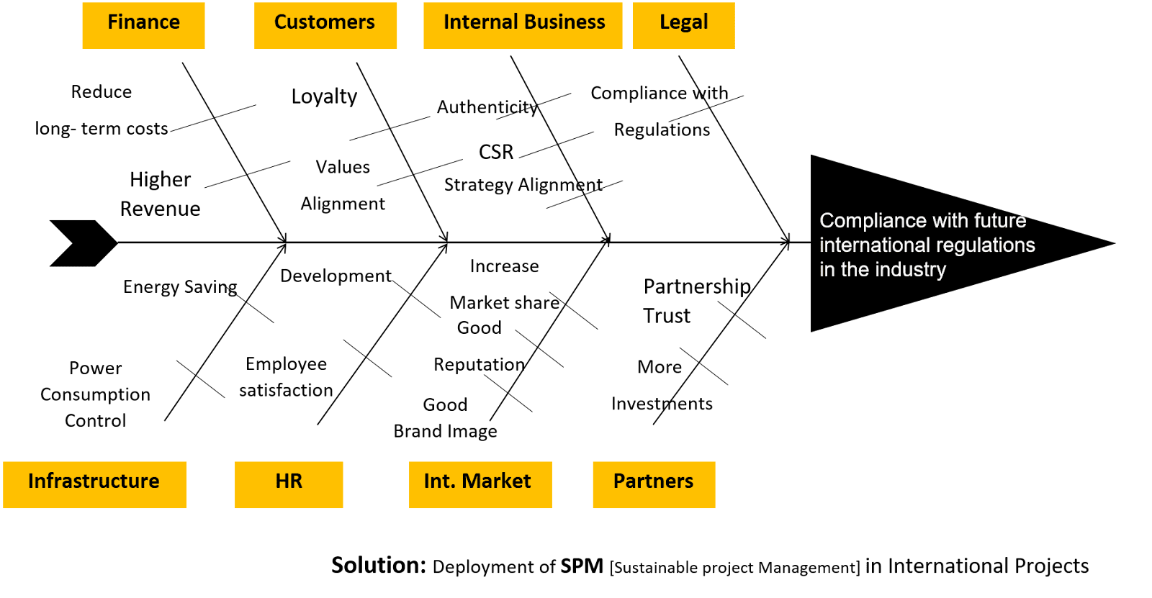
SPM [Sustainable project Management]
Fishbone Diagram
The Fishbone Diagram is a tool used to categorize factors that can enhance performance or achieve new goals. The diagram displays different categories such as people, processes, and equipment, making it easier to identify areas for improvement. By applying the 80/20 rule (Pareto Principle), you can focus on the 20% of factors that may yield 80% of the positive results in seizing opportunities

Slide 8
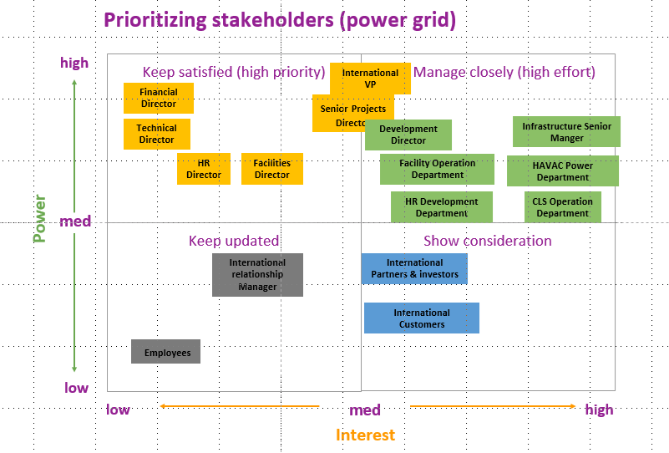
Project Initiation
Stakeholder Analysis & Power Grid
Stakeholder Analysis is a tool used to identify and evaluate individuals or groups that affect or are affected by a specific project, helping to understand their needs and priorities.
The Power Interest Grid is a visual tool used to categorize stakeholders based on their power and influence over the project, as well as their level of interest. By using this matrix, you can determine how to communicate with each stakeholder, enhancing collaboration and effectively achieving project goals.
RACI Chart
RACI Chart is a tool used to clarify roles and responsibilities within a project. The acronym RACI stands for Responsible (who does the work), Accountable (who is ultimately answerable), Consulted (who provides input and expertise), and Informed (who needs to be kept updated). By defining these roles, a RACI Chart helps ensure clear communication and accountability, improving project efficiency and collaboration.

Slide 9
SPM [Sustainable project Management]
SMART Objectives
A framework for setting clear and achievable goals, characterized by five criteria: Specific (clearly defined), Measurable (quantifiable to track progress), Achievable (realistic and attainable), Relevant (aligned with broader goals), and Time-bound (having a specific deadline). This approach ensures that objectives are well-defined and focused, facilitating effective planning and evaluation.
10% Enhancement power consumption awareness by replacing 20% the cooling and lighting systems (HVAC) in the cable landing stations (CLSs) which are (Abt,eldars) to sustainable systems in 3 months , starting 2025 one system every 6 weeks handled by power team.
20% Upgrade to the power consumption system by using PUE metric in 20% of the cable landing stations (CLSs) in Telecom Egypt by the calculations of all energy and loads used in (Abt,eldars) starts after HVAC system upgrade by the second quarter of 2025. (The power usage effectiveness: Total amount of Energy used / IT equipment energy usage) handled by the O & M team.
Enhance the Conditions of work 10% at Telecom Egypt by replacing 35% of the office in the basement floor to a place with good ventilation, lighting and furniture at the first quarter of 2025 handled by the facility team.
Develop 20% of the employees in supervisory positions at Telecom Egypt by using leadership workshops to enhance employee satisfaction 10% at the first quarter of 2025 handled by the HR team.

Slide 10
Project Initiation
Project Charter
Executive Summary: The Deployment of SPM (Sustainable Project Management) in International Projects aims to enhance Telecom Egypt’s sustainability efforts and operational efficiency. This project is driven by the need to adapt to global sustainable development goals and improve energy consumption practices within the organization.
Project Goal
10% Enhancement power consumption awareness by replacing 20% the cooling and lighting systems (HVAC) in the cable landing stations (CLSs) which are (Abt,eldars) to sustainable systems in 3 months , starting 2025 one system every 6 weeks handled by power team. 20% Upgrade to the power consumption system by using PUE metric in 20% of the cable landing stations (CLSs) in Telecom Egypt by the calculations of all energy and loads used in (Abt,eldars) starts after hvac system upgrade by the second quarter of 2025. (The power usage effectiveness: Total amount of Energy used / IT equipment energy usage) handled by the O & M team. Enhance the Conditions of work 10% at Telecom Egypt by replacing 35% of the office in the basement floor to a place with good ventilation, lighting and furniture at the first quarter of 2025 handled by the facility team. Develop 20% of the employees in supervisory positions at Telecom Egypt by using leadership workshops to enhance employee satisfaction 10% at the first quarter of 2025 handled by the HR team.
Deliverables
Two new sustainable systems of the (HVAC) in the cable landing stations (Abt,eldars) Two PUE metric reports for (Abt,eldars) by the end of Project. (The power usage effectiveness)): Total amount of Energy used / IT equipment energy usage) Upgrade & transfer fifteen offices from basement floor to be with good ventilation, lighting and furniture Leadership Training program for supervisory positions to finish development workshops.

Slide 11
Project Initiation
Project Charter
Business Case / Background
Telecom Egypt is the only telecom operator investing in Subsea cables in Egypt. The global world is attentive to sustainable development goals and policies which affect several aspects environmental, social and economic. The subsea industry is always targeting international customers. It would be promising opportunity to embrace the values and tools of Sustainable Project Management at Telecom Egypt’s Projects , especially projects related to submarine cable industry(For example, clean sources energy, curbing power consumption, inducing CO2 footprint and effective project management) Customers: over the top(OTTs) , International Telecom operators. Effect • Lower costs in long-term • Customers will experience value Alignment • Lower pollution and environmental risks that affects customer’s health • Wide range of telecommunications services with No ethical concerns Saving taxes when applying carbon credit rules Impact International projects and investments are smoothly carried out Coping with the advancement in developed world Compliance with future international regulations in the industry Increase in Telecom Egypt’s Regional market share Increase number of Pro-sustainability customers Gain in Long-term profits Boost Telecom Egypt Reputation Reduce long-term costs of the international projects Sustainable projects can be a competitive advantage in the regional marketing Boost customer loyalty to Telecom Egypt

Slide 12
Project Initiation
Project Charter
Benefits, Costs, and Budget
Benefits: Support new service leading to 5% revenue increase, reduce costs, increase sales increase customer satisfaction, Brand image, employee satisfaction, increase customer loyalty Costs: Price of systems, installation fees, offices preparations, time spent on training, support services Budget needed: EGP 3000000
Scope and Exclusion
In-Scope: Installment of HVAC Systems, dismantle to legacy HVAC System, Supervisory positions Training, Basement floor evacuate, Furniture the first floor Out-of-Scope: Facility refurbishment in the CLS The team members development Other power measurements Other equipment, Pcs or laptop replacements

Slide 13
Project Initiation
Project Charter
Project Team
Project Sponsor: development : CEO, VP, Development Director, infrastructure senior manager , Projects senior director Project Lead: Project Manager Project Team: HR department, CLS operations department, HVAC department, Facility department Additional Stakeholders: Technical director, Financial director, HR Director, Facility director
Measuring Success
Upgrade to the power consumption system by 20% in 3 months. Enhancement awareness about Power consumption by 10% by the second quarter of 2025 Enhancement in the Conditions of work by 10% in the 3 months Better Employee satisfaction by 10% by the first quarter of 2025.

Slide 14

Project Plan
Work Breakdown Structure” WBS”
a visual tool that breaks a project into smaller, more manageable parts or tasks. It helps organize the project’s scope, making it easier to plan, allocate resources, and track progress. The WBS ensures that all aspects of the project are covered and provides a clear framework for project management.
SPM
1.REPLACEMENT HVAC
2.REPLACEMENT OF OFFICES
3.DEVELOPMENT AND TRAINING FOR SUPERVISORY POSITIONS
4.Utilization of PUE Matrices
1.1CUERRENT SYSTEM ASSESSMENT
1.2 Purchase equipment
1.3 HVAC installation
2.1SURVEY THE TEAMS REPLACEMENT
2.2 FURNITURE SECOND FLOOR
2.3 EVACUATE THE BASEMENT
3.1TRAINING CONTENT PREPARATION
3.2TRAINING
4.1Equipment Power management
4.2 PUE Measurement

Slide 15
Project Plan
Precedence Diagram
A
2
B
8
C
4
I
3
J
4
START
G
2
H
7
END
D
2
E
7
F
3
2P=DEF=12W
3P=9W

Slide 16
Project Plan
Precedence Diagram
ES | 2 |  | EF
0 |  |  | 2
A
0 | 0 |  | 2
LS |  |  | LF
FS | 8 |  | EF
2 |  |  | 10
B
2 | 0 |  | 10
LS |  |  | LF
ES | 4 |  | EF
10 |  |  | 14
C
10 | 0 |  | 14
LS |  |  | LF
ES | 3 | EF
14 |  | 17
I
14 | 0 | 17
LS | F | LF
ES | 4 | EF
17 |  | 21
J
17 | 0 | 21
LS | F | LF
ES | 2 | EF
0 |  | 2
G
12 | 12 | 14
LS | F | LF
ES | 7 | EF
2 |  | 9
H
14 | 12 | 21
LS | F | LF
END
START
ES | 2 | EF
0 |  | 2
D
9 | 9 | 11
LS | F | LF
ES | 8 | EF
2 |  | 10
E
11 | 9 | 19
LS | F | LF
ES | 2 |  | EF
10 |  |  | 12
F
19 | 9 |  | 21
LS |  |  | LF

Slide 17
Project Plan
Gantt Chart
Gantt Chart a visual project management tool that displays the timeline of a project. It represents tasks or activities on the vertical axis and time intervals on the horizontal axis. Each task is shown as a horizontal bar, indicating its start date, duration, and end date. Gantt Charts help project managers and teams track progress, manage resources, and ensure that the project stays on schedule by providing a clear overview of task dependencies and milestones.
Budget plan
Budget plan a detailed financial outline for a project, specifying how resources will be allocated and spent. It includes estimates for all costs related to the project, such as labor, materials, equipment, and other expenses. The budget plan helps track spending against the approved budget, ensuring that the project remains financially viable. It also allows for adjustments in case of unforeseen costs and provides a framework for financial decision-making throughout the project’s lifecycle.
Statement Of Work “SOW”
SOW a formal document that outlines the scope of work to be performed in a project. It includes detailed descriptions of the project’s objectives, deliverables, timeline, tasks, and responsibilities. The SOW serves as a guide for both the project manager and the vendor, ensuring clarity on what needs to be done, by when, and under what conditions. It helps set expectations and provides a framework for measuring progress and success.

Slide 18
Project Plan
Risk plan
Risk Plan a formal document outlining the approach to managing risks in a project. It includes the processes for identifying, assessing, and prioritizing risks, as well as strategies for mitigating or avoiding them. The plan details who is responsible for managing each risk, how risks will be monitored, and what actions will be taken if risks materialize. A well-structured risk plan helps ensure that potential challenges are addressed proactively, minimizing their impact on the project.
Communication plan
Communication plan a document that outlines how information will be shared throughout a project. It details the communication methods, frequency, stakeholders involved, and the types of information to be conveyed. The plan ensures that everyone is informed, reducing misunderstandings and improving collaboration. It specifies who will send and receive updates, the channels used (e.g., emails, meetings), and key dates for important communications. A well-structured communication plan helps keep all stakeholders aligned and ensures smooth project progress.

Slide 19
Project Plan
Project Plan
A comprehensive document that outlines the roadmap for how a project will be executed, monitored, and controlled. It includes key elements such as the project’s objectives, scope, timeline, tasks, resources, budget, risk management, and communication strategies. The project plan serves as a guide for the project team and stakeholders, ensuring that everyone understands the project’s goals, deadlines, and responsibilities. It is essential for tracking progress and making adjustments to keep the project on track toward successful completion
Project Name: SPM (Sustainable project Management)
Description: This is a document resource overview plan for telecomegypt new SPM.
Owner: Shereen Eltayeb
Status: Draft
Key Docs | Description
Situational Statement | summarizes the project’s context, including its background, challenges, objectives, and stakeholders, to ensure alignment on its importance
SWOT Analysis | identifies Strengths, Weaknesses, Opportunities, and Threats to inform strategic decision-making for the project
Fishbone Analysis | identifies potential causes of problems by categorizing them into key areas such as people, processes, materials, and environment, helping to pinpoint root issues and improve project outcomes
Project charter | An overview of the project, key elements and expectations
Statement of work HVAC | Identifies the work that is included in the project and the pricing that was quoted initially.
Statement of work Office | Identifies the work that is included in the project and the pricing that was quoted initially.
Risk management plan | Identifies the potential risks to the project, their likelihood, and how you plan to mitigate them if they become realized.
Schedule | Identifies the planned schedule as well as any changes through out the project lifecycle.
Budget | Identifies the planned budget as well as any over and under runs. Allows you to estimate the cost at completion.
Communication plan | Identifies how often, what type of communication method, and what information your stakeholders needs to know
RACI chart | Identifies who is responsible, accountable, consulted and informed within the project.

