Slide 1
SHERLY PERSIS VINSTA.S
Final Project
3/21/2024 Annual Review

Slide 2
PROJECT TITLE
ATTENDANCE SYSTEM USING
FACE DETECTION
(HAAR CASCADE)
3/21/2024 Annual Review

Slide 3


AGENDA
Problem Statement
Project Overview
End Users
Solution and Value Proposition
Unique Aspects
Modelling
Results
3/21/2024 Annual Review

Slide 4

PROBLEM STATEMENT
In educational institutions, workplaces, and various organizations, maintaining accurate attendance records is essential for tracking the presence of individuals.
Traditional methods of attendance tracking, such as manual roll calls or paper-based systems, are often time-consuming, error-prone, and susceptible to manipulation.
To address these challenges, the development of an automated attendance system using face detection technology presents an efficient and reliable solution.
3/21/2024 Annual Review

Slide 5

PROJECT OVERVIEW
The primary objective of this project is to develop an automated attendance system that utilizes face detection technology based on the Haar cascade algorithm.
The Haar cascade algorithm is a machine learning-based approach used for detecting faces in images or video frames captured by a camera.
By automatically detecting and recognizing faces, the system will streamline the attendance tracking process, reduce administrative overhead, and provide a more accurate and secure method of attendance management.
3/21/2024 Annual Review

Slide 6

WHO ARE THE END USERS?
Educational Institutions
Workplaces
Organizations
Individual Users
Software Developers
3/21/2024 Annual Review

Slide 7

YOUR SOLUTION AND ITS VALUE PROPOSITION
ALGORITHM USED:
HAAR CASCADE is an algorithm that detects faces by first creating a Haar Cascade classifier using a set of positive and negative images.The Haar-like features can be used to distinguish between facial features such as the eyes, nose, and mouth.
All the students of the class must register themselves by
entering the required details and then their images will be
captured and stored in the dataset.
During each session, faces will be detected from live streaming video of classroom. The faces detected will be compared with images present in the dataset.
If match found, attendance will be marked for the
respective student.
3/21/2024 Annual Review

Slide 8

THE WOW IN YOUR SOLUTION
User-Friendly Interface: The graphical user interface (GUI) provides a simple and intuitive platform for users to interact with the system.
Password Protection: The system incorporates a password protection mechanism to secure sensitive functionalities such as profile registration and system configuration
Real-Time Attendance Tracking: The system enables real-time attendance tracking by continuously monitoring the camera feed and detecting faces in the environment.
Automatic Attendance Recording: Upon face detection and recognition, the system automatically records attendance details including ID, name, date, and time. Attendance records are stored in organized files for easy access and analysis.
3/21/2024 Annual Review

Slide 9
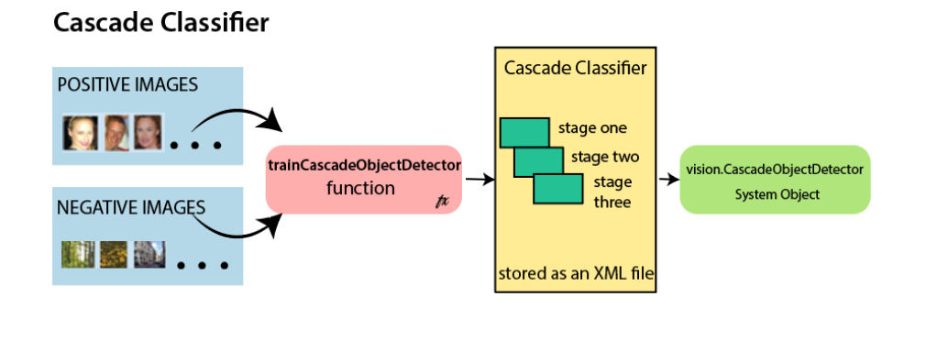
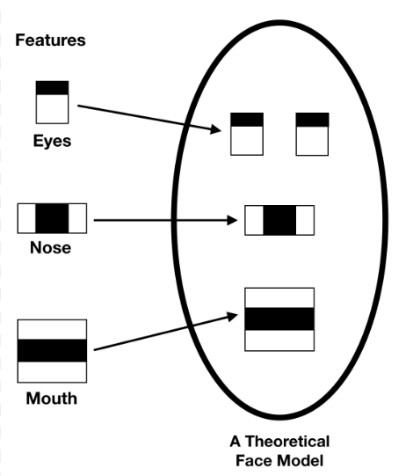
MODELLING
1.Initialization: The system initializes by loading the pre-trained Haar cascade classifier for face detection and connecting to the camera or video feed.
3/21/2024 Annual Review

Slide 10
MODELLING
2.Face Detection: The system continuously captures images or video frames from the camera and applies the Haar cascade classifier to detect faces. When a face is detected, the system proceeds to the next step.
3.Face Recognition: Optionally, the system can perform face recognition to identify individuals based on detected faces. This step involves matching detected faces against a database of known individuals.
LBPH (Local Binary Pattern Histogram) is a Face-Recognition algorithm it is used to recognize the face of a person. It is known for its performance and how it is able to recognize the face of a person from both front face and side face.
4.Attendance Recording: Once a face is detected and recognized (if enabled), the system records the attendance of the individual associated with the detected face. Attendance records are stored in a database for future reference.
5.User Interaction: Users can interact with the system through the user interface to view attendance records, generate reports, and perform administrative tasks. The user interface provides a seamless experience for system management and monitoring

Slide 11
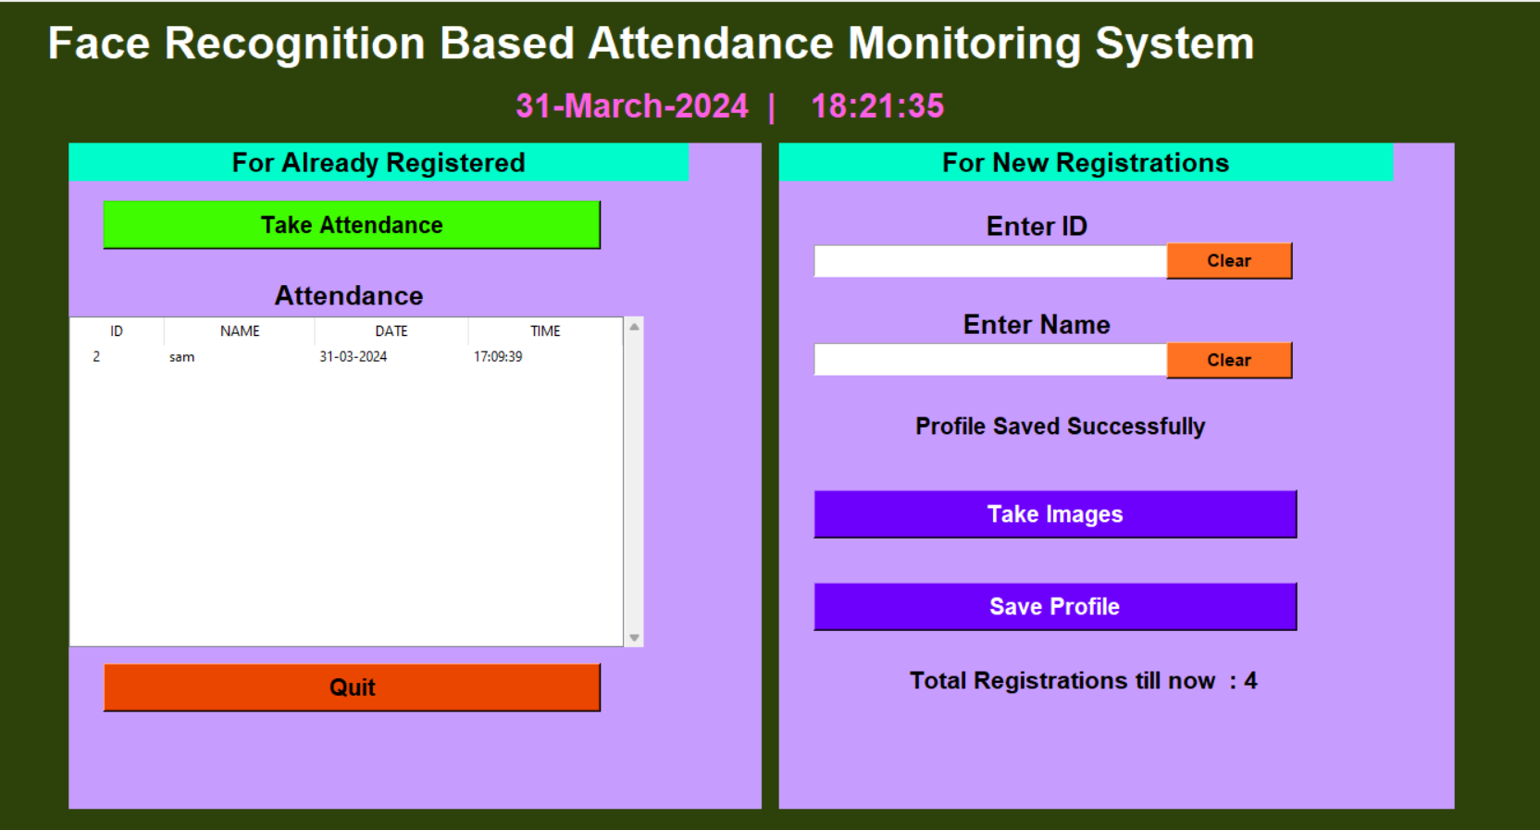
RESULTS

Slide 12
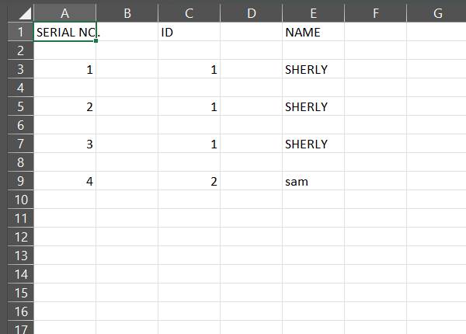
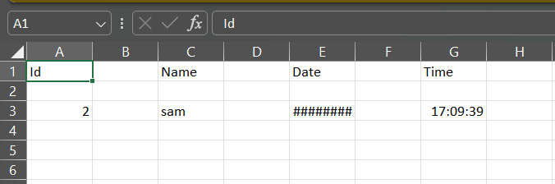
RESULTS
STUDENT DETAILS
ATTENDANCE
Demo Link
3/21/2024 Annual Review

