Slide 1
DATABASE MANAGEMENT SYSTEMS
Dr.A.Kannan

Slide 2
Database Management Systems (DBMS)
Database: Collection of related data.
Ex. The names, telephone numbers and addresses of all the people you know.
Database System: A computer based record-keeping system.
Data base management system: A software that helps to store the data in a database and to retrieve the stored data efficiently.

Slide 3
Student Student(Rollno, Sname, Age, Branch, City, Marks)
Roll_no | Sname | Age | Branch | City | Marks
100 | Hari | 20 | CSE | Chennai | 81
200 | Anand | 21 | IT | Vellore
300 | Uma | 18 | CSE | Chennai | 81
400 | Rama | 19 | IT | Chennai | 72
500 Rows : Tuples | Raja Columns: Attributes | 20 Table: Relation | IT | Vellore | 95

Slide 4
Examples of commercial database management systems
ORACLE
DB2
Ingres
Postgres
SQL Server
MySQL
MS-ACCESS

Slide 5
Database Management System
Database - Collection of interrelated data.
DBMS - Set of programs to access the data.
DBMS contains information about a particular enterprise. Eg: Bank, University, Railways, Super_market.
DBMS provides an environment that is both convenient and efficient to use.

Slide 6
Operations on Databases
Create a Database
Create a Table
Insert Rows into a Table
Delete Rows from a Table
Update Rows
Retrieve Rows

Slide 7
Database Applications
Database Applications
- Banking: all transactions.
- Airlines: reservations, schedules.
- Universities: registration, grades
- Sales: customers, products, purchases.
- Manufacturing: production, inventory, orders, supply chain.
- Human resources: employee records, salaries, tax deductions.
Databases touch all aspects of our lives.

Slide 8
Purpose of Database Systems
Database management systems were developed to handle the following difficulties of typical file-processing systems supported by
conventional operating systems.
Data redundancy and inconsistency
Difficulty in accessing data
Data isolation – multiple files and formats
Integrity problems
Atomicity of updates
Concurrent access by multiple users
Security problems

Slide 9
ADVANTAGES OF DBMS
CENTRALISED CONTROL
INTEGRATED AND SHARED
REDUNDANCY CAN BE REDUCED
INCONSISTENCY CAN BE AVOIDED
STANDARDS CAN BE ENFORCED
SECURITY RESTRICTIONS
DATA INDEPENDENCE
INTEGRITY CAN BE MAINTAINED

Slide 10
KEYS
CANDIDATE KEY
College(rollno, sname, address, age, marks)
Hostel(Stu_host_Id, sname, Mess_type, Hostel_bolck, Room_no, rollno)
PRIMARY KEY
FORIEGN KEY

Slide 11
Candidate Keys
Candidate Key : An attribute(column) or a set of attributes that uniquely identify the tuples (rows) of a relation (table) is known as the candidate key for the relation.
Primary Key: Among the different candidate keys, one of the candidate keys will be designated as the primary key by the programmer. All the other candidate keys are known as the alternate keys.

Slide 12
Foreign Key
An attribute which is a primary key in one table but an ordinary attribute in some other table is known as the foreign key in the table where it is not the primary key.
College(rollno, sname, address, age, marks)
Primary Key: rollno
Hostel(Stuent_ID_hostel, sname, Mess_type, Hostel_bolck, Room_no, rollno)
Primary Key: Student_ID-hostel,
Foreign Key: rollno

Slide 13
Integrity Rules
Domain Integrity Rule
All values in a table must be from a domain (Range of Values)
Age: 0 – 125
Entity Integrity
No component of the primary key value can be NULL.
Referential Integrity
For every foreign key value, there must be a matching primary key value.

Slide 14
Schema and Sub Schema
The overall logical Structure of a database is known as Schema.
Sub-Schema is derived from schema. (Part of a Schema).
Eg:Schema
employee(eno, ename, address, dept, designation, age, salary)
Sub_schemas:
Emp1(eno, ename, address, salary)
Emp2(eno, address, dept, age, designation)

Slide 15
Data Sub Language
Every DBMS is provided with a data sub language for efficiently storing and retrieving the data.
Example: Oracle – SQL
Ingres – QUEL
Data Definition Language (Create table or view)
Data Manipulation Language ( Insert, delete, update, retrieve)
Data Control Language (grant, revoke)

Slide 16
Levels of Abstraction
Physical level describes how a record (e.g., employee ) is stored.
Logical level: describes data stored in database, and the relationships among the data.
type employee = record name : string;
age : integer; street : string; city : integer;
salary: float; end;
View level: application programs hide details of data types. Views can also hide information (e.g., salary) for security purposes.

Slide 17
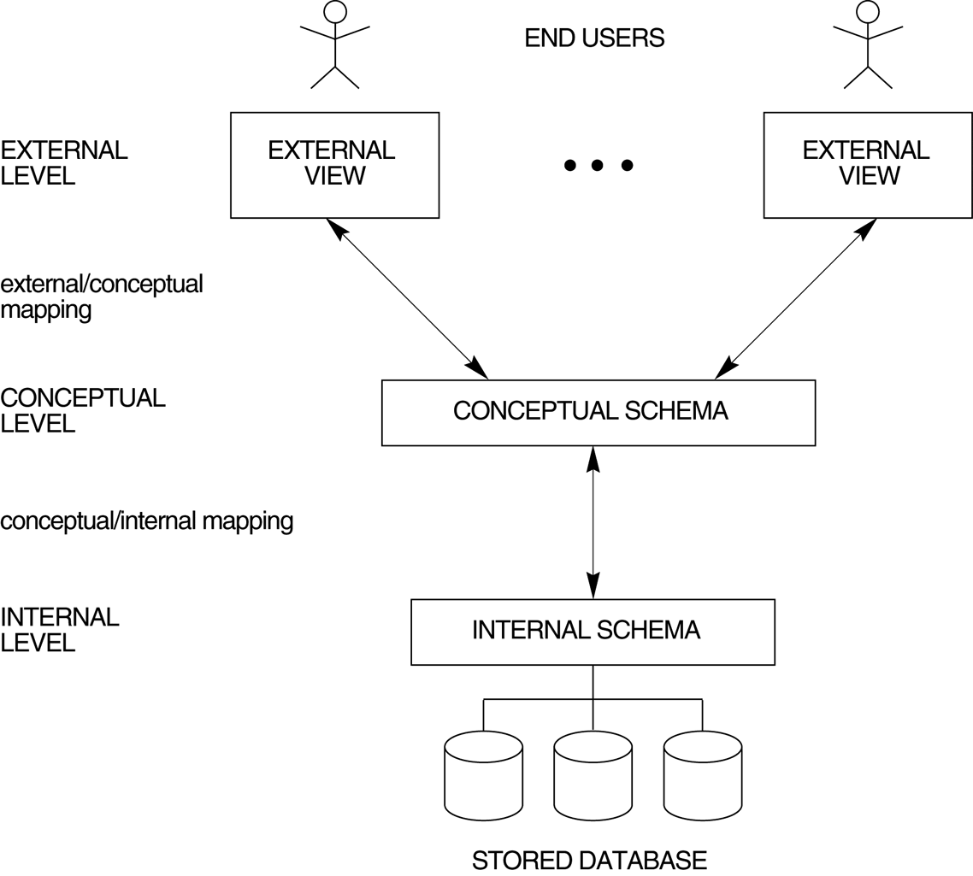
The Three Schema architecture.

Slide 18
Three Level Architecture
External Level – C user
struct employee { char empno(6);
int salary;
};
External Level – COBOL
01 EMP.
02 EMPNO PIC X(6).
02 DEPTNO PIC X(4).

Slide 19
Three Level Architecture
CONCEPTUAL LEVEL
EMPLOYEE
EMPLOYEE_NUMBER CHARACTER(6);
EMPLOYEE_NAME CHARACTER(20);
DEPARTMENT_NUMBER CHARACTER (4);
SALARY DECIMAL (5);
EMPLOYEE_ADDRESS CHAR(24);

Slide 20
Three Level Architecture
INTERNAL LEVEL
STORED_EMPLOYEE BYTES = 64
PREFIX BYTES = 6, OFFSET = 0
EMP# BYTES = 6, OFFSET = 6, INDEX =EMPX
ENAME BYTES = 20, OFFSET = 12
DEPTNO BYTES = 4, OFFSET = 32
SALARY BYTES = 10, OFFSET = 36
EADDRESS BYTES = 24, OFFSET= 40

Slide 21
Three Schema Architecture
Defines DBMS schemas at three levels:
Internal schema at the internal level to describe physical storage structures and access paths. Typically uses a physical data model.
Conceptual schema at the conceptual level to describe the structure and constraints for the whole database for a community of users. Uses a conceptual or an implementation data model.
External schemas at the external level to describe the various user views. Usually uses the same data model as the conceptual level.

Slide 22
Database Users
End users
Use the database system to achieve some goal.
Application developers
Write software to allow end users to interface with the database system.
Database Administrator (DBA)
Designs and manages the database system.
Database systems programmer
Writes the database software itself.

Slide 23
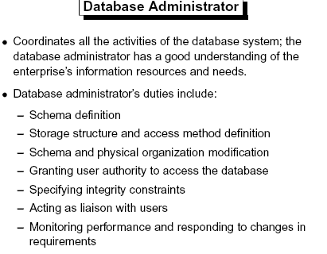

Slide 24
Data Dictionary - Metadata
The dictionary or catalog stores information about the database itself
This is data about data or ‘metadata’
Almost every aspect of the DBMS uses the dictionary
The dictionary holds
Descriptions of database objects (tables, users, rules, views, indexes,…)
Information about who is using which data (locks)
Schemas and mappings

Slide 25
Data Definition Language (DDL)
Specification notation for defining the database schema
E.g. create table account ( account-number char(10), not null, primary key, balance integer)
DDL compiler generates a set of tables stored in a data dictionary.
Data dictionary contains metadata (i.e., data about data)
Table name: account
Owner: Kannan
Date: 05/08/2021
Attributes: account-number , data type char(10), Constraints – not null, primary key
Balance: integer

Slide 26
Data Manipulation Language (DML)
Language for accessing and manipulating the data organized by the appropriate data model
DML also known as query language
Two classes of languages
Procedural – user specifies what data is required and how to get those data.
You must write Programs to get your data.
Nonprocedural – user specifies what data is required without specifying how to get those data.
Select rollno, name, address from student;
SQL is the most widely used query language (Non-Procedural Language)
SQL – Structured Query Language

Slide 27
ORACLE
CONNECT – Cannot create tables. Works in the tables created by others if they give permission.
Resource – Can create tables only in their account (area allotted to them), do operations only on their tables.
DBA – Powers with all users tables and accounts.

Slide 28
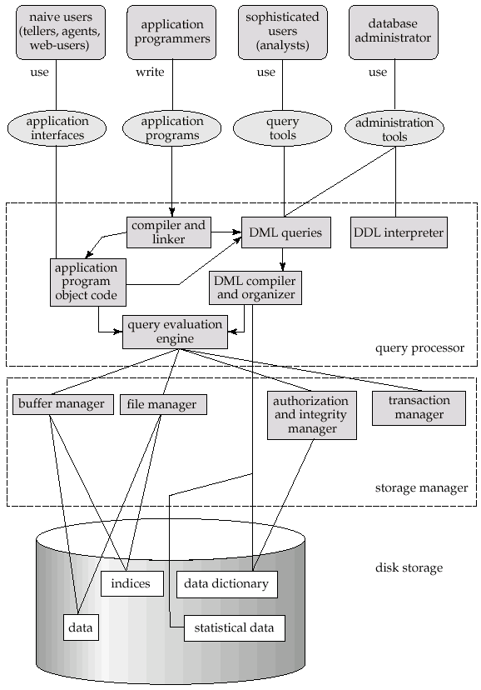
Overall System Structure

Slide 29
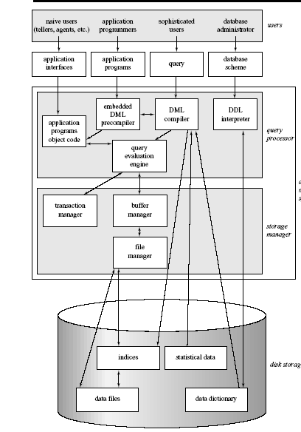

Slide 30
DATA MODELS
Hierarchical Model, Network Model and Relational Model.
Hierarchical Model:
- Stores the data using Tree Data Structures.
- Eg: IMS in IBM Main Frames
DL/1 – Data Language 1
Network Model
- Stores the data using Graph Data Structure.
- Eg: IDMS from IBM Mainframe
Relational Model
- Stores in the data in Table format.
Example: Oracle, SQL Server, MySQL, DB2 etc.

Slide 31
DATA MODELS
HIERARCHICAL MODEL
NETWORK MODEL

Slide 32
DATA MODELS
Hierarchial DBMS
Understands relations in the form of one to many data connections made by you at the time of data definition
It is like a tree structure
Explores from a parent to one or more children

Slide 33
RELATIONAL MODEL
COLUMN
TABLE
ROW
VALUE

Slide 34
Relation Example
Relational Database Management Systems (RDBMS)
Rollno = { 1, 2, 3}
Names = { A, B, C}
Cartesian product – The set of all ordered pairs.
R= Rollno x Names = { (1,A), (1,B), (1,C), (2,A), (2,B), (2,C), (3,A), (3,B), (3,C) }
Relations : Subset of Cartesian Product.
Eg: R1= { (1,A), (2,B)} is a subset of R.
Student = { (1,A), (2,B), (3,C) } is another subset of R
R2 = { (1,B), (1,C), (2,A), (2,B), (3,A), (3,C) }

Slide 35
Relations
Relations can be represented in the form Tables.
Table Name : Student
The Schema for this relation is:
Student(Rollno, Name)
Here, student is the Table name ;
Rollno and Name are the Attribute Names.
Rollno | Name
1 | A
2 | B
3 | C

Slide 36
Relational Model
Data are stored in the form of tables
Rows can be in any order
Columns can be in any order
No two rows are equal
No two columns are equal
Let A and B be any two sets. Then a relation R can be defined as a subset of A x B.( A cross B).
Therefore, a relation is nothing but a subset of the Cartesian Product.

Slide 37
Relational Model
Table name is called as relation.
Rows are called Tuples
Columns are called as Attributes
There must be a primary key formed from one or more attributes.
The data sub language must be based on Relational Algebra or Relational Calculus.

Slide 38
Two Tier Client-Server Architecture
59
A client program may connect to several DBMSs, sometimes called the data sources.
In general, data sources can be files or other non-DBMS software that manages data.
Other variations of clients are possible: e.g., in some object DBMSs, more functionality is transferred to clients including data dictionary functions, optimization and recovery across multiple servers, etc.

Slide 39
Three Tier Client-Server Architecture
60
Common for Web applications
Intermediate Layer called Application Server or Web Server:
Stores the web connectivity software and the business logic part of the application used to access the corresponding data from the database server
Acts like a conduit for sending partially processed data
between the database server and the client.
Three-tier Architecture Can Enhance Security:
Database server only accessible via middle tier
Clients cannot directly access database server

Slide 40
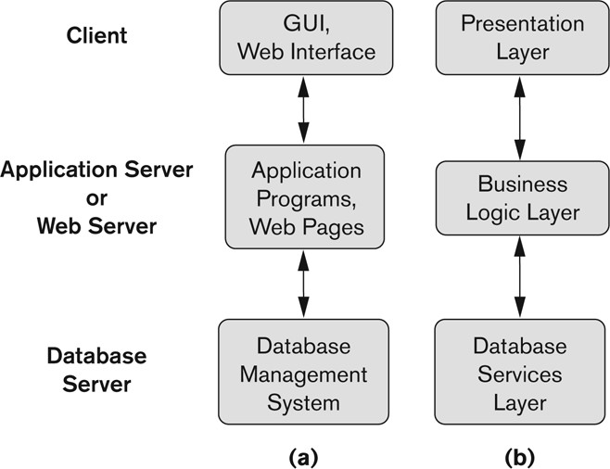
Three-tier client-server architecture
61

Slide 41
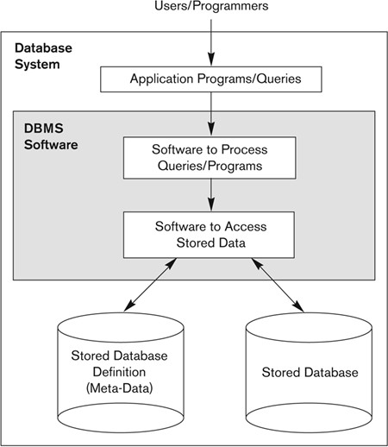
Simplified database system environment

Slide 42
RDBMS
CODD’s 12 Rules Rule 1
Information Rule
All Information in a relational database including table names, column names are represented explicitly by values in tables.
Knowledge of only one language is necessary to access all data
Dr.E.F.CODD

Slide 43
RDBMS
CODD’s 12 Rules Rule 2
Guaranteed Access Rule
Every piece of data in the relational database, can be accessed by using a combination of a table name, a primary key value that identifies the row and a column name that identifies the cell. This will avoid using physical pointers.

Slide 44
RDBMS
CODD’s 12 Rules Rule 3
Systematic Treatment of Nulls Rule
The RDBMS handles records that have unknown values in a predefined fashion. RDBMS distinguishes between zeroes, blanks and nulls in records.

Slide 45
RDBMS
CODD’s 12 Rules Rule 4
Active on-line catalog based on the relational model
The description of a database and its contents are database tables and queries can be online via the data language

Slide 46
RDBMS
CODD’s 12 Rules Rule 5
Comprehensive Data Sublanguage Rule
A RDBMS may support several languages, but atleast one of them allows the user to do all of the following : define tables, query and update data, set integrity constraints, set authorization and define transactions

Slide 47
RDBMS
CODD’s 12 Rules Rule 6
View Updating Rule
Any view that is theoretically updatable, if changes can be made to the tables that effect the desired changes in the veiw. Data consistency is ensured since in the underlying tables are transmitted to the view they support. Logical data independence reduces maintenance cost.
Base Table: The table exists physically
View Table: It is a virtual table created from one or more base tables.

Slide 48
RDBMS
CODD’s 12 Rules Rule 7
High level inserts, Update and Delete
The RDBMS supports insertion, updation and deletion at a table level. With this the RDBMS can improve performance by optimizing the path to be taken to execute the action.

Slide 49
RDBMS
CODD’s 12 Rules Rule 8
Physical Data Independence
The execution of adhoc requests and application programs is not affected by changes in the physical data access and storage methods. DBA’s (DataBase Administrators) can make changes to the physical data

Slide 50
RDBMS
CODD’s 12 Rules Rule 9
Logical Data Independence
Logical changes in tables and view such as adding / deleting columns or changing field lengths do not necessitate modifications in application programs or in the format of adhoc requests.

Slide 51
RDBMS
CODD’s 12 Rules Rule 10
Integrity Independence
Like table definitions integrity constraints are stored in the online catalog. The following two integrity constraints must be supported.
Entity Integrity
No component of primary key is allowed to have a null value
Referential Integrity
For each non null foreign key value in a table, there must exist a matching primary key

Slide 52
RDBMS
CODD’s 12 Rules Rule 11
Distribution Independence
Application programs and adhoc requests are not affected by changes in the distribution of the physical data

Slide 53
RDBMS
CODD’s 12 Rules Rule 12
Non Subversion Rule
If the RDBMS has a language change that accesses the information of a record at a time, this language cannot be used to by-pass the integrity constraints. In order to adhere to this rule the RDBMS must have an active catalog that contains the constraints.

Slide 54
Typical DBMS Functionality
Define a particular database in terms of its data types, structures, and constraints
Construct or Load the initial database contents on a secondary storage medium
Manipulating the database:
Retrieval: Querying, generating reports
Modification: Insertions, deletions and updates to its content
Accessing the database through Web applications
Processing and Sharing by a set of concurrent users and application programs – yet, keeping all data valid and consistent

Slide 55
FUNCTIONS OF A DBMS
STORAGE MANAGEMENT
RETRIEVAL OF DATA
QUERY PROCESSING
TRANSACTION MANAGEMENT
- CONCURRENCY CONTROL
- RECOVERY
INTEGRITY AND SECURITY

Slide 56
Conclusion
Database
DBMS
Data Models
Query Languages
Architecture
Data Structures
Client/Server DBMS

