Slide 1
RELATIONAL ALGEBRA
Dr.A.Kannan

Slide 2
Relational Algebra
The relational algebra provides the operations on Relations (Tables).
The relational algebra operators are:
Union
Intersection
Difference
Cartesian Product
Selection
Projection
Join
Division
Rename

Slide 3
Union (U)
The union of two relations R1 and R2 consists of the set all tuples which are present in R1 or R2 or both.
Ex: R = R1 U R2, Union Compatibility
R1 R2
Rollno | Name | Branch
100 | A | CSE
200 | B | IT
300 | C | CSE
1000 | K | IT
Rollno | Name | Branch
200 | B | IT
300 | C | CSE
400 | D | IT
500 | E | CSE

Slide 4
Union
R1 R2

Slide 5
Intersection (∩)
R1 R2

Slide 6
Difference

Slide 7
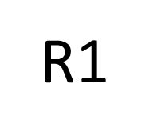
Cartesian Product (× )
R2
R = R1 × R2

Slide 8
Tables - Relations
Rows - Tuples
Columns - Attributes

Slide 9
Selection(σ)
The SELECT operation is used for selecting a subset of the tuples according to a given selection condition.
Sigma(σ)Symbol denotes it. It is used as an expression to choose tuples which meet the selection condition.

Slide 10
Select Operation – Example
Relation r
A
B
C
D
α
α
β
β
α
β
β
β
1
5
12
23
7
7
3
10
_{(A=B) ^ (D > 5)} (r)
A
B
C
D
α
β
α
β
1
23
7
10

Slide 11
Selection with >=
Example: Pick The Rows (Tuples) belonging to CSE Students from the Following Student Table (Relation).
Select the tuples of students with Marks >= 65.
Result = σ _{marks >= 65} (Student)
_{Student}

Slide 12
Selection
Result of = σ _{marks >= 65} (Student)

Slide 13
Selection with =
Result of = σ _{branch = ‘CSE’} (Student1)
Student1
Result of Query
Rollno | Name | Branch
100 | A | CSE
200 | B | IT
300 | C | CSE
1000 | K | IT
400 | D | IT
500 | E | CSE
Rollno | Name | Branch
100 | A | CSE
300 | C | CSE
500 | E | CSE

Slide 14
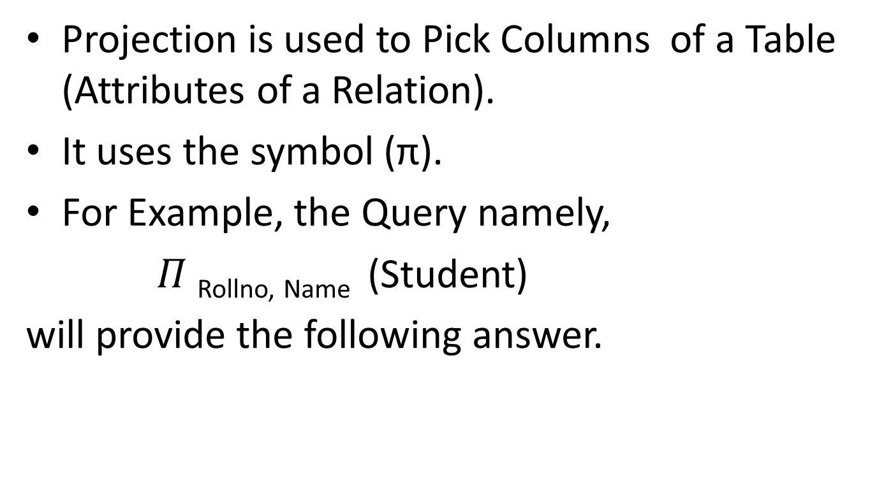
Projection
Projection is used to Pick Columns of a Table (Attributes of a Relation).
It uses the symbol (π).
For Example, the Query namely,
$Π$ _{Rollno, Name} (Student)
will provide the following answer.

Slide 15

Projection
The Query $Π$ _{Rollno, Name} (Student)
Student $Π$ _{Rollno, Name} (Student)

Slide 16

Projection
The Query $Π$_{Name , Branch} (Student)
Student $Π$ _{Name, Branch} (Student)

Slide 17
Project Operation – Example
A
B
C
Relation r:
α
α
β
β
10
20
30
40
1
1
1
2
A
C
A
C
∏_{A,C} (r)
α
α
β
β
1
1
1
2
α
β
β
1
1
2
=

Slide 18
Equi-join
To form the Equi-Join of two tables R1 and R2 the following operations must be done.
1. Form the Cartesian Product of R1 and R2
2. Pick the rows satisfying the condition
R1.Common-Column = R2.Cmmon-Column

Slide 19
Equi-Join
If R1 has the schema
R1(Rollno, Name, Address)
and R2 has the schema
R2(Rollno, Branch, Marks), then the Join Condition will be:
R1.Rollno = R2.Rollno
Here, Rollno is the common column between the two tables namely R1 and R2.

Slide 20
Equi-Join Step-1: Form the Cartesian Product
R2
R = R1 × R2

Slide 21
Equi-Join
Pick rows satisfying the condition R1.Rollno = R2.Rollno
Here, Result R = (σ _{R1.Rollno = R2.Rollno} (R1 x R2))

Slide 22
Natural Join
Natural Join is also called as the Join of two Tables using a common column.

Slide 23
Natural Join
To find the Natural Join of two Relations R1 and R2, we must perform the following operations:
1. Product: Form the Cartesian product of R1 and R2.
2. Selection: Pick the rows satisfying the condition
R1.Common_col = R2.Common_col
3. Projection: Eliminate the duplicating columns by projecting the common column only once.

Slide 24
Join(⋈)
_{R = R1 ⋈ R2}
R = (π _{R1.Rollno, Name, Branch}(σ _{R1.Rollno = R2.Rollno}(R1 x R2)))

Slide 25
Join Step-1: Form the Cartesian Product
R2
R = R1 × R2

Slide 26
Join
Step-2: Pick rows satisfying the condition R1.Rollno = R2.Rollno
Here, Result R = (σ _{R1.Rollno = R2.Rollno} (R1 x R2))

Slide 27
Join
Step-3 : Pick columns namely R1.Rollno, Name, Branch from the Equi-join Result.
NATURAL JOIN
R =

Slide 28
Theta Join (θ-Join)
In Equi-Join, the selection condition uses the = operator.
Eg:R = (σ _{R1.Rollno = R2.Rollno} (R1 x R2))
However, if we use less than symbol,
R = (σ _{R1.Rollno <} _{R2.Rollno} (R1 x R2)), we get less than Join.
If we use <=, we get less than or equal to join.

Slide 29
Theta Join (θ-Join)
If we use >=, we get greater than or equal to join.
If we use > , we get greater than join.
If we use <>, we get not equal to join.
In general, if we use the θ operator, we get
θ-Join.
Here, theta can be any one of the following:
<, <=, =, <>, >, >=

Slide 30
Division
Not supported as a primitive operator, but useful for expressing queries like: Find sailors who have reserved all boats.
Let A have 2 fields, x and y; B have only field y:
A/B =
i.e., A/B contains all x tuples (sailors) such that for every y tuple (boat) in B, there is an xy tuple in A.
Or: If the set of y values (boats) associated with an x value (sailor) in A contains all y values in B, the x value is in A/B.
Notes:
13

Slide 31
Examples of Division A/B
B1
B2
B3
A
A/B1
A/B2
A/B3
Notes:
14

Slide 32
Rename
The RENAME operation is used to rename the output of a relation.
Sometimes it is simple and suitable to break a complicated sequence of operations and rename it as a relation with different names.

Slide 33
Rename
Reasons to rename a relation can be many, like –
We may want to save the result of a relational algebra expression as a relation so that we can use it later.
T = t1 + t2 + t3 + t1+ t2+ t4 + t1 +t2
k=t1+t2
J = t3 + t4
T = k + j
We may want to join a relation with itself, in that case, it becomes too confusing to specify which one of the tables we are talking about, in that case, we rename one of the tables and perform join operations on them.

Slide 34
Rename(ρ)
Notation:
ρ _{X} (R) where the symbol ‘ρ’ is used to denote the RENAME operator and R is the result of the sequence of operation or expression which is saved with the name X.
Example-1: Query to rename the relation Student as CSE Student and the attributes of Student – RollNo, Name as (Sid, SName).

Slide 35
Rename Example
Rename the attributes Rollno and Name as
“Sid and Sname” in the Student Table for CSE students and project only these two attributes.
ρ _{Student(Sid, SName)}π_{RollNo,Name}(σ_{branch=}‘CSE’(Student))

Slide 36
Schema for Example Tables
Sailors: ( sid, sname, rating, age )
Boats: ( bid, color, bname )
Reserves: ( sid, bid, date )
Notes:
15

Slide 37
Sailors
sid, sname, rating, age
10 A 9 32
20 B 8 27
30 C 9 20
40 D 10 22
50 E 8 41

Slide 38
Boats: ( bid, color, bname )
Bid Color Bname
100 Red X
101 Green Y
103 Red Z
104 Blue AA
105 Green BB

Slide 39
Reserves: ( sid, bid, date )
Sid bid date
10 100 24/8/21
20 103 24/8/21
30 103 24/8/21
40 101 24/8/21

Slide 40
20 103 24/8/21
30 103 24/8/2
JOIN Result
Sid Sname Rating Age Bno Date
20 B 8 27 103 24/8/21
30 C 9 20 103 2/8/21

Slide 41
Find names of sailors who’ve reserved boat #103
Solution 1:
Same:
Solution 2:
Notes:
16

Slide 42
Find names of sailors who’ve reserved a red boat
Information about boat color only available in Boats; so need an extra join:
A more efficient solution:
A query optimizer can find this, given the first solution!
Notes:
17

Slide 43
Find sailors who’ve reserved a red or a green boat
Can identify all red or green boats, then find sailors who’ve reserved one of these boats:
Can also define Tempboats using union! (How?)
What happens if is replaced by in this query?
Notes:
18

Slide 44
Find sailors who’ve reserved a red and a green boat
Previous approach won’t work! Must identify sailors who’ve reserved red boats, sailors who’ve reserved green boats, then find the intersection (note that sid is a key for Sailors):
Notes:
19

Slide 45
Summary
The relational model has rigorously defined query languages that are simple and powerful.
Relational algebra is more operational; useful as internal representation for query evaluation plans.
Several ways of expressing a given query; a query optimizer should choose the most efficient version.

Slide 46
Thank You

