Slide 1
Distributed Databases

Slide 2


TERMINALS
MAINFRAME COMPUTER
DUMB
DUMB
SPECIALISED NETWORK CONNECTION
DUMB
PRESENTATION LOGIC
BUSINESS LOGIC
DATA LOGIC

Slide 3
CLIENT/SERVER DATABASE SYSTEM

Slide 4
CLIENT/SERVER DBMS
    Manages user interface
    Accepts user data
    Processes application/business logic
    Generates database requests (SQL)
    Transmits database requests to server
    Receives results from server
    Formats results according to application logic
    Present results to the user
CLIENT PROCESS

Slide 5
CLIENT/SERVER DBMS
    Accepts database requests
    Processes database requests
      Performs integrity checks
      Handles concurrent access
      Optimises queries
      Performs security checks
      Enacts recovery routines
    Transmits result of database request to client
SERVER PROCESS

Slide 6
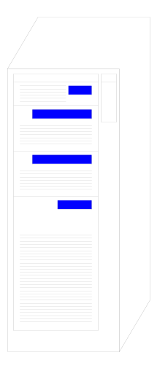
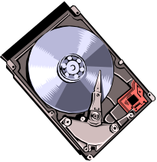
CLIENT/SERVER
DBMS ARCHITECTURE
CLIENT#1
①
SERVER
CLIENT#2
①
②
D/BASE
NETWORK
②
DBMS
CLIENT#3
①
②
DATA LOGIC
PRESENTATION LOGIC
BUSINESS LOGIC
① Data Request
② Data Response
(FAT CLIENT)

Slide 7
CLIENT/SERVER
DBMS ARCHITECTURE
CLIENT#1
①
SERVER
CLIENT#2
①
②
D/BASE
NETWORK
PL/SQL
②
DBMS
CLIENT#3
①
②
BUSINESS LOGIC
DATA LOGIC
PRESENTATION LOGIC
(THIN CLIENT)
① Data Request
② Data Response

Slide 8
DISTRIBUTED PROCESSING ARCHITECTURE
CLIENT
CLIENT
CLIENT
CLIENT
LAN
LAN
CLIENT
CLIENT
CLIENT
CLIENT
WIDE AREA NETWORK
Stratford
Leyton
CLIENT
CLIENT
CLIENT
CLIENT
LAN
LAN
DBMS
CLIENT
CLIENT
CLIENT
CLIENT
Barking
Leytonstone

Slide 9
DISTRIBUTED DATABASE SYSTEM

Slide 10
DISTRIBUTED DATABASES
WHAT IS A DISTRIBUTED DATABASE?
    A distributed database system is a collection of
    logically related databases that co-operate in a
    transparent manner.
    Transparent implies that each user within the
    system may access all of the data within all of the
    databases as if they were a single database
    There should be ‘location independence’ i.e.- as
    the user is unaware of where the data is located it
    is possible to move the data from one physical
    location to another without affecting the user.

Slide 11
DISTRIBUTED DATABASE ARCHITECTURE
CLIENT
CLIENT
CLIENT
CLIENT
CLIENT
LAN
DBMS
DBMS
CLIENT
CLIENT
CLIENT
CLIENT
WIDE AREA NETWORK
Stratford
Leyton
CLIENT
CLIENT
CLIENT
CLIENT
CLIENT
LAN
DBMS
DBMS
CLIENT
CLIENT
CLIENT
CLIENT
Barking
Leytonstone

Slide 12
M:N CLIENT/SERVER DBMS ARCHITECTURE
SERVER #1
CLIENT#1
D/BASE
DBMS
CLIENT#2
NETWORK
SERVER #2
D/BASE
CLIENT#3
DBMS
NOT TRANSPARENT!

Slide 13
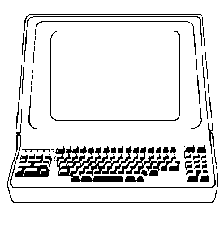
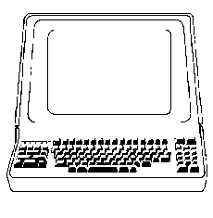
COMPONENTS OF A DDBMS
Site 1
DDBMS
DC
LDBMS
GSC
Computer
DB
Network
GSC
DDBMS
LDBMS = Local DBMS
DC = Data Communications GSC = Global Systems Catalog DDBMS = Distributed DBMS
DC
Site 2

Slide 14
DISTRIBUTED DATABASES
ADVANTAGES
Reduced Communication Overhead
Most data access is local, less expensive and performs
better.
Improved Processing Power
Instead of one server handling the full database, we now
have a collection of machines handling the same database.
Removal of Reliance on a Central Site
If a server fails, then the only part of the system that is
affected is the relevant local site. The rest of the system
remains functional and available.

Slide 15
DISTRIBUTED DATABASES
ADVANTAGES
Expandability
It is easier to accommodate increasing the size of the
global (logical) database.
Local autonomy
The database is brought nearer to its users. This can effect
a cultural change as it allows potentially greater control
over local data .

Slide 16
DISTRIBUTED DATABASES
DATE’S TWELVE RULES FOR A DDBMS
  A distributed system looks exactly like
  a non-distributed system to the user!
  Local autonomy
  No reliance on a central site
  Continuous operation
  Location independence
  Fragmentation independence
  Replication independence
  Distributed query independence
  Distributed transaction processing
  Hardware independence
  Operating system independence
  Network independence
  Database independence

Slide 17
DISTRIBUTED DATABASES
ISSUES
    Data Allocation
    Data Fragmentation
    Distributed Catalogue Management
    Distributed Transactions
    Distributed Queries

Slide 18
DISTRIBUTED DATABASES
DATA ALLOCATION METRICS
  Locality of reference
    Is the data near to the sites that need it?
  Reliability and availability
    Does the strategy improve fault tolerance and accessibility?
  Performance
    Does the strategy result in bottlenecks or under-utilisation of resources?
  Storage costs
    How does the strategy effect the availability and cost of data storage?
  Communication costs
    How much network traffic will result from the strategy?

Slide 19
DISTRIBUTED DATABASES
DATA ALLOCATION STRATEGIES
  CENTRALISED
Locality of Reference
Lowest
Reliability/Availability
Lowest
Storage Costs
Lowest
Performance
Unsatisfactory
Communication Costs
Highest

Slide 20
DISTRIBUTED DATABASES
DATA ALLOCATION STRATEGIES
  PARTITIONED/FRAGMENTED
Locality of Reference
High
Reliability/Availability
Low (item) – High (system)
Storage Costs
Lowest
Performance
Satisfactory
Communication Costs
Low

Slide 21
DISTRIBUTED DATABASES
DATA ALLOCATION STRATEGIES
  COMPLETE REPLICATION
Locality of Reference
Highest
Reliability/Availability
Highest
Storage Costs
Highest
Performance
High
Communication Costs
High (update) – Low (read)

Slide 22
DISTRIBUTED DATABASES
DATA ALLOCATION STRATEGIES
  SELECTIVE REPLICATION
Locality of Reference
High
Reliability/Availability
Low (item) – High (system)
Storage Costs
Average
Performance
Satisfactory
Communication Costs
Low

Slide 23
DISTRIBUTED DATABASES
WHY FRAGMENT DATA?
  Usage
    Applications are usually interested in ‘views’ not whole relations.
  Efficiency
    It’s more efficient if data is close to where it is frequently used.
  Parallelism
    It is possible to run several ‘sub-queries’ in tandem.
  Security
    Data not required by local applications is not stored at the local
    site.

Slide 24
DISTRIBUTED DATABASES
HORIZONTAL DATA FRAGMENTATION
ACCOUNT
CUSTOMER
BRANCH
BALANCE
200
JONES
STRATFORD
1000.00
324
GRAY
BARKING
200.00
345
SMITH
STRATFORD
23.17
350
GREEN
BARKING
340.14
400
ONO
BARKING
500.00
456
KHAN
STRATFORD
333.00
Horizontal Fragmentation: Consists of a Restriction on a Relation.
e.g., (σ _{branch = ‘Stratford’} Account)

Slide 25
DISTRIBUTED DATABASES
HORIZONTAL DATA FRAGMENTATION
STRATFORD BRANCH
ACCT NO.
CUSTOMER
BRANCH
BALANCE
200
JONES
STRATFORD
1000.00
345
SMITH
STRATFORD
23.17
456
KHAN
STRATFORD
333.00
BARKING BRANCH
ACCT NO.
CUSTOMER
BRANCH
BALANCE
324
GRAY
BARKING
200.00
350
GREEN
BARKING
340.14
400
ONO
BARKING
500.00

Slide 26
DISTRIBUTED DATABASES
VERTICAL DATA FRAGMENTATION
S#
NAME
SITE
PHONE NO
LOGIN
PASSWORD
200
JONES
STRATFORD
0208-500-9000
JON200T
XXYY22
324
GRAY
BARKING
0208-545-7528
GRA324S
ZZEE56
456
KHAN
STRATFORD
0208-500-5821
KHA456T
KJTR78
Vertical Fragmentation: Consists of a Projection on a Relation.
e.g., (∏ _{S#, NAME, SITE, PHONE NO} Student)

Slide 27
DISTRIBUTED DATABASES
VERTICAL DATA FRAGMENTATION
STUDENT ADMINISTRATION
S#
NAME
SITE
PHONE NO.
200
JONES
STRATFORD
0208-500-9000
324
GRAY
BARKING
0208-545-7528
456
KHAN
STRATFORD
0208-500-5821
NETWORK ADMINISTRATION
S#
LOGIN-ID
PASSWORD
200
JON200T
XXYY22
324
GRA324S
ZZEE56
456
KHA456T
KJTR78

Slide 28
DISTRIBUTED DATABASES
DISTRIBUTED CATALOG MANAGEMENT
Centralised Global Catalog
One site maintains the full global catalog. All changes to
any local system catalog have to be propagated to the site
maintaining the global catalog. Bad performance, single
point of failure, compromises site autonomy.
Dispersed Catalog
There is no physical global catalog. Each time a remote
data item is required, the catalogues from ALL other sites
are examined for the item. This has severe performance
penalties.

Slide 29
DISTRIBUTED DATABASES
DISTRIBUTED CATALOG MANAGEMENT
Replicated Global Catalog
Each site maintains its own global catalog. Although this
greatly speeds up remote data location, it is very
inefficient to maintain. A detail of every data item added,
changed or deleted locally has to be propagated to ALL
other sites .
Local-Master Catalog
Each site maintains both its local system catalog as well
as a catalog of all of its data items that are replicated at
other sites. This avoids compromising site autonomy, is
fairly efficient, and is not a single point of failure.

Slide 30
DISTRIBUTED DATABASES
DISTRIBUTED TRANSACTIONS
Stratford
Client
Stratford
DBMS
(a)
Stratford
Client
Stratford DB
Stratford
Client
X
(b)
Barking
DBMS
ATOMIC DISTRIBUTED TRANSACTION
Barking DB
Global Transaction
(a) Debit Stratford A/C £500
(b) Credit Barking A/C £350
(c) Credit Leyton A/C £150
Leyton
DBMS
(c)
Leyton DB

Slide 31
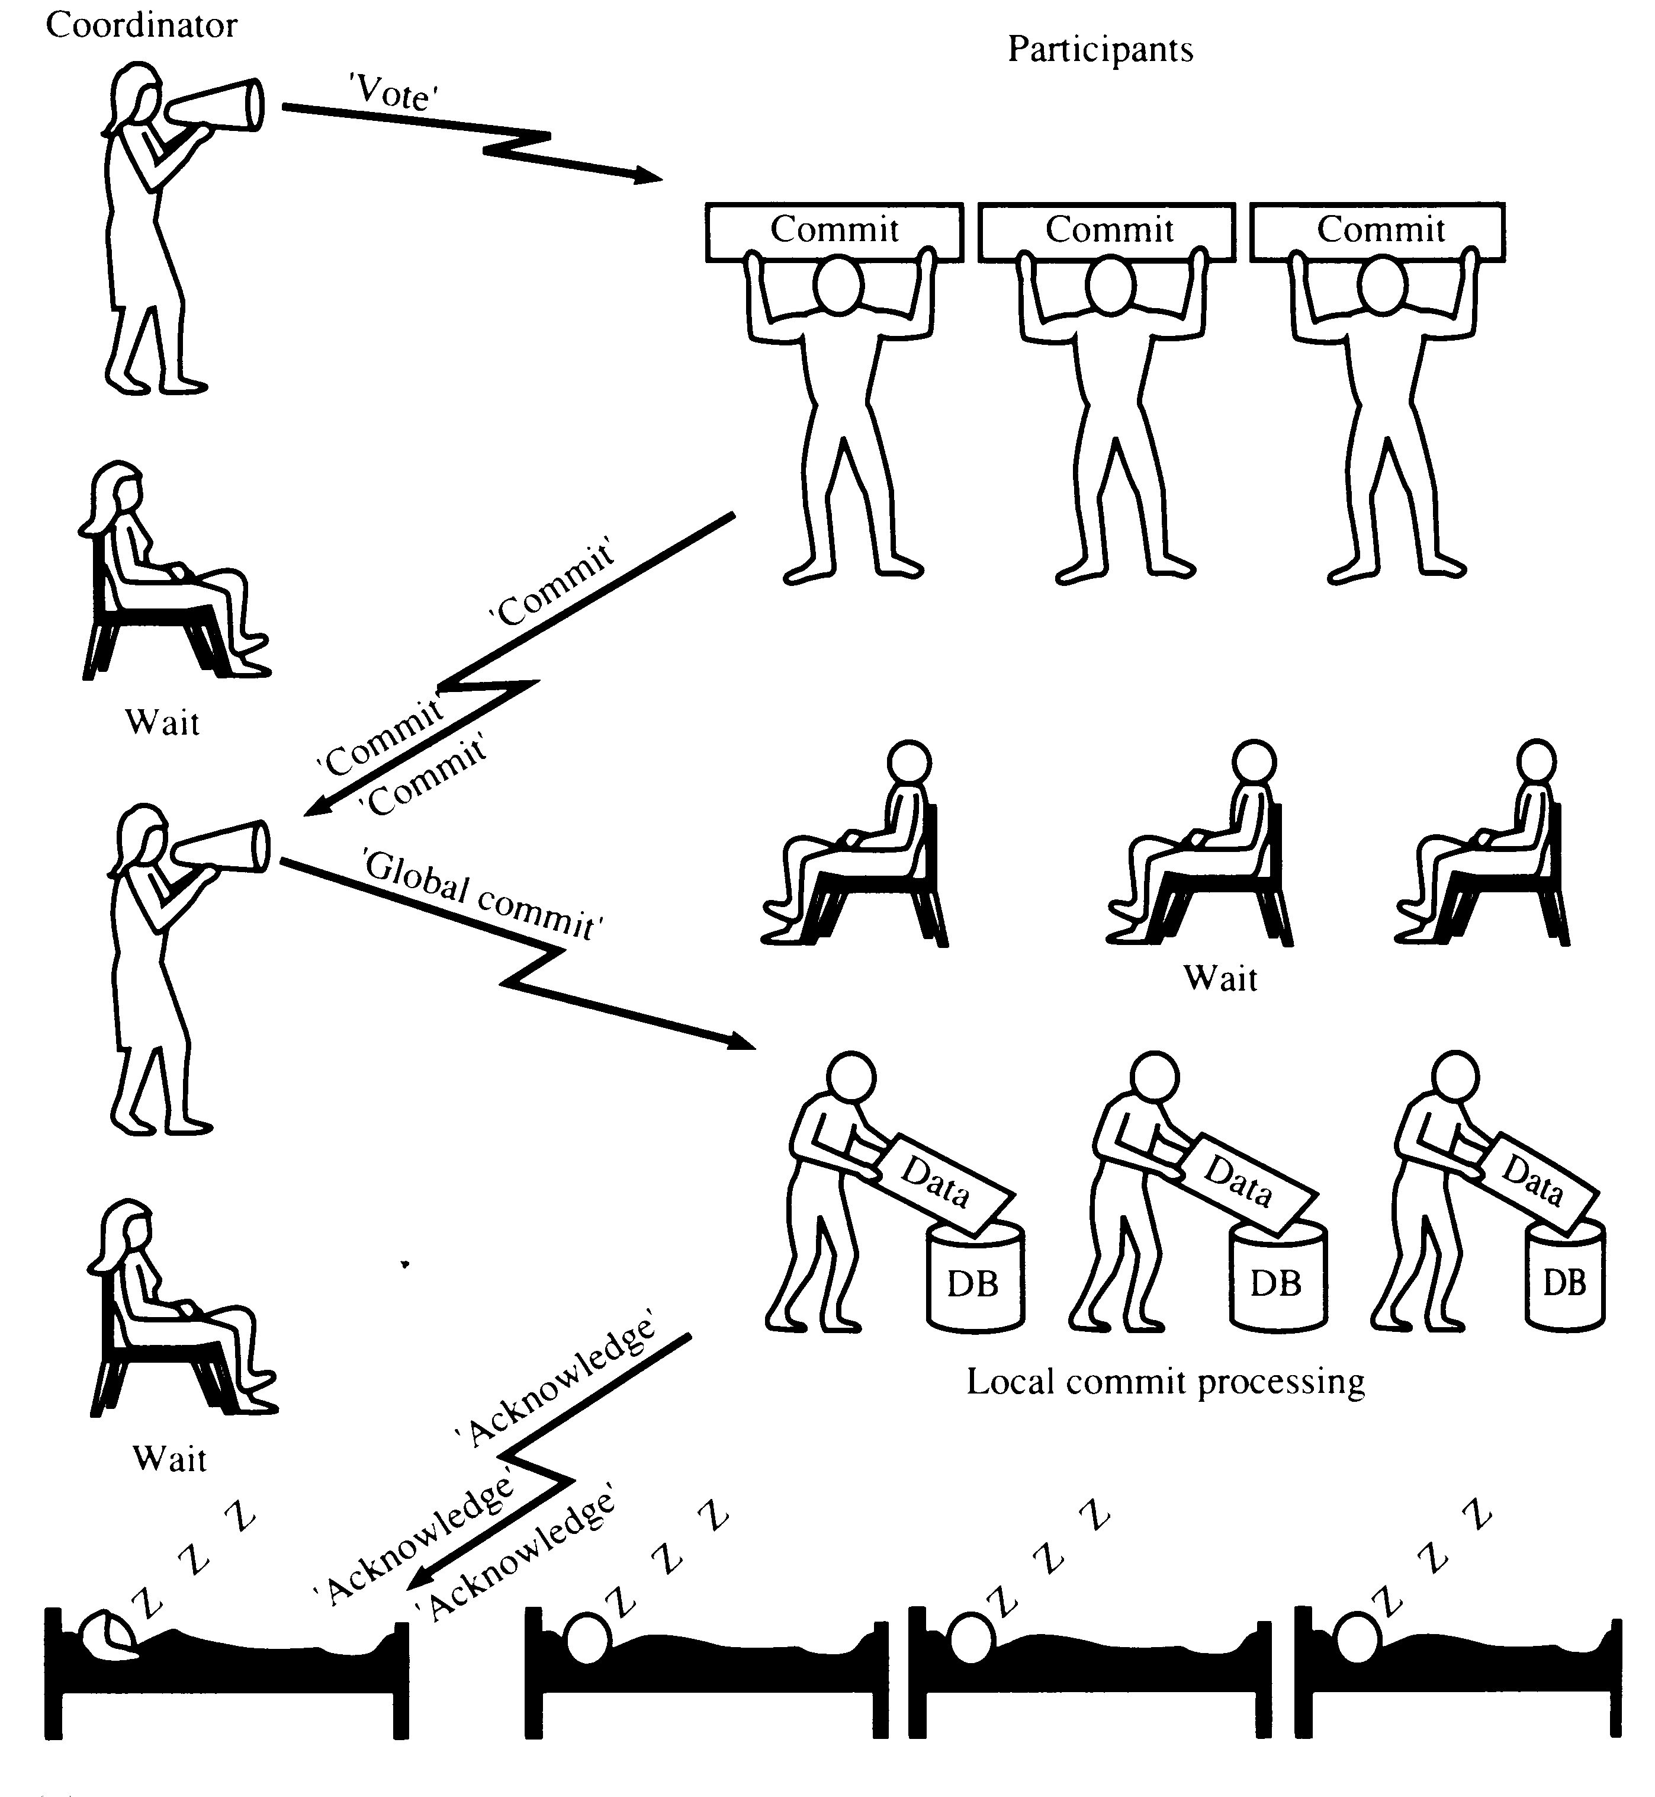
TWO-PHASE COMMIT (2PC) - OK

Slide 32
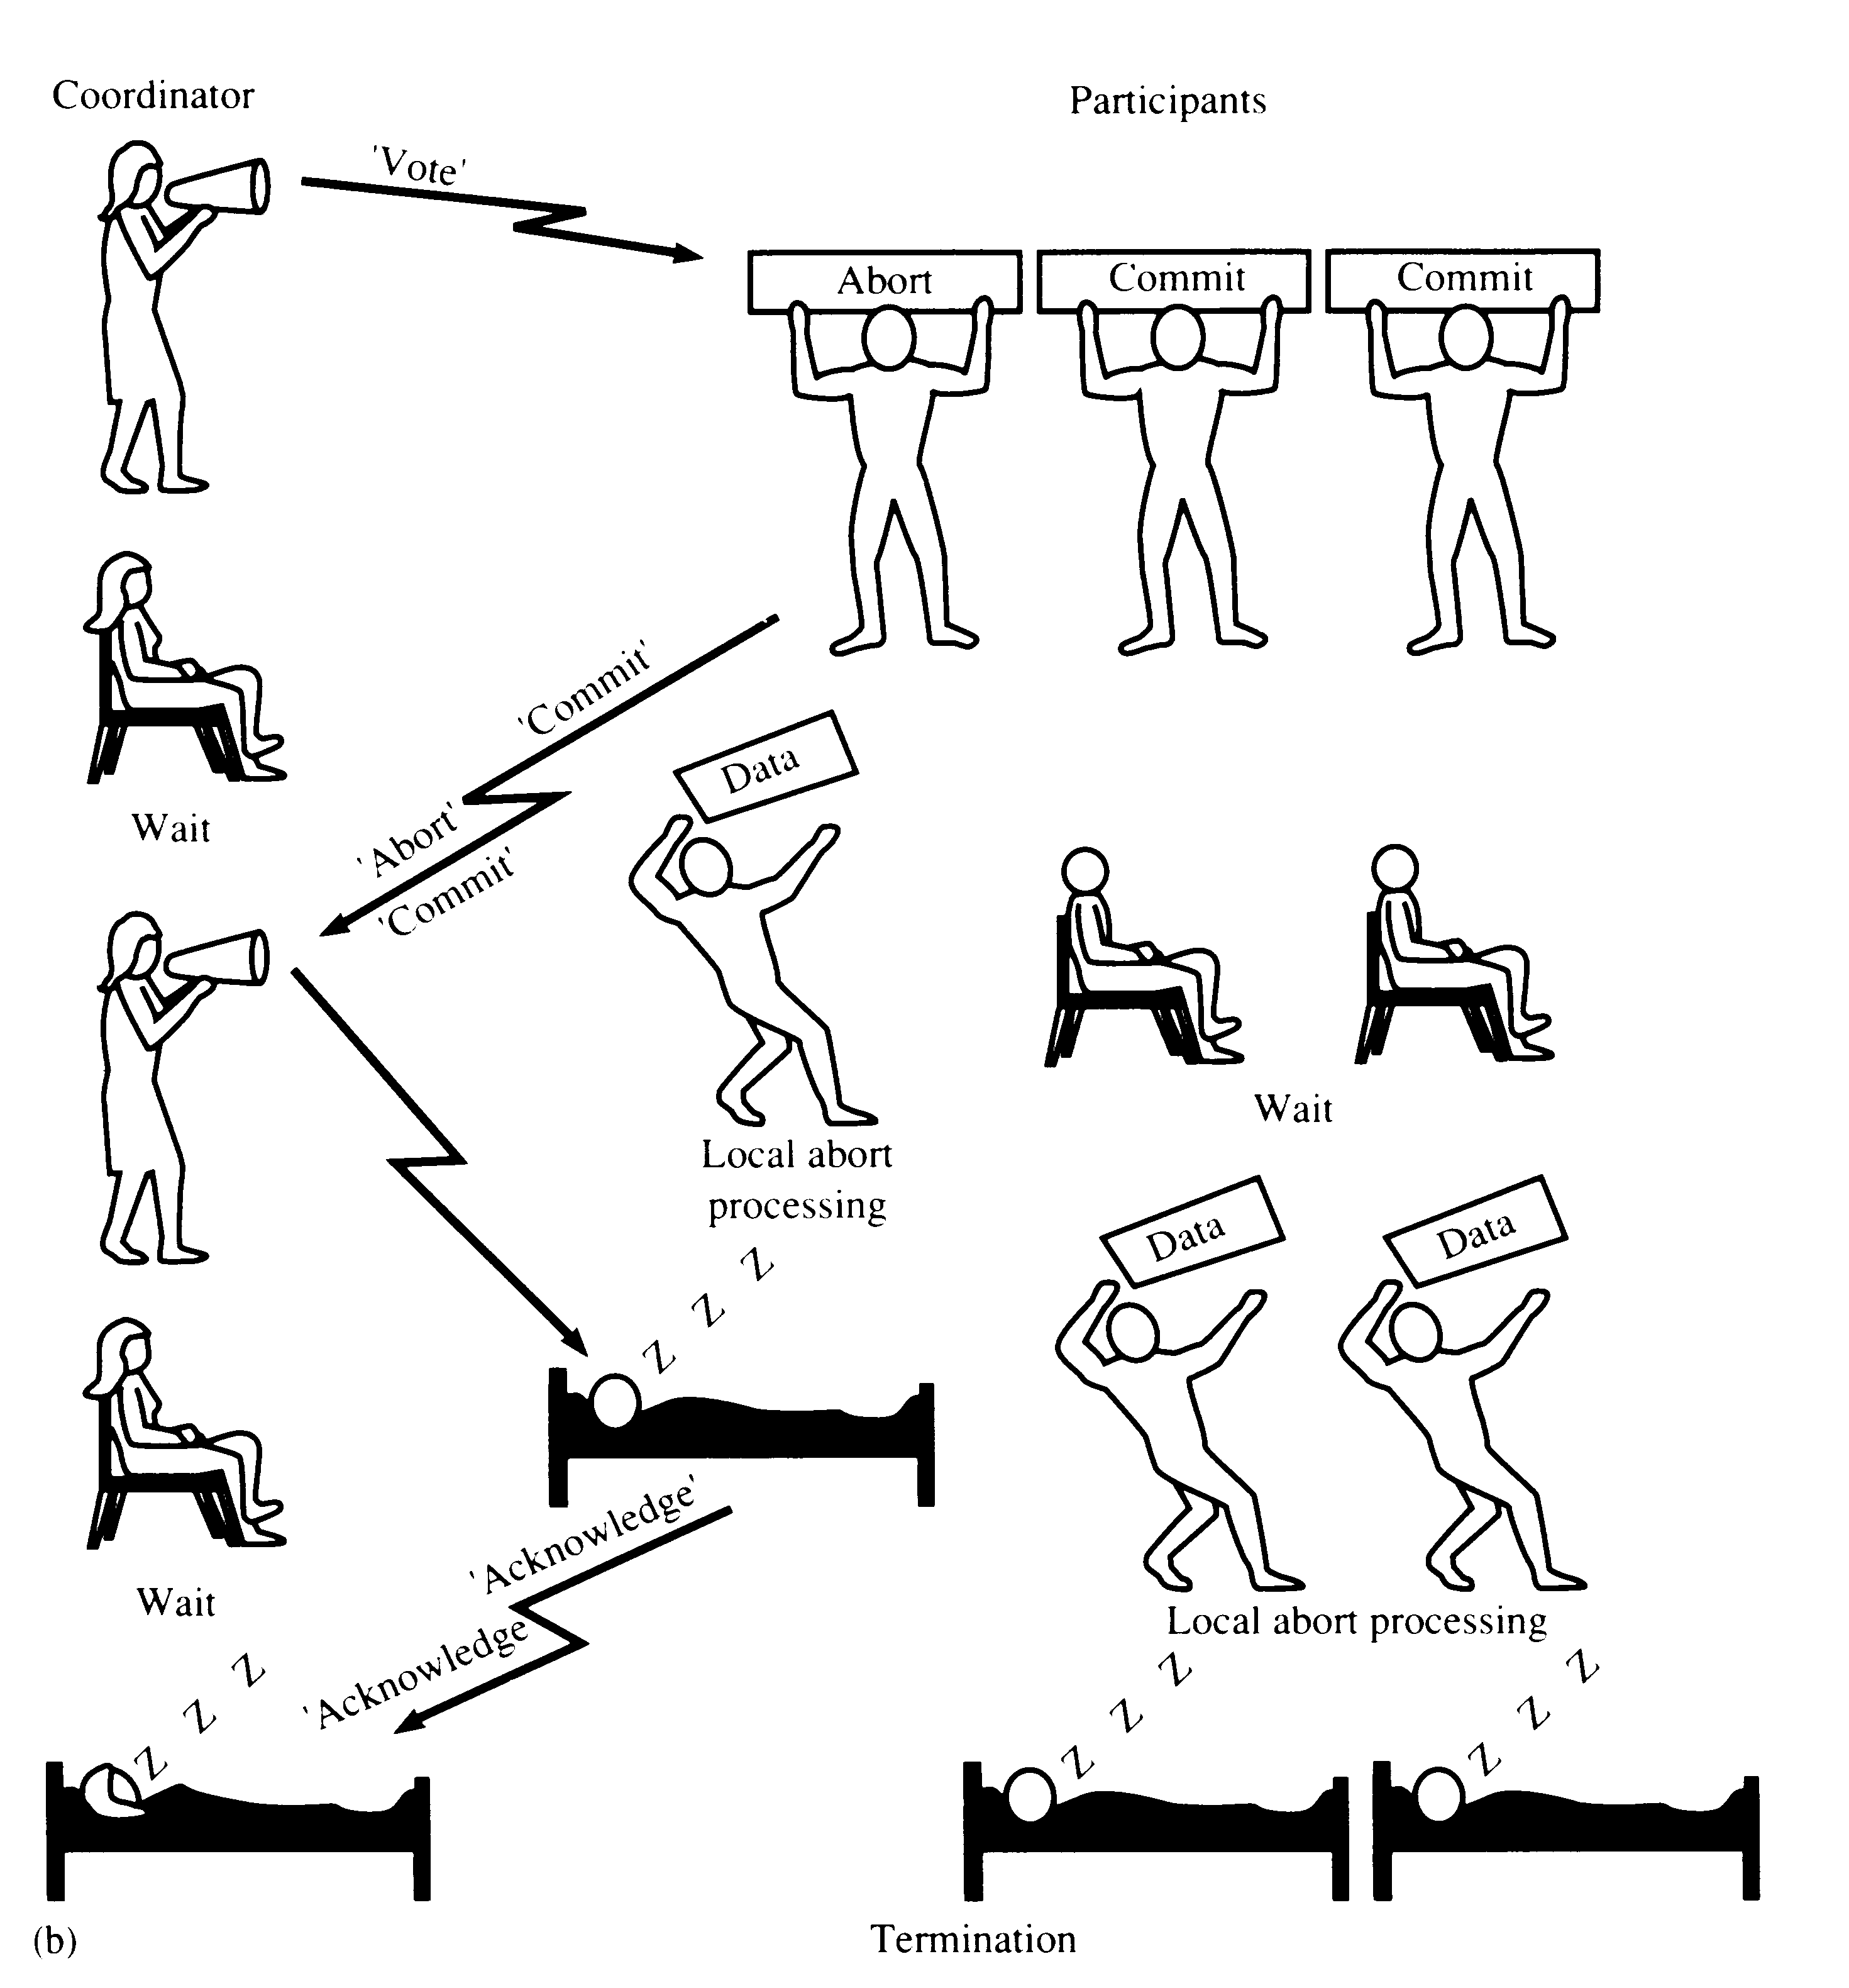
TWO-PHASE COMMIT (2PC) - ABORT
‘Global Abort’

Slide 33
DISTRIBUTED DATABASES
DISADVANTAGES OF DDBMSs
Architectural complexity.
Cost.
Security.
Integrity control more difficult.
Lack of standards.
Lack of experience.
Database design more complex.

