Slide 1
NORMALISATION
Normal Forms:
First Normal Form (1NF)
Second Normal Form (2NF)
Third Normal Form (3NF)
Boyce/Codd Normal Form (BC/NF)
Fourth Normsal Form (4NF)
Fifth Normal Form (5NF)
Domain Key Normal Form (DK/NF) (Only theoretical)

Slide 2
Normalization
Normalization is the process of crystalising a relation into one or more relations to
(i) Reduce the Redundancy
(ii) Avoid Modification Anomalies
- Insertion Anomaly
- Deletion Anomaly

Slide 3
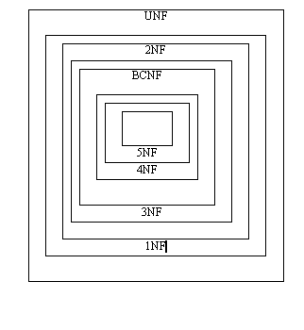

Normalization
1NF : A relation having all the domain containing atomic values only.
2nf : A relation is in 2nf if and only if it is in 1nf and every non-key attributed is fully dependent on a primary key
3nf : A relation is in 3nf if and only if it is in 2nf and every non-key attribute is non-transitivity dependent on primary key
Relation in 3nf are sufficient for most practical dbms application
BCNF : Boyce codd normal form
4nf : No multivalued dependency
5nf : Project join normal form
domain key normal form

Slide 4
1 NF
A relation is said to be in 1NF if it has only atomic values.
teacher | Subject
PAUL | O.R MATHS
RAM | OOPS
ANAND | NEURAL IMAGE
TEACHER | SUBJECT
PAUL | O.R
PAUL | MATHS
RAM | OOPS
ANAND | NEURAL
ANAND | IMAGE

Slide 5
Teacher Subject
A Neural, C,C++

Slide 6
MODIFICATION ANOMALIES
ACTIVITY (sid,activity,fee)
key:sid
INSERTION ANOMALIES
DELETION
ANOMALIES
sid | activity | Fee
100 | cricket | 2000
150 | swimming | 500
175 | driving | 500
200 | swimming | 500

Slide 7
FUNCTIONAL DEPENDENCIES
Rent is depending on Block_name
Rent is Functionally Dependent on Block Name.
Rent = f(Block-name)
BlocK- Name Rent
A 1000
B 500
C 2000
D 1500

Slide 8
Functional Dependencies (FDs)
Block name Determines Rent
BLOCK_NAME → RENT
Determinant
Sid →(Block,Room)
ACTIVITY → Fee
X → (Y,Z) implies that X→Y and X→Z
(X,Y)→Z does not imply that X→Z or Y→Z

Slide 9
FUNCTIONAL DEPENDENCIES
BLOCK-NAME→RENT
Block name determines rent is a Functional Dependency.
The Block name is called as a Determinant in this Example.
Rent is (Functionally) dependent of Block-name.

Slide 10
ACTIVITIES
KEY : (SID, Activity)
FDs : Activity → Fee
The key attributes are SID and Activity.
The non Key Attribute is Fee.
Here, the non-key attribute Fee is depending only on Activity.
A Relation with a Two-Attribute key (in 1NF but not in 2NF)
SID | ACTIVITY | FEE
100 | CRICKET | 2000
100 | MUSIC | 500
150 | SWIMMING | 500
175 | DRIVING | 5000
180 190 | SWIMMING Swimming | 500 500
200 | Driving | 5000
100 | Swimming | 500

Slide 11
2NF
A relation R is in 2NF if it is in 1NFand all non-key attributes of R are dependent on all of the key attributes.
. Decomposition
ACTIVITIES[SID,ACTIVITY]
Key: [SID, ACTIVITY]
Act-Fee[Activity,Fee]
Key: Activity

Slide 12
A RELATION WITH TRANSITIVE DEPENDENCY
Key : SID
FDs : Building→Fee
SID→Building
SID→Fee
SID | Building | Fee
100 | BLOCK 10 | 1200
150 | BLOCK5 | 1100
200 | BLOCK10 | 1200
250 | BLOCK 4 | 1100
300 | BLOCK 10 | 1200

Slide 13
A Relation is in 3NF if it is in 2NF and it is without transitive dependencies.
a R b, b R c → a R c

Slide 14
ELIMINATION OF TRANSITIVE DEPENDENCY
Stu - hostel
key : SID
Bldg-Fee
Key : Building
SID | Building
100 150 200 250 300 | BLOCK 10 BLOCK 5 BLOCK 10 BLOCK 4 BLOCK 10
Building | Fee
Block 10 Block 5 Block 4 | 1200 1100 1100

Slide 15
Relation in 3NF
ADVISOR
Key :( primary ) : (SID,Major)
Key :(Candidate) : (SID,Fname)
Functional Dependencies : Fname→Major
SID | Major | Fname
100 150 200 250 300 | MATHS CSE MATHS MATHS CSE | PAUL RAM RAJ PAUL ANAND

Slide 16
Boyce Codd Normal Form (BC/NF)
A relation R is in BC/NF if it is in 3NF and in which Every Determinant is a candidate key.
A relation is in 4NF if it is in BC/NF and is without multi-valued dependencies.

Slide 17
Relations in BCNF
Stu -Adv (Sid, Fname)
Key :SID
FD: Sid→ Fname
Adv-sub
Key : Fname
Fname →Major
SID | Fname
100 150 200 250 300 | PAUL RAM RAJ PAUL ANAND
Fname | Major
PAUL RAM RAJ ANAND | MATHS CSE MATHS CSE

Slide 18
Relation with multivalued dependencies
STUDENT
KEY(sid,major,activity)
multivalued sid→→major
dependencies sid →→activity
sid | major | activity
100 100 100 100 150 | maths Cs maths Cs maths | Swimming Swimming Tennies Tennies cricket

Slide 19
Insertion of a single tuple
sid | major | activity
100 100 100 100 100 150 | maths maths Cs maths Cs maths | football Swimming Swimming Tennis Tennis Cricket

Slide 20
Insertion of two tuples
sid | major | activity
100 100 100 100 100 100 150 | maths Cs maths Cs maths Cs Maths | football football Swimming Swimming Tennis Tennis Cricket

Slide 21
Elimination of MVDS
stu-major
key:sid,major
stu-act
Key:sid,activiy
sid | Activity
100 100 100 150 | football Swimming tennies cricket
sid | Major
100 100 150 | Maths Cs maths

Slide 22
Relation in 4nf
STUDENT
KEY:sid
FDS:sid→shoe-size;
sid→mariatal-status
MVDS: sid→→ shoe-size/ mariatal-status
4nf if MVDS are implied by candidate keys of R
sid | Shoe-size | Martial-status
100 159 200 250 | 8 10 5 12 | M S S S

Slide 23
5NF
A relation R is in 5NF if it is in 4NF and Every Join Dependency in R is implied by candidate keys of R.
K-Decomposition
SPJ: Key[S#, P#,J#]
S# | P# | J#
S1 S1 S2 S1 | P1 P2 P1 P1 | J2 J1 J1 J1

Slide 24
join over p#
SP:
Join over P#
PJ:
S# | P#
S1 S1 S2 | P1 P2 P1
P# | J#
P1 P2 P1 | J2 J1 J1

Slide 25
SPJ
S# | P# | J#
S1 S1 S2 S2 S1 | P1 P2 P1 P1 P1 | J2 J1 J1 J2 →spurious J1

Slide 26
5NF
join over J#,S#→original SPJ
J# | S#
j2 j1 j1 | S1 S1 S2

Slide 27
DK/NF
A relation is in domain-key normal form (DK/NF) if every constraint on the relation is a logical consequence of the definition of keys and domains.
A relation is in DK/NF when insertion or delete anomalies are not present in the database.

Slide 28
DK/NF
.
Domain-Key Normal Form is the highest form of Normalization.
The reason is that the insertion and deletion (updation) anomalies are removed.
The constraints are verified by the domain and key constraints.

Slide 29
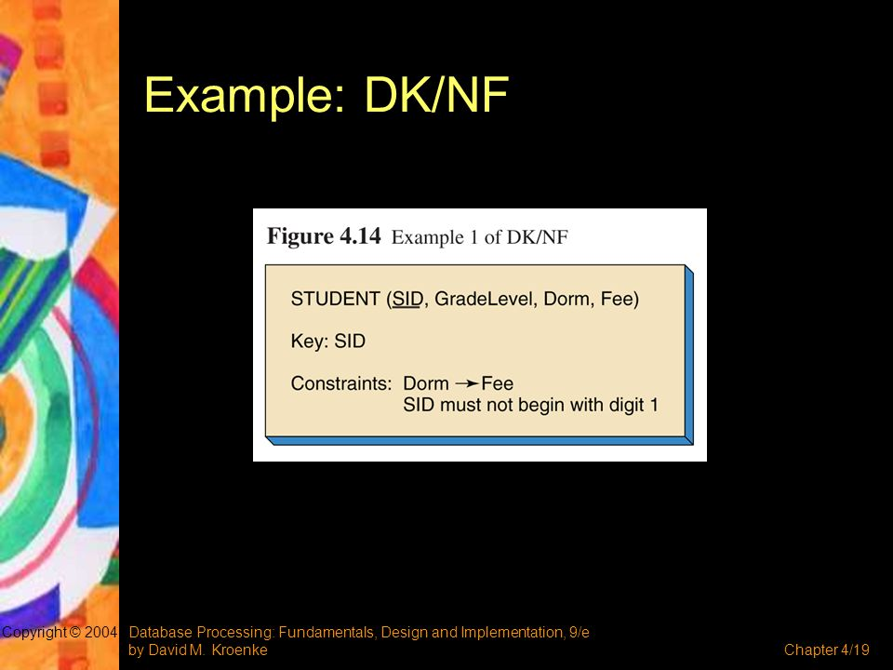


Slide 30
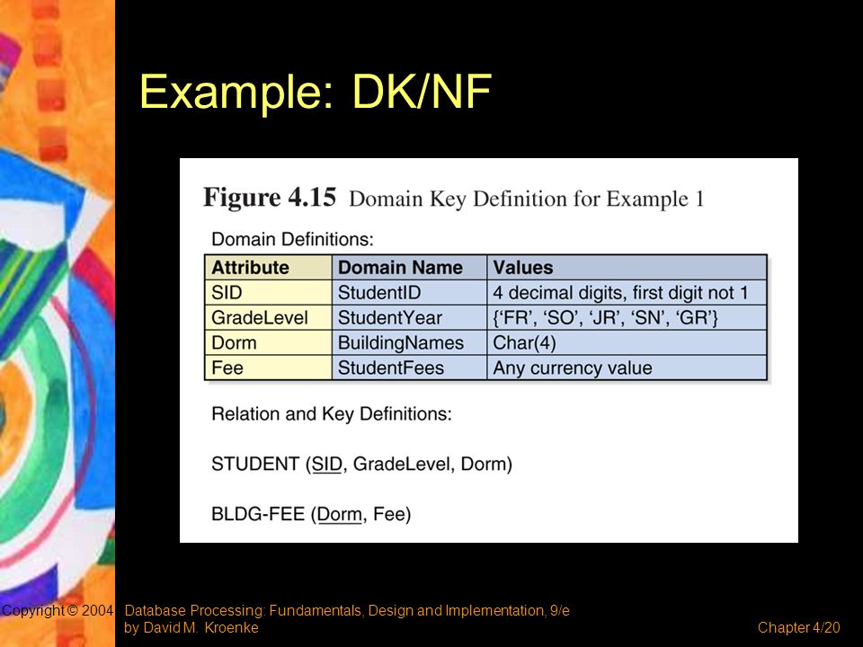

Slide 31
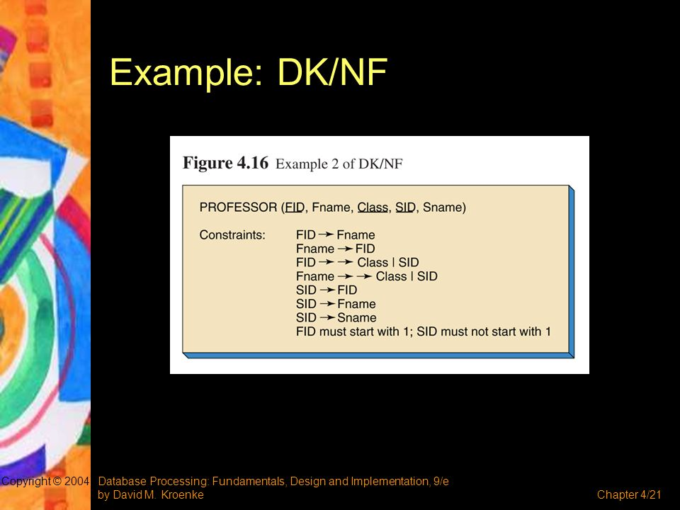

Slide 32
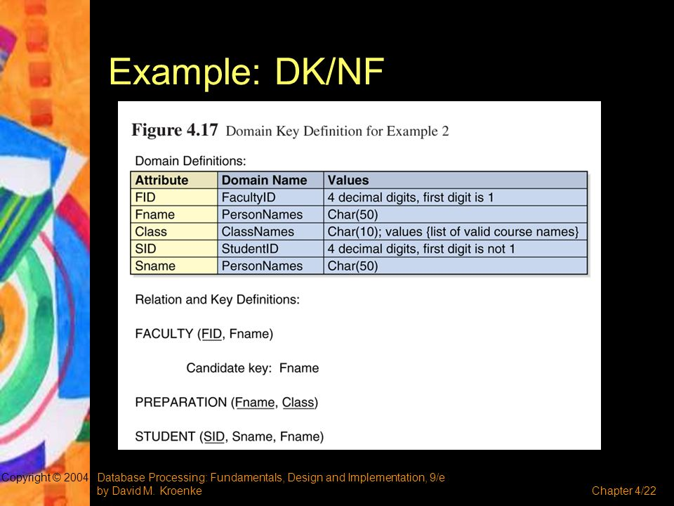

Slide 33
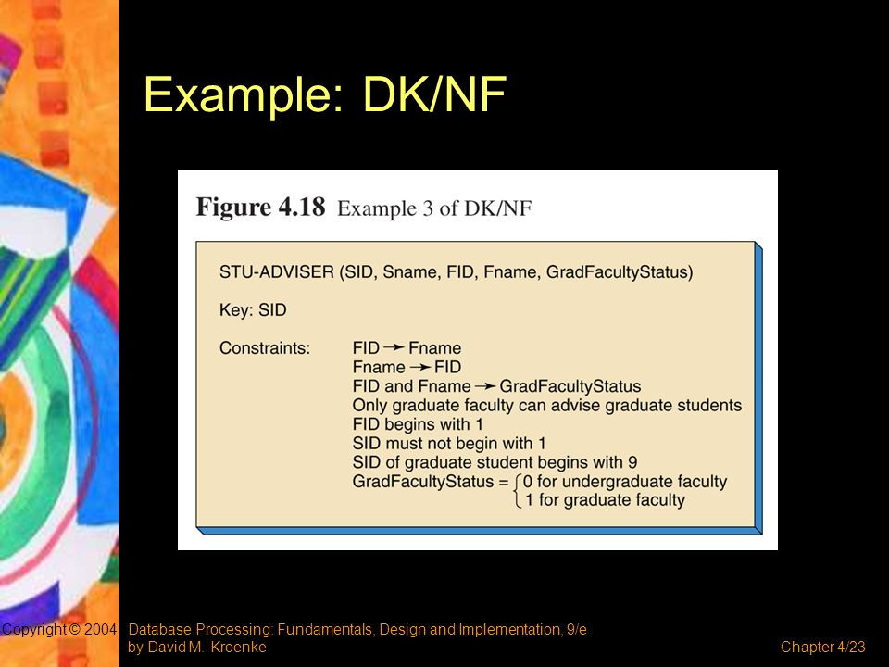

Slide 34
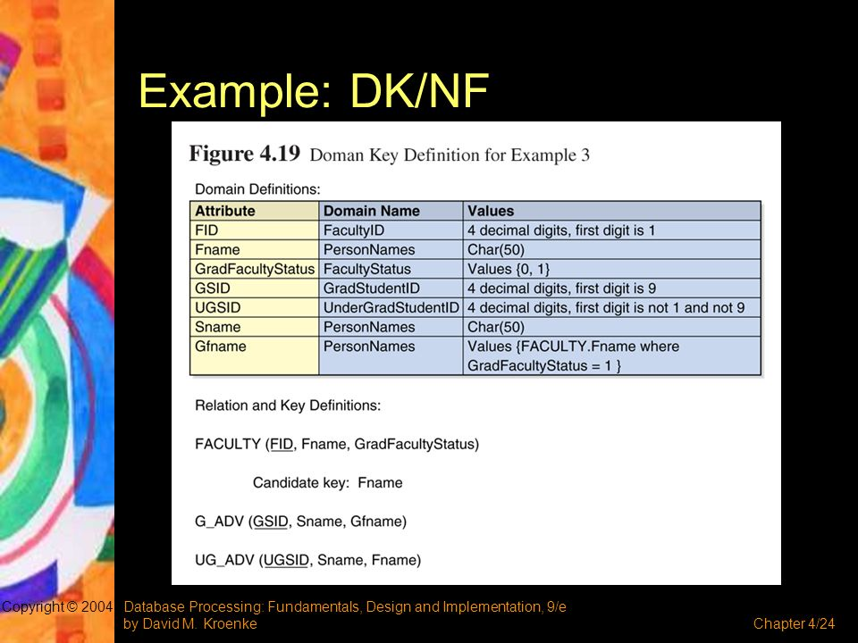

Slide 35
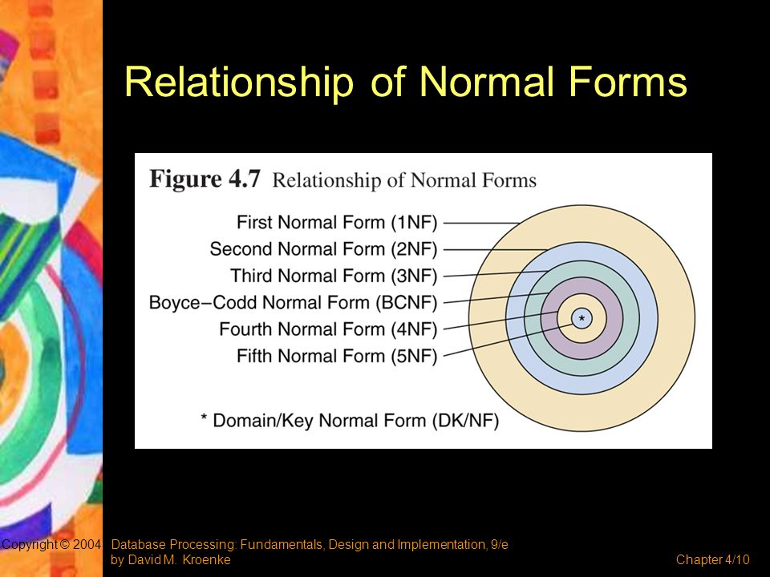

Slide 36
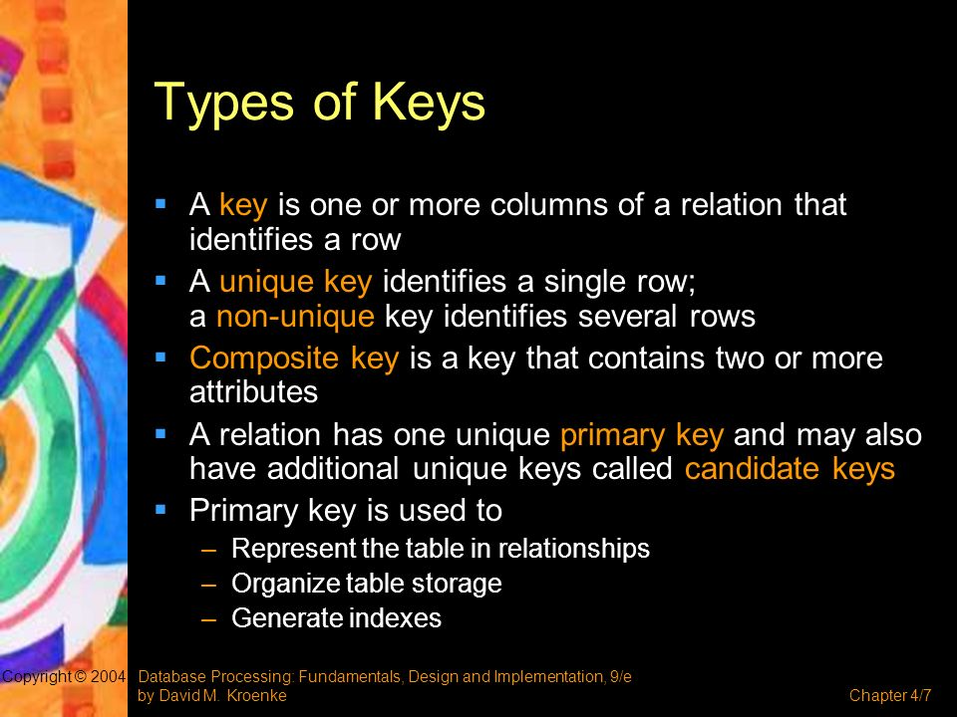
Keys

