Slide 1
Database Tuning
Lecture Delivered By:
Dr.A.Kannan

Slide 2
Database Tuning
Database Tuning is the activity of making a database application run more quickly.
“More quickly” usually means higher throughput, though it may mean lower response time for time-critical applications.

Slide 3
Application
Programmer
(e.g., business analyst,
Data architect)
Application
Sophisticated
Application
Programmer
(e.g., Systems, Applications
and Product admin)
Query Processor
Indexes
Storage Subsystem
Concurrency Control
Recovery
DBA,
Tuner
Operating System
Hardware
[Processor(s), Disk(s), Memory]

Slide 4
Tuning Principles
Think globally, fix locally (does it matter?)
Partitioning breaks bottlenecks (temporal and spatial).
Start-up costs are high; running costs are low (disk transfer, cursors)
Be prepared for trade-offs (indexes and inserts).

Slide 5
Index Tuning
Index issues
  Indexes may be better or worse than scans.
  Multi-table joins that run on for hours, because the wrong indexes are defined.
  Concurrency control bottlenecks.
  Indexes that are maintained and never used.

Slide 6
Clustered / Non clustered index
Clustered index (Primary index)
  A clustered index on attribute X co-locates records whose X values are near to one another.
Non-clustered index (Secondary index)
  A non clustered index does not constrain table organization.
  There might be several non-clustered indexes per table.
Records
Records

Slide 7
Dense / Sparse Index
Sparse index
  Pointers are associated to pages.
Dense index
  Pointers are associated to records.
  Non clustered indexes are dense.
P1
P2
Pi
record
record
record

Slide 8
Index Implementations in some major DBMS
SQL Server
  B+-Tree data structure.
  Clustered indexes are sparse.
  Indexes are maintained when updates /insertions /deletes are performed.
DB2
  - B+-Tree data structure, spatial extender for R-tree.
  - Clustered indexes are dense.
  - Explicit command for index reorganization.
Oracle
  B+-tree, hash, bitmap (image storage), spatial extender for R-Tree
  Clustered index
    Index organized table (unique/clustered)
    Clusters used when creating tables.
TimesTen (Main-memory DBMS)
  T-tree

Slide 9
Types of Queries
Point Query
SELECT balance
FROM accounts
WHERE acc-number = 1023;
Multipoint Query
SELECT balance
FROM accounts
WHERE branchnum = 100;
Range Query
SELECT number
FROM accounts
WHERE balance > 10000 and balance <= 20000;
Prefix Match Query
SELECT *
FROM employees
WHERE name = ‘J*’ ;

Slide 10
More Types of Queries
Extremal (Aggregates) Query
SELECT *
FROM accounts
WHERE balance =
max(select balance from accounts)
Ordering Query
SELECT *
FROM accounts
ORDER BY balance;
Grouping Query
SELECT branchnum, avg(balance)
FROM accounts
GROUP BY branchnum;
Join Query
SELECT distinct branch.adresse
FROM accounts, branch
WHERE
accounts.branchnum = branch.number
and accounts.balance > 10000;

Slide 11
Covered query
A covered query is a database query that can be entirely satisfied by an index, without the need to access the actual data documents or rows.
This means that all the necessary information for the query, including the fields used in the query conditions (e.g., WHERE clauses) and the fields returned in the result set (e.g., SELECT or projection clauses), is present within the index itself.

Slide 12
Covered query
Key characteristics of a covered query:
All fields in the query are part of an index: This includes fields used for filtering, sorting, or grouping.
All fields returned in the results are in the same index: The index contains all the data required for the projection.
No access to the underlying documents/rows is required: The database system can fulfill the query solely by reading the index.

Slide 13
Covered query
Benefits of covered queries:
Improved performance:
Accessing data from an index is generally faster than accessing full documents or rows, as indexes are typically smaller and often reside in memory.
Covered queries eliminate the need for additional disk I/O to fetch data from the main storage.
Reduced resource consumption:
By avoiding document scans, covered queries can reduce CPU and memory usage.

Slide 14
Point query and multi-point query
A point query retrieves data associated with a single, specific value, while a multi-point query retrieves data associated with multiple, distinct values or a collection of points.

Slide 15
Point Query Example
Example of Retrieving a specific customer's details using their unique customer ID (Point Query).
Code:
SELECT *
FROM Customers
WHERE Customer_ID = 12345;

Slide 16
Multi-Point Query Example
Retrieving data for multiple distinct values: Finding details for several specific products using a list of product IDs.
Code
SELECT ProductName, Price
FROM Products
WHERE ProductID IN (101, 105, 210);

Slide 17
Index Tuning -- data
Settings:
  employees(ssnum, name, lat, long, hundreds1,
  hundreds2);
  clustered index c on employees(hundreds1)
  with fillfactor = 100; //100% can be filled on leaf index pages.
  nonclustered index nc on employees (hundreds2);
  index nc3 on employees (ssnum, name, hundreds2);
  index nc4 on employees (lat, ssnum, name);
  1000000 rows ; Cold buffer
  Dual Xeon (550MHz,512Kb), 1Gb RAM, Internal RAID controller from Adaptec (80Mb), 4x18Gb drives (10000RPM), Windows 2000.

Slide 18
Index Tuning -- operations
Operations:
  Update:
  update employees set name = ‘XXX’ where ssnum = ?;
  Insert:
  insert into employees values (1003505,'polo94064',97.48,84.03,4700.55,3987.2);
  Multipoint query:
  select * from employees where hundreds1= ?;
  select * from employees where hundreds2= ?;
  Covered query:
  select ssnum, name, lat from employees;
  Range Query:
  select * from employees where long between ? and ?;
  Point Query:
  select * from employees where ssnum = ?

Slide 19
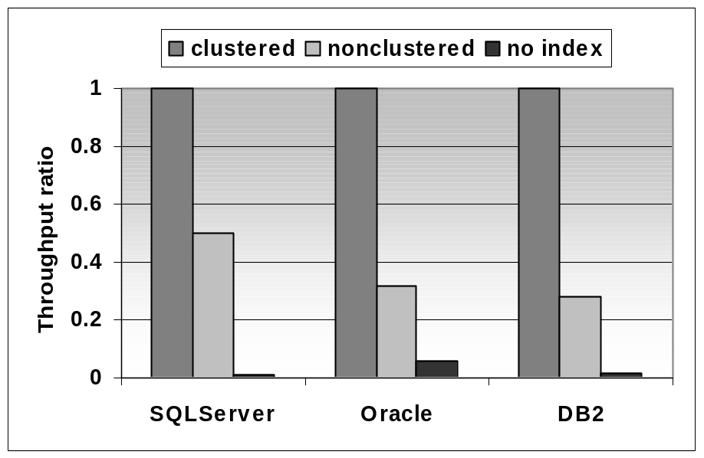
Clustered Index
Multipoint query that returns 100 records out of 1000000.
Cold buffer.
Clustered index is twice as fast as non-clustered index and orders of magnitude faster than a scan.

Slide 20
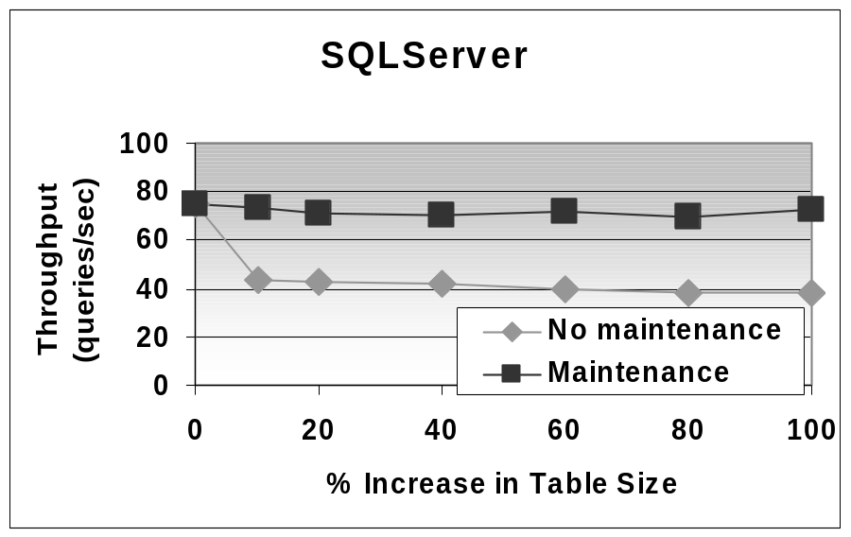
Index “Face Lifts”
Index is created with fillfactor = 100.
Insertions cause page splits and extra I/O for each query.
Maintenance consists in dropping and recreating the index.
With maintenance performance is constant while performance degrades significantly if no maintenance is performed.

Slide 21
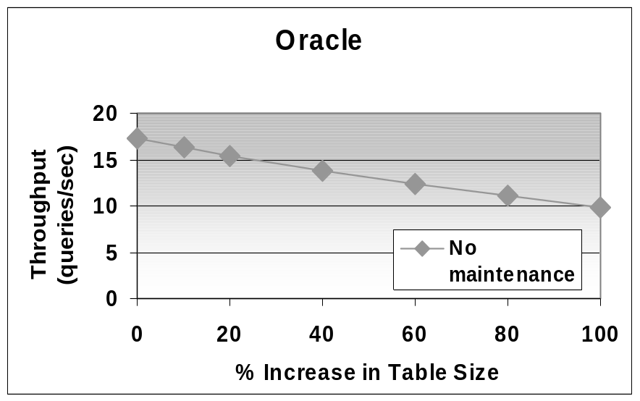
Index Maintenance
In Oracle, clustered index are approximated by an index defined on a clustered table.
No automatic physical reorganization.
Index defined with pctfree = 0.
Overflow pages cause performance degradation.

Slide 22
PCTFREE
When an index is defined with PCTFREE 0, it means that no space is reserved within index blocks for future updates or inserts.
This can lead to more efficient space utilization and potentially faster index creation, especially when dealing with data that is primarily insert-only or when updates are infrequent and don't significantly increase the size of indexed data.

Slide 23
Covering Index - defined
Select name from employee where department = “marketing”
Good covering index would be on (department, name)
Index on (name, department) less useful.
Index on department alone moderately useful.

Slide 24
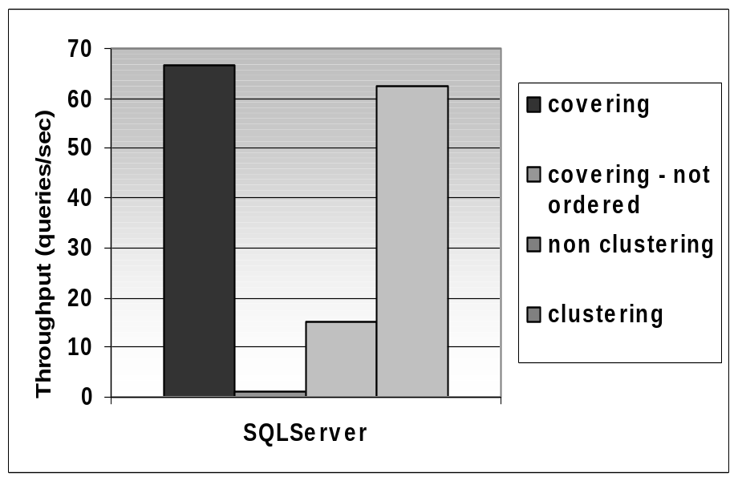
Covering Index - impact
Covering index performs better than clustering index when first attributes of index are in the where clause and last attributes in the select.
When attributes are not in order then performance is much worse.

Slide 25
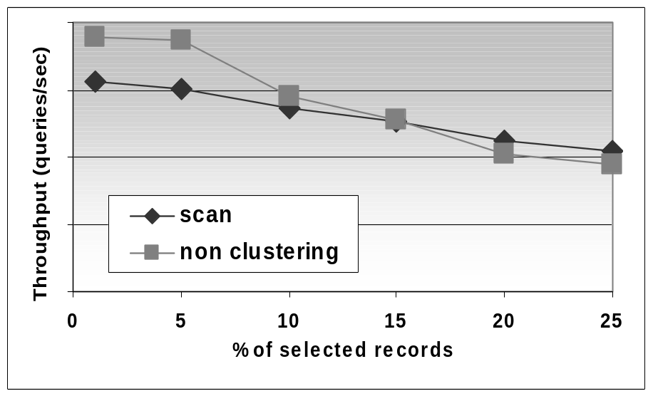
Scan Can Sometimes Win
IBM DB2 v7.1 on Windows 2000
Range Query
If a query retrieves 10% of the records or more, scanning is often better than using a non-clustering non-covering index. Crossover > 10% when records are large or table is fragmented on disk – scan cost increases.

Slide 26
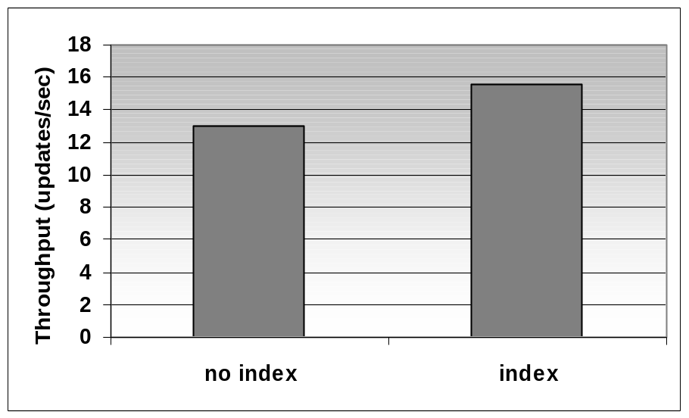
Index on Small Tables
Small table: 100 records, i.e., a few pages.
Two concurrent processes perform updates (each process works for 10ms before it commits)
No index: the table is scanned for each update. No concurrent updates.
A clustered index allows to take advantage of row locking.

Slide 27
Bitmap vs. Hash vs. B+-Tree
Settings:
  employees(ssnum, name, lat, long, hundreds1,
  hundreds2);
  create cluster c_hundreds (hundreds2 number(8)) PCTFREE 0;
  create cluster c_ssnum(ssnum integer) PCTFREE 0 size 60;
  create cluster c_hundreds(hundreds2 number(8)) PCTFREE 0 HASHKEYS 1000 size 600;
  create cluster c_ssnum(ssnum integer) PCTFREE 0 HASHKEYS 1000000 SIZE 60;
  create bitmap index b on employees (hundreds2);
  create bitmap index b2 on employees (ssnum);
  1000000 rows ; Cold buffer
  Dual Xeon (550MHz,512Kb), 1Gb RAM, Internal RAID controller from Adaptec (80Mb), 4x18Gb drives (10000RPM), Windows 2000.

Slide 28
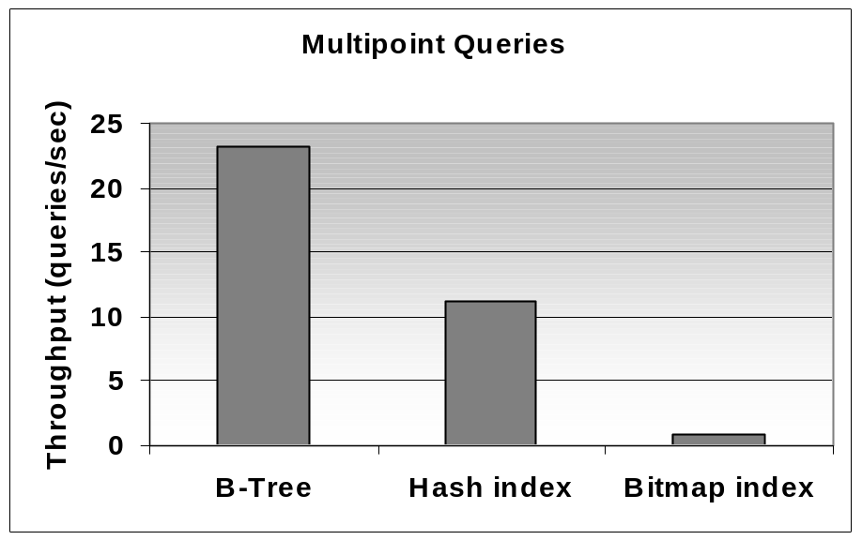
Multipoint query: B-Tree, Hash Tree, Bitmap
There is an overflow chain in a hash index
In a clustered B-Tree index records are on contiguous pages.
Bitmap is proportional to size of table and non-clustered for record access.

Slide 29
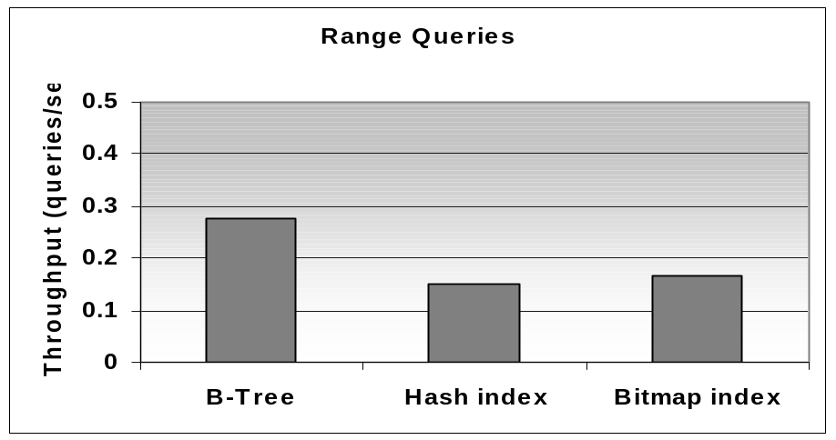
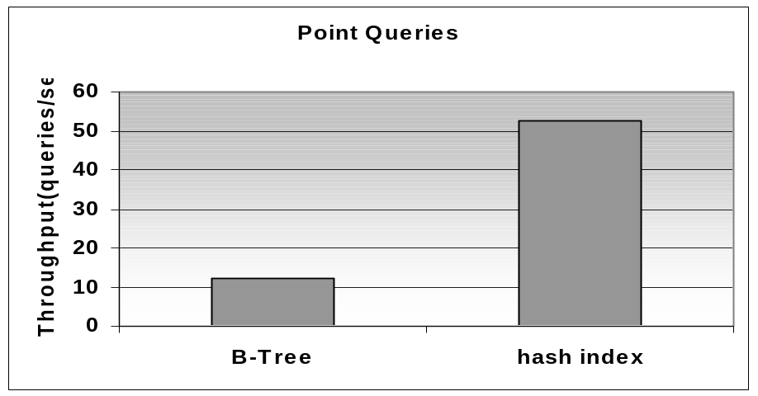
B-Tree, Hash Tree, Bitmap
Hash indexes don’t help when evaluating range queries
Hash index outperforms B-tree on point queries

Slide 30
Tuning Relational Systems
Schema Tuning
  Denormalization
Query Tuning
  Query rewriting
  Materialized views

Slide 31
Denormalizing -- data
Settings:
  lineitem ( L_ORDERKEY, L_PARTKEY , L_SUPPKEY, L_LINENUMBER, L_QUANTITY, L_EXTENDEDPRICE ,
  L_DISCOUNT, L_TAX , L_RETURNFLAG, L_LINESTATUS ,
  L_SHIPDATE, L_COMMITDATE,
  L_RECEIPTDATE, L_SHIPINSTRUCT ,
  L_SHIPMODE , L_COMMENT );
region( R_REGIONKEY, R_NAME, R_COMMENT );
nation( N_NATIONKEY, N_NAME, N_REGIONKEY, N_COMMENT,);
supplier( S_SUPPKEY, S_NAME, S_ADDRESS, S_NATIONKEY, S_PHONE, S_ACCTBAL, S_COMMENT);
  600000 rows in lineitem, 25 nations, 5 regions, 500 suppliers

Slide 32
Denormalizing -- transactions
lineitemdenormalized ( L_ORDERKEY, L_PARTKEY , L_SUPPKEY, L_LINENUMBER, L_QUANTITY, L_EXTENDEDPRICE ,
L_DISCOUNT, L_TAX , L_RETURNFLAG, L_LINESTATUS ,
L_SHIPDATE, L_COMMITDATE,
L_RECEIPTDATE, L_SHIPINSTRUCT ,
L_SHIPMODE , L_COMMENT, L_REGIONNAME);
  600000 rows in lineitemdenormalized
  Cold Buffer
  Dual Pentium II (450MHz, 512Kb), 512 Mb RAM, 3x18Gb drives (10000RPM), Windows 2000.

Slide 33
Queries on Normalized vs. Denormalized Schemas
Queries:
select L_ORDERKEY, L_PARTKEY, L_SUPPKEY, L_LINENUMBER, L_QUANTITY, L_EXTENDEDPRICE, L_DISCOUNT, L_TAX, L_RETURNFLAG, L_LINESTATUS, L_SHIPDATE, L_COMMITDATE, L_RECEIPTDATE, L_SHIPINSTRUCT, L_SHIPMODE, L_COMMENT, R_NAME
from LINEITEM, REGION, SUPPLIER, NATION
where
L_SUPPKEY = S_SUPPKEY
and S_NATIONKEY = N_NATIONKEY
and N_REGIONKEY = R_REGIONKEY
and R_NAME = 'EUROPE';
select L_ORDERKEY, L_PARTKEY, L_SUPPKEY, L_LINENUMBER, L_QUANTITY, L_EXTENDEDPRICE, L_DISCOUNT, L_TAX, L_RETURNFLAG, L_LINESTATUS, L_SHIPDATE, L_COMMITDATE, L_RECEIPTDATE, L_SHIPINSTRUCT, L_SHIPMODE, L_COMMENT, L_REGIONNAME
from LINEITEMDENORMALIZED
where L_REGIONNAME = 'EUROPE';

Slide 34
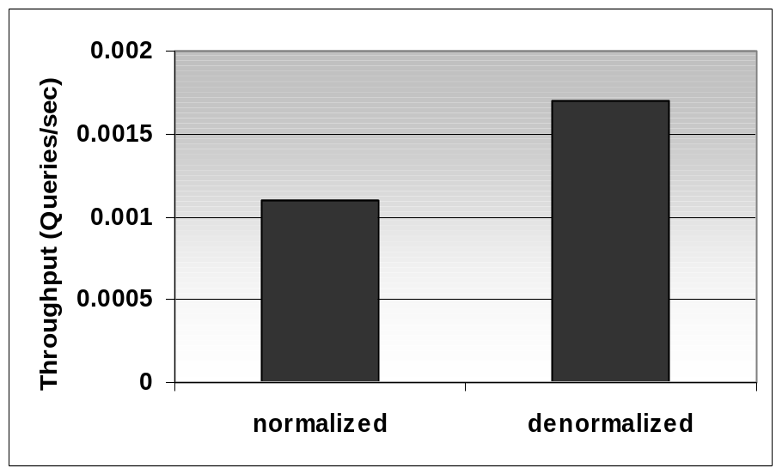
Denormalization
TPC-H schema
Query: find all lineitems whose supplier is in Europe.
With a normalized schema this query is a 4-way join.
If we denormalize lineitem and add the name of the region for each lineitem (foreign key denormalization) throughput improves 30%

Slide 35
Queries
Settings:
  employee(ssnum, name, dept, salary, numfriends);
  student(ssnum, name, course, grade);
  techdept(dept, manager, location);
  clustered index i1 on employee (ssnum);
  nonclustered index i2 on employee (name);
  nonclustered index i3 on employee (dept);
  clustered index i4 on student (ssnum);
  nonclustered index i5 on student (name);
  clustered index i6 on techdept (dept);
  100000 rows in employee, 100000 students, 10 departments; Cold buffer
  Dual Pentium II (450MHz, 512Kb), 512 Mb RAM, 3x18Gb drives (10000RPM), Windows 2000.

Slide 36
Queries – View on Join
View Techlocation:
create view techlocation as
select ssnum, techdept.dept, location
from employee, techdept
where employee.dept = techdept.dept;
Queries:
  Original:
    select dept from techlocation where ssnum = ?;
  Rewritten:
    select dept from employee where ssnum = ?;

Slide 37
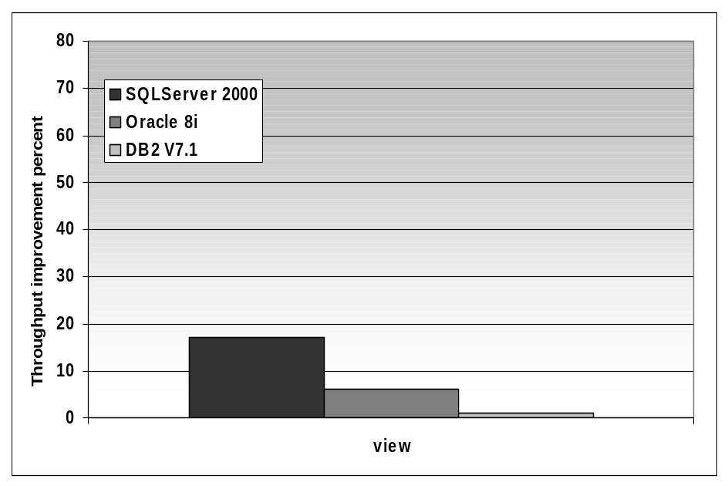
Query Rewriting - Views
All systems expand the selection on a view into a join
The difference between a plain selection and a join (on a primary key-foreign key) followed by a projection is greater on SQL Server than on Oracle and DB2 v7.1.

Slide 38
Queries – Correlated Subqueries
Queries:
  Original:
    select ssnum
    from employee e1
    where salary =
    (select max(salary)
    from employee e2
    where e2.dept = e1.dept);
  Rewritten:
    select max(salary) as bigsalary, dept
    into TEMP
    from employee group by dept;
    select ssnum
    from employee, TEMP
    where salary = bigsalary
    and employee.dept = temp.dept;

Slide 39
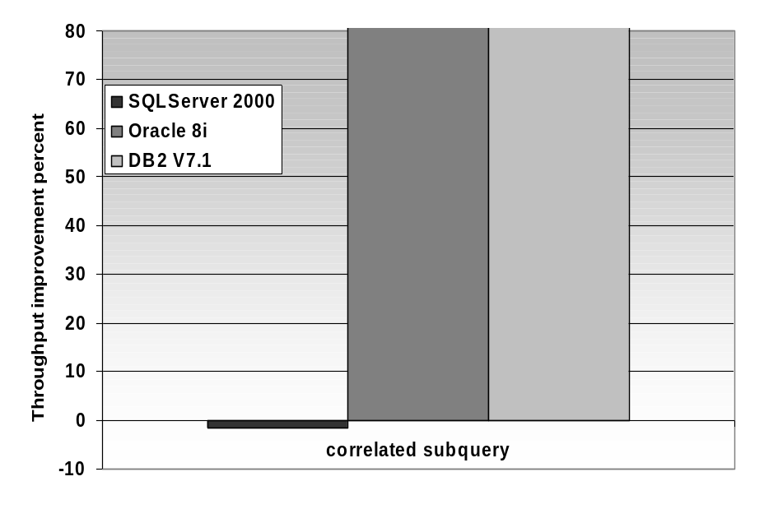
Query Rewriting –
Correlated Subqueries
SQL Server 2000 does a good job at handling the correlated subqueries (a hash join is used as opposed to a nested loop between query blocks)
  The techniques implemented in SQL Server 2000 are described in “Orthogonal Optimization of Subqueries and Aggregates” by C.Galindo-Legaria and M.Joshi, SIGMOD 2001.
> 1000
> 10000

Slide 40
Aggregate Maintenance -- data
Settings:
  orders( ordernum, itemnum, quantity, purchaser, vendor );
  create clustered index i_order on orders(itemnum);
  store( vendor, name );
  item(itemnum, price);
  create clustered index i_item on item(itemnum);
  vendorOutstanding( vendor, amount);
  storeOutstanding( store, amount);
  1000000 orders, 10000 stores, 400000 items; Cold buffer
  Dual Pentium II (450MHz, 512Kb), 512 Mb RAM, 3x18Gb drives (10000RPM), Windows 2000.

Slide 41
Aggregate Maintenance -- triggers
Triggers for Aggregate Maintenance
  create trigger updateVendorOutstanding on orders for insert as
  update vendorOutstanding
  set amount =
  (select vendorOutstanding.amount+sum(inserted.quantity*item.price)
  from inserted,item
  where inserted.itemnum = item.itemnum
  )
  where vendor = (select vendor from inserted) ;
  create trigger updateStoreOutstanding on orders for insert as
  update storeOutstanding
  set amount =
  (select storeOutstanding.amount+sum(inserted.quantity*item.price)
  from inserted,item
  where inserted.itemnum = item.itemnum
  )
  where store = (select store.name from inserted, store
  where inserted.vendor = store.vendor) ;

Slide 42
Aggregate Maintenance -- transactions
Concurrent Transactions:
  Insertions
insert into orders values
(1000350,7825,562,'xxxxxx6944','vendor4');
  Queries (first without, then with redundant tables)
select orders.vendor, sum(orders.quantity*item.price)
from orders,item
where orders.itemnum = item.itemnum
group by orders.vendor;
vs. select * from vendorOutstanding;
select store.name, sum(orders.quantity*item.price)
from orders,item, store
where orders.itemnum = item.itemnum
and orders.vendor = store.vendor
group by store.name;
vs. select * from storeOutstanding;

Slide 43
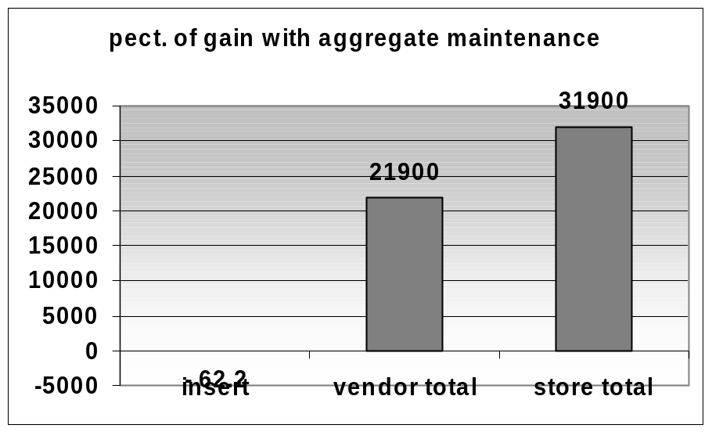
Aggregate Maintenance
SQLServer 2000 on Windows 2000
Using triggers for view maintenance
If queries frequent or important, then aggregate maintenance is good.

Slide 44
Superlinearity -- data
Settings:
  sales( id, itemid, customerid, storeid, amount, quantity);
  item (itemid);
  customer (customerid);
  store (storeid);
  A sale is successful if all foreign keys are present.
  successfulsales(id, itemid, customerid, storeid, amount, quantity);
  unsuccessfulsales(id, itemid, customerid, storeid, amount, quantity);
  tempsales( id, itemid, customerid, storeid, amount,quantity);

Slide 45
Superlinearity -- indexes
Settings (non-clustering, dense indexes):
  index s1 on item(itemid);
  index s2 on customer(customerid);
  index s3 on store(storeid);
  index succ on successfulsales(id);
  1000000 sales, 400000 customers, 40000 items, 1000 stores
  Cold buffer
  Dual Pentium II (450MHz, 512Kb), 512 Mb RAM, 3x18Gb drives (10000RPM), Windows 2000.

Slide 46
Superlinearity -- queries
Queries:
  Insert/create indexdelete
    insert into successfulsales
    select sales.id, sales.itemid, sales.customerid, sales.storeid, sales.amount, sales.quantity
    from sales, item, customer, store
    where sales.itemid = item.itemid
    and sales.customerid = customer.customerid
    and sales.storeid = store.storeid;
    insert into unsuccessfulsales
    select * from sales;
    go
    delete from unsuccessfulsales
    where id in (select id from successfulsales)

Slide 47
Superlinearity -- batch queries
Queries:
  Small batches
    DECLARE @Nlow INT;
    DECLARE @Nhigh INT;
    DECLARE @INCR INT;
    set @INCR = 100000
    set @NLow = 0
    set @Nhigh = @INCR
    WHILE (@NLow <= 500000)
    BEGIN
    insert into tempsales
    select * from sales
    where id between @NLow and @Nhigh
    set @Nlow = @Nlow + @INCR
    set @Nhigh = @Nhigh + @INCR
    delete from tempsales
      where id in (select id from successfulsales);
    insert into unsuccessfulsales
    select * from tempsales;
    delete from tempsales;
    END

Slide 48
Superlinearity -- outer join
Queries:
  outerjoin
    insert into successfulsales
    select sales.id, item.itemid, customer.customerid, store.storeid, sales.amount, sales.quantity
    from
    ((sales left outer join item on sales.itemid = item.itemid)
    left outer join customer on sales.customerid = customer.customerid)
    left outer join store on sales.storeid = store.storeid;
    insert into unsuccessfulsales
    select *
    from successfulsales
    where itemid is null
    or customerid is null
    or storeid is null;
    go
    delete from successfulsales
    where itemid is null
    or customerid is null
    or storeid is null

Slide 49
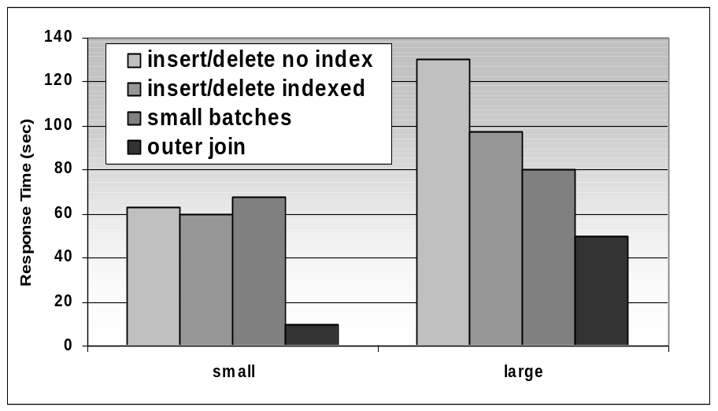
Circumventing Superlinearity
SQL Server 2000
Outer join achieves the best response time.
Small batches do not help because overhead of crossing the application interface is higher than the benefit of joining with smaller tables.

Slide 50
Tuning the Application Interface
4GL
  Power++, Visual basic
Programming language +
Call Level Interface
  ODBC: Open DataBase Connectivity
  JDBC: Java based API
  OCI (C++/Oracle), CLI (C++/ DB2), Perl/DBI
In the following experiments, the client program is located on the database server site. Overhead is due to crossing the application interface.

Slide 51
Looping can hurt -- data
Settings:
  lineitem ( L_ORDERKEY, L_PARTKEY , L_SUPPKEY, L_LINENUMBER, L_QUANTITY, L_EXTENDEDPRICE ,
  L_DISCOUNT, L_TAX , L_RETURNFLAG, L_LINESTATUS ,
  L_SHIPDATE, L_COMMITDATE,
  L_RECEIPTDATE, L_SHIPINSTRUCT ,
  L_SHIPMODE , L_COMMENT );
  600 000 rows; warm buffer.
  Dual Pentium II (450MHz, 512Kb), 512 Mb RAM, 3x18Gb drives (10000RPM), Windows 2000.

Slide 52
Looping can hurt -- queries
Queries:
  No loop:
    sqlStmt = “select * from lineitem where l_partkey <= 200;”
    odbc->prepareStmt(sqlStmt);
    odbc->execPrepared(sqlStmt);
  Loop:
    sqlStmt = “select * from lineitem where l_partkey = ?;”
    odbc->prepareStmt(sqlStmt);
    for (int i=1; i<100; i++)
    {
    odbc->bindParameter(1, SQL_INTEGER, i);
    odbc->execPrepared(sqlStmt);
    }

Slide 53
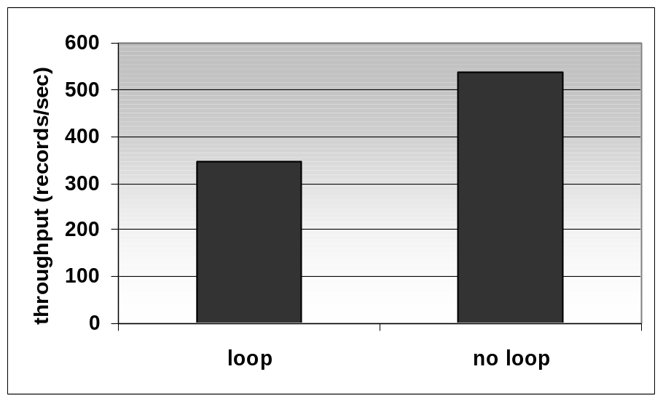
Looping can Hurt
SQL Server 2000 on Windows 2000
Crossing the application interface has a significant impact on performance.
Why would a programmer use a loop instead of relying on set-oriented operations: object-orientation?

Slide 54
Cursors are Death -- data
Settings:
  employees(ssnum, name, lat, long, hundreds1,
  hundreds2);
  100000 rows ; Cold buffer
  Dual Pentium II (450MHz, 512Kb), 512 Mb RAM, 3x18Gb drives (10000RPM), Windows 2000.

Slide 55
Cursors are Death -- queries
Queries:
  No cursor
  select * from employees;
  Cursor
  DECLARE d_cursor CURSOR FOR select * from employees;
  OPEN d_cursor
  while (@@FETCH_STATUS = 0)
  BEGIN
  FETCH NEXT from d_cursor
  END
  CLOSE d_cursor
  go

Slide 56
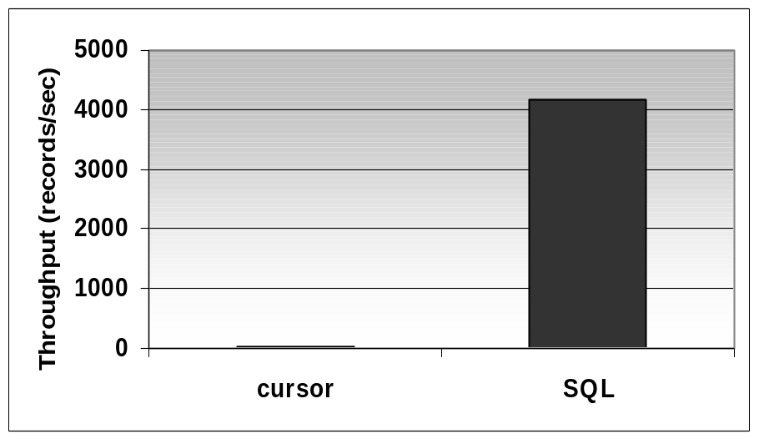
Cursors are Death
SQL Server 2000 on Windows 2000
Response time is a few seconds with a SQL query and more than an hour iterating over a cursor.

Slide 57
Retrieve Needed Columns Only - data
Settings:
  lineitem ( L_ORDERKEY, L_PARTKEY , L_SUPPKEY, L_LINENUMBER, L_QUANTITY, L_EXTENDEDPRICE ,
  L_DISCOUNT, L_TAX , L_RETURNFLAG, L_LINESTATUS ,
  L_SHIPDATE, L_COMMITDATE,
  L_RECEIPTDATE, L_SHIPINSTRUCT ,
  L_SHIPMODE , L_COMMENT );
  create index i_nc_lineitem on lineitem (l_orderkey, l_partkey, l_suppkey, l_shipdate, l_commitdate);
  600 000 rows; warm buffer.
  Lineitem records are ~ 10 bytes long
  Dual Pentium II (450MHz, 512Kb), 512 Mb RAM, 3x18Gb drives (10000RPM), Windows 2000.

Slide 58
Retrieve Needed Columns Only - queries
Queries:
  All
    Select * from lineitem;
  Covered subset
    Select l_orderkey, l_partkey, l_suppkey, l_shipdate, l_commitdate from lineitem;

Slide 59
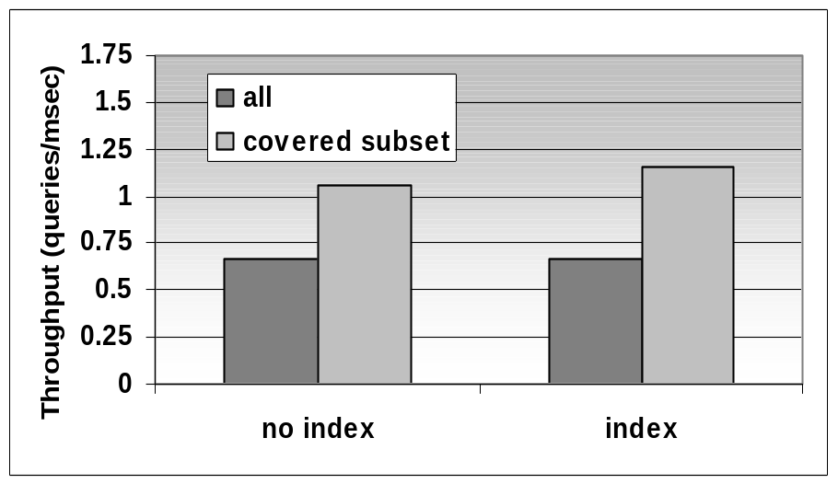
Retrieve Needed Columns Only
Avoid transferring unnecessary data
May enable use of a covering index.
In the experiment the subset contains ¼ of the attributes.
  Reducing the amount of data that crosses the application interface yields significant performance improvement.
Experiment performed on
Oracle8iEE on Windows 2000.

Slide 60
Bulk Loading Data
Settings:
  lineitem ( L_ORDERKEY, L_PARTKEY , L_SUPPKEY, L_LINENUMBER, L_QUANTITY, L_EXTENDEDPRICE ,
  L_DISCOUNT, L_TAX , L_RETURNFLAG, L_LINESTATUS ,
  L_SHIPDATE, L_COMMITDATE,
  L_RECEIPTDATE, L_SHIPINSTRUCT ,
  L_SHIPMODE , L_COMMENT );
  Initially the table is empty; 600 000 rows to be inserted (138Mb)
  Table sits one disk. No constraint, index is defined.
  Dual Pentium II (450MHz, 512Kb), 512 Mb RAM, 3x18Gb drives (10000RPM), Windows 2000.

Slide 61
Bulk Loading Queries
Oracle 8i
sqlldr directpath=true control=load_lineitem.ctl data=E:\Data\lineitem.tbl
load data
infile "lineitem.tbl"
into table LINEITEM append
fields terminated by '|'
(
L_ORDERKEY, L_PARTKEY, L_SUPPKEY, L_LINENUMBER, L_QUANTITY, L_EXTENDEDPRICE, L_DISCOUNT, L_TAX, L_RETURNFLAG, L_LINESTATUS, L_SHIPDATE DATE "YYYY-MM-DD", L_COMMITDATE DATE "YYYY-MM-DD", L_RECEIPTDATE DATE "YYYY-MM-DD", L_SHIPINSTRUCT, L_SHIPMODE, L_COMMENT
)

Slide 62
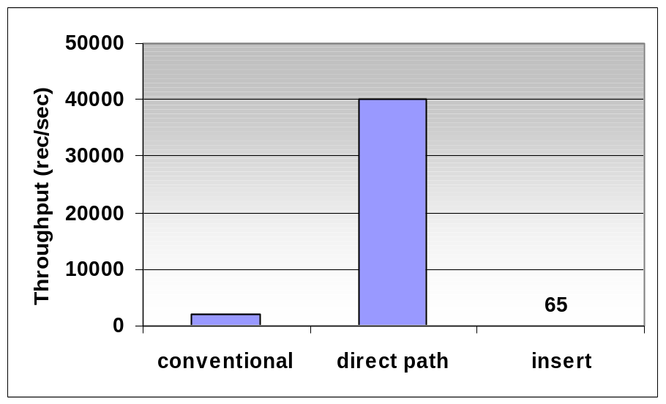
Direct Path
Direct path loading bypasses the query engine and the storage manager. It is orders of magnitude faster than for conventional bulk load (commit every 100 records) and inserts (commit for each record).
Experiment performed on
Oracle8iEE on Windows 2000.

Slide 63
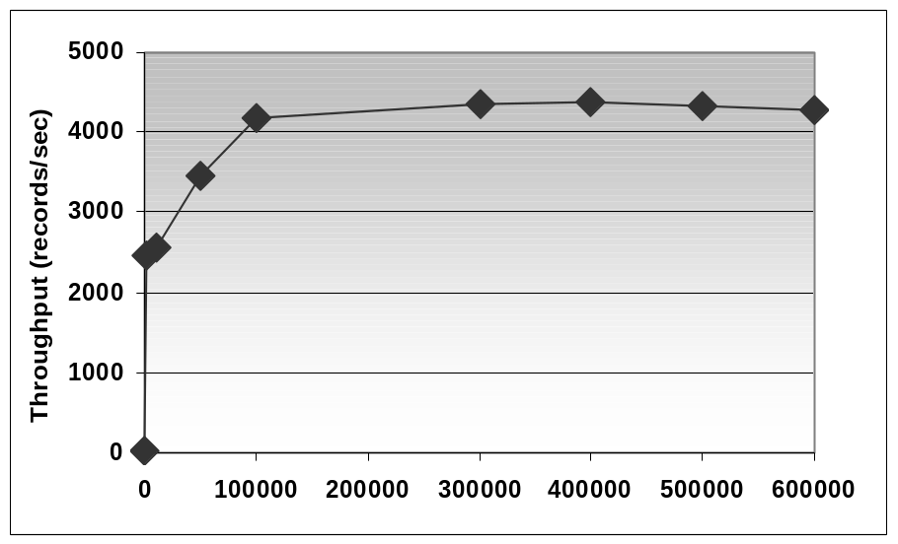
Batch Size
Throughput increases steadily when the batch size increases to 100000 records.Throughput remains constant afterwards.
Trade-off between performance and amount of data that has to be reloaded in case of problem.
Experiment performed on
SQL Server 2000
on Windows 2000.

Slide 64
Tuning
E-Commerce Applications
Database-backed web-sites:
  Online shops
  Shop comparison portals
  MS TerraServer

Slide 65
E-commerce Application Architecture
Clients
Web servers
Application servers
Database server
Web cache
DB cache
Web cache
DB cache
Web cache

Slide 66
E-commerce Application Workload
Touristic searching (frequent, cached)
  Access the top few pages. Pages may be personalized. Data may be out-of-date.
Category searching (frequent, partly cached and need for timeliness guarantees)
  Down some hierarchy, e.g., men’s clothing.
Keyword searching (frequent, uncached, need for timeliness guarantees)
Shopping cart interactions (rare, but transactional)
Electronic purchasing (rare, but transactional)

Slide 67
Design Issues
Need to keep historic information
  Electronic payment acknowledgements get lost.
Preparation for variable load
  Regular patterns of web site accesses during the day, and within a week.
Possibility of disconnections
  State information transmitted to the client (cookies)
Special consideration for low bandwidth
Schema evolution
  Representing e-commerce data as attribute-value pairs (IBM Websphere)

Slide 68
Caching
Web cache:
  Static web pages
  Caching fragments of dynamically created web pages
Database cache (Oracle9iAS, TimesTen’s FrontTier)
  Materialized views to represent cached data.
  Queries are executed either using the database cache or the database server. Updates are propagated to keep the cache(s) consistent.
  Note to vendors: It would be good to have queries distributed between cache and server.

Slide 69
Ecommerce -- setting
Settings:
  shoppingcart( shopperid, itemid, price, qty);
  500000 rows; warm buffer
  Dual Pentium II (450MHz, 512Kb), 512 Mb RAM, 3x18Gb drives (10000RPM), Windows 2000.

Slide 70
Ecommerce -- transactions
Concurrent Transactions:
  Mix
    insert into shoppingcart values (107999,914,870,214);
    update shoppingcart set Qty = 10 where shopperid = 95047 and itemid = 88636;
    delete from shoppingcart where shopperid = 86123 and itemid = 8321;
    select shopperid, itemid, qty, price from shoppingcart where shopperid = ?;
  Queries Only
    select shopperid, itemid, qty, price from shoppingcart where shopperid = ?;

Slide 71
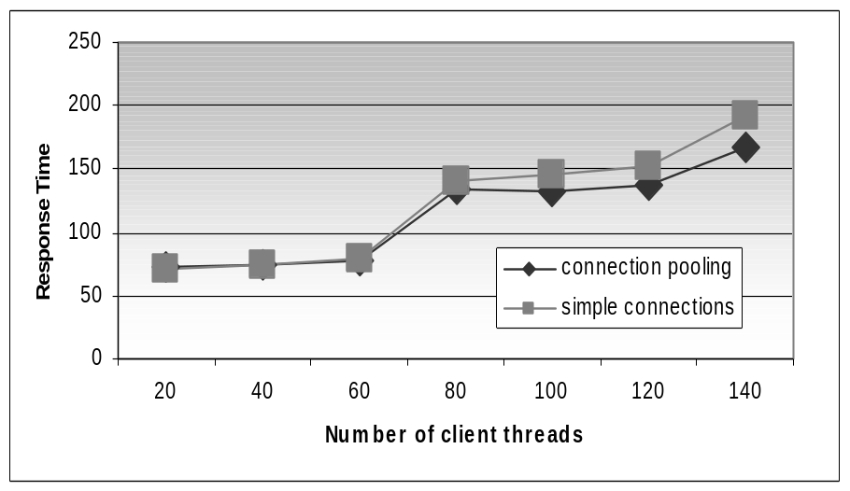
Connection Pooling (no refusals)
Each thread establishes a connection and performs 5 insert statements.
If a connection cannot be established the thread waits 15 secs before trying again.
The number of connection is limited to 60 on the database server.
Using connection pooling, the requests are queued and serviced when possible. There are no refused connections.
Experiment performed on Oracle8i on Windows 2000

Slide 72
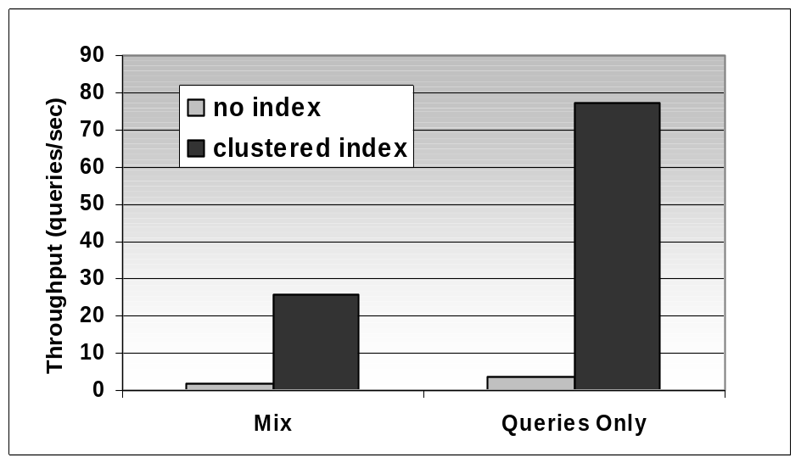
Indexing
Using a clustered index on shopperid in the shopping cart provides:
  Query speed-up
  Update/Deletion speed-up
Experiment performed on
SQL Server 2000
on Windows 2000

Slide 73
Capacity Planning Primer
Dennis Shasha

Slide 74
Capacity Planning
Entry (S1)
0.4
0.5
Arrival Rate
  A1 is given as an assumption
  A2 = (0.4 A1) + (0.5 A2)
  A3 = 0.1 A2
Service Time (S)
  S1, S2, S3 are measured
Utilization
  U = A x S
Response Time
  R = U/(A(1-U)) = S/(1-U)
  (assuming Poisson arrivals)
Search (S2)
0.1
Checkout (S3)
Getting the demand assumptions right
is what makes capacity planning hard

Slide 75
Computing Arrival Rates
Given the state transition graph and an assumed arrival rate in S1, we can determine arrival rates for the other states:
A2 = (0.4 * A1) + (0.5 * A2)
A3 = (0.1 * A2)
So, solving this we get A2 = 0.8 A1 and
A3 = 0.08 A1

Slide 76
How to Handle Multiple Servers
Suppose one has n servers for some task that requires S time for a single server to perform.
The perfect parallelism model is that it is as if one has a single server that is n times as fast.
However, this overstates the advantage of parallelism, because even if there were no waiting, single tasks require S time.

Slide 77
Rough Estimate for Multiple Servers
There are two components to response time: waiting time + service time.
In the parallel setting, the service time is still S.
The waiting time however can be well estimated by a server that is n times as fast.

Slide 78
Approximating waiting time for n parallel servers.
Recall: R = U/(A(1-U)) = S/(1-U)
On an n-times faster server, service time is divided by n, so the single processor utilization U is also divided by n. So we would get: Rideal = (S/n)/(1 – (U/n)).
That Rideal = serviceideal + waitideal.
So waitideal = Rideal – S/n
Our assumption: wait for n processors is close to this waitideal.

Slide 79
Approximating response time for n parallel servers
Waiting time for n parallel processors ~ (S/n)/(1 – (U/n)) – S/n =
(S/n) ( 1/(1-(U/n)) – 1) =
(S/(n(1 – U/n)))(U/n) =
(S/(n – U))(U/n)
So, response time for n parallel processors is above waiting time + S.

Slide 80
Example
A = 8 per second.
S = 0.1 second.
U = 0.8.
Single server response time = S/(1-U) = 0.1/0.2 = 0.5 seconds.
If we have 2 servers, then we estimate waiting time to be (S/(n – U))(U/n) = (0.1/(2-0.8))(0.4) = 0.04/1.2 = 0.033. So the response time is 0.133.
For a 2-times faster server, S = 0.05, U = 0.4, so response time is 0.05/0.6 = 0.0833

