Slide 1
CONCURRENCY
ACID PROPERTIES

Slide 2
Lock-Based Protocols
A lock is a mechanism to control concurrent access to a data item
Data items can be locked in two modes :
1. exclusive (X) mode. Data item can be both read as well as
written. X-lock is requested using lock-X instruction.
2. shared (S) mode. Data item can only be read. S-lock is
requested using lock-S instruction.
Lock requests are made to concurrency-control manager. Transaction can proceed only after request is granted.

Slide 3

Lock-Based Protocols (Cont.)
Lock-compatibility matrix
A transaction may be granted a lock on an item if the requested lock is compatible with locks already held on the item by other transactions
Any number of transactions can hold shared locks on an item, but if any transaction holds an exclusive on the item no other transaction may hold any lock on the item.
If a lock cannot be granted, the requesting transaction is made to wait till all incompatible locks held by other transactions have been released. The lock is then granted.

Slide 4
Lock-Based Protocols (Cont.)
Example of a transaction performing locking:
T₂: lock-S(A);
read (A);
unlock(A);
lock-S(B);
read (B);
unlock(B);
display(A+B)
Locking as above is not sufficient to guarantee serializability — if A and B get updated in-between the read of A and B, the displayed sum would be wrong.
A locking protocol is a set of rules followed by all transactions while requesting and releasing locks. Locking protocols restrict the set of possible schedules.

Slide 5

Pitfalls of Lock-Based Protocols
Consider the partial schedule
Neither T₃ nor T₄ can make progress — executing lock-S(B) causes T₄ to wait for T₃ to release its lock on B, while executing lock-X(A) causes T₃ to wait for T₄ to release its lock on A.
Such a situation is called a deadlock.
  To handle a deadlock one of T₃ or T₄ must be rolled back
  and its locks released.

Slide 6
Pitfalls of Lock-Based Protocols (Cont.)
The potential for deadlock exists in most locking protocols. Deadlocks are a necessary evil.
Starvation is also possible if concurrency control manager is badly designed. For example:
  A transaction may be waiting for an X-lock on an item, while a sequence of other transactions request and are granted an S-lock on the same item.
  The same transaction is repeatedly rolled back due to deadlocks.
Concurrency control manager can be designed to prevent starvation.

Slide 7
The Two-Phase Locking Protocol
This is a protocol which ensures conflict-serializable schedules.
Phase 1: Growing Phase
  transaction may obtain locks
  transaction may not release locks
Phase 2: Shrinking Phase
  transaction may release locks
  transaction may not obtain locks
The protocol assures serializability. It can be proved that the transactions can be serialized in the order of their lock points (i.e. the point where a transaction acquired its final lock).

Slide 8
The Two-Phase Locking Protocol (Cont.)
Two-phase locking does not ensure freedom from deadlocks
Cascading roll-back is possible under two-phase locking. To avoid this, follow a modified protocol called strict two-phase locking. Here a transaction must hold all its exclusive locks till it commits/aborts.
Rigorous two-phase locking is even stricter: here all locks are held till commit/abort. In this protocol transactions can be serialized in the order in which they commit.

Slide 9
The Two-Phase Locking Protocol (Cont.)
There can be conflict serializable schedules that cannot be obtained if two-phase locking is used.
However, in the absence of extra information (e.g., ordering of access to data), two-phase locking is needed for conflict serializability in the following sense:
Given a transaction T_{i} that does not follow two-phase locking, we can find a transaction T_{j} that uses two-phase locking, and a schedule for T_{i} and T_{j} that is not conflict serializable.

Slide 10
Lock Conversions
Two-phase locking with lock conversions:
– First Phase:
  can acquire a lock-S on item
  can acquire a lock-X on item
  can convert a lock-S to a lock-X (upgrade)
– Second Phase:
  can release a lock-S
  can release a lock-X
  can convert a lock-X to a lock-S (downgrade)
This protocol assures serializability. But still relies on the programmer to insert the various locking instructions.

Slide 11
Graph-Based Protocols
Graph-based protocols are an alternative to two-phase locking
Impose a partial ordering → on the set D = {d₁, d₂ ,..., d_{h}} of all data items.
  If d_{i} → d_{j} then any transaction accessing both d_{i} and d_{j} must access d_{i} before accessing d_{j}.
  Implies that the set D may now be viewed as a directed acyclic graph, called a database graph.
The tree-protocol is a simple kind of graph protocol.

Slide 12

Tree Protocol
Only exclusive locks are allowed.
The first lock by T_{i} may be on any data item. Subsequently, a data Q can be locked by T_{i} only if the parent of Q is currently locked by T_{i}.
Data items may be unlocked at any time.

Slide 13
Graph-Based Protocols (Cont.)
The tree protocol ensures conflict serializability as well as freedom from deadlock.
Unlocking may occur earlier in the tree-locking protocol than in the two-phase locking protocol.
  shorter waiting times, and increase in concurrency
  protocol is deadlock-free, no rollbacks are required
  the abort of a transaction can still lead to cascading rollbacks.
  (this correction has to be made in the book also.)
However, in the tree-locking protocol, a transaction may have to lock data items that it does not access.
  increased locking overhead, and additional waiting time
  potential decrease in concurrency
Schedules not possible under two-phase locking are possible under tree protocol, and vice versa.

Slide 14
Timestamp-Based Protocols
Each transaction is issued a timestamp when it enters the system. If an old transaction T_{i} has time-stamp TS(T_{i}), a new transaction T_{j} is assigned time-stamp TS(T_{j}) such that TS(T_{i}) <TS(T_{j}).
The protocol manages concurrent execution such that the time-stamps determine the serializability order.
In order to assure such behavior, the protocol maintains for each data Q two timestamp values:
  W-timestamp(Q) is the largest time-stamp of any transaction that executed write(Q) successfully.
  R-timestamp(Q) is the largest time-stamp of any transaction that executed read(Q) successfully.

Slide 15
Timestamp-Based Protocols (Cont.)
The timestamp ordering protocol ensures that any conflicting read and write operations are executed in timestamp order.
Suppose a transaction T_{i} issues a read(Q)
1. If TS(T_{i}) ≤ W-timestamp(Q), then T_{i} needs to read a value of Q
that was already overwritten. Hence, the read operation is
rejected, and T_{i} is rolled back.
2. If TS(T_{i})≥ W-timestamp(Q), then the read operation is
executed, and R-timestamp(Q) is set to the maximum of R-
timestamp(Q) and TS(T_{i}).

Slide 16
Timestamp-Based Protocols (Cont.)
Suppose that transaction T_{i} issues write(Q).
If TS(T_{i}) < R-timestamp(Q), then the value of Q that T_{i} is producing was needed previously, and the system assumed that that value would never be produced. Hence, the write operation is rejected, and T_{i} is rolled back.
If TS(T_{i}) < W-timestamp(Q), then T_{i} is attempting to write an obsolete value of Q. Hence, this write operation is rejected, and T_{i} is rolled back.
Otherwise, the write operation is executed, and W-timestamp(Q) is set to TS(T_{i}).

Slide 17
Thomas’ Write Rule
Modified version of the timestamp-ordering protocol in which obsolete write operations may be ignored under certain circumstances.
When T_{i} attempts to write data item Q, if TS(T_{i}) < W-timestamp(Q), then T_{i} is attempting to write an obsolete value of {Q}. Hence, rather than rolling back T_{i} as the timestamp ordering protocol would have done, this {write} operation can be ignored.
Otherwise this protocol is the same as the timestamp ordering protocol.
Thomas' Write Rule allows greater potential concurrency. Unlike previous protocols, it allows some view-serializable schedules that are not conflict-serializable.

Slide 18
Multiple Granularity
Allow data items to be of various sizes and define a hierarchy of data granularities, where the small granularities are nested within larger ones
Can be represented graphically as a tree (but don't confuse with tree-locking protocol)
When a transaction locks a node in the tree explicitly, it implicitly locks all the node's descendents in the same mode.
Granularity of locking (level in tree where locking is done):
  fine granularity (lower in tree): high concurrency, high locking overhead
  coarse granularity (higher in tree): low locking overhead, low concurrency

Slide 19
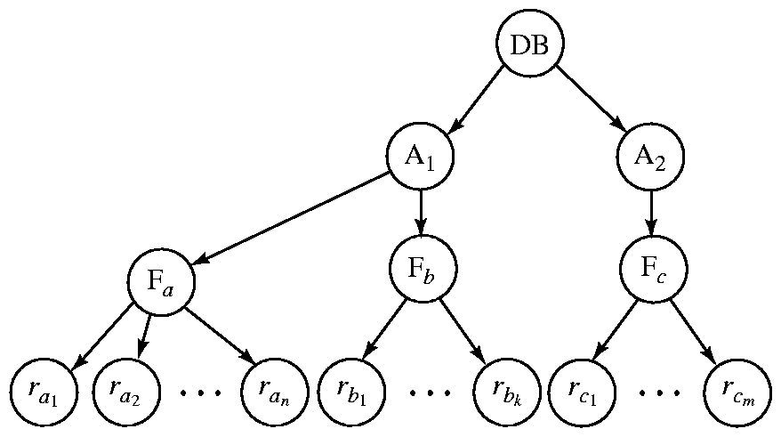
Example of Granularity ((Hierarchy
The highest level in the example hierarchy is the entire database.
The levels below are of type area, file and record in that order.

Slide 20
Intention Lock Modes
In addition to S and X lock modes, there are three additional lock modes with multiple granularity:
  intention-shared (IS): indicates explicit locking at a lower level of the tree but only with shared locks.
  intention-exclusive (IX): indicates explicit locking at a lower level with exclusive or shared locks
  shared and intention-exclusive (SIX): the subtree rooted by that node is locked explicitly in shared mode and explicit locking is being done at a lower level with exclusive-mode locks.
intention locks allow a higher level node to be locked in S or X mode without having to check all descendent nodes.

Slide 21
Compatibility Matrix with
Intention Lock Modes
The compatibility matrix for all lock modes is:
IS
IX
S
S IX
X
IS
✓
✓
✓
✓
×
IX
✓
✓
×
×
×
S
✓
×
✓
×
×
S IX
✓
×
×
×
×
X
×
×
×
×
×

Slide 22
Deadlock Handling
Consider the following two transactions:
T₁: write (X) T₂: write(Y)
write(Y) write(X)
Schedule with deadlock
T₁
T₂
lock-X on X
write (X)
lock-X on Y
write (Y)
wait for lock-X on X
wait for lock-X on Y

Slide 23
Deadlock Handling
System is deadlocked if there is a set of transactions such that every transaction in the set is waiting for another transaction in the set.
Deadlock prevention protocols ensure that the system will never enter into a deadlock state. Some prevention strategies :
  Require that each transaction locks all its data items before it begins execution (predeclaration).
  Impose partial ordering of all data items and require that a transaction can lock data items only in the order specified by the partial order (graph-based protocol).

Slide 24
More Deadlock Prevention Strategies
Following schemes use transaction timestamps for the sake of deadlock prevention alone.
wait-die scheme — non-preemptive
  older transaction may wait for younger one to release data item. Younger transactions never wait for older ones; they are rolled back instead.
  a transaction may die several times before acquiring needed data item
wound-wait scheme — preemptive
  older transaction wounds (forces rollback) of younger transaction instead of waiting for it. Younger transactions may wait for older ones.
  may be fewer rollbacks than wait-die scheme.

Slide 25
Deadlock prevention (Cont.)
Both in wait-die and in wound-wait schemes, a rolled back transactions is restarted with its original timestamp. Older transactions thus have precedence over newer ones, and starvation is hence avoided.
Timeout-Based Schemes :
  a transaction waits for a lock only for a specified amount of time. After that, the wait times out and the transaction is rolled back.
  thus deadlocks are not possible
  simple to implement; but starvation is possible. Also difficult to determine good value of the timeout interval.

Slide 26
Deadlock Detection
Deadlocks can be described as a wait-for graph, which consists of a pair G = (V,E),
  V is a set of vertices (all the transactions in the system)
  E is a set of edges; each element is an ordered pair T_{i} →T_{j}.
If T_{i} → T_{j} is in E, then there is a directed edge from T_{i} to T_{j}, implying that T_{i} is waiting for T_{j} to release a data item.
When T_{i} requests a data item currently being held by T_{j}, then the edge T_{i} T_{j} is inserted in the wait-for graph. This edge is removed only when T_{j} is no longer holding a data item needed by T_{i}.
The system is in a deadlock state if and only if the wait-for graph has a cycle. Must invoke a deadlock-detection algorithm periodically to look for cycles.

Slide 27


Deadlock Detection (Cont.)
Wait-for graph without a cycle
Wait-for graph with a cycle

Slide 28

Partial Schedule Under Two-Phase Locking

Slide 29

Incomplete Schedule With a Lock Conversion

Slide 30
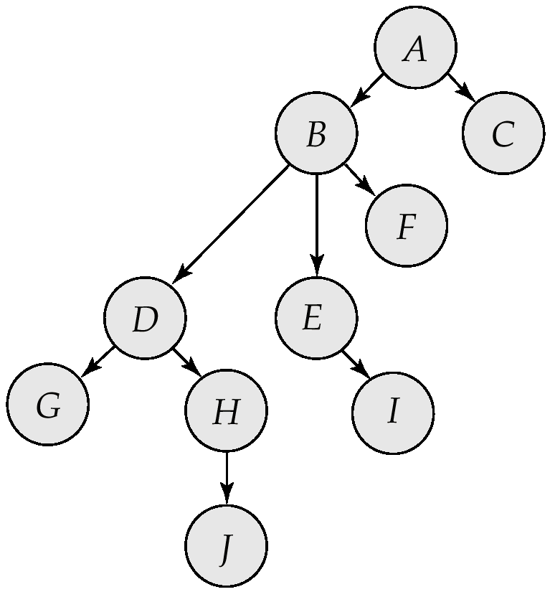
Tree-Structured Database Graph

Slide 31
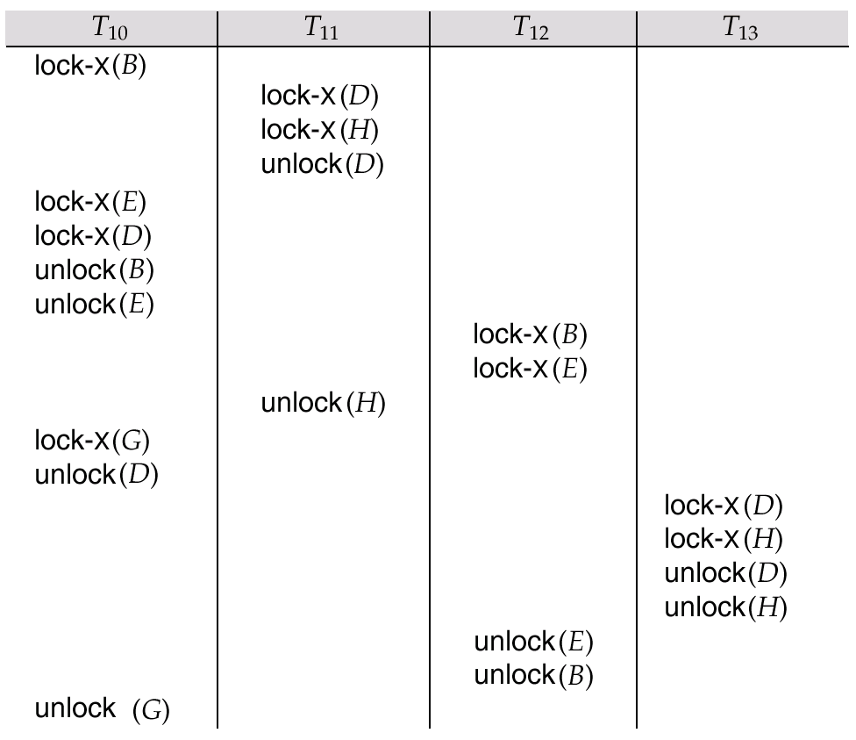
Serializable Schedule Under the Tree Protocol

Slide 32
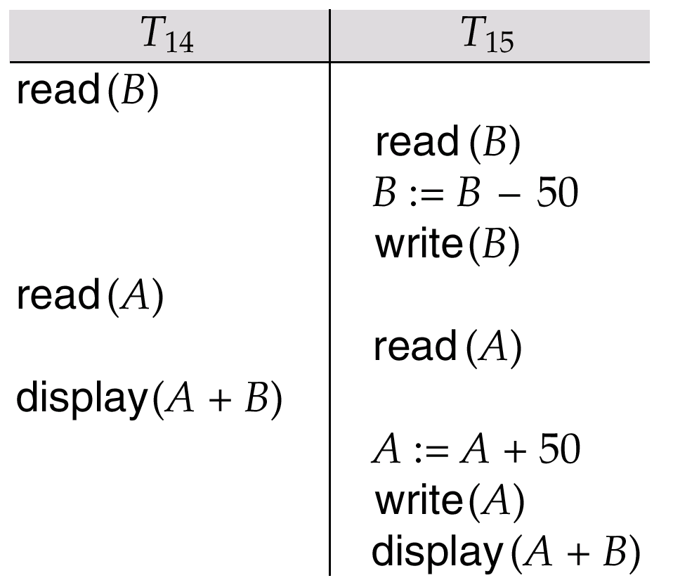
Schedule 3

Slide 33
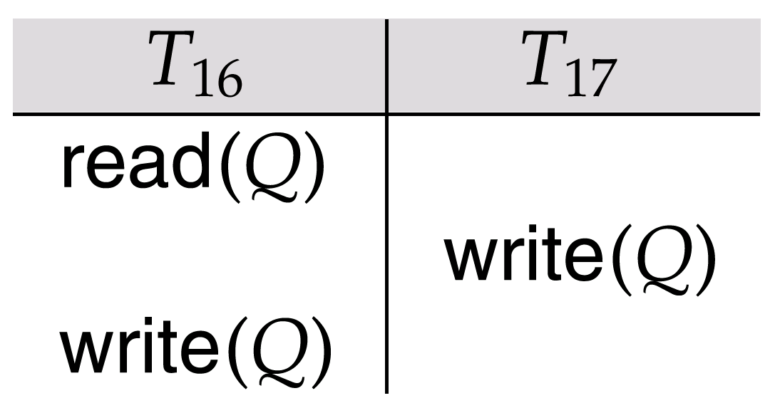
Schedule 4

Slide 34
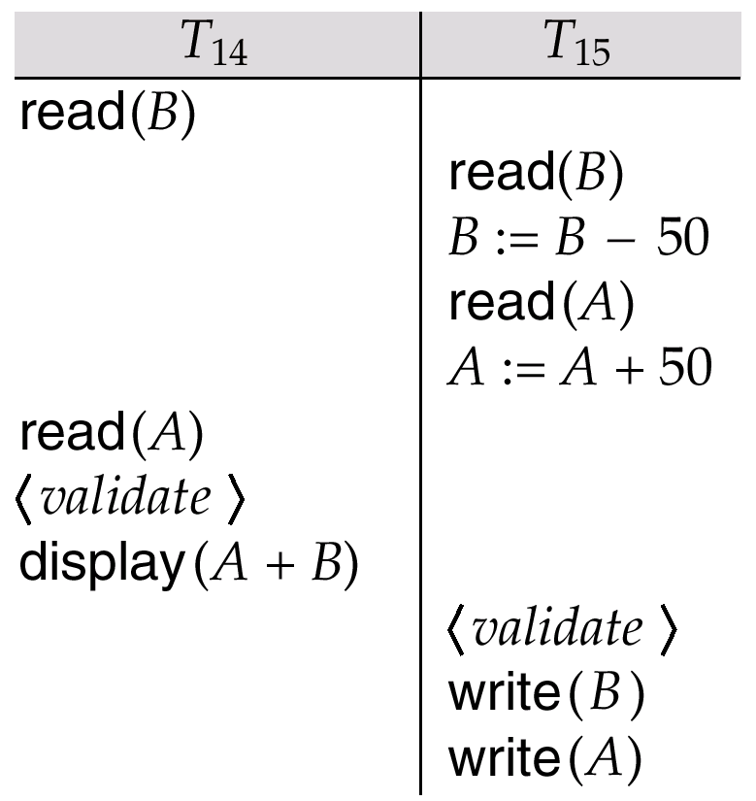
Schedule 5, A Schedule Produced by Using Validation

Slide 35
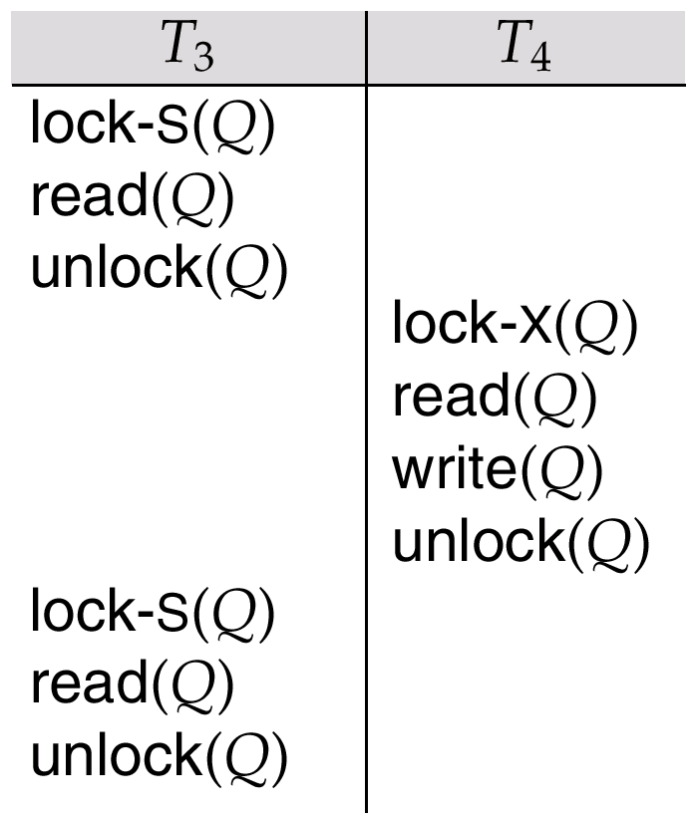
Nonserializable Schedule with Degree-Two Consistency

Slide 36
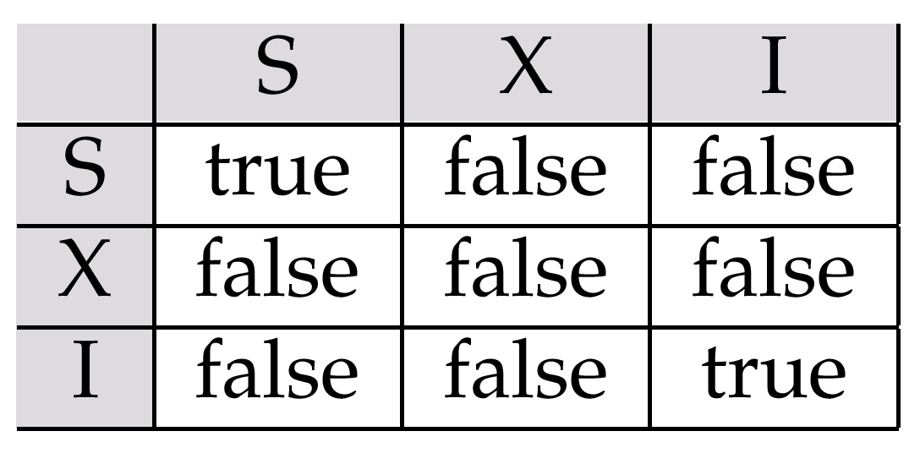
Lock-Compatibility Matrix

