Slide 1
KLE TECHNONOGICAL UNIVERSITY
Department of Electrical & Electronics Engineering

Slide 2
COURSE: DIGITAL CIRCUITS LABORATORY
Course Code: 15EEEP203
Batch : 12

Slide 3
Assignment Questions
Gray to Binary and Excess-3 to BCD Code Converters Using NAND Gates
01
02
Subtractor Using 74153 Multiplexer

Slide 4
Team
01FE19BEE046
01FE19BEE048
01FE19BEE049
R Vishwas
Nikhita Banapur
Sheshank Shyam Kindalkar
Batch-12

Slide 5
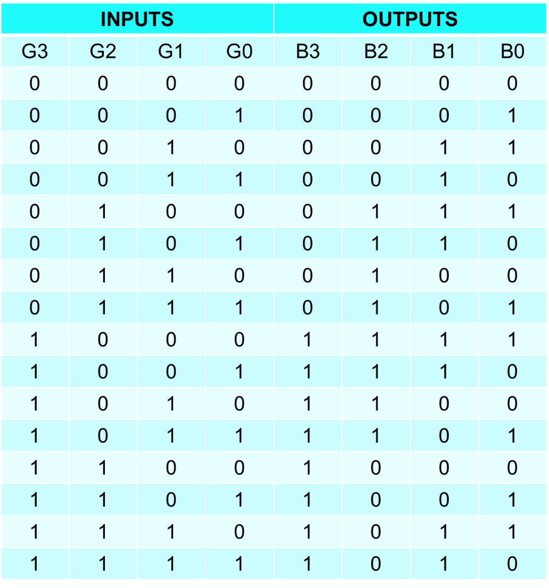
1a. Gray to Binary Code Converters Using NAND Gates
The reflected binary code or Gray code is an ordering of the binary numeral system such that two successive values differ in only one bit (binary digit). Gray codes are very useful in the normal sequence of binary numbers generated by the hardware that may cause an error or ambiguity during the transition from one number to the next. So, the Gray code can eliminate this problem easily since only one bit changes its value during any transition between two numbers.
Conversion of Gray to Binary Code
Gray codes are used in rotary and optical encoders, Karnaugh maps, and error detection. The hamming distance of two neighbors Gray codes is always 1 and also first Gray code and last Gray code also has Hamming distance is always 1, so it is also called Cyclic codes. You can convert a Gray code to Binary number using two methods.

Slide 6
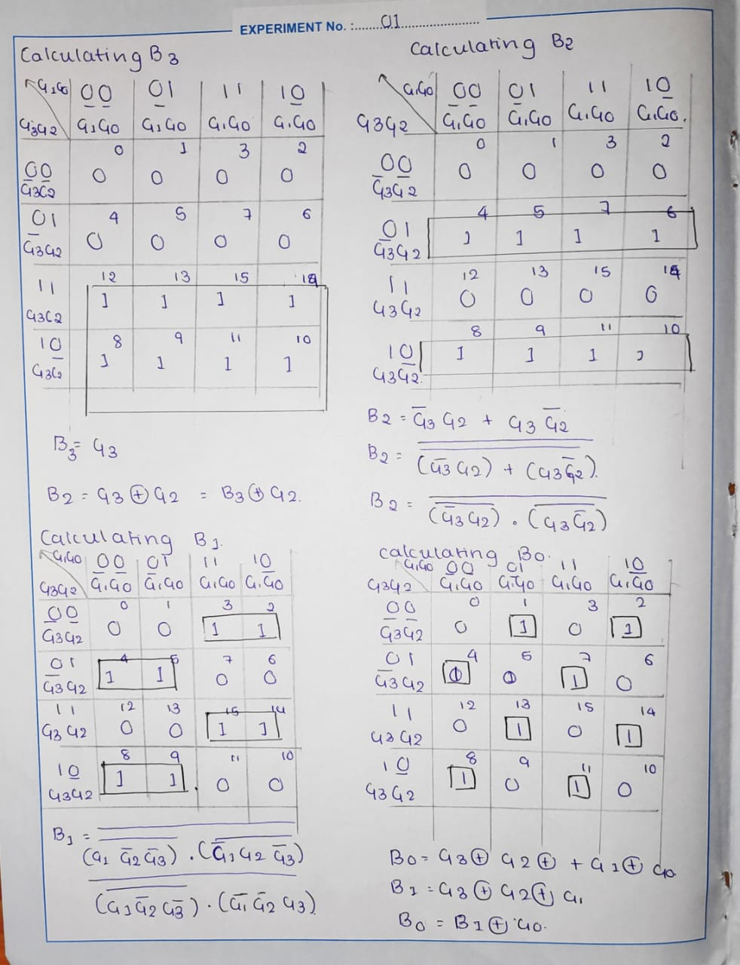
1a. Gray to Binary Code Converters Using NAND Gates
K-Map for Calculating B3, B2, B1 & B0

Slide 7
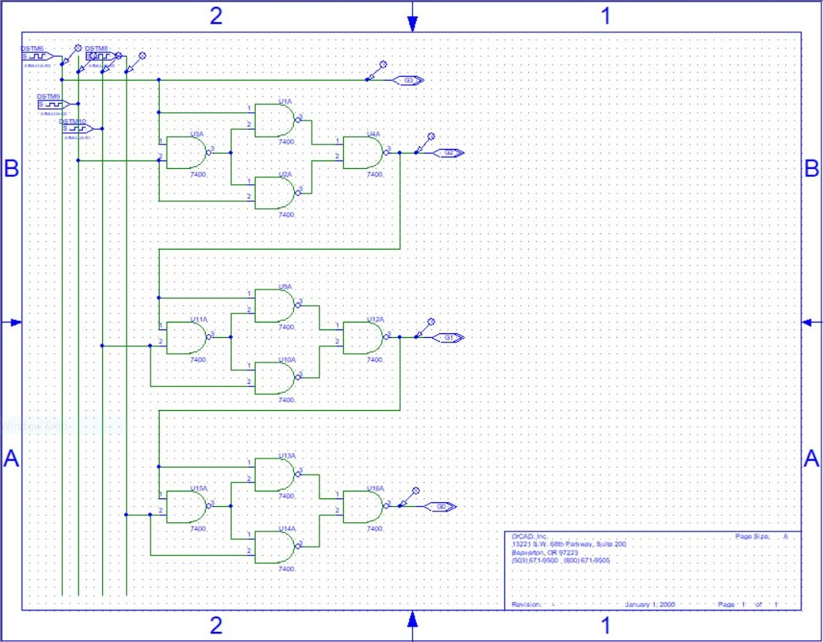
1a. Gray to Binary Code Converters Using NAND Gates
Circuit Diagram
Gray to Binary Code Converters Using NAND Gates

Slide 8
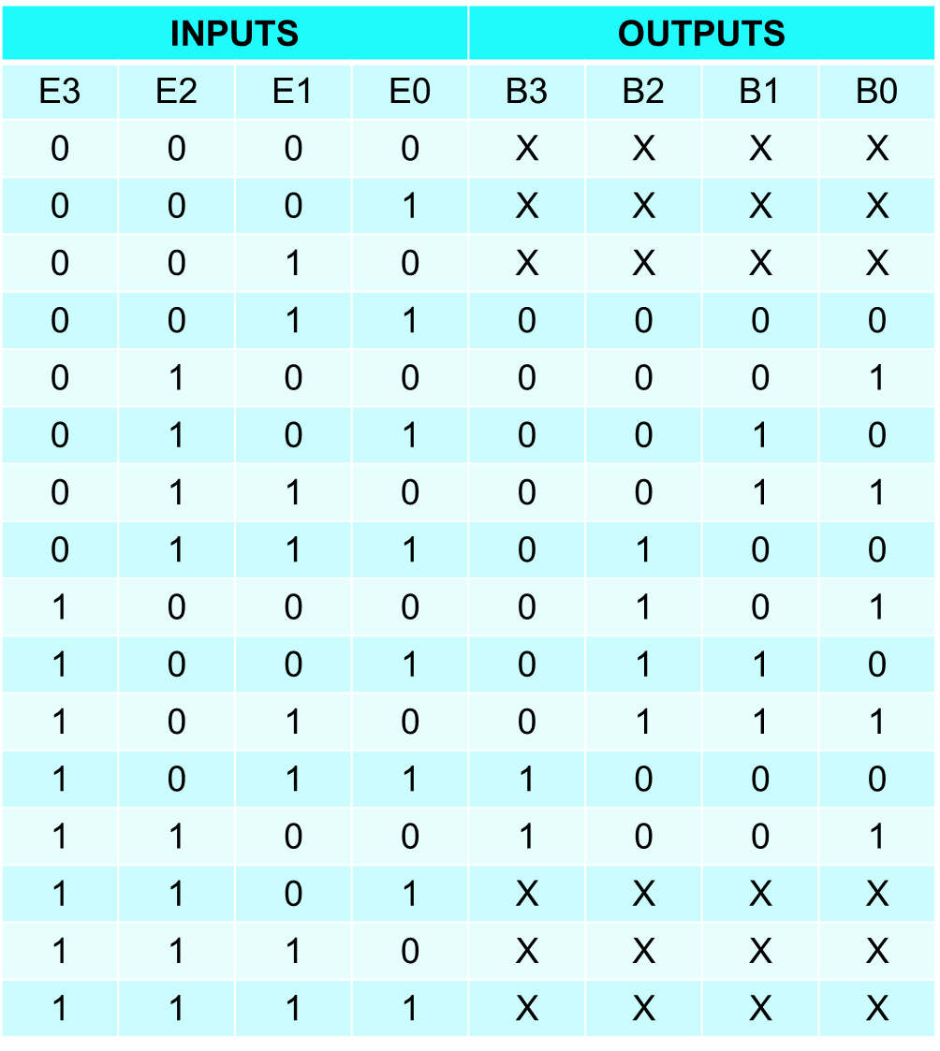
1b. Excess-3 to BCD Code Converters Using NAND Gates

Slide 9
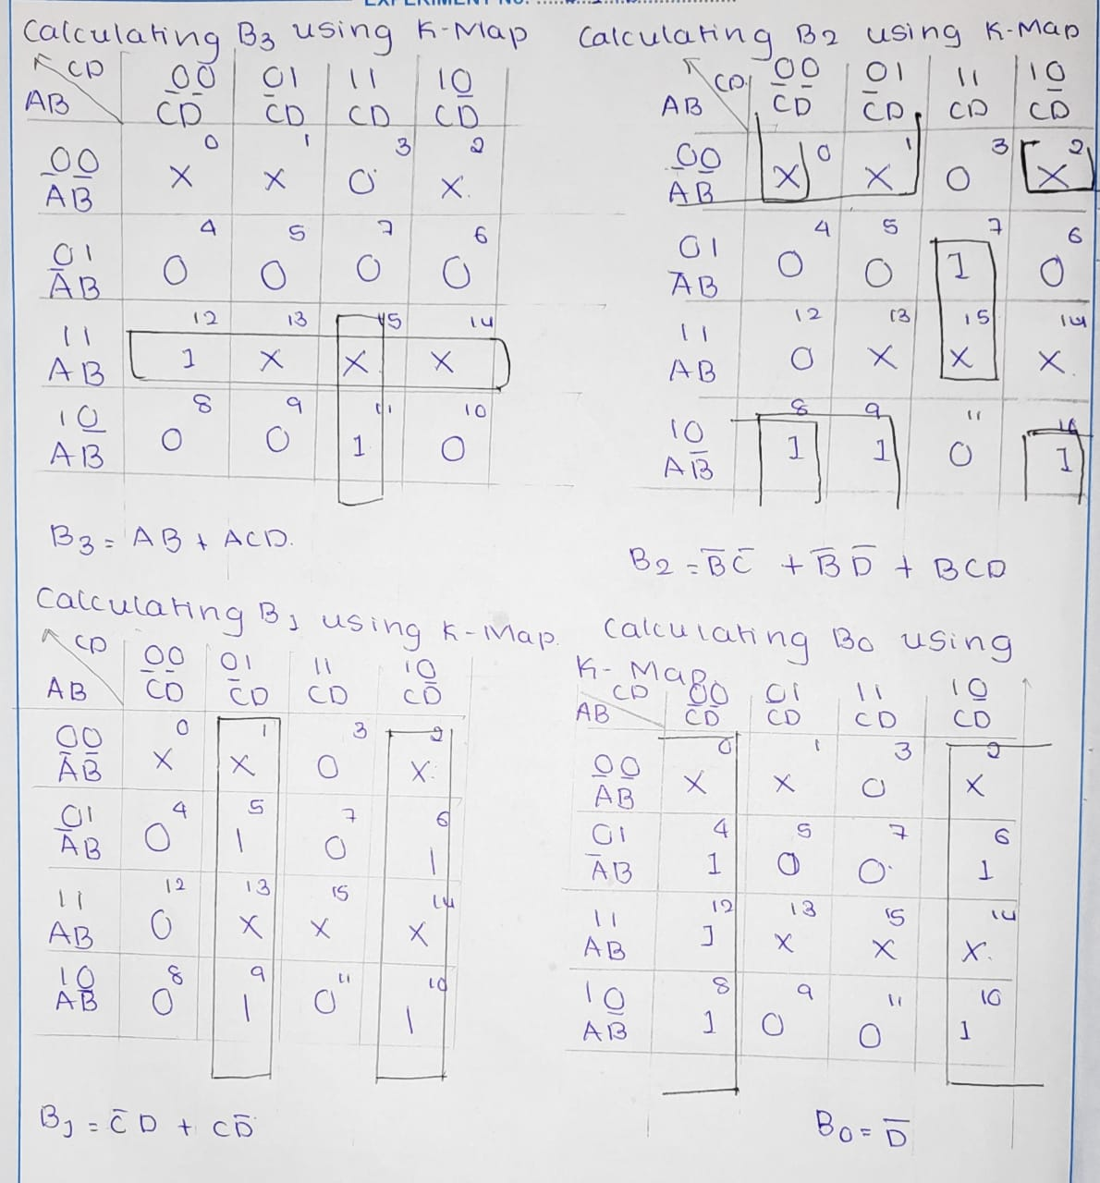
1b. Excess-3 to BCD Code Converters Using NAND Gates
K-Map for Calculating B3, B2, B1 & B0

Slide 10
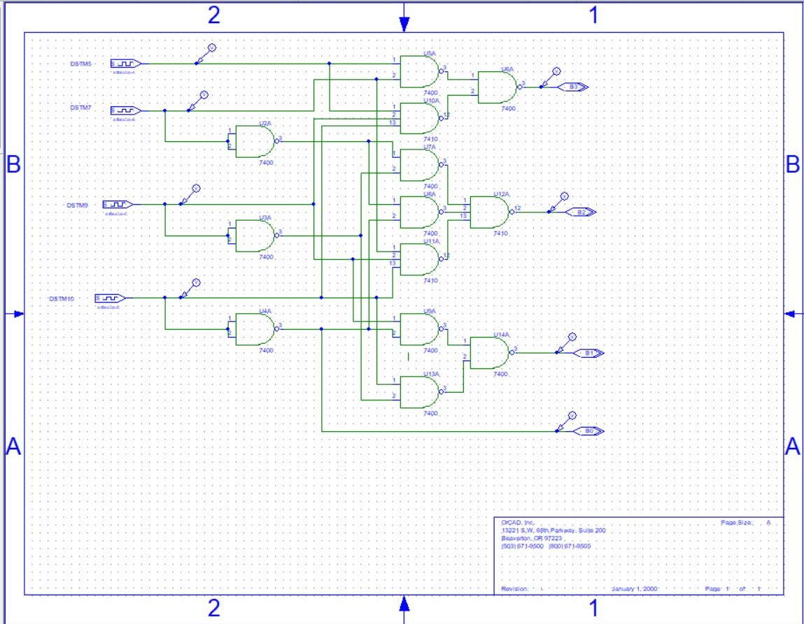
1b. Excess-3 to BCD Code Converters Using NAND Gates
Circuit Diagram
Gray to Binary Code Converters Using NAND Gates

Slide 11
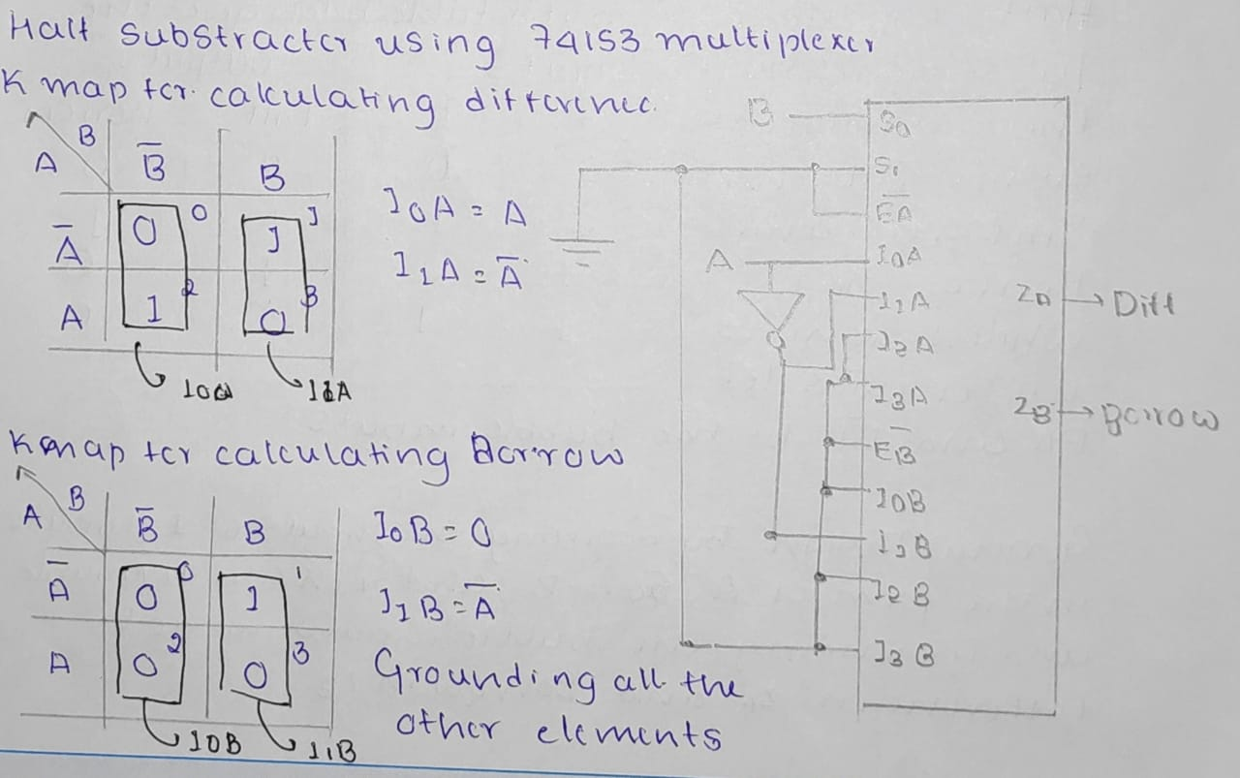
2a. Half-Subtractor using 74153 Multiplexer
Truth Table and Calculation of Difference and Borrow using K-Map
Inputs |  | Outputs
A | B | D | Br
0 | 0 | 0 | 0
0 | 1 | 1 | 1
1 | 0 | 1 | 0
1 | 1 | 0 | 0

Slide 12
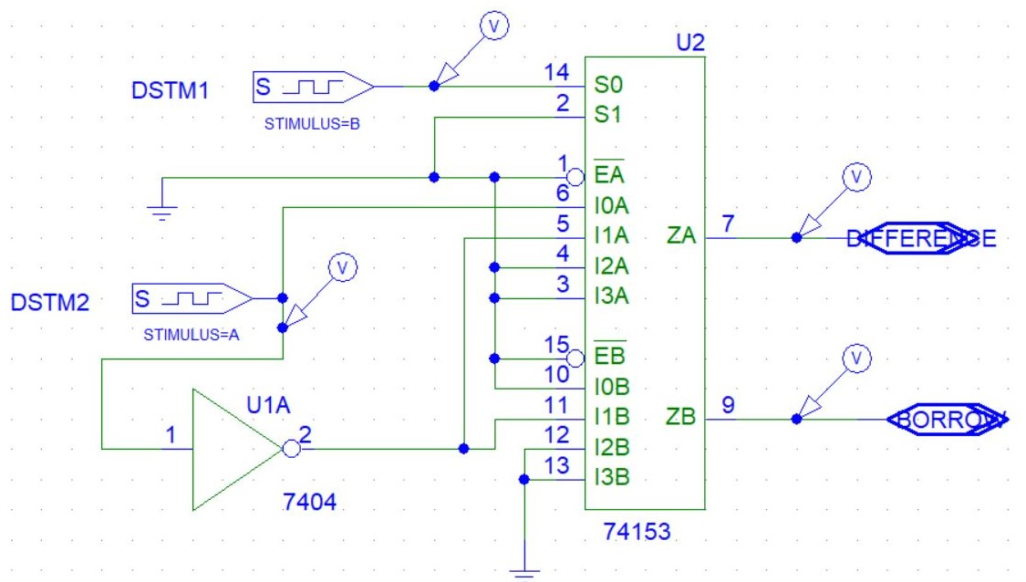
2a. Half-Subtractor using 74153 Multiplexer
Circuit Design : Half-Subtractor using 74153 Multiplexer
Easy to change colors, photos and Text.
Easy to change colors, photos and Text.

Slide 13
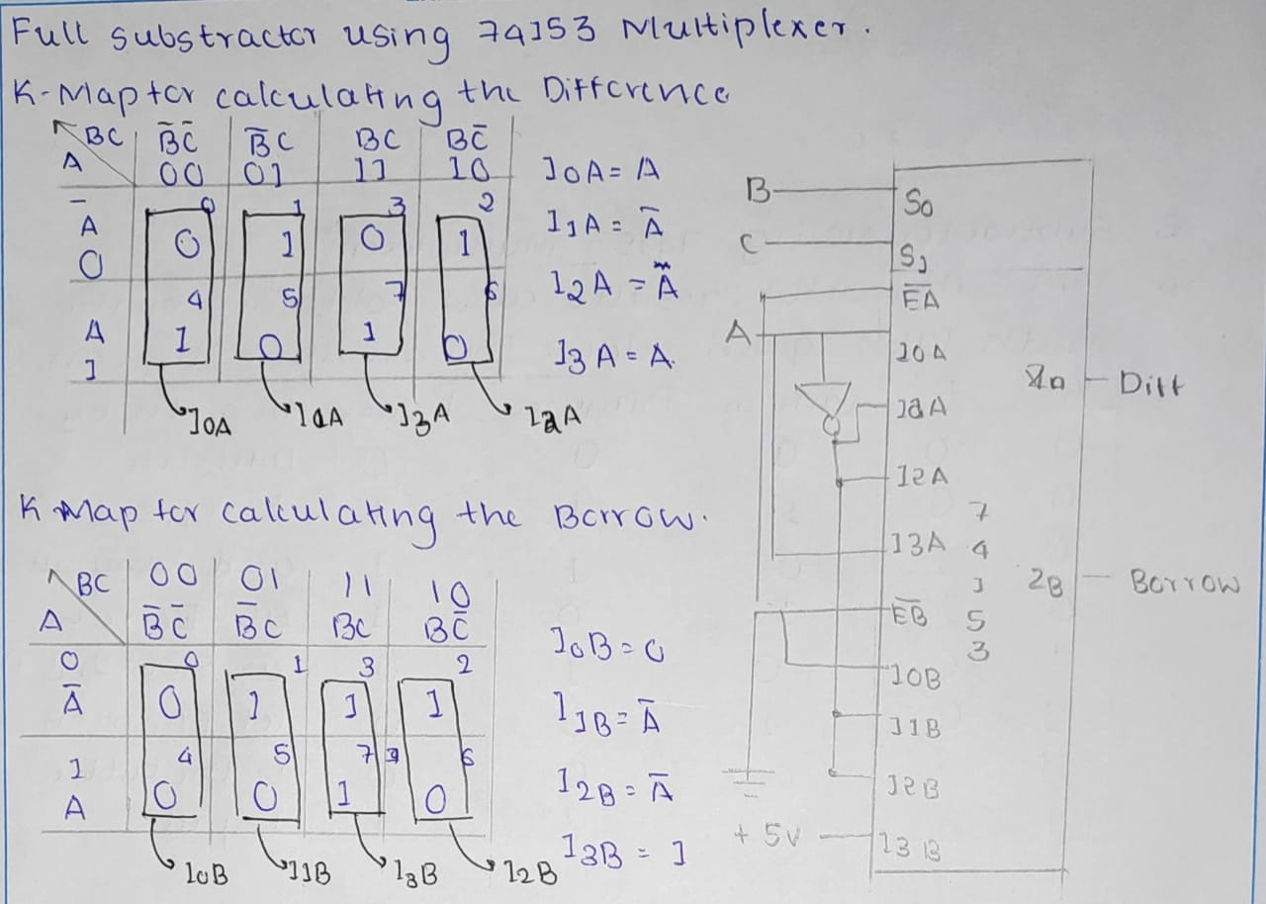
2b. Full-Subtractor using 74153 Multiplexer
Truth Table and Calculation of Difference and Borrow using K-Map
Inputs |  |  | Outputs
A | B | C | D | Br
0 | 0 | 0 | 0 | 0
0 | 0 | 1 | 1 | 1
0 | 1 | 0 | 1 | 1
0 | 1 | 1 | 0 | 1
1 | 0 | 0 | 1 | 0
1 | 0 | 1 | 0 | 0
1 | 1 | 0 | 0 | 0
1 | 1 | 1 | 1 | 1

Slide 14
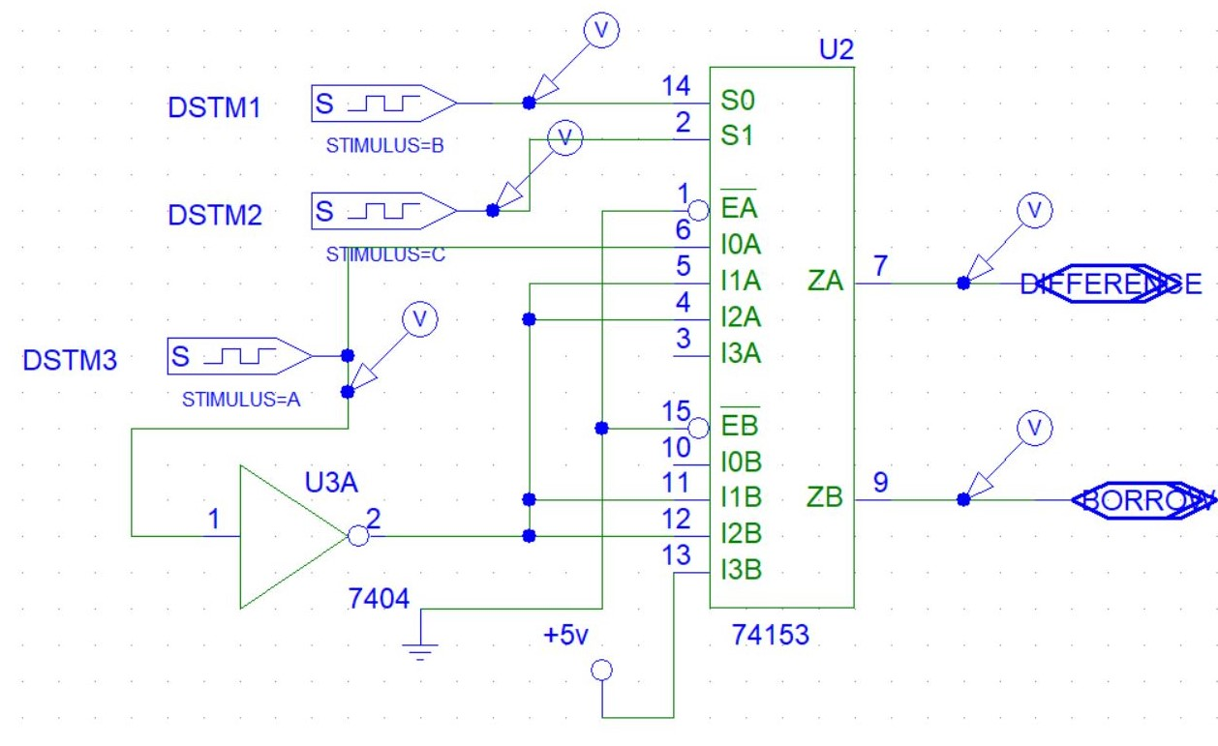
2b. Full-Subtractor using 74153 Multiplexer
Circuit Design :
Full-Subtractor using 74153 Multiplexer
Easy to change colors, photos and Text.

Slide 15
THANK YOU

