Slide 1
Marketing Data Analysis
Healthcare physician outreach | Jan–Mar 2024 Candidate ID: B211623

Slide 2
1. Executive Summary
Reach = 25,208 unique physicians.
Frequency = 3.97 activity-log records per reached physician.
Engagement = 18,521 Open/Click interactions (18.5% of activity records).
Email provides the broadest channel reach (22,092); SMS has the highest engagement rate (50.1%).
January maximizes reach; March maximizes activity volume and frequency.
Recommendation: retain Email for scale, test targeted SMS, and monitor March contact intensity.

Slide 3
2. Metric Definitions & Assumptions
Reach = unique Physician ID count.
Frequency = total activity records ÷ unique physicians. This is an activity-log frequency because the data mixes Sent, Delivered, Open, Click and other events.
Engagement = Open + Click records; Unsubscribe is treated as a separate negative response.
Engagement Rate = Engagement ÷ Total Activity. It is descriptive, not a standard email open/click-through rate.
Segment reach is not additive because physicians may appear in multiple segments.
The Activity Metrics field is incomplete and is therefore not the primary engagement measure.

Slide 4
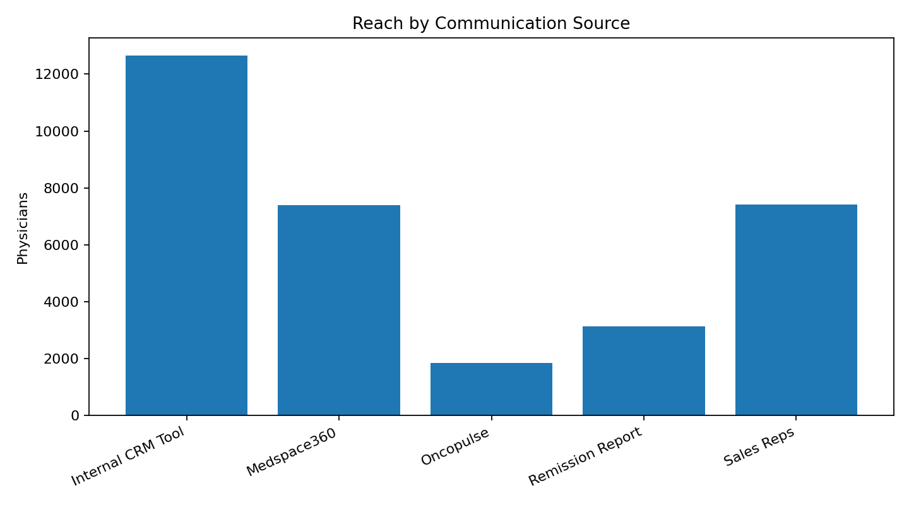
3. Reach by Communication Source
Internal CRM Tool has the largest source reach: 12,647.
Sales Reps and Medspace360 reach 7,420 and 7,388.
Do not add source reaches to estimate overall unique reach.

Slide 5
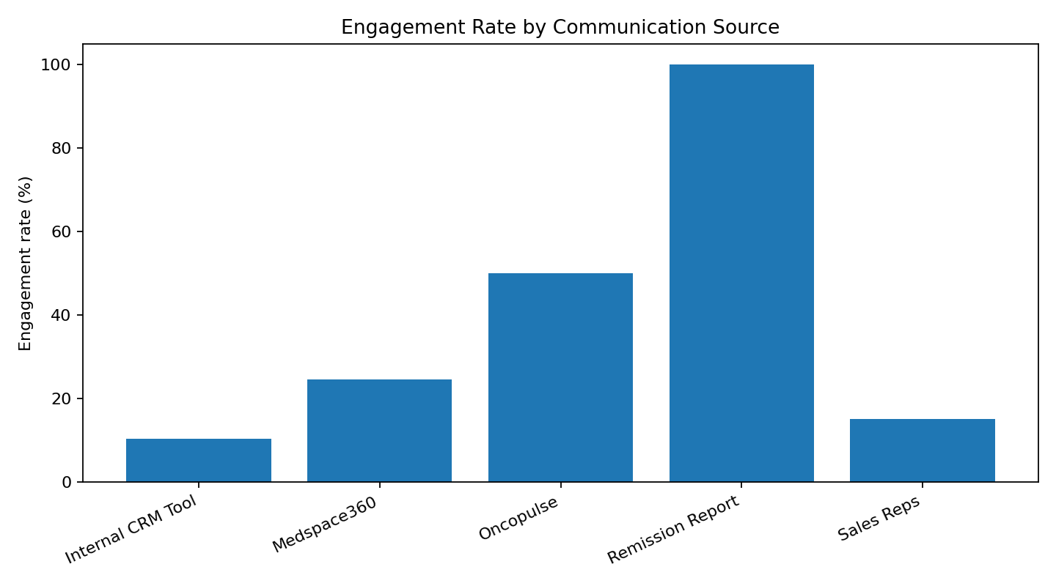
4. Engagement by Communication Source
Highest engagement rate: Remission Report at 100.0%.
Internal CRM Tool has the lowest rate at 10.5%, despite the largest reach.
This shows a scale-versus-engagement trade-off.
Validate event/source definitions before making major budget shifts.

Slide 6
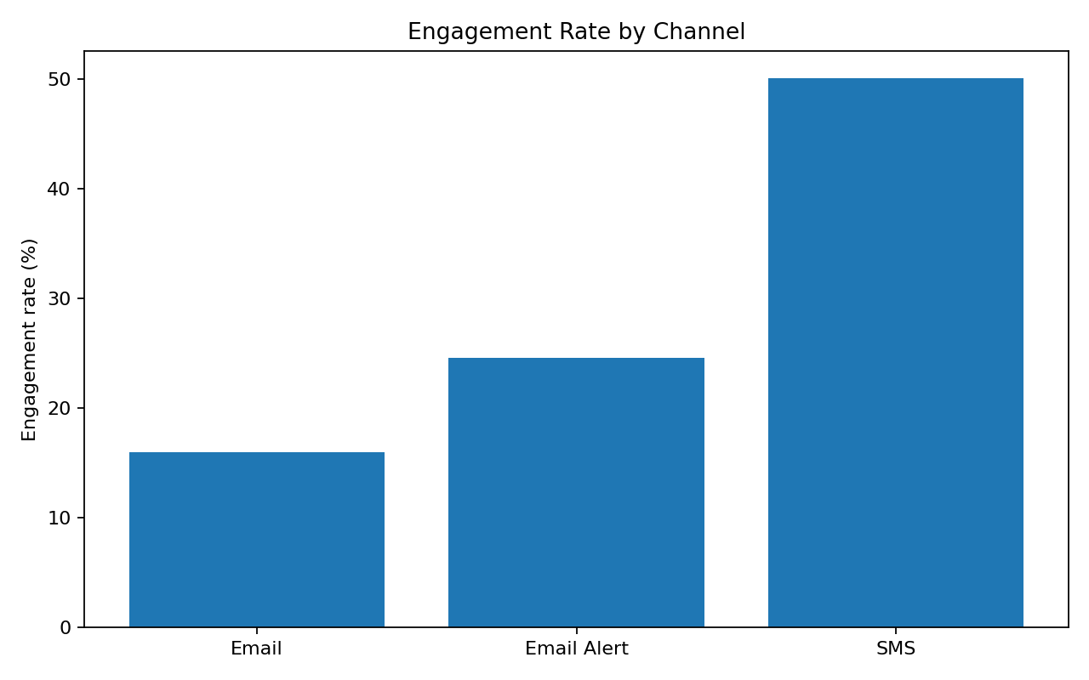
5. Channel Comparison
Email: 22,092 reach; 16.0% engagement rate.
Email Alert: 7,388 reach; 24.6% engagement rate.
SMS: 1,848 reach; 50.1% engagement rate.
Use Email for scale and targeted SMS for higher-engagement opportunities.

Slide 7
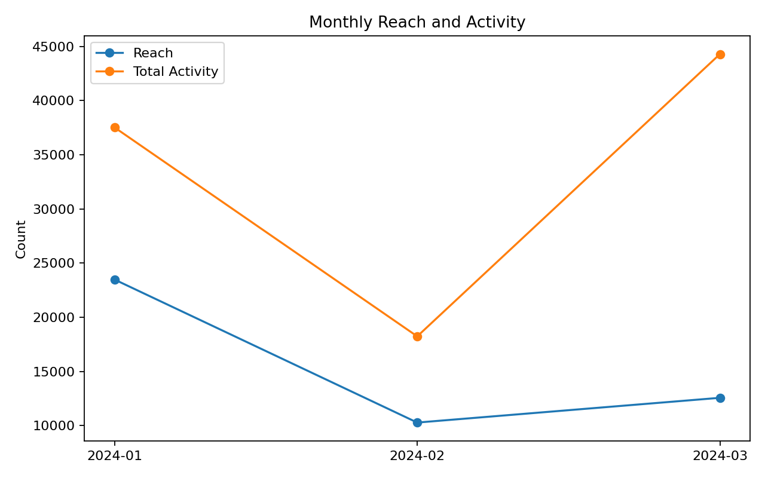
6. Monthly Trend
January reach: 23,480.
February activity: 18,239 records.
March activity: 44,284 records; frequency 3.52.
March's higher contact intensity should be monitored for over-contacting.

Slide 8
7. Activity Mix & Data Quality
Sent: 62,061; Open: 17,745; Delivered: 14,798.
Click: 776; Unsubscribe: 65.
Bounce + Hard Bounce: 4,595.
Therapeutic Area is missing in 4,222 rows; Device is UNKNOWN in 96,905 rows.
The Activity Metrics field is missing in most rows, so it is not used as the primary engagement metric.

Slide 9
8. Recommendations
Maintain Email as the main scale channel.
Use targeted SMS experiments where high engagement can justify narrower reach; monitor opt-outs.
Review March campaign cadence and physician-level contact frequency before increasing volume.
Use source-level engagement to optimize campaigns, while validating that event definitions are comparable.
Improve Therapeutic Area, Device and Activity Metrics completeness.
Add campaign IDs, send IDs and downstream outcome/conversion fields to enable ROI and true funnel metrics.

Slide 10
9. Conclusion
The program reached 25,208 unique physicians across 100,040 activity records.
The data shows a clear scale-versus-engagement trade-off across sources and channels.
The strongest practical strategy is broad Email coverage combined with selective high-engagement outreach.
Detailed calculations and segment tables are included in the companion Excel workbook.

