Slide 1
Agenda
What is Big Data?
What is Hadoop?
Hadoop Related Open Source Projects
Example of Hadoop In Action
Big Data Solutions and Cloud

Slide 2
What is data
In order to understand 'Big Data', we first need to know what 'data' is. Oxford dictionary defines 'data' as –
The quantities, characters, or symbols on which operations are performed by a computer, which may be stored and transmitted in the form of electrical signals and recorded on magnetic, optical, or mechanical recording media. "

Slide 3
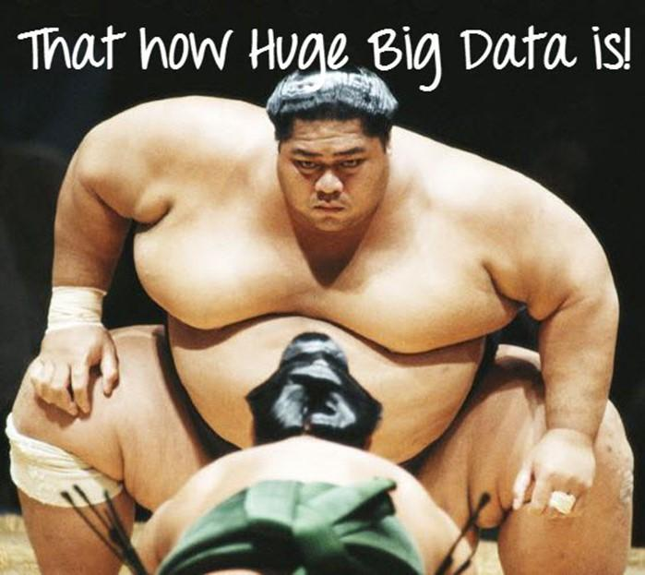
What is Big Data
'Big Data' is also a data but with a huge size. 'Big Data' is a term used to describe collection of data that is huge in size and yet growing exponentially with time.In short, such a data is so large and complex that none of the traditional data management tools are able to store it or process it efficiently.

Slide 4
Characteristics Of 'Big Data'
(i)Volume – The name 'Big Data' itself is related to a size which is enormous. Size of data plays very crucial role in determining value out of data. Also, whether a particular data can actually be considered as a Big Data or not, is dependent upon volume of data. Hence, 'Volume' is one characteristic which needs to be considered while dealing with 'Big Data'.
(ii)Variety – The next aspect of 'Big Data' is its variety.
Velocity – The term 'velocity' refers to the speed of generation of data. How fast the data is generated and processed to meet the demands, determines real potential in the data.

Slide 5



Examples of BigData
The New York Stock Exchange generates about one terabyte of new trade data per day.
Statistic shows that 500+terabytes of new data gets ingested into the databases of social media site Facebook, every day. This data is mainly generated in terms of photo and video uploads, message exchanges, putting comments etc.
Single Jet engine can generate 10+terabytes of data in 30 minutes of a flight time. With many thousand flights per day, generation of data reaches up to many Petabytes.

Slide 6
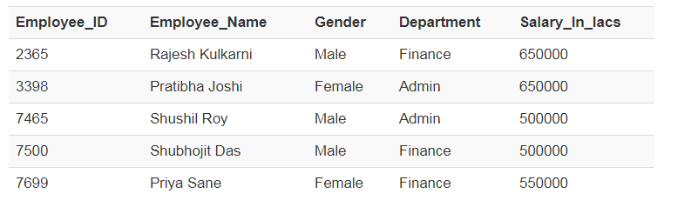
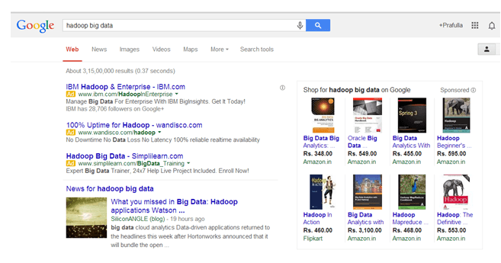
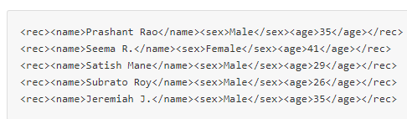
Categories Of 'Big Data'
Structured
Any data that can be stored, accessed and processed in the form of fixed format is termed as a 'structured' data
Unstructured
Any data with unknown form or the structure is classified as unstructured data.
Combination of simple text files, images, videos etc
Semi-structured
Semi-structured data can contain both the forms of data. We can see semi-structured data as a strcutured in form but it is actually not defined with e.g

Slide 7
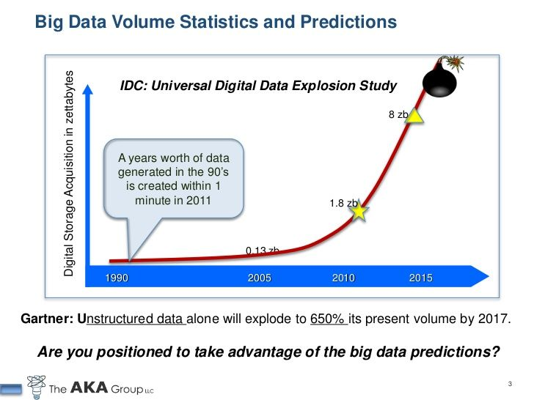

Slide 8
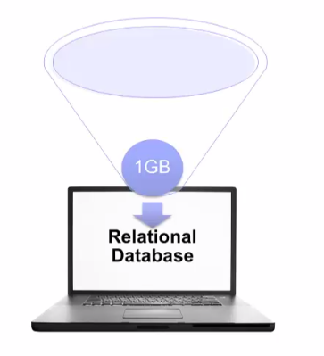
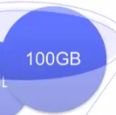


What is Hadoop?

Slide 9
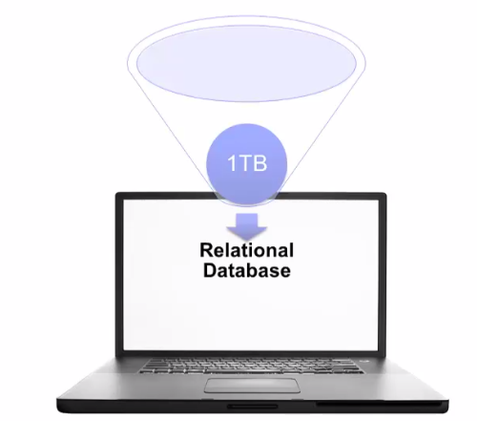
What is Hadoop?

Slide 10


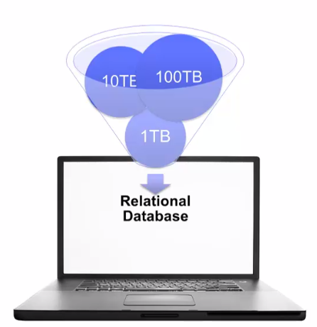
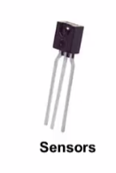

What is Hadoop?

Slide 11
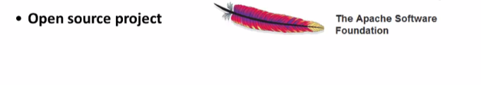
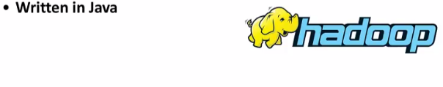






Slide 12
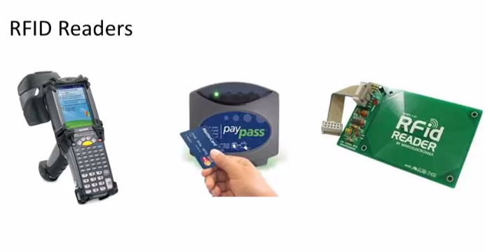
What is Hadoop?

Slide 13
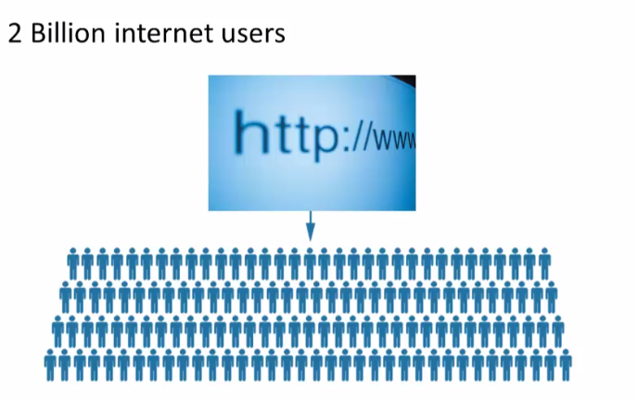
What is Hadoop?

Slide 14
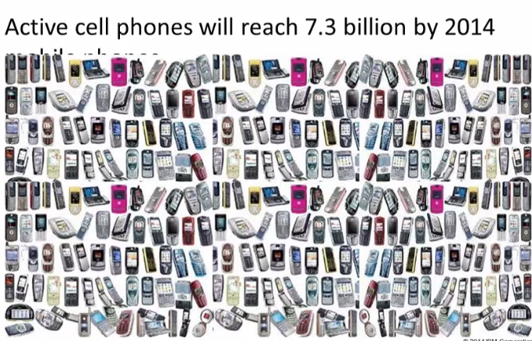
What is Hadoop?

Slide 15
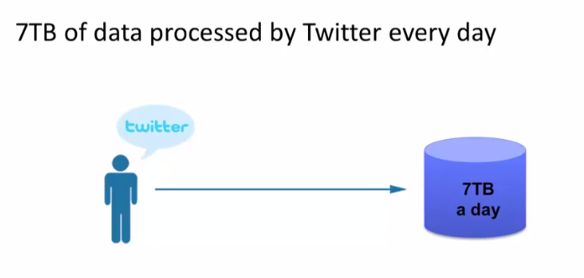
What is Hadoop?

Slide 16
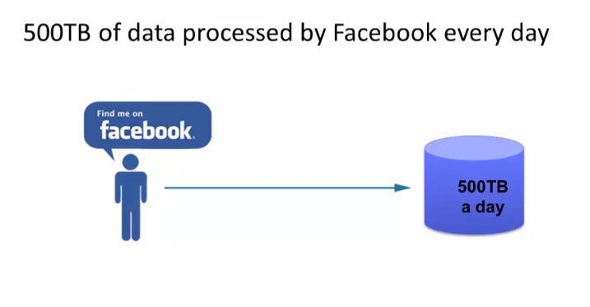
What is Hadoop?

Slide 17
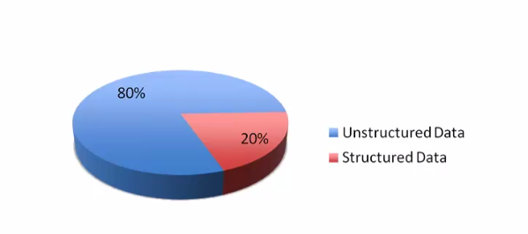
What is Hadoop?
Massive Quantity of data need Fast and Refillable solution to process the data , therefore Big data Solutions like Hadoop More reliable

Slide 18
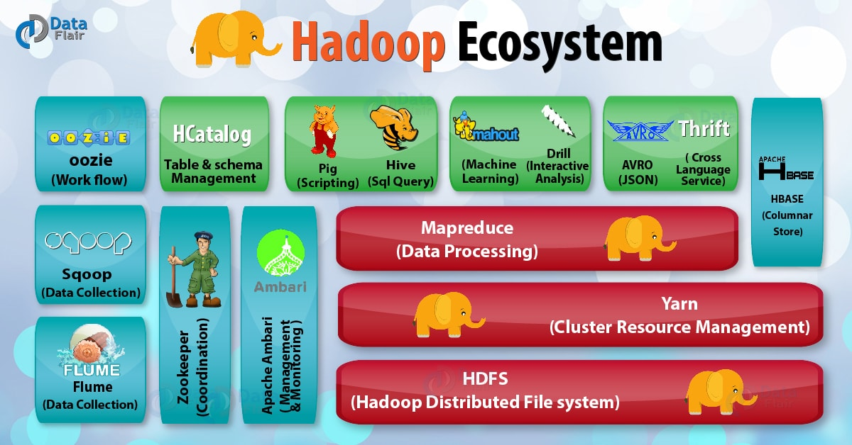
Hadoop related open source projects

Slide 19
Example of Hadoop in action
In the Telecom industries
China Mobile, a company that built a Hadoop cluster to perform data mining on Call Data Records
China Mobile was producing 5-8TB of these records daily
Hadoop-based system they were able to process 10 times as much data as when using their old system, and at one fifth of the cost

Slide 20
Example of Hadoop in action
In the media
we have the New York Times which wanted to host on
their website all public domain articles from 1851 to 1922.
They converted articles from 11 million image files to 1.5TB of PDF documents.
This was implemented by one employee who ran a job in 24 hours on a 100-instance Amazon EC2 Hadoop cluster at a very low cost.

Slide 21
Example of Hadoop in action
In Technology
There are also many internet or social network companies using Hadoop such as Yahoo, Facebook, Amazon, eBay, Twitter, StumbleUpon, Rackspace, Ning, AOL, and so on.
Yahoo is, of course, the largest production user with an application running a Hadoop cluster consisting of approximately 10,000 Linux machines
Yahoo is also the largest contributor to the Hadoop open source project

Slide 22
Hadoop is not a magic bullet that solves all kinds of problems.
Hadoop is not good to process transactions due to its lack random
access.
It is not good when the work cannot be parallelized or when there are
dependencies within the data, that is, record one must be processed
before record two.
It is not good for low latency data access.
Not good for processing lots of small files
And it is not good for intensive calculations with little data

Slide 23
Big Data solutions are more than just Hadoop. They can integrate analytic solutions to the mix to derive valuable information that can combine structured legacy data with new unstructured data.
Big data solutions may also be used to derive information from data in motion.
For example, IBM has a product called InfoSphere Streams that can be used to quickly determine customer sentiment for a new product based on Facebook or Twitter comments

Slide 24
Hadoop on Cloud
Cloud computing has gained a tremendous track in the past few years, and it is a perfect fit for Big Data solutions.
Using the cloud, a Hadoop cluster can be setup in minutes, on demand, and it can run for as long as is needed without having to pay for more than what is used

