Slide 1
DATA MINING & WAREHOUSING MINI PROJECT REPORT ON COVID-19 Tweets Sentiment Analysis
Made By:
Aakash Patil – 41247
Saket Gupta – 41256

Slide 2
Problem Statement
The objective of this mini project is to classify the sentiment a Tweet conveys about the COVID-19 pandemic into the categories Positive, Negative, and Neutral.

Slide 3

Multinomial Naive Bayes:
Naive Bayes classifiers are a family of simple, probabilistic classifiers based on Bayes’ Theorem, which describes the probability of a certain event occurring based on prior knowledge of conditions that might be related to the event.
Naive Bayes is a technique for constructing classifiers, which applies the above theorem with the strong (naive) assumption that the features are largely independent (little to no correlation).
The model assigns the class labels (in this case, Positive, Negative, Neutral) to the problem instances. The model is actually a family of algorithms based on the common principle of the Naive Bayes classifier.

Slide 4
Linear Support Vector Classification:
A Linear Support Vector Classifier plots each data item in the dataset as a point in n-dimensional space (where n is number of features) with the value of each feature being the value of a particular coordinate.
While SVM is typically a binary classification method, a multi-class classification problem can be solved by reducing it to multiple binary classification problems; this is made easy through sklearn’s Linear SVC model.
Mathematically, if the dataset is represented as (⃗x1, y),…, (⃗xn, y) where the yi are either 1 or -1, indicating which class the point xi belongs.
The objective is to find a maximum margin hyperplane that divides the group of points ⃗ xi for which yi = 1 from the group of points for which yi = -1, defined such that the distance between the hyperplane and the nearest point xi from either group is maximised.

Slide 5
Random Forest Classification:
Random forests are an ensemble learning method for classification that operate by constructing a multitude of decision trees at training time and outputting the class that is the mode of the classes.
They solve the overfitting problem that occurs when using Decision Tree classifiers by averaging multiple deep decision trees trained on different parts of the same training set, with the goal of reducing variance. This is called bagging (bootstrap aggregating).
This method leads to better model performance because it decreases the variance of the model, without increasing the bias. This is because while the predictions of a single tree are highly sensitive to noise in its training set, the average of many trees is not.

Slide 6
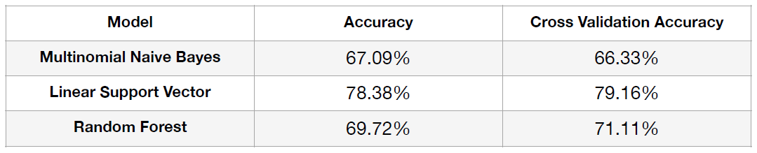
Comparison of Classifiers:

Slide 7
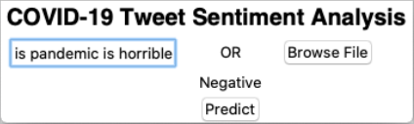
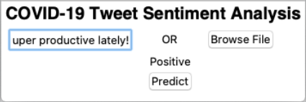

Output:

Slide 8
Applications:
Understanding trio of sentiments (fear-panic-despair) to effectively deploy public service announcements as well as motivational solutions and strategies.
Corporations and small businesses can benefit through such analyses to better understand consumer sentiment and expectations.

Slide 9
Conclusion:
Sentiment Analysis (Classification) for a given Tweet text was successfully performed using 3 different classifiers namely Multinomial Naive Bayes, Linear Support Vector, and Random Forest.
The different classification algorithms behind the methods were understood, along with the concept of cross-validation.
The Linear Support Vector model was found to be the most accurate model for classifying the tweets.

