Slide 1
SOFTWARE TESTING AND QUALITY ASSURANCE MINI PROJECT REPORT ON LIBRARY MANAGEMENT SYSTEM
Made By:
Aakash Patil – 41247
Saket Gupta – 41256

Slide 2
Problem Statement
The objective of this mini project is to
Develop a java application with GUI for Library Management System
To prepare suitable test cases for developed application
Prepare a test report for the application

Slide 3
JUnit:
JUnit is a unit testing framework for Java programming language.
JUnit has been important in the development of test-driven development and is one of a family of unit testing frameworks collectively known as xUnit, that originated with Junit.
Features of Junit:
JUnit is an open-source framework, which is used for writing and running tests.
Provides annotations to identify test methods.
Provides assertions for testing expected results.
Provides test runners for running tests.
JUnit tests allow you to write codes faster, which increases quality.
JUnit is elegantly simple. It is less complex and takes less time.
JUnit tests can be run automatically, and they check their own results and provide immediate feedback.
JUnit tests can be organized into test suites containing test cases and even other test suites.
JUnit shows test progress in a bar that is green if the test is running smoothly, and it turns red when a test fails.

Slide 4
Unit Test Case:
A Unit Test Case is a part of code, which ensures that another part of code (method) works as expected. To achieve the desired results quickly, a test framework is required. JUnit is a perfect unit test framework for Java programming language.
A formal written unit test case is characterized by a known input and an expected output, which is worked out before the test is executed. The known input should test a precondition and the expected output should test a post-condition.

Slide 5
Types of Testing:
Exploratory (Black Box Testing): The purpose of this test is to make sure critical defects are removed before the next levels of testing can start.
Functional Test (White Box Testing): Functional testing will be performed to check the functions of the application. The input is fed and the output from the application is validated.
User Acceptance Test (Integration Testing): This test focusses on validating the business logic. It allows the end user to complete one final review of the system prior to deployment.

Slide 6
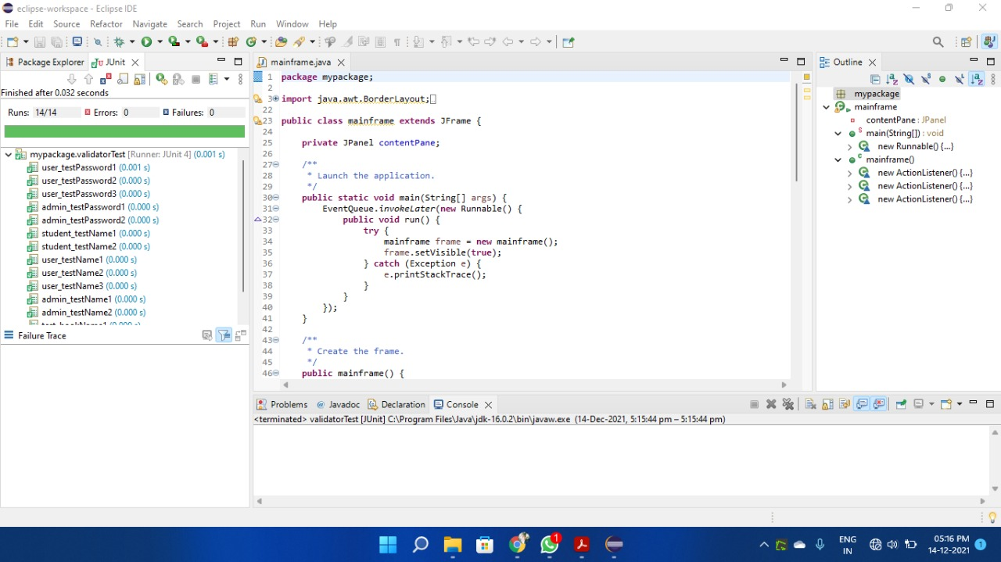
Testing Output:

Slide 7
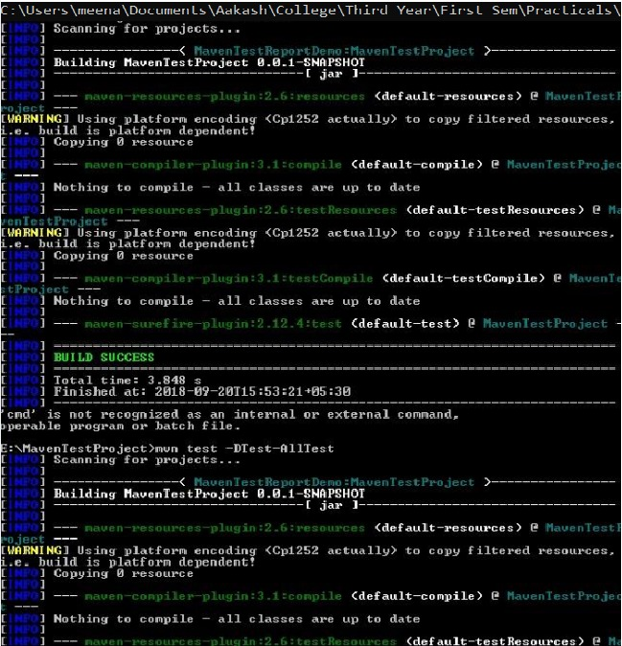
Testing Report:

Slide 8
Conclusion:
Successfully implemented Library Management System and performed the testing using Junit and Maven.
Generated a test case report using maven-sure fire plugin.

