Slide 1
Excitability in Gene Regulatory Networks
Linan Shi’s Undergraduate Thesis (Jun 2, 2022)
Supervisor: Professor Feng Liu, Nanjing University
Oct 12, 2022

Slide 2
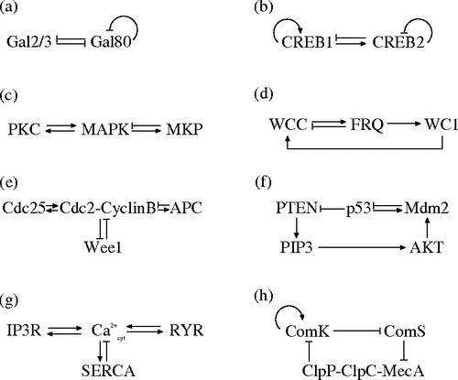
Background: Interlinked Positive and Negative Feedback Loops and Excitability
Interlinked positive and negative feedback loops are universal in biological systems. Different kinds of behaviors can be achieved, such as mono-stability, bi-stability, oscillation and excitability.
Excitability is the ability of systems to enter an excited state quickly in response to a stimulus and to return to the initial state when the stimulus is withdrawn. Two examples: the neuron’s action potential and the Bacillus subtilis competence.
TIAN X J, ZHANG X P, LIU F, et al. Physical Review E, 2009, 80(1): 011926.

Slide 3
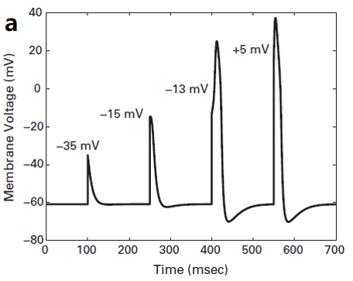
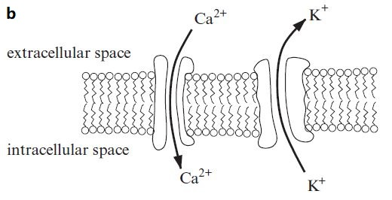
Example: Neuron’s Action Potential
Herris-Lecar model
INGALLS B P. MIT press, 2013.
Notes:
When the potential is raised above a threshold, great amount of Calcium channels will open, let more Calcium inside, and the potential proceed to increase. Then the Potassium channels will open, and let the potassium outside, and the potential will then decrease.

Slide 4
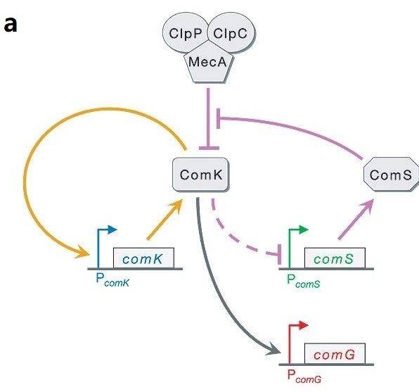
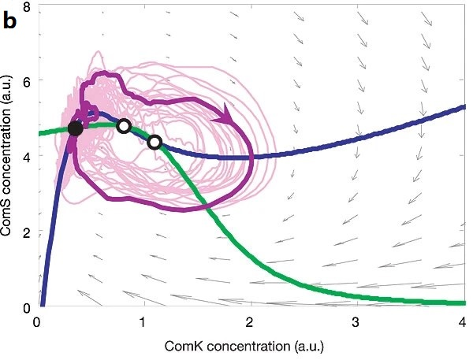
Example: Bacillus Subtilis Competence
SÜEL G M, GARCIA-OJALVO J, LIBERMAN L M, et al. Nature, 2006, 440(7083): 545-550.
Question: How to achieve excitability in a gene regulatory network with 3 nodes?
Notes:
In bacteria competence, gene comK can be self-actived by its product, but they are usually suppressed by MecA complex. If some perturbation activate the system, ComK will significantly increase because of its own positive feedback loop. Then the negative feedback loop will function and drag the system back to rest.

Slide 5
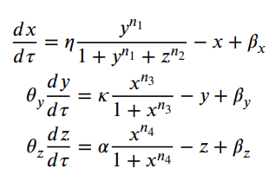
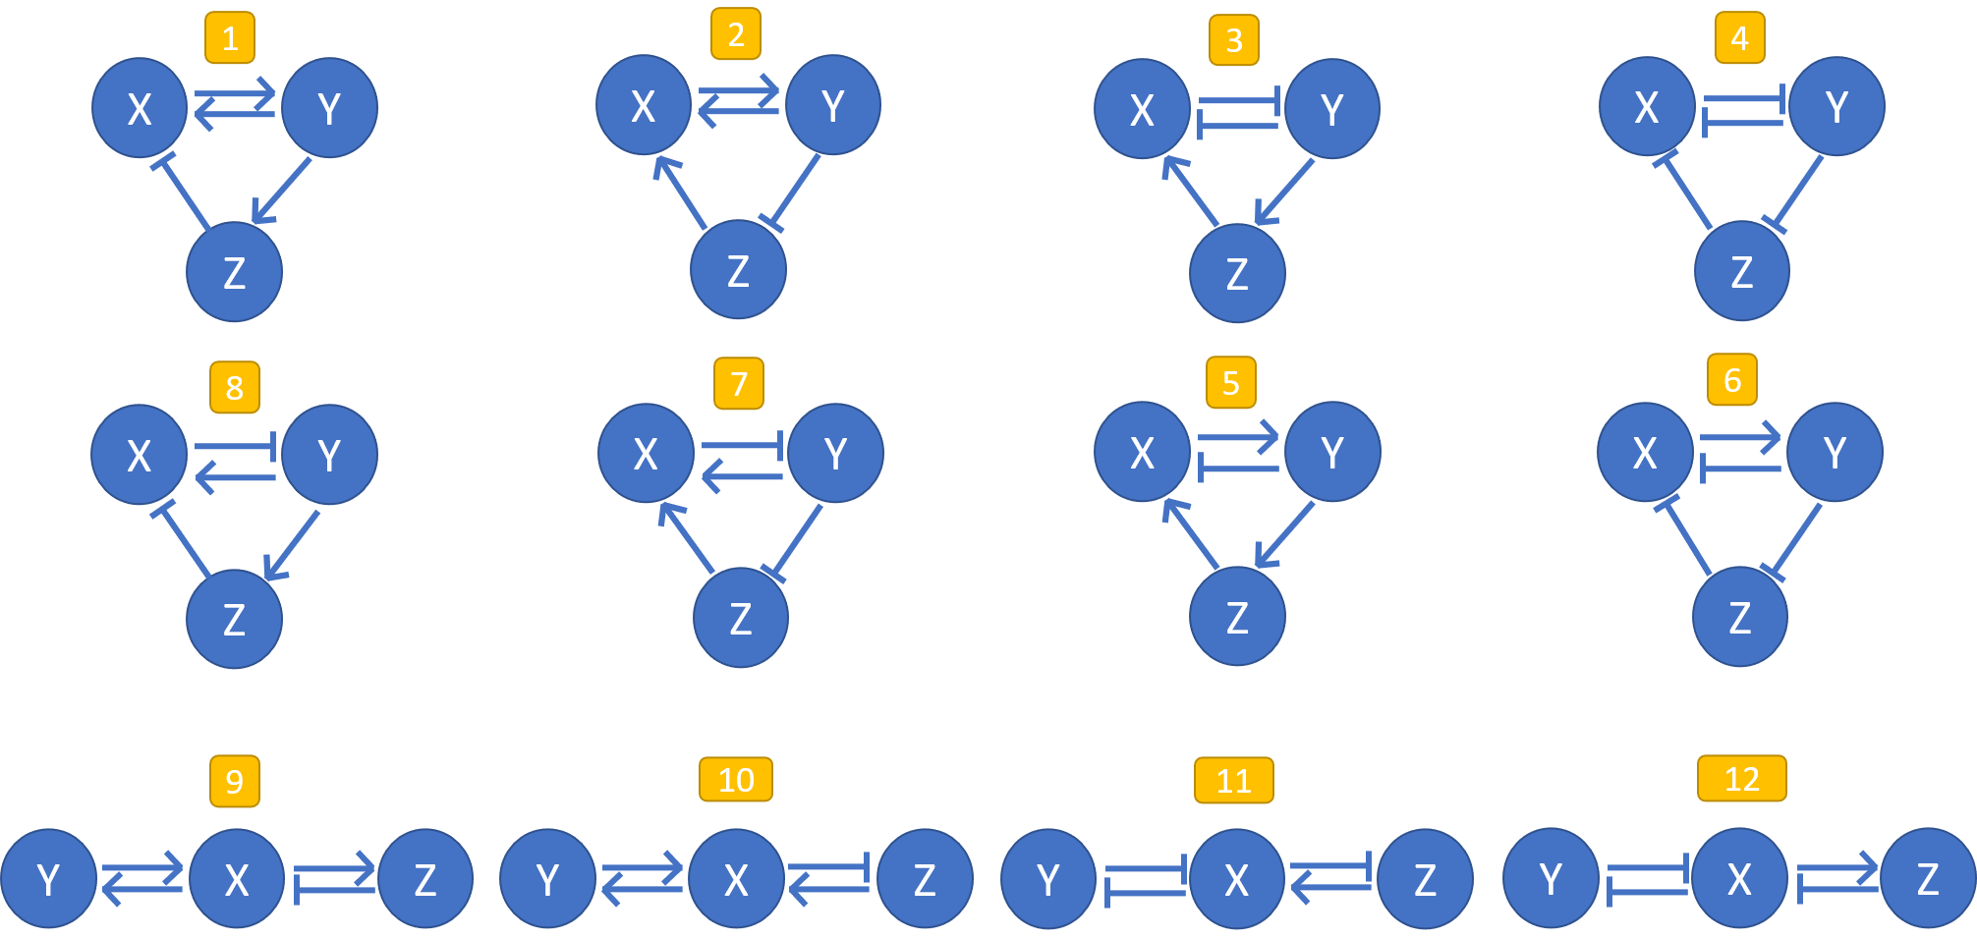
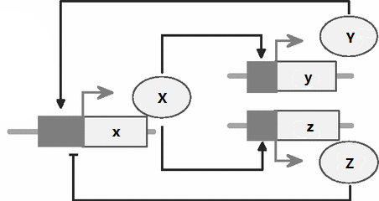
Mathematical Model
The transcription process is regulated. Regulatory proteins’ binding to DNA is considered quasi-static, thus we use Hill-function to describe the binding, and thus the rate of production of protein.
The mRNA was treated quasi-statically as the usual mRNA kinetic time scale is much smaller than its corresponding protein kinetic time scale.
Notes:
Here are 12 different structures of networks. They are aligned by similar structures. We assume that......
Then we can get the ordinary differential equations to describe its dynamics. To reduce the number of parameters to determine, we nondimensionalize the equations. For sufficient non-linear effect to achieve multiple behaviurs, we set the n of Hill-function as 2.

Slide 6
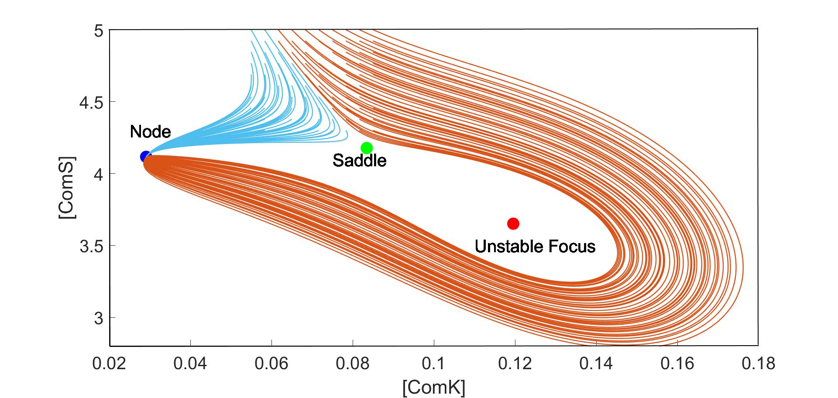
Excitability and Fixed Points
Fixed Points analysis: 3 fixed points – a stable node/focus (rest), a saddle and an unstable focus.
Excitement can be activated by a transient perturbation: the trajectory will cross the stable manifold of the saddle, then cross the unstable focus, and finally returns to the stable fixed point.
Background from: SÜEL G M, GARCIA-OJALVO J, LIBERMAN L M, et al. Nature, 2006, 440(7083): 545-550.
Notes:
If a system is excitable, there should be 3 fixed points: first, …, where the system is at its rest, second, and third

Slide 7
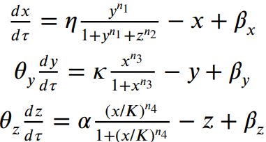
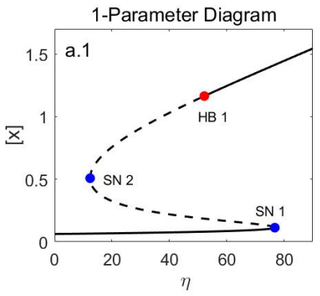
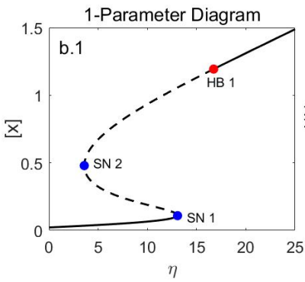
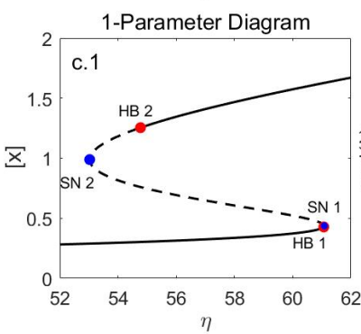
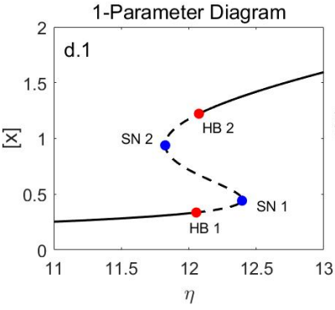
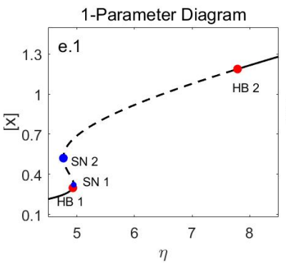
Excitability and 1-Parameter Diagram of Bifurcations
Choose η to draw 1-Parameter Diagram, choose other parameters as random numbers (0.01-100, logspace). (For each network structure among 12, 3 trials, each 100,000 set of random numbers.)
If the relationship of bifurcations on the diagrams looks like the 5 below, it indicates that within a range of η, the system has 3 fixed points: a stable node/focus, a saddle and an unstable focus.
Steady-State Analysis is applied to identify bifurcations and draw these diagrams.
Notes:
How to search for the set of parameters with which the system is excitable? We draw 1-parameter diagram and consider the bifurcation.

Slide 8
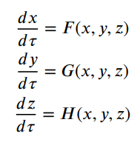
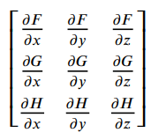
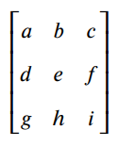

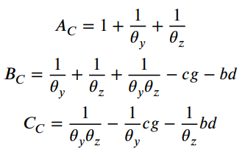

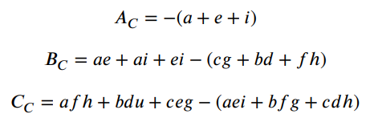

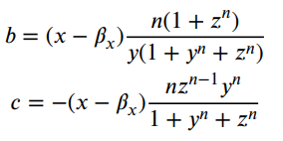
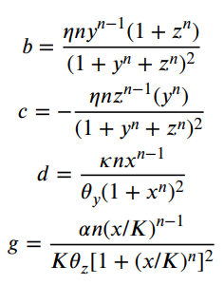
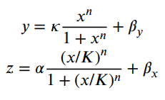
Steady-State Analysis with Jacobian Matrix Near the Fixed Points
Saddle-node bifurcation: λ=0 ↔ C_{C}=0
Hopf bifurcation: λ=0±iω ⬅ A_{C} B_{C} -C_{C}=0
For x in range [0,100]
A_{C}, B_{C}, and C_{C} can be denoted as functions of x (steady), to identify the bifurcations
η can be denoted as a function of x, draw the 1-Parameter Diagram
Notes:
This is the mathematical detail of steady-state analysis with Jacobian matrix near the fixed points, and I would like to skip that. All in all, with this method, we can distinguish bifurcations on the 1-parameter diagram of eta. And then we can decide whether the system is excitable under this set of parameters.

Slide 9
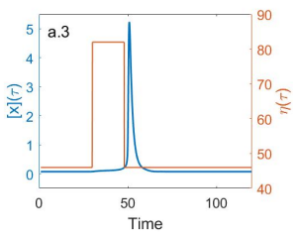
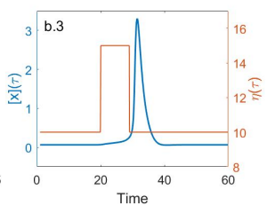
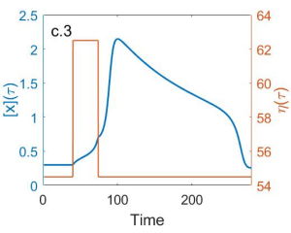
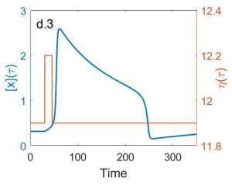
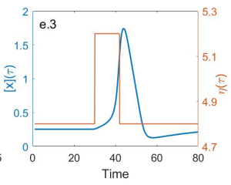
Excitability and 1-Parameter Diagram of Bifurcations
Notes:
The program will give us the set of parameters under which the system is excitable. I interpret the dynamics of excitement of the results from the program.

Slide 10
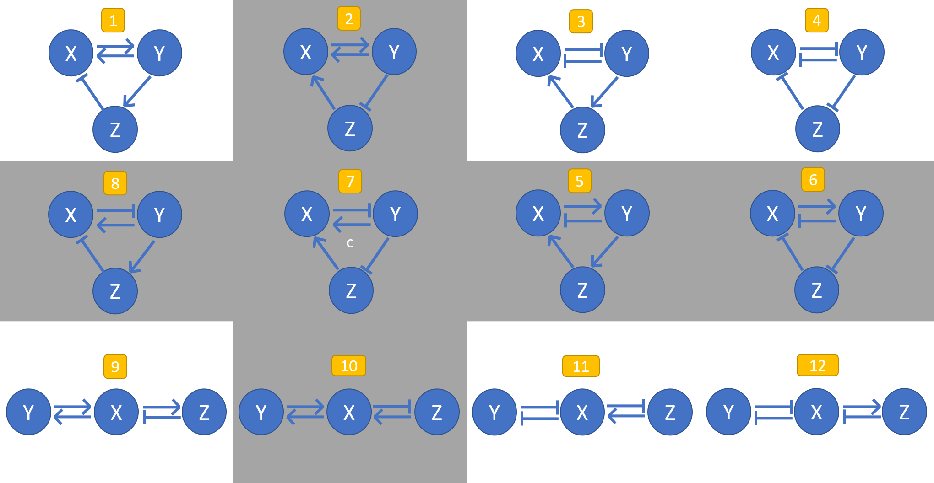
Network structures and excitability
Conclusion:
Six network structures with
(5-8) positive feedback involving three nodes or
(2,7,10) two nodes simultaneously promoting another node
are difficult to achieve excitability, while the others can allow for excitability.
Notes:
After testing 12 different network structures, we draw a conclusion.

Slide 11
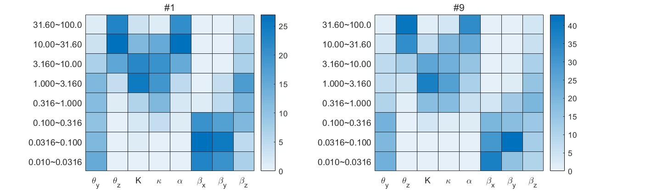
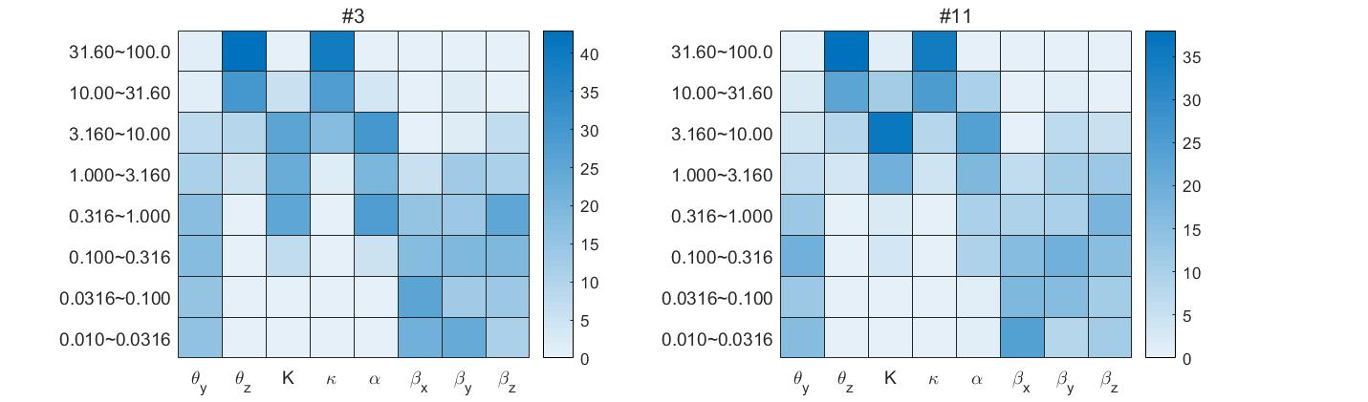
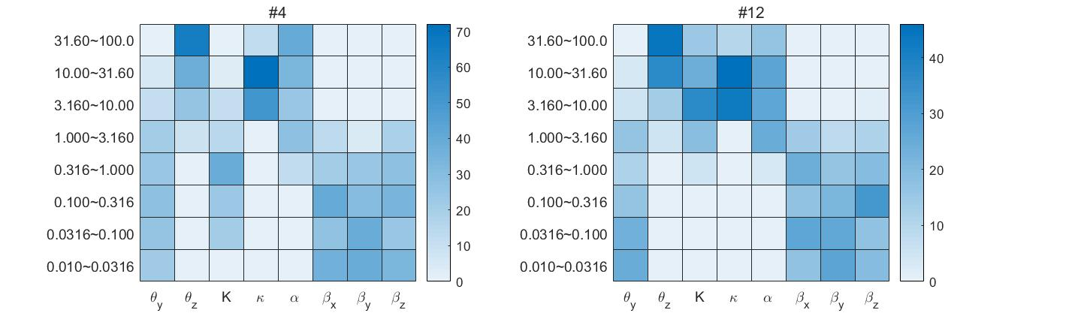
Parameter distribution of Excitable Networks
Notes:
For 6 excitable networks have similar structures, the pattern are similar, too. We can see, for example, for every networks, if theta_y is too big or theta_z is too large, excitability is hard to achieve.

Slide 12
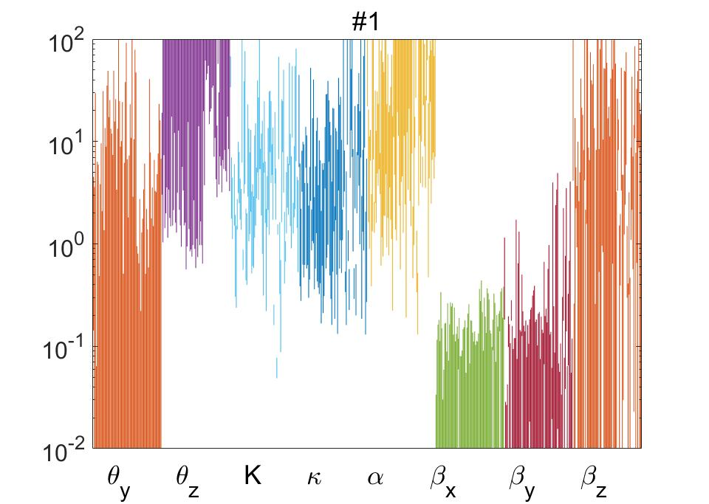
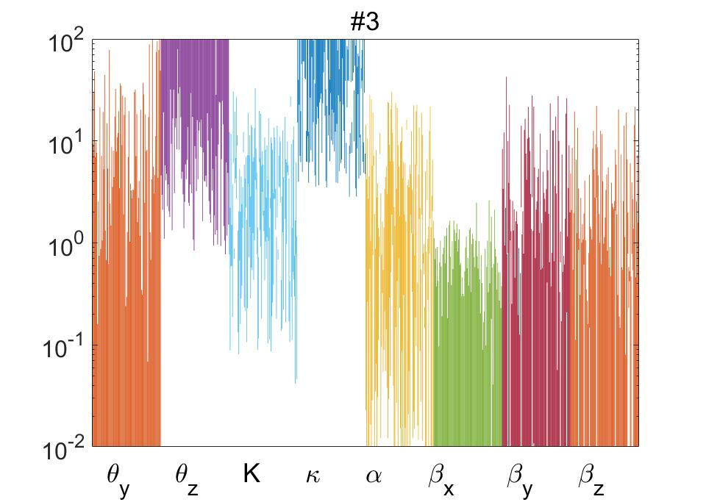
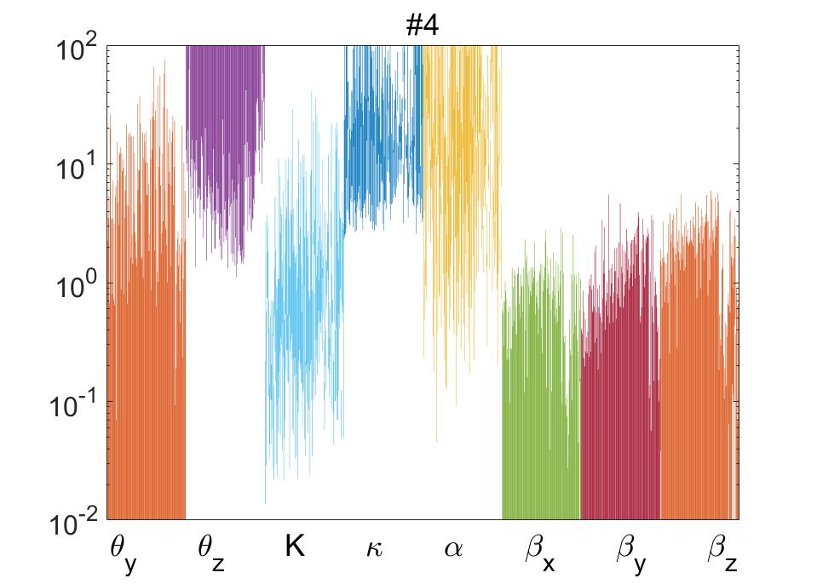
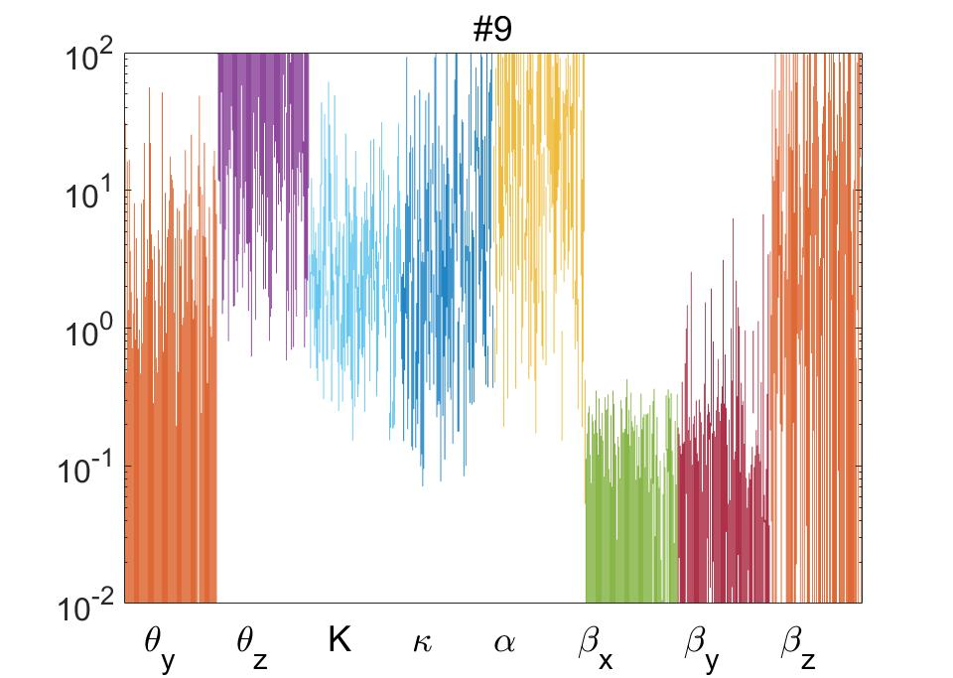
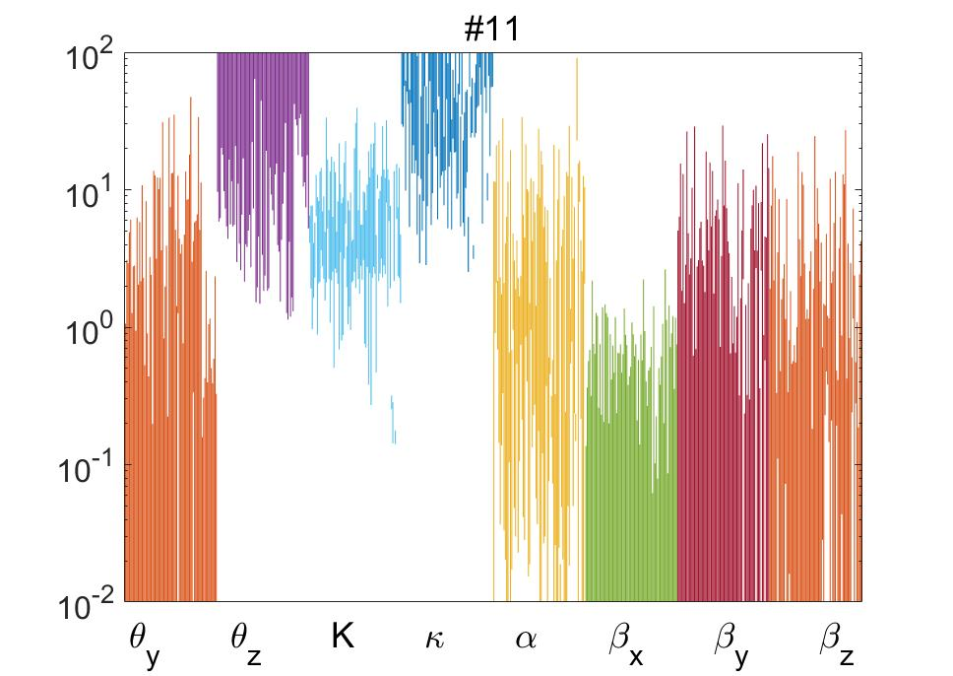
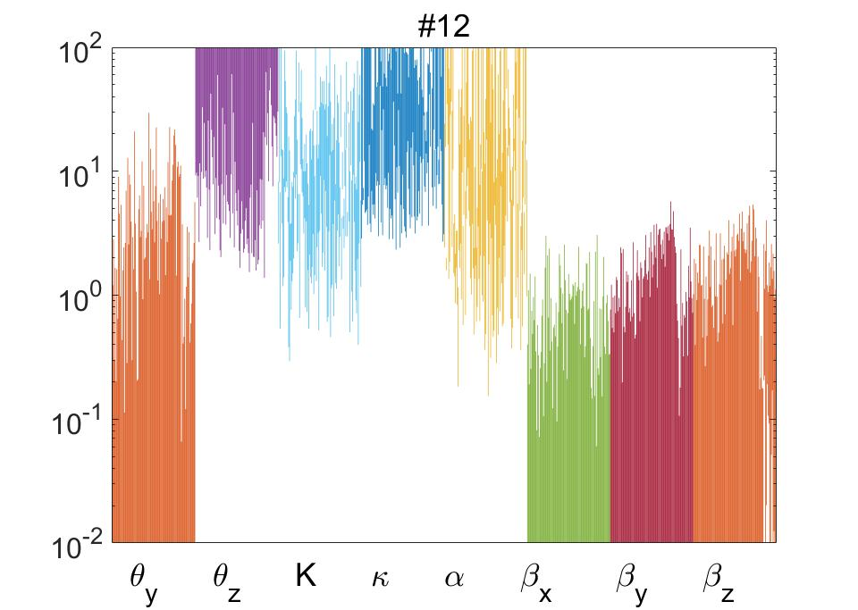
Parameter Sensitivity of Excitable Networks
Notes:
With a set of excitable parameters, we change the value of each parameter and see whether the 1-parameter diagram changes qualitatively, that is, whether a range of eta allows for excitability still exists. We can see that for all networks, a smaller theta_y is safe, while a bigger theta_z is safe. Also, for networks of similar structures, the patterns are similar, too.

Slide 13
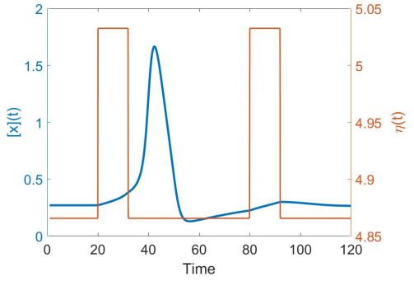
Hyperpolarization and Refractory Period
Stable fixed point: stable node or stable focus
Stable node: eigenvalues of Jacobian matrix are negative real numbers
Stable focus: eigenvalues of Jacobian matrix include conjugate complex roots, and real parts of all eigenvalues are negative
Notes:
Two different kinds of stable fixed point affect the behaviour. For a stable node, …. For a stable focus, ….

Slide 14
Hyperpolarization and Refractory Period
If stable fixed point is a focus but not a node, vector filed circles around the stable fixed point, hyperpolarization (draw on the black board)
During hyperpolarization, refractory period, restrict the frequency of excitement (e.g. neuron’s action potential )
Notes:
During hyperpolarization, there is a refractory period, when the system is harder to activate. This restricts the frequency of excitement (e.g. neuron’s action potential )

Slide 15
Excitability under Intrinsic Noise
In biological systems, the intrinsic noise due to factors such as transcription can be ignored because the number of expressed proteins is relatively large and the dynamical properties of many networks are mainly regulated by the expression mean. But in some situations, we cannot ignore the effect of intrinsic noise…
To analyse intrinsic noise, we cannot treat mRNA as quasi-static any more, based on the fact that stochasticity of transcription plays a much more important role than stochasticity of translation.
Regulatory proteins’ binding to DNA is still treated as quasi-static.
Use Gillespie algorithm to simulate all 15 reactions of transcription and translation in a 3-node network.

Slide 16
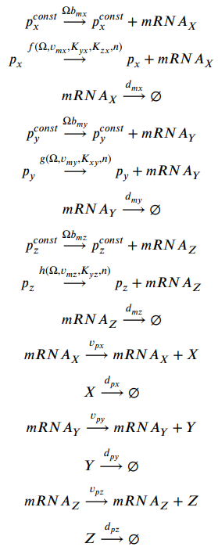
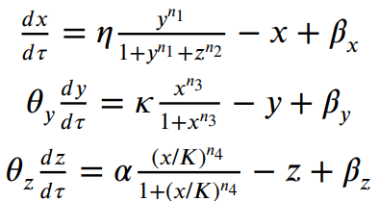
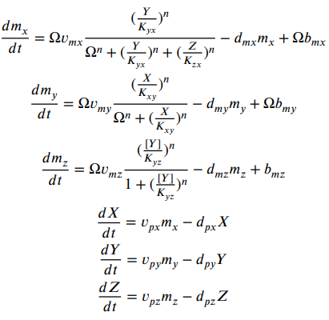
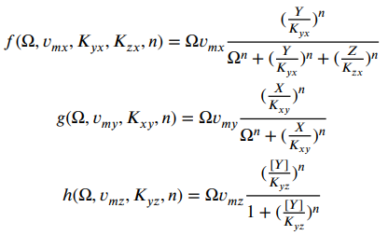
Excitability under intrinsic noise
New parameters to decide (former parameters only gives the relationship between those new parameters). I refer to a paper of my reference to choose them.
Notes:
If we split the systems by transcription and translation, there will be new parameters to decide. The former parameters for the nondimensionalized quasi-static equations only give the relationship of those parameters for transcription and translation.

Slide 17
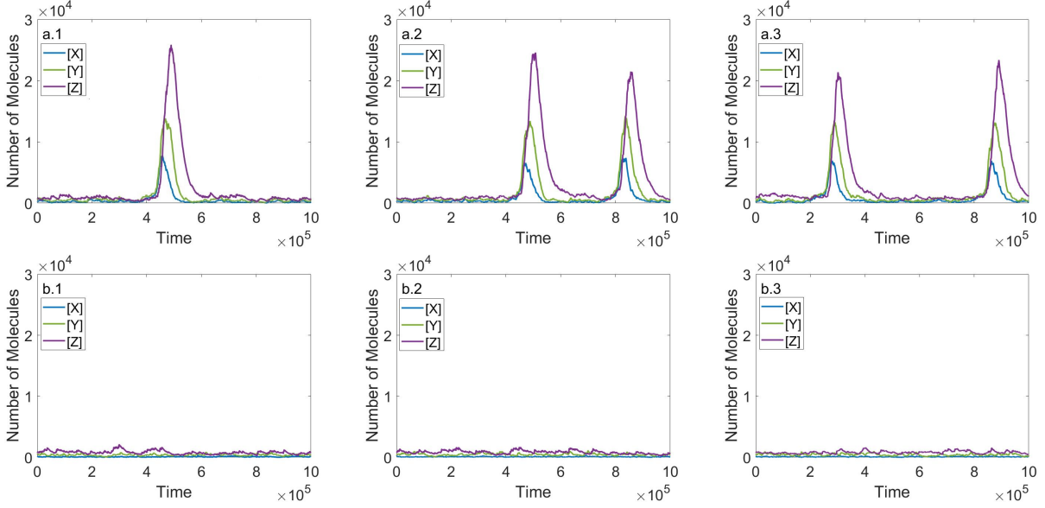
Fixed Points and Activation of auto-excitement
𝑣_{mx} = 0.07 (η=14): Stable node near “excited” side of the saddle, easier for auto-excitement
𝑣_{mx} = 0.037 (η=7.5): Stable node far from “excited” side of the saddle, no auto-excitement
Notes:
If the stable fixed point is near the “excited” site of the saddle, the system is easier for auto-excitement, which means excitement triggered by only intrinsic noise. The two lines only differ from the value of vms, which means eta.

Slide 18
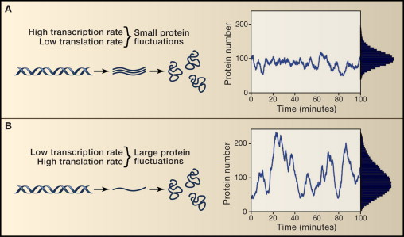
Rates of transcription and translation and intrinsic noise
×m
Same Mean
×n
When the transcription rate is high, variability in protein levels is low (A), but when the transcription rate is lowered and the translation rate is raised, gene expression is far noisier (B), even at the same mean (Ozbudak et al. (2002))
Notes:
… In my model, mathematically, if we multiply all rates of transcription by m, or multiply all rates of translation by n, the mean of the steady state of the system will not change.

Slide 19
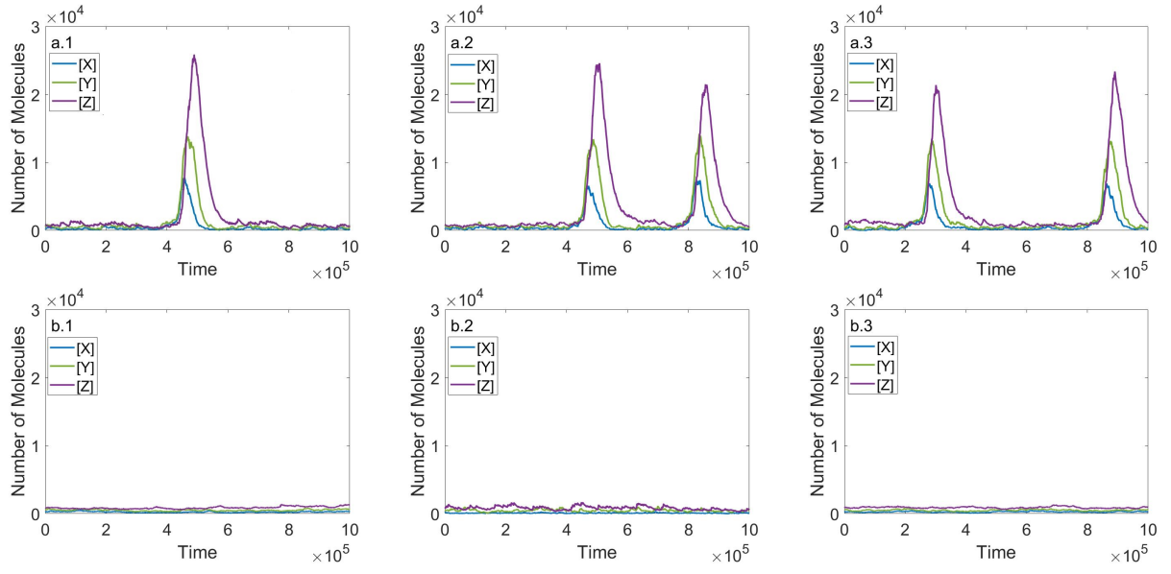
Rates of transcription and translation and intrinsic noise
Transcription: ×0.5 Translation: ×2, easier for auto-excitement
Transcription: ×1 Translation: ×1, no auto-excitement
Notes:
For the first line, the transcription rates are 0.5 fold of the second line, while the translation rates are 2 folds of the second line, the system is noisier, and easier for auto-excitement.

Slide 20
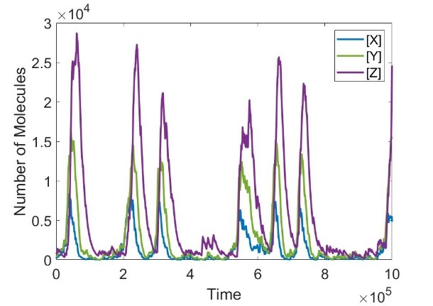
Rates of transcription and translation and intrinsic noise
Transcription: ×0.5 Translation: ×2
Transcription: ×0.25 Translation: ×4
A lot of auto-excitement
Transcription: ×1 Translation: ×1
Notes:
The slower the transcription is, while the faster the translation is, the noisier the system will be.

Slide 21
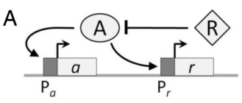
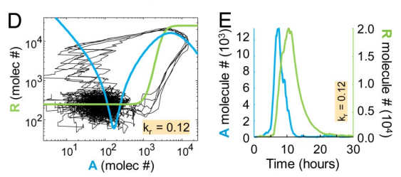
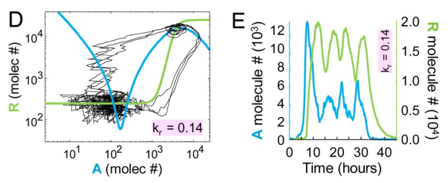
A genetic timer induced by intrinsic noise
Marc Turcotte et al. constructed a genetic timer with network interlinked PFL & NFL. (The timer behaviour is achieved by intrinsic noise, and can’t be achieved in deterministic models!)
The unstable state is stabilized by intrinsic noise: Normally trajectories cross the unstable focus and heads to the rest state directly, but under certain conditions, the trajectories may circle around the unstable focus for several times.
Similar time spend for each circle, polymodal distribution of duration time.
This new behaviour may be an inspiration in synthetic biology.

Slide 22
A genetic timer induced by intrinsic noise
Mathematical essence for a genetic timer:
Able to trigger auto-excitement: appropriate relative rates for transcription and translation, “excited site” of the saddle sufficiently near the stable state.
Small absolute value for the conjugate eigenvalues of the unstable focus: more likely to “circle around”
With this information, I can also build a genetic timer in my 3-node network by simple steps of adjusting parameters.
Explain an example on the blackboard.

Slide 23

A genetic timer induced by intrinsic noise

Slide 24
Summary
Constructed mathematical model of 3-node genetic networks of interlinked PFL and NFL (Regulated on transcription level)
Fixed points and excitability.
Among 12 structures, only 6 structures are excitable.
Parameter distribution of excitable networks.
Stable fixed point: node or focus. Focus: hyperpolarization and refractory period.
Intrinsic noise and auto-excitement: relationship between fix points.
Intrinsic noise and auto-excitement: relationship between rates of transcription and translation.
Intrinsic noise to achieve a “genetic timer”.

Slide 25
thanks

