Slide 1

Clustering Solar Energy
Production Zones
A Machine Learning Approach for Strategic Solar Market Analysis
Author: Shijan Shiby | Organization: Spinnaker Analytics | Domain: Data Science & AI
Internship Project Report

Slide 2






Table of Contents
01
Project Overview & Objectives
06
Energy Production Zones
02
Dataset Overview & EDA
07
Interactive Map Visualization
03
Data Preprocessing & Features
08
Business Recommendations
04
Clustering Algorithms
09
Conclusion & Next Steps
05
Algorithm Comparison & Results

Slide 3

Project Overview
Objective: Leverage solar project data to cluster geographical areas (NY counties) by energy production, enabling strategic decision-making for Spinnaker Analytics.
Strategic Targeting
Project Feasibility
Data-Driven Decisions
Identify high-potential regions for focused sales & marketing efforts
Pre-identify areas with high historical production for client proposals
Insights into solar variability to guide project allocation and deployment
Key Deliverables
Clustering Algorithm Implementation
Interactive Map Visualization
Project Report & Recommendations
Jupyter Notebook Submission

Slide 4
Dataset Overview
218,115
17
62
7
Solar Projects
Features
NY Counties
Utilities
Key Dataset Features
Feature | Type | Description
County / City / Zip | Geographic | Location identifiers for clustering
Estimated Annual PV Energy (kWh) | Target | Primary clustering variable
Estimated PV System Size (kWdc) | Numeric | System capacity in DC kilowatts
PV System Size (kWac) | Numeric | System capacity in AC kilowatts
Utility | Categorical | 7 utilities across New York State
Developer | Categorical | Solar project developer/installer
Interconnection Date | Date | Date project was connected to grid

Slide 5
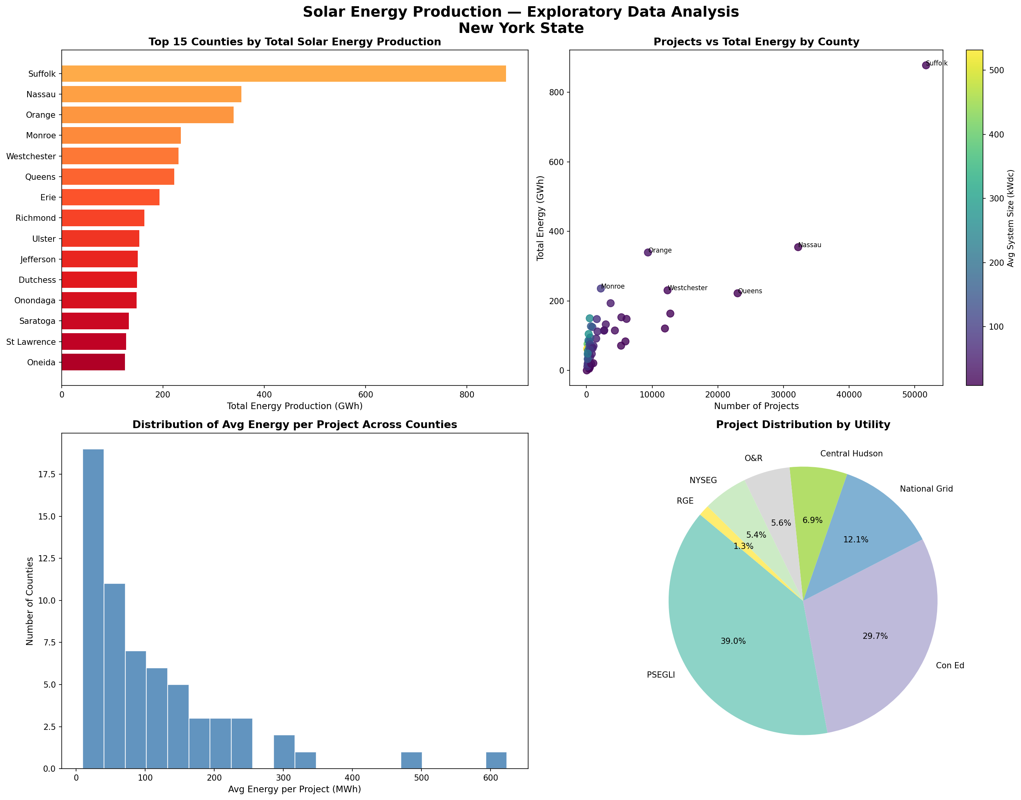
Exploratory Data Analysis

Slide 6
Data Preprocessing & Feature Engineering
Data Cleaning Steps
Engineered Features (County Level)
Filled missing Developer & City/Town → 'Unknown'
total_energy_kwh
Sum of all energy production
Dropped Energy Storage column (98% missing)
avg_energy_kwh
Mean energy per project
Removed 3 rows with missing Project ID
total_projects
Count of solar projects
Parsed Interconnection & Data Through dates
avg_system_size_kw
Mean PV system size (kWdc)
total_capacity_kw
Total installed capacity
Removed top 0.1% energy outliers
energy_per_project
Derived: energy efficiency proxy
Standardized features with StandardScaler
capacity_per_project
Derived: avg project scale

Slide 7
Clustering Algorithms Explored
K-Means
Hierarchical
DBSCAN
✅ Best
✅ Good
❌ Poor fit
Pros:
Pros:
Pros:
Fast & scalable
No k required upfront
Finds arbitrary shapes
Interpretable clusters
Dendrogram visualization
Handles noise/outliers
Well-defined zone boundaries
Ward linkage = compact clusters
Cons:
Deterministic with fixed seed
Cons:
Only 1 cluster found
Cons:
Slower on large data
NY counties too uniform in density
Requires pre-set k value
Cannot reassign points
Sensitive to outliers
k=4, Silhouette=0.431
k=4, Silhouette=0.416
1 cluster, 4 noise pts

Slide 8
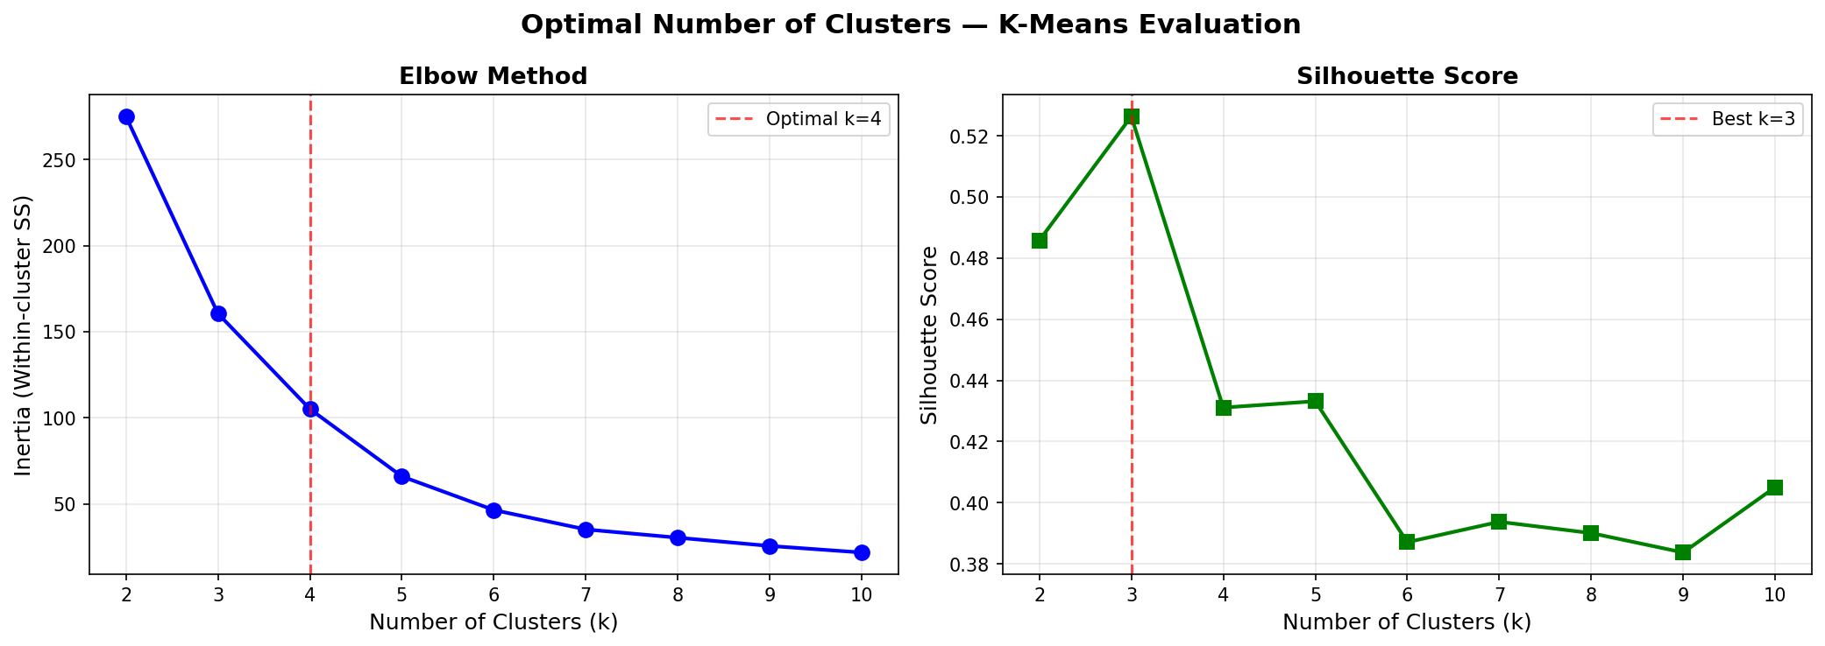
Algorithm Comparison & Model Selection
Evaluation Metrics
Metric | K-Means | Hierarch.
Silhouette ↑ | 0.4311 ✅ | 0.4163
Davies-Bouldin ↓ | 0.5317 ✅ | 0.5519
Calinski-Harabasz ↑ | 60.54 ✅ | 59.33
Interpretability | High ✅ | High ✅
Speed | Fast ✅ | Moderate
🏆 Winner: K-Means (k=4)
Best scores across all 3 metrics
Why k=4? Silhouette score peaks at k=3 (0.526), but k=4 provides superior business interpretability — four distinct strategic zones (Premium, High Volume, Moderate, Emerging) align directly with Spinnaker's sales & planning framework.

Slide 9
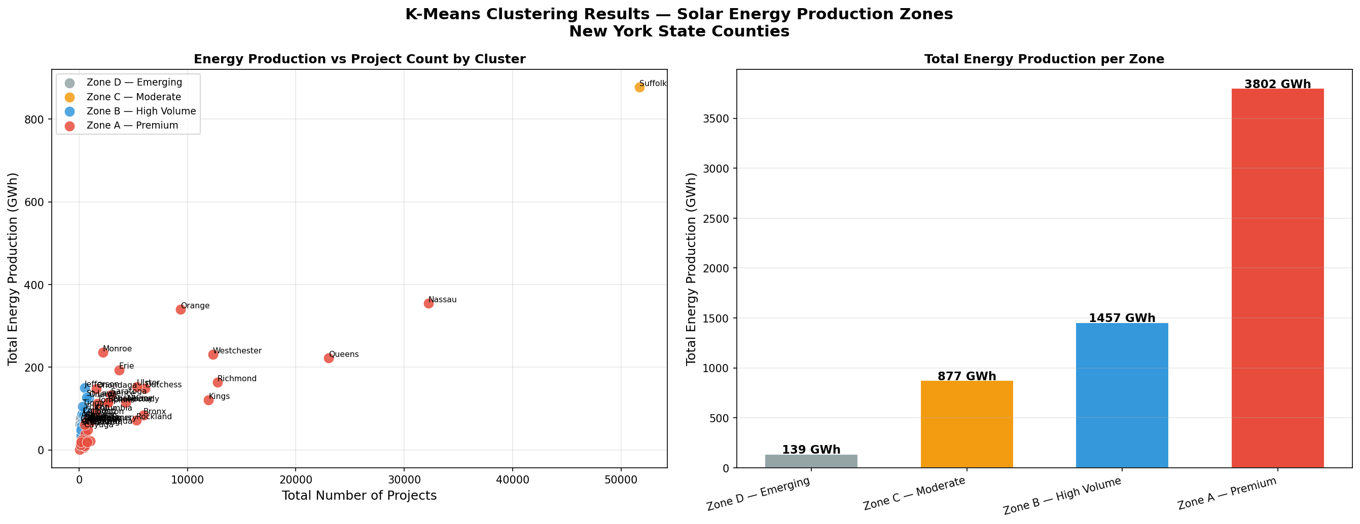
K-Means Clustering Results

Slide 10
Solar Energy Production Zones
Zone
A
Premium
Zone
B
High Volume
▸ 39 counties
▸ 20 counties
▸ 3,802 GWh total
▸ 1,457 GWh total
▸ 158,350 projects
▸ 7,790 projects
▸ 42.5 kW avg
▸ 166.8 kW avg
Albany, Erie, Nassau, Westchester...
Jefferson, Oneida, Oswego, Steuben...
Zone
C
Moderate
Zone
D
Emerging
▸ 1 counties
▸ 2 counties
▸ 877 GWh total
▸ 139 GWh total
▸ 51,712 projects
▸ 260 projects
▸ 14.5 kW avg
▸ 468.8 kW avg
Suffolk (standalone market)
Allegany, Lewis

Slide 11
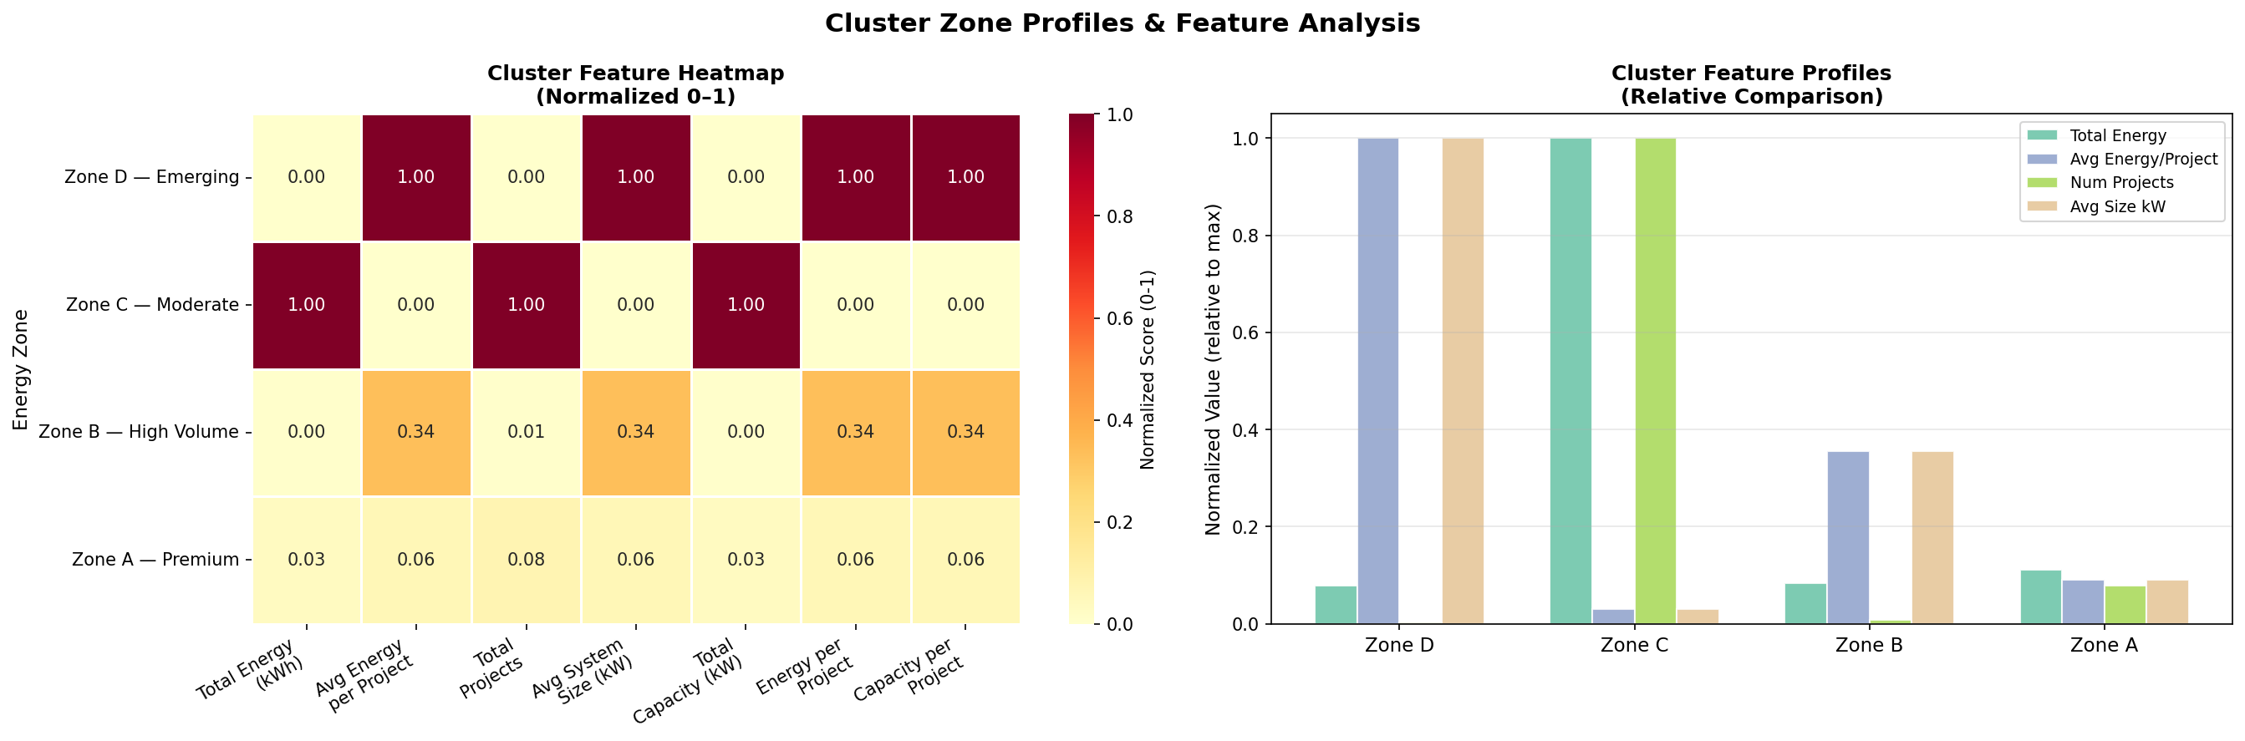
Cluster Feature Heatmap & Zone Breakdown

Slide 12

Interactive Map Visualization
Zone Legend
Zone A — Premium
39 counties
Zone B — High Volume
20 counties
Zone C — Moderate
1 county
Interactive Plotly Choropleth Map
Zone D — Emerging
2 counties
All 62 NY counties color-coded by
Solar Energy Production Zone
Built with Plotly Express using NY county FIPS codes & GeoJSON data. Fully interactive in Jupyter Notebook.
Hover over each county for: Total Energy (GWh), Project Count, Avg System Size

Slide 13
Business Recommendations
Zone A — Premium — Prioritize Immediately
Zone B — High Volume — Commercial Focus
Deploy dedicated sales teams in Nassau, Erie, Westchester, Queens
Target industrial & commercial clients (high avg system size)
Focus on solar expansions & system upgrade proposals
Partner with local utilities and established developers
Target utility-scale & commercial installation clients
Conduct feasibility studies for utility-scale projects
Zone C — Moderate — Suffolk Strategy
Zone D — Emerging — Long-term Growth
Suffolk is a standalone market with 51,712 projects
Low competition — establish early presence now
Invest in community solar, residential, and NEM programs
Run feasibility pilots in Allegany & Lewis counties
Focus on storage, upgrades & incentive programs
Engage municipalities for solar incentive programs
💡 Cross-Zone: Allocate 70% of sales budget to Zone A | Use Zone B for B2B enterprise | Enrich future data with GHI/DNI irradiance for precision clustering

Slide 14


Conclusion & Next Steps
218,115 NY solar projects successfully clustered into 4 actionable production zones
K-Means outperformed Hierarchical & DBSCAN across all evaluation metrics
Zone A (39 counties) identified as top priority market for Spinnaker
Interactive Plotly map enables county-level exploration of results
Next Steps
Shijan Shiby
Enrich dataset with solar irradiance (GHI/DNI) data
Data Analyst Intern
Spinnaker Analytics
Build Power BI / Tableau dashboard for stakeholders
Track zone migration year-over-year
Deploy model as a REST API for real-time scoring

