Slide 1
COMP3011 COURSEWORK 1 – INDIVIDUAL WEB SERVICES API DEVELOPMENT PROJECT
Housing Data API for UK Rental and Sales Analysis
A RESTful API for UK housing data with lookup, analytics, authentication, and testing support
Shirui Zhao
2026-03-12

Slide 2


COMP3011 COURSEWORK 1 – INDIVIDUAL WEB SERVICES API DEVELOPMENT PROJECT
Problem and Motivation
UK housing data is spread across multiple sources
Raw datasets are not easy to query directly
Users need a clean API for lookup, filtering, and trend analysis
Build a RESTful, data-driven API
Support both official data and user-managed records
Emphasise good API design, database integration, testing, and documentation
Shirui Zhao
2026-03-12

Slide 3
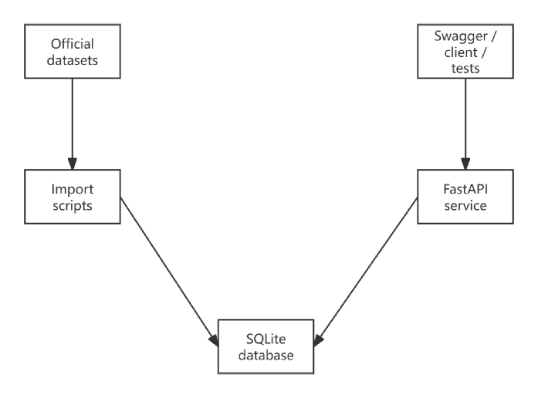
COMP3011 COURSEWORK 1 – INDIVIDUAL WEB SERVICES API DEVELOPMENT PROJECT
Data Sources and System Overview
Reference data: areas, postcode mapping
Official datasets: rent statistics, sales transactions
User data: user-submitted rental/sales records
Designed as a database-backed REST API with clear separation between data ingestion, service logic, and API routing.
Shirui Zhao
2026-03-12

Slide 4
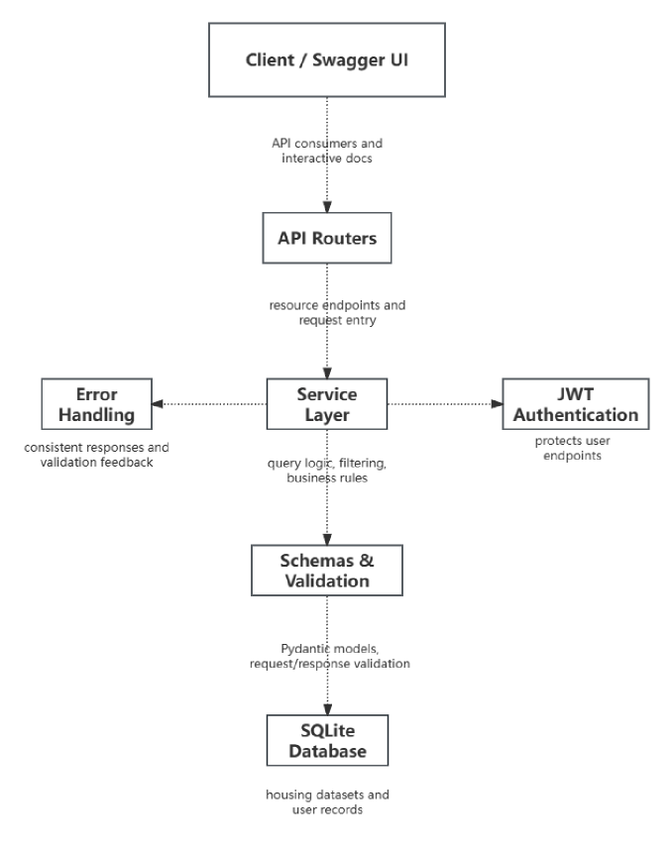
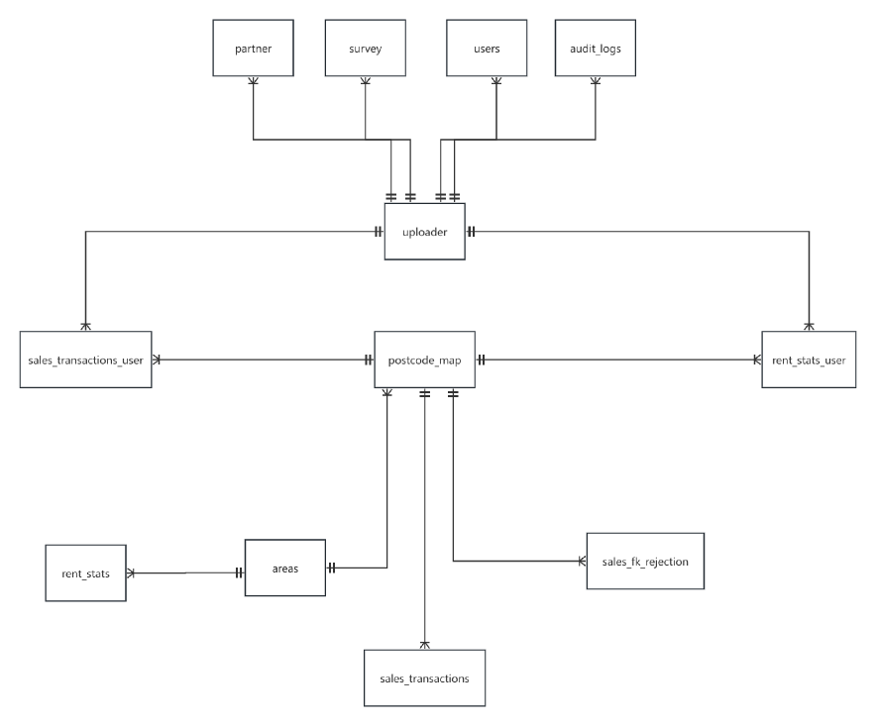
COMP3011 COURSEWORK 1 – INDIVIDUAL WEB SERVICES API DEVELOPMENT PROJECT
Database And Architecture Design
Shirui Zhao
2026-03-12

Slide 5
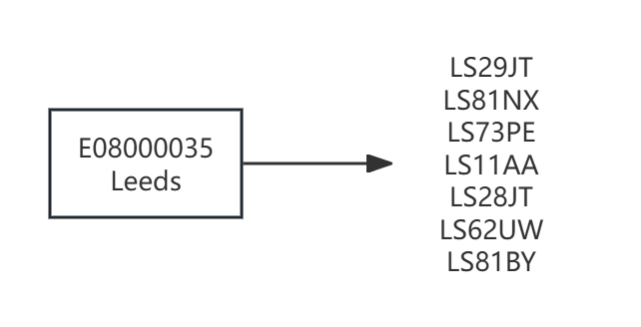
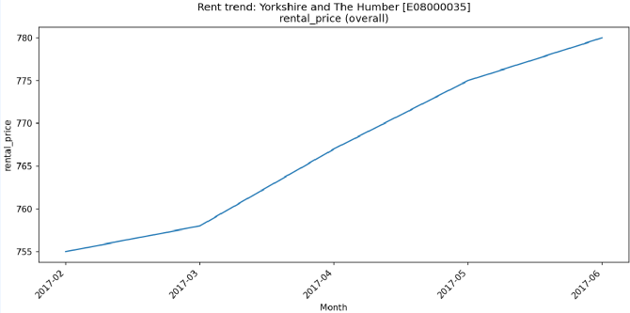
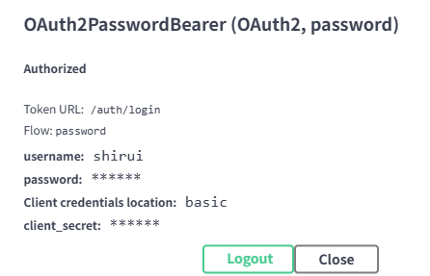
COMP3011 COURSEWORK 1 – INDIVIDUAL WEB SERVICES API DEVELOPMENT PROJECT
API Design Highlights
A
B
C
Reference Geography
Official Statistics
User Records & Auth
GET /AREAS
GET /AREAS/{AREA_CODE}
GET /POSTCODE_MAP/{POSTCODE}
Rent statistics by area and period
Sales transaction queries and summaries
Read-oriented access to official datasets
POST /register
POST /login
Protected CRUD for user records
Reference lookup for areas and postcode mapping
Authenticated operations for user-managed data
/rent_stats_official/areas/{area_code}/rent-trend.png
Shirui Zhao
2026-03-12

Slide 6
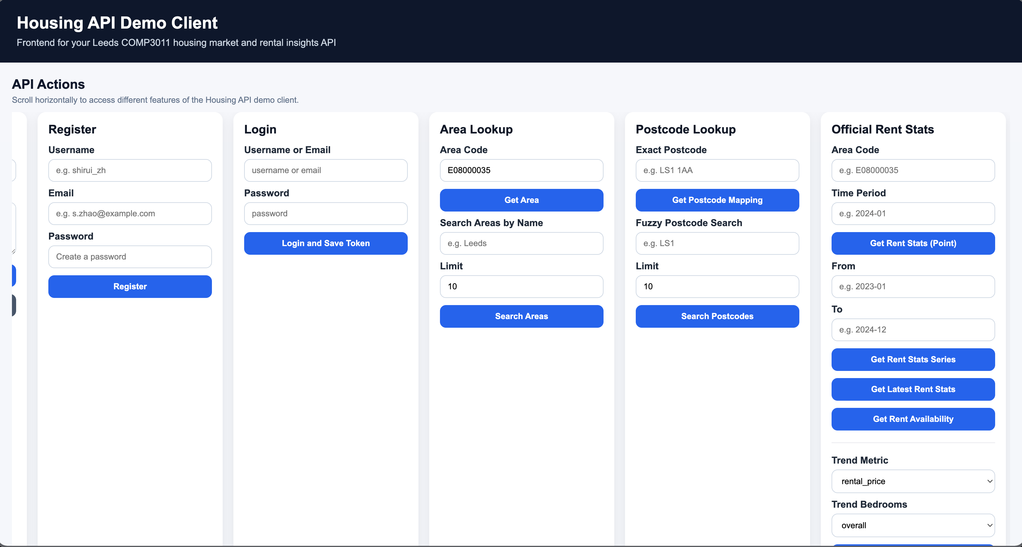
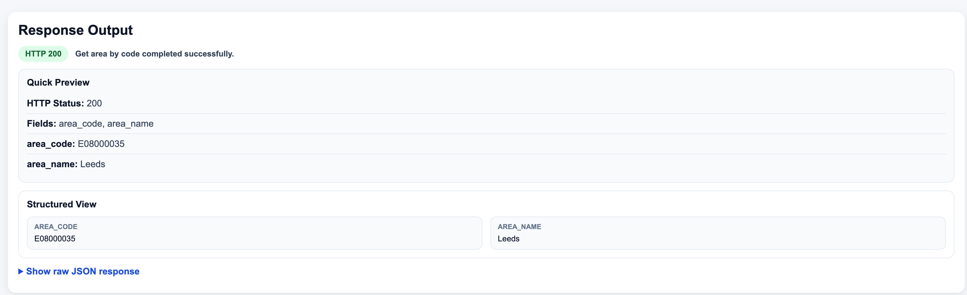
COMP3011 COURSEWORK 1 – INDIVIDUAL WEB SERVICES API DEVELOPMENT PROJECT
Frontend Interface
Key Points
Lightweight web interface built on top of the same FastAPI backend
Supports human-centred exploration beyond raw Swagger/API calls
Demonstrates selected workflows such as lookup, analytics, and user interaction
Thin client layer: presentation logic separated from backend service logic
Shirui Zhao
2026-03-12

Slide 7
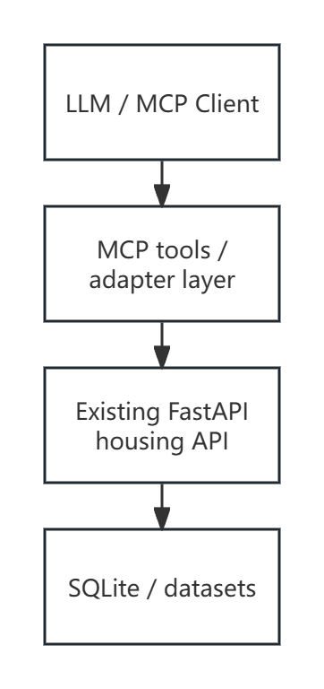
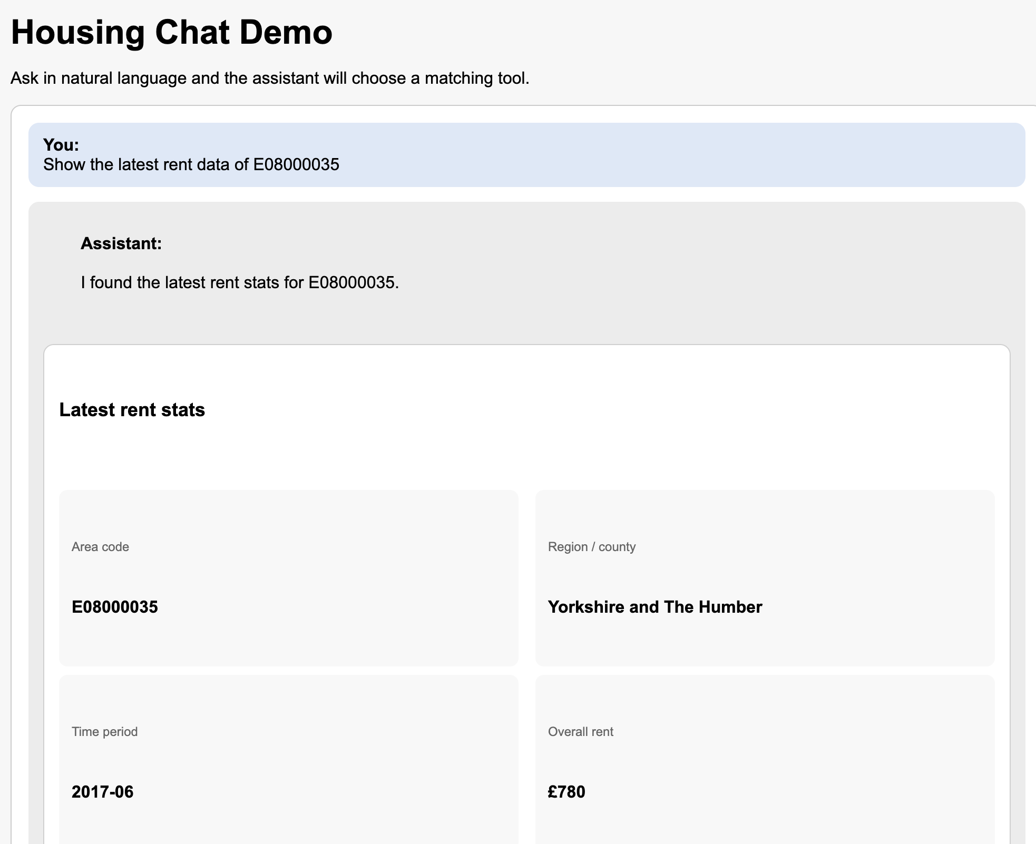
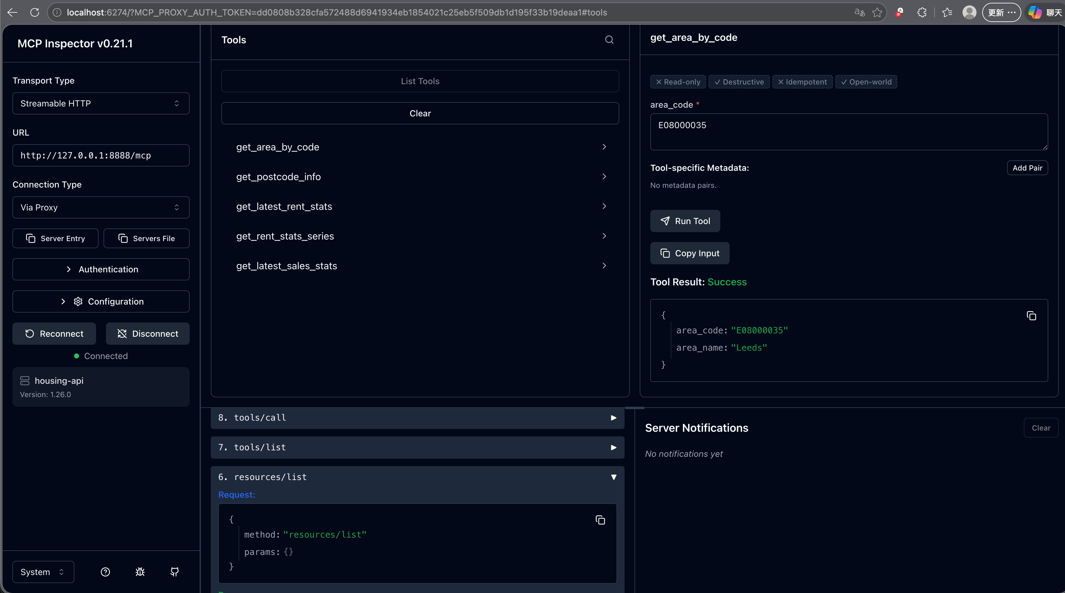
COMP3011 COURSEWORK 1 – INDIVIDUAL WEB SERVICES API DEVELOPMENT PROJECT
MCP Integration
Exposes selected housing-data capabilities through a tool-oriented interface
Reuses existing backend logic rather than creating a separate service stack
Shows extensibility beyond conventional REST consumption
Shirui Zhao
2026-03-12

Slide 8
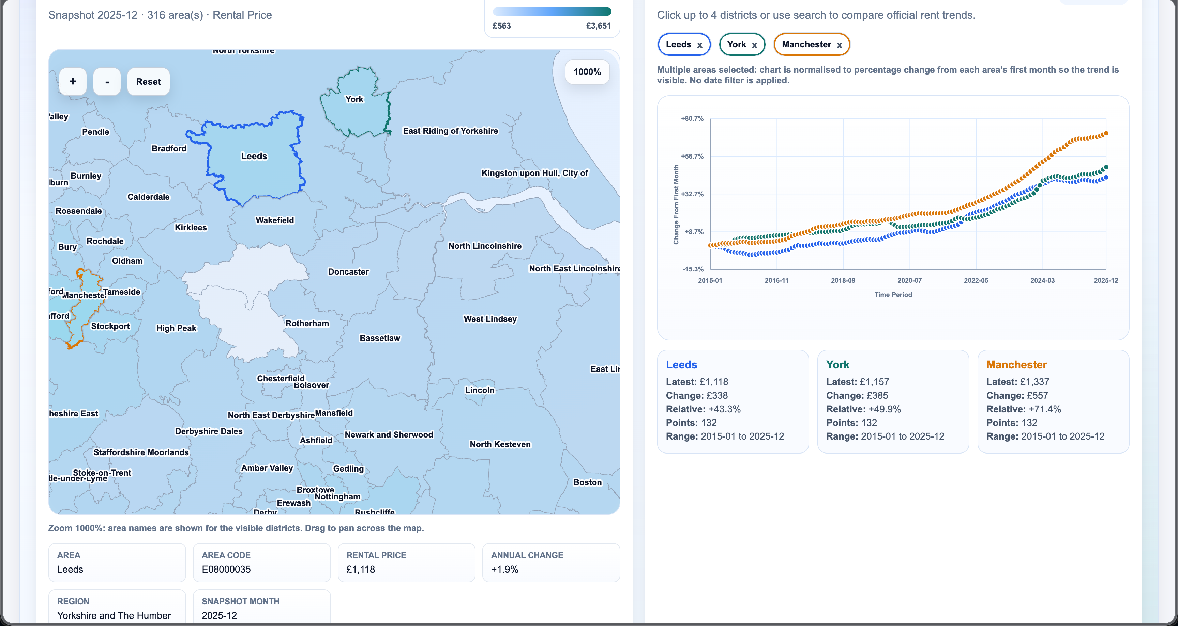
COMP3011 COURSEWORK 1 – INDIVIDUAL WEB SERVICES API DEVELOPMENT PROJECT
Geographic Rent Explorer
Loads historical rent data by area and time period
Supports area selection and side-by-side comparison
Improves interpretability for non-technical users
Shirui Zhao
2026-03-12

Slide 9

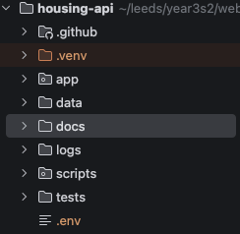
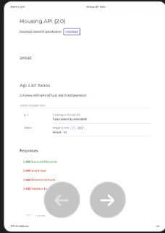
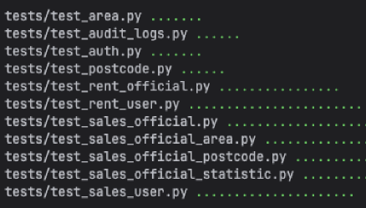
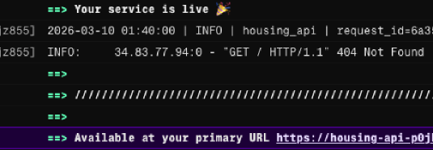
COMP3011 COURSEWORK 1 – INDIVIDUAL WEB SERVICES API DEVELOPMENT PROJECT
Testing, Deployment, and Deliverables
A
B
C
Testing
Deployment
Deliverables
Deployed as a runnable web service
Interactive API documentation available
Submission version aligned with hosted demo
CI/CD used for deployment validation
Public GitHub repository with commit history
API documentation and technical report
Source code, database setup, and evidence of development
Presentation and submission-ready materials
Endpoint tests with pytest
Validation of success and error cases
Coverage of query parameters and edge cases
Verified expected status codes and responses
Shirui Zhao
2026-03-12

Slide 10
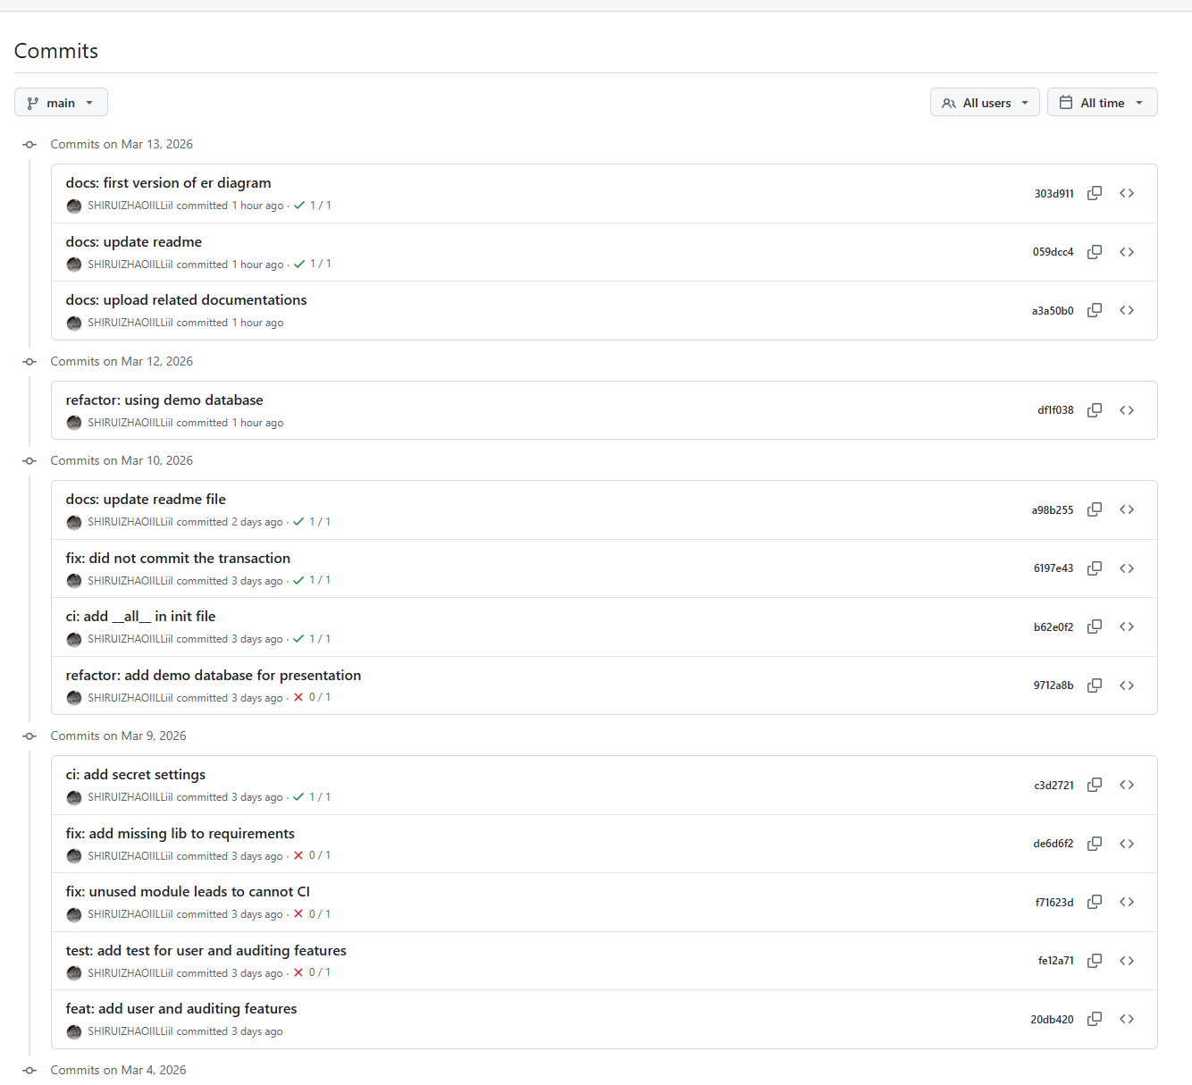
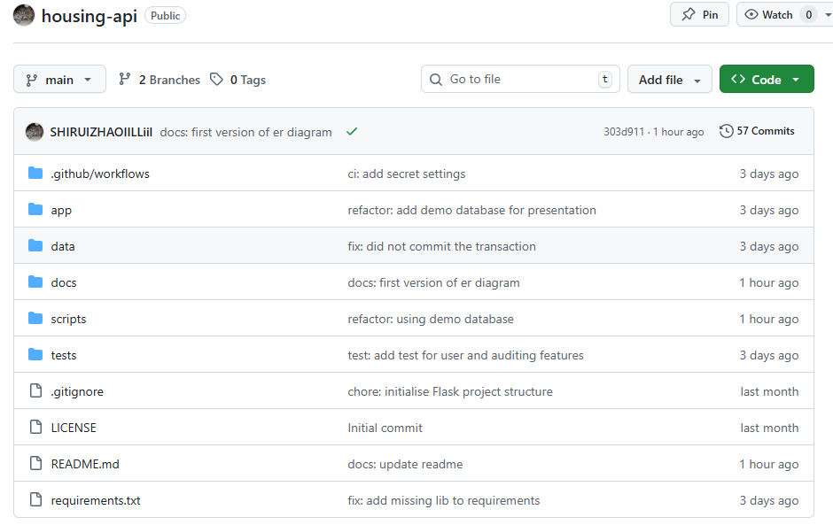
COMP3011 COURSEWORK 1 – INDIVIDUAL WEB SERVICES API DEVELOPMENT PROJECT
Version Control Practices and Commit History
Public GitHub repository used throughout development.
Incremental commits documented database setup, API implementation, testing, and deployment changes.
Commit history reflects staged development rather than one-time upload.
Shirui Zhao
2026-03-12

Slide 11
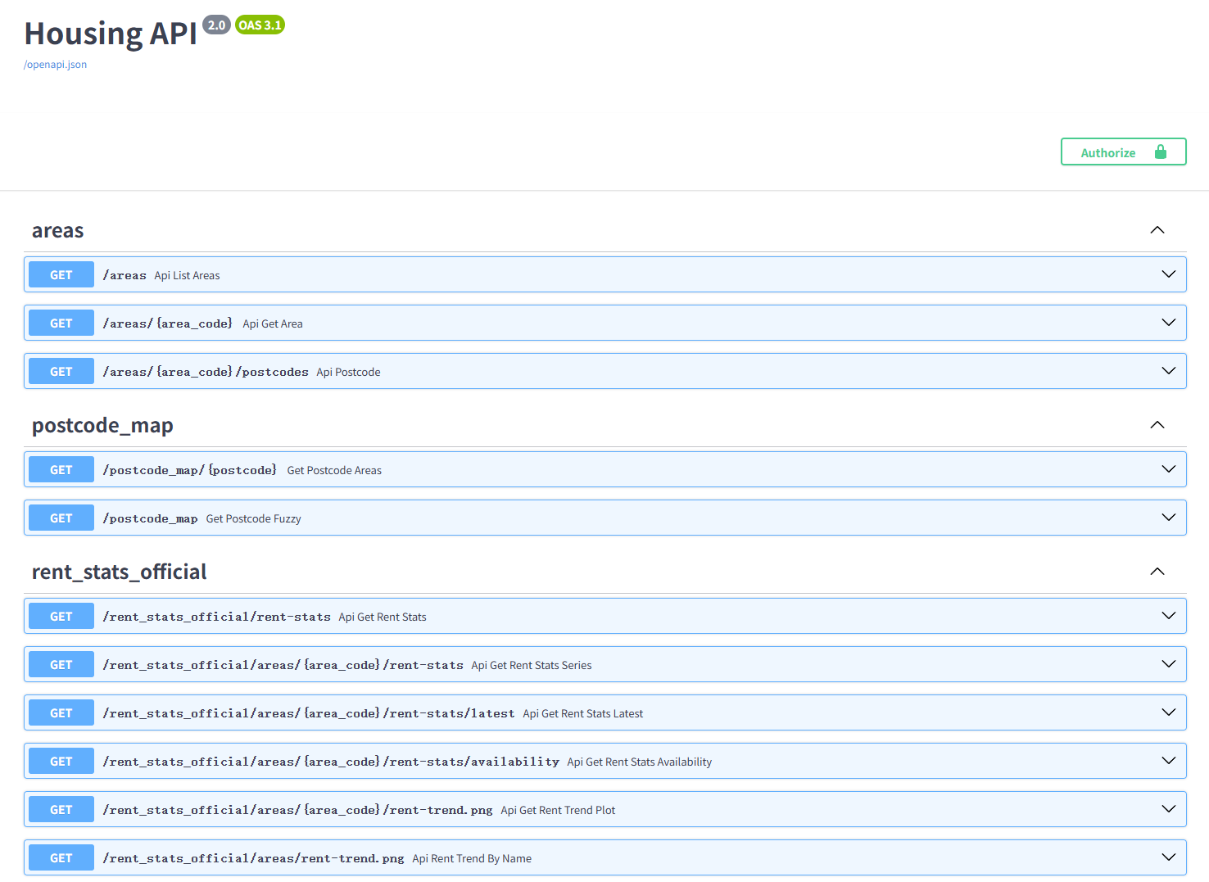
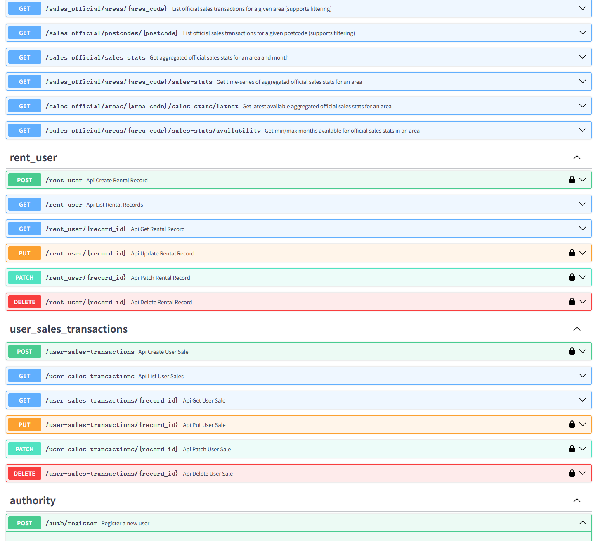
COMP3011 COURSEWORK 1 – INDIVIDUAL WEB SERVICES API DEVELOPMENT PROJECT
API Documentation Overview
FastAPI auto-generated OpenAPI / Swagger documentation
documents routes, request models, responses, authentication flows
reduces drift between implementation and documentation
Shirui Zhao
2026-03-12

Slide 12
COMP3011 COURSEWORK 1 – INDIVIDUAL WEB SERVICES API DEVELOPMENT PROJECT
Technical Report Highlights
Architecture: layered FastAPI design with routers, services, and database separation
Design choice: official datasets separated from user-managed editable records
Technology stack: FastAPI + SQLite chosen for portability, schema-first design, and coursework practicality
Lessons learned: testing improved not just correctness, but API contract clarity
Shirui Zhao
2026-03-12

Slide 13
COMP3011 COURSEWORK 1 – INDIVIDUAL WEB SERVICES API DEVELOPMENT PROJECT
Project Links
GitHub Repository: https://github.com/SHIRUIZHAOIILLiil/housing-api
API Documentation PDF: https://github.com/SHIRUIZHAOIILLiil/housing-api/tree/main/docs/Housing-API.pdf
Technical Report PDF: https://github.com/SHIRUIZHAOIILLiil/housing-api/tree/main/docs/Housing-API-technical-report.pdf
Presentation Slides: https://github.com/SHIRUIZHAOIILLiil/housing-api/tree/main/docs/Housing-API.pptx
Shirui Zhao
2026-03-12

Slide 14
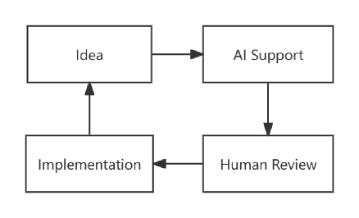

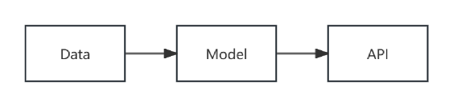
COMP3011 COURSEWORK 1 – INDIVIDUAL WEB SERVICES API DEVELOPMENT PROJECT
Reflection, GenAI Usage, and Future Work
A
B
C
Reflection
GenAI Usage
Future Work
Add richer analytics and comparison endpoints
Introduce role-based authorization and stronger security controls
Move to cloud database and more production-ready deployment
Learned practical REST API design and data modelling
Improved testing, debugging, and project structuring skills
Better understood how to turn raw datasets into usable services
Used GenAI for planning, debugging, and refining design ideas
Outputs were reviewed, adapted, and validated before use
Usage was documented in the report with supporting evidence
Shirui Zhao
2026-03-12

Slide 15
COMP3011 COURSEWORK 1 – INDIVIDUAL WEB SERVICES API DEVELOPMENT PROJECT
That is the end. Thank you
Shirui Zhao
2026-03-12

