Slide 1
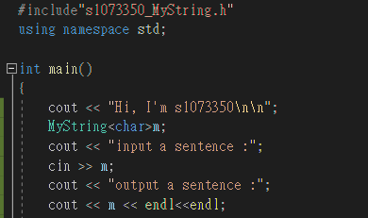

1.測試operator<<
2.測試operator>>
3.測試Constructor(Constructs an empty string, with a length of zero characters.
*default capacity = 10)

Slide 2
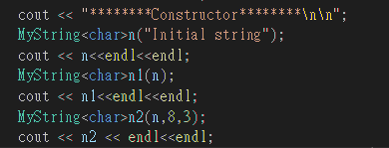
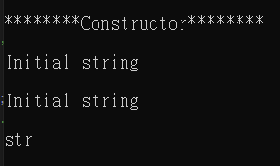
1.測試Constructor::MyString(const char* s)
2.測試Constructor(copy constructor)
3.測試Constructor(substring constructor)
(圖由上往下的順序為測試順序)

Slide 3
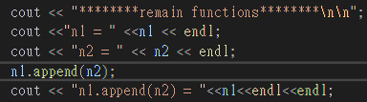
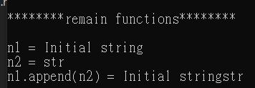
1.測試append

Slide 4
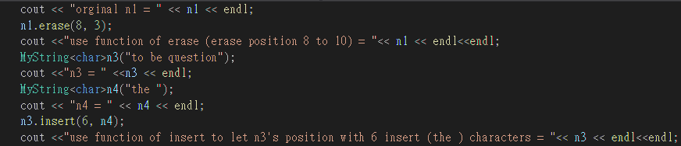
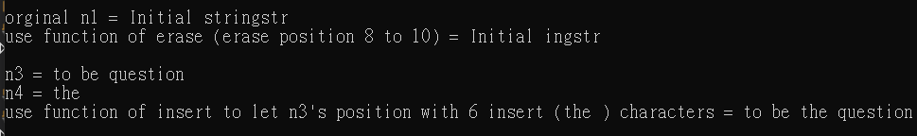
1.測試erase
2.測試insert(size_t pos, const MyString& str)

Slide 5
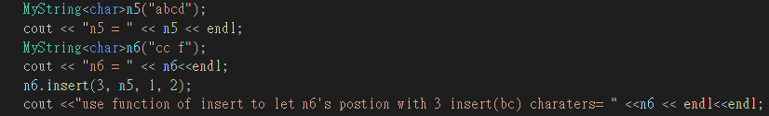

1.測試insert(size_t pos, const MyString& str, size_t subpos, size_t sublen)

Slide 6
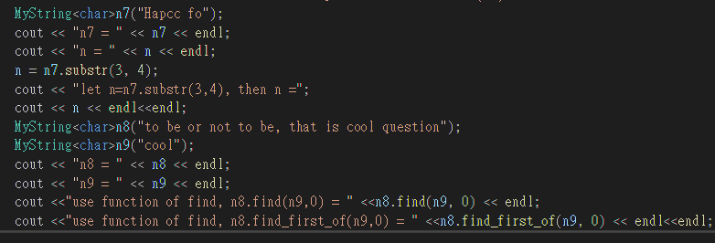
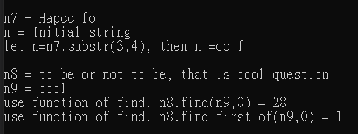
1.測試substr
2.測試find
3.測試find_first_of

Slide 7
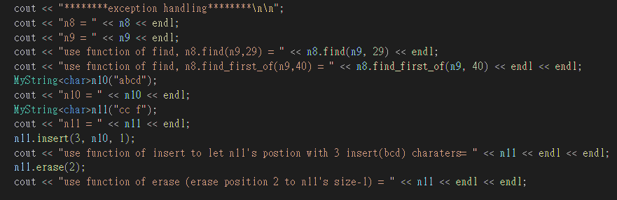
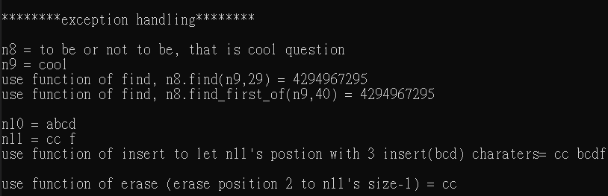
測試exception handling

