Slide 1
Welcome

Slide 2

Introduction
SHITOL CHANDRO SARKER
Department of Computer Science and Engineering
Rangpur Engineering College, Rangpur.
(Affiliated by University of Rajshahi)
Session : 2016-2017
Student ID : 1737620122
Part- IV Odd Semester

Slide 3



Slide 4
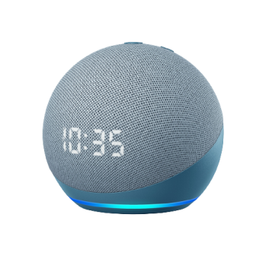
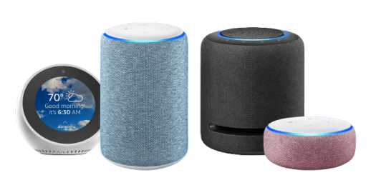
Meet Amazon Alexa
“Amazon Alexa, also known simply as Alexa, is a virtual assistant technology developed by Amazon, first used in the Amazon Echo smart speaker and the Echo Dot, Echo Studio and Amazon Tap speakers developed by Amazon Lab126.”
Amazon echo
Amazon echo dot

Slide 5
Meet Amazon Alexa
Developer(s) : Amazon
Initial release : March 19, 2013; 8 years ago
Platform : Amazon echo, Fire OS, iOS, Android, Linux, Windows.
Type : Intelligent personal assistant, cloud-based voice service.
Website : developer.amazon.com/alexa
Available in : English, France, German, Japanese, Korean, Italian, Spanish, Portuguese, Hindi, Tamil, Kannada, Telugu, Malayalam, Marathi, Gujarati, Chinese.

Slide 6
Capable of -
Voice interaction
Music playback
Providing real time information
Controls several smart devices such as home automation system

Slide 7

Command for Alexa
“Alexa, What is my Credit card Balance”
“Alexa, Turn Off Light”
“Alexa, Play a music”
“Alexa, call Alex”
“Alexa, what time is it”
“Alexa, What’s in the news”

Slide 8
Working Procedure of Alexa
Alexa is always ready to help, When someone want to talk to Alexa on there Echo device, Then they have to first say the wake word, which by default is “Alexa,”
When the device detects the wake word, it sends request to Amazon’s secure cloud, where the cloud’s more powerful capabilities verify the wake word as a request is being processed. After confirmation, an answer according to the request is sent back.

Slide 9
Working Procedure of Alexa
Anchored speech detection
“Alexa,
Turn on the kitchen light !”
Wake word
“Anchor”
Request
Speech consistent with anchor

Slide 10
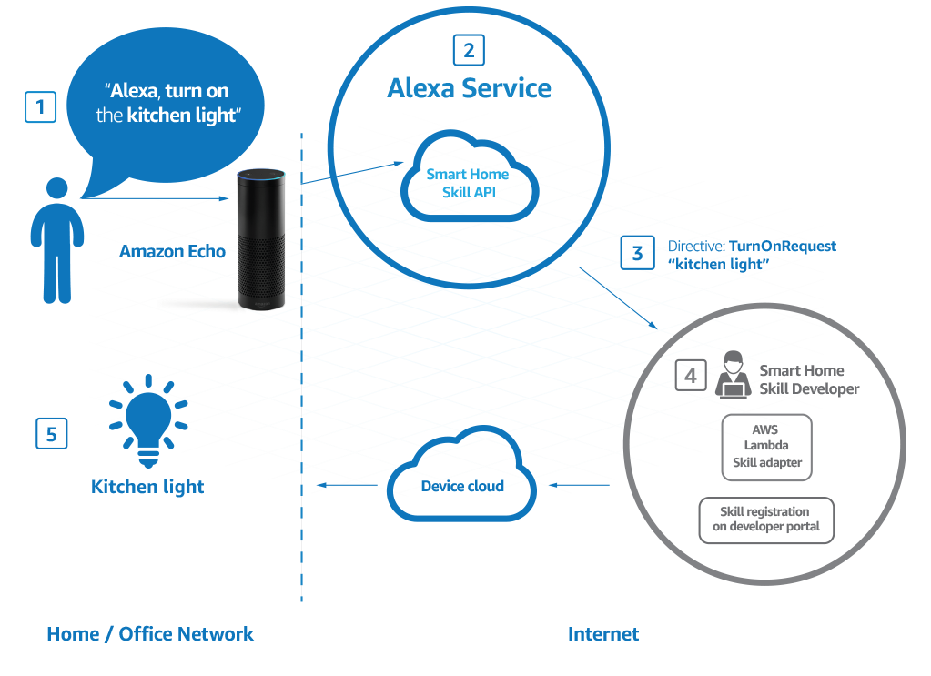
Working Procedure of Alexa

Slide 11
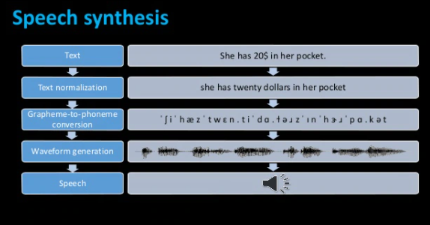
Text to Speech Conversation

Slide 12
Alexa Skill
Alexa has three types of skill :
Smart Home Skill
Flash Briefing Skill
Custom Skill

Slide 13
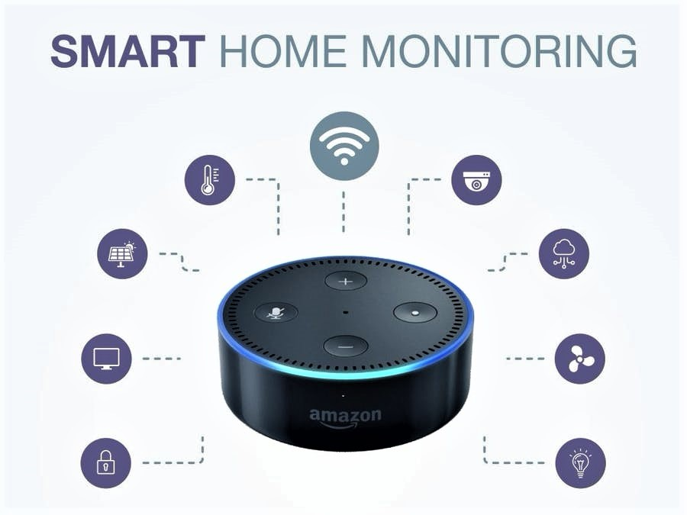
Alexa Skill
Smart Home Skill :

Slide 14
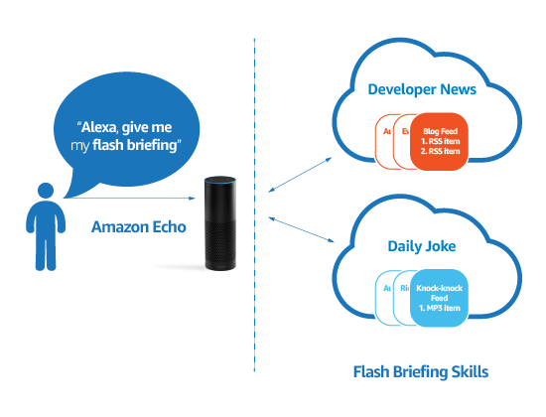
Alexa Skill
Flash briefing Skill :

Slide 15
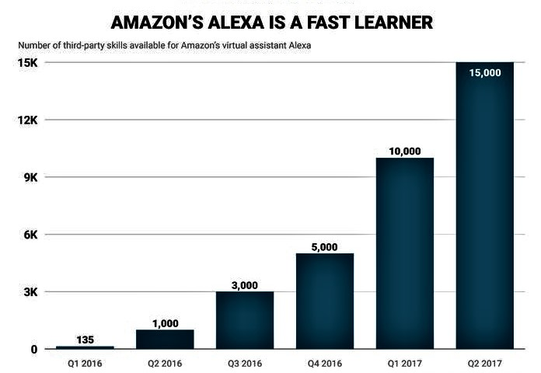
Alexa Skill
Alexa Custom Skill :

Slide 16
Alexa Security

Slide 17
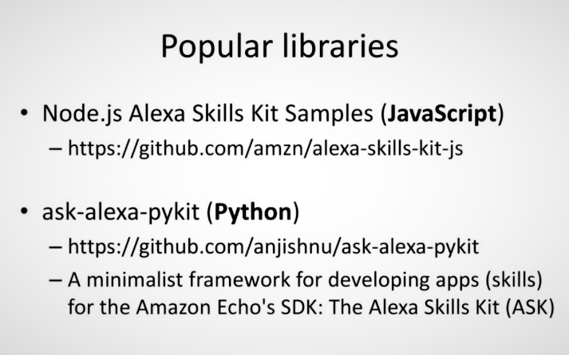
Alexa Library for Developers

Slide 18
Thank You
for your attention.

