Slide 1
Welcome

Slide 2

Introduction
SHITOL CHANDRO SARKER
Department of Computer Science and Engineering
Rangpur Engineering College, Rangpur.
(Affiliated by University of Rajshahi)
Session : 2016-2017
Student ID : 1737620122
Part- IV Odd Semester

Slide 3



Slide 4
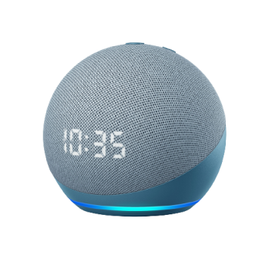
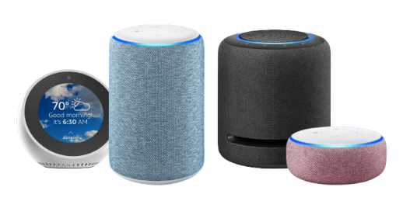
Meet Amazon Alexa
“Amazon Alexa is an intelligent personal assistant developed by Amazon,
Which made popular by the amazon echo and echo dot devices developed by amazon”
Amazon echo
Amazon echo dot

Slide 5
Capable of -
Voice interaction
Music playback
Providing real time information
Controls several smart devices such as home automation system

Slide 6
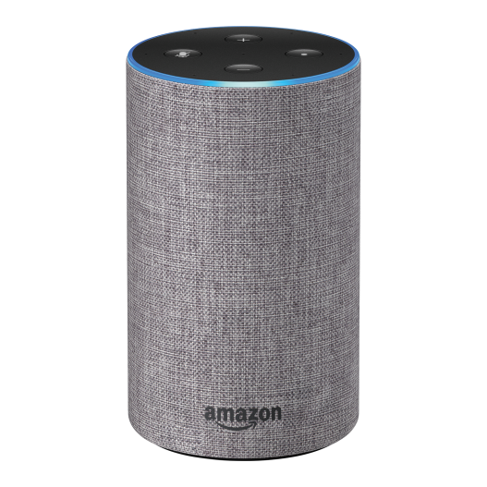
Command for Alexa
“Alexa, What is my Credit card Balance”
“Alexa, Turn Off Light”
“Alexa, Play a music”
“Alexa, call Alex”
“Alexa, what time is it”
“Alexa, What’s in the news”

Slide 7
What is needed to learn Data Science ?
Data Science
Mathematics
Machine Learning or Deep Learning
Database
Analytical Knowledge
Statistics
Computer Programming
Artificial Intelligence

Slide 8
Applications of Data Science ?

Slide 9

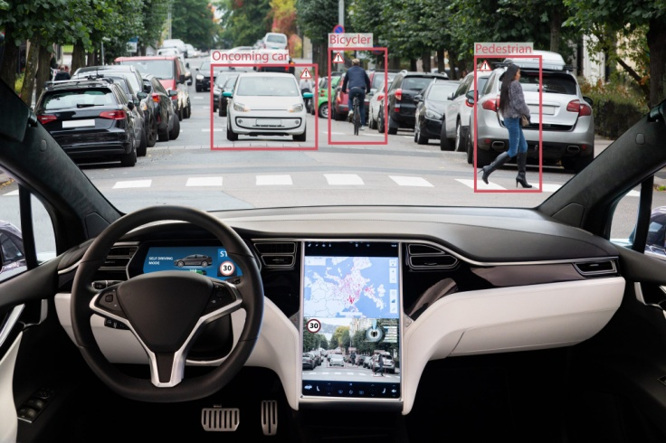

Real World Example of Data Science..

Slide 10
Advantage of Data Science ?
It’s in Demand
A Highly Paid Career
Data Science is Versatile
Data Science Makes Data Better
Computer Science

Slide 11
Disadvantage of Data Science ?
Mastering Data Science is near to impossible
Large Amount of Domain Knowledge Required
Problem of Data Privacy

Slide 12
Have Any Question ?

Slide 13
Thank You

