Slide 1




TITLE PAGE
Problem Statement Title -Build an AI-powered assistant that helps students manage study schedules, reminds them of deadlines, and answers questions using a custom-trained academic knowledge base.
Theme - Artificial Intelligence and Automation
Team ID - SBIBAC03
Team Name - Backstreet - boys
•Participant Names – D.Shiva kumar, D.Srikanth, A.Pranay kumar
Sri Indu College of Engg & Tech - Cyber Club, Department of Cyber Security
Page 01

Slide 2

Smart AI-Powered Voice Assistant
Backstreet - boys
Project: Voice-Controlled AI Assistant
Key Features:
Responds to voice commands
Provides real-time weather updates (OpenWeatherMap API)
Plays YouTube videos via voice
Fetches movie details using OMDb API
Communicates with Google Gemini for intelligent responses
Technology: Voice recognition, API integration, AI reasoning
Highlight: Seamless integration of multiple APIs for real-time interaction and smart assistance
Sri Indu College of Engg & Tech - Cyber Club, Department of Cyber Security
Page 02

Slide 3
TECHNICAL APPROACH
Backstreet - boys
Technologies Used:
Programming Language:
Python
Libraries/APIs:
SpeechRecognition, Pyttsx3 (TTS)
Google Gemini (AI)
OpenWeatherMap (Weather)
OMDb (Movies)
PyWhatKit (YouTube)
Threading (Concurrency)
Sri Indu College of Engg & Tech - Cyber Club, Department of Cyber Security
Page 03

Slide 4
TECHNICAL APPROACH
Backstreet - boys
Methodology:
Voice Input: Captured via microphone
Command Parsing: Routes to appropriate module
Execution:
Weather, Movie info, YouTube
General queries via Gemini AI
Concurrency: Multi-threading for background tasks
Sri Indu College of Engg & Tech - Cyber Club, Department of Cyber Security
Page 03

Slide 5
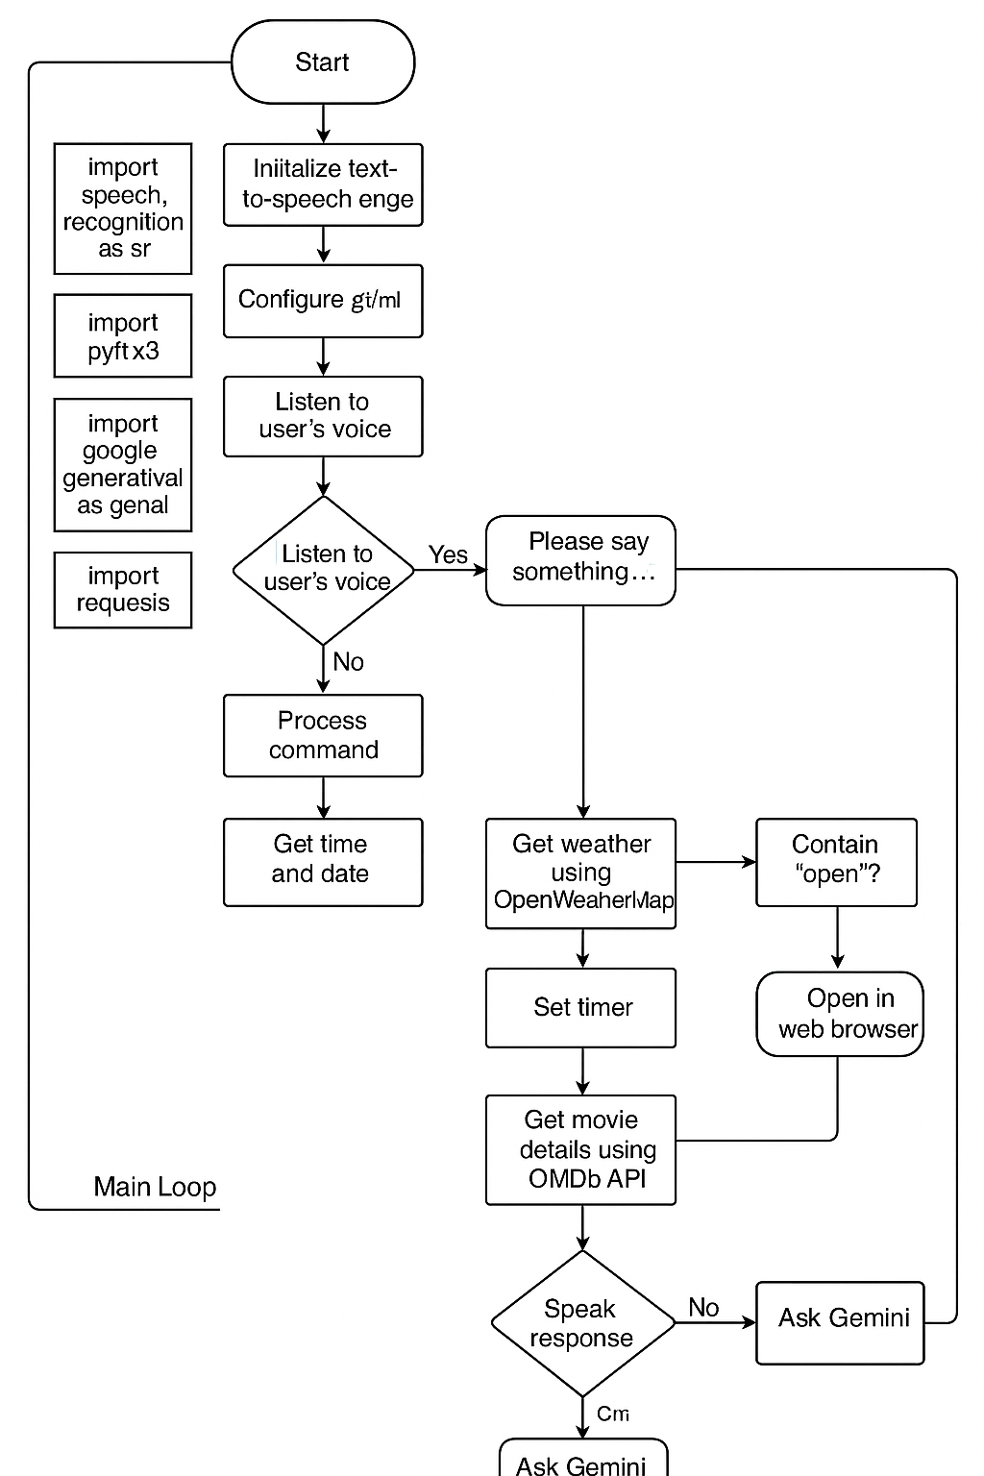
FLOAT CHART
Backstreet - boys
Sri Indu College of Engg & Tech - Cyber Club, Department of Cyber Security
Page 03

Slide 6
FEASIBILITY AND VIABILITY
Backstreet - boys
Runs on standard systems with a microphone
Handles speech, APIs, and UI via console
Challenges: Noise, API limits, connectivity
Solutions: Noise filtering, error handling, offline plans
Sri Indu College of Engg & Tech - Cyber Club, Department of Cyber Security
Page 04

Slide 7
IMPACT AND BENEFITS
Backstreet - boys
Enhances accessibility (e.g., visually impaired)
Free, open-source, and customizable
Educational value: combines ML, APIs, voice tech
Real-life use of conversational AI
Sri Indu College of Engg & Tech - Cyber Club, Department of Cyber Security
Page 05

Slide 8
RESEARCH AND REFERENCES
Backstreet - boys
Google Gemini API Docs
OpenWeatherMap API
OMDb API
PyWhatKit
SpeechRecognition Documentation
Sri Indu College of Engg & Tech - Cyber Club, Department of Cyber Security
Page 06

Slide 9
Backstreet - boys
FUTURE ENHANCEMENTS
Add offline functionality using local ML models
Custom wake word and emotion-based responses
Expand commands to include smart home integration
Sri Indu College of Engg & Tech - Cyber Club, Department of Cyber Security
Page 07

Slide 10
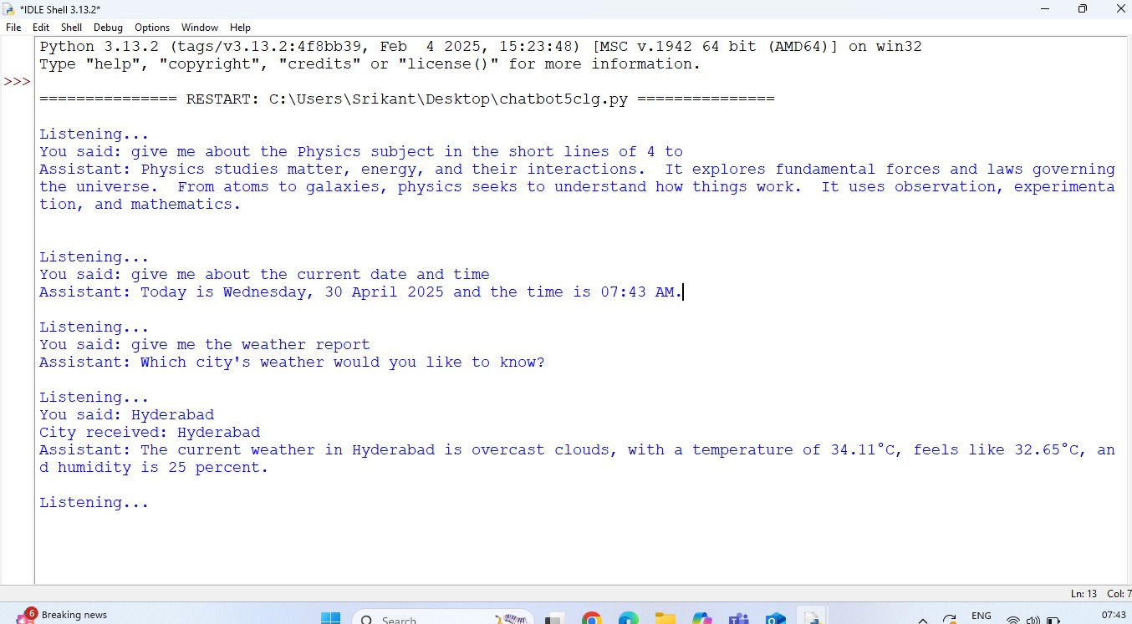
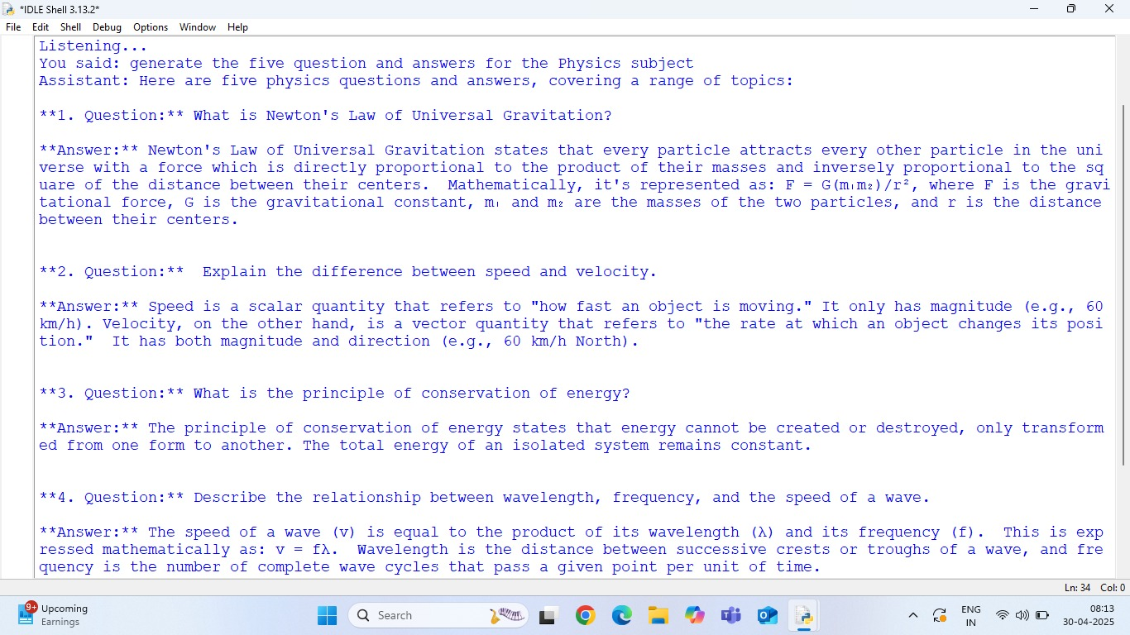
Backstreet - boys
DEMO
Sri Indu College of Engg & Tech - Cyber Club, Department of Cyber Security
Page 08

Slide 11
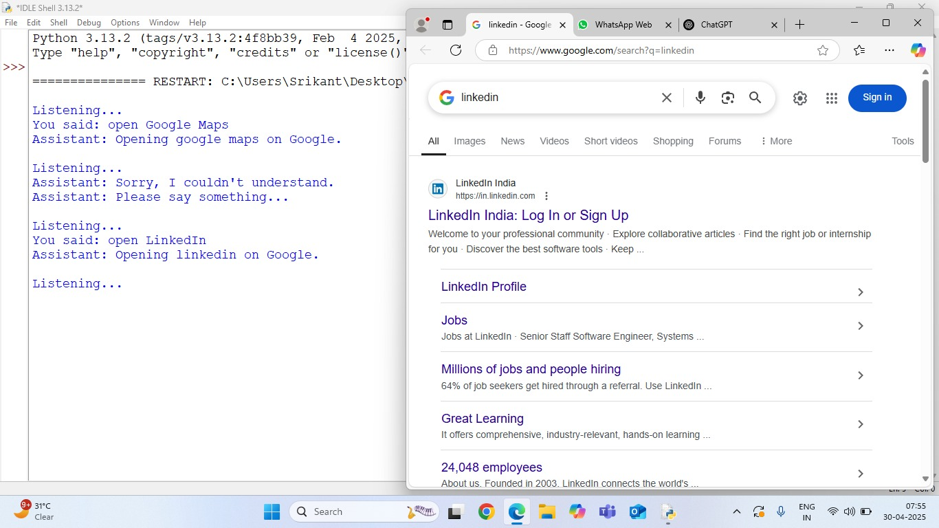
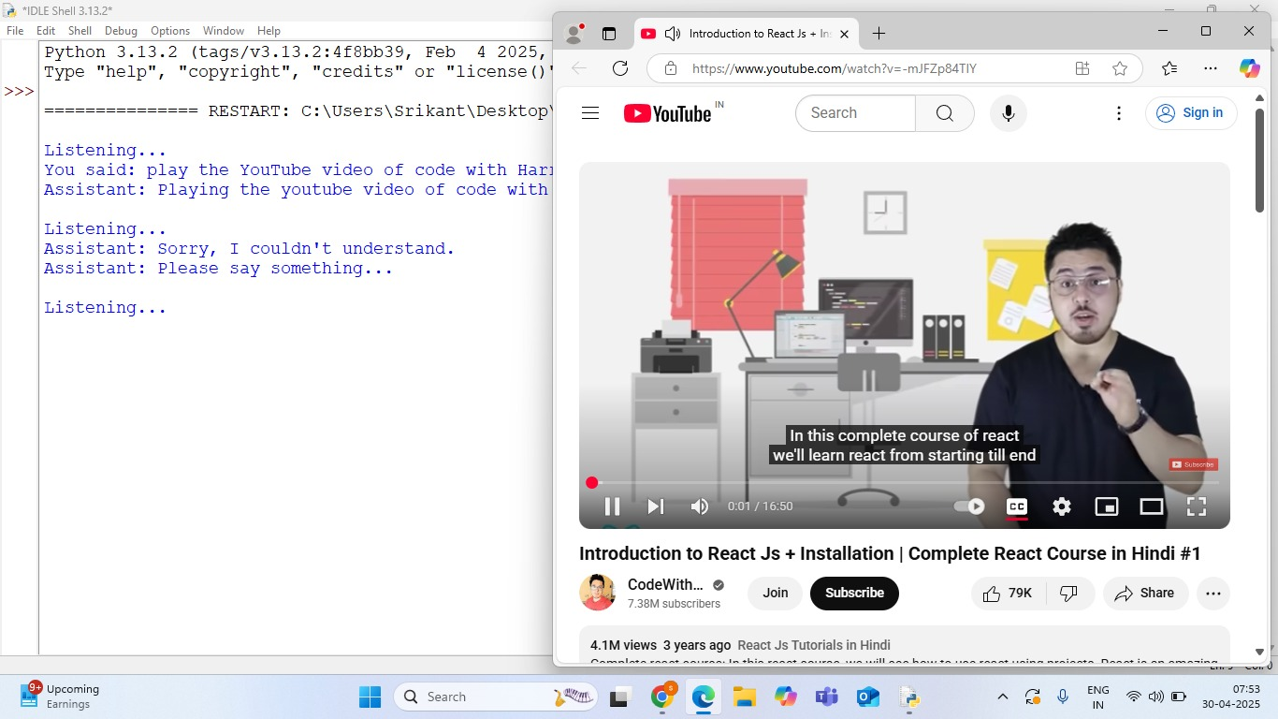
Backstreet - boys
DEMO
Sri Indu College of Engg & Tech - Cyber Club, Department of Cyber Security
Page 08

Slide 12
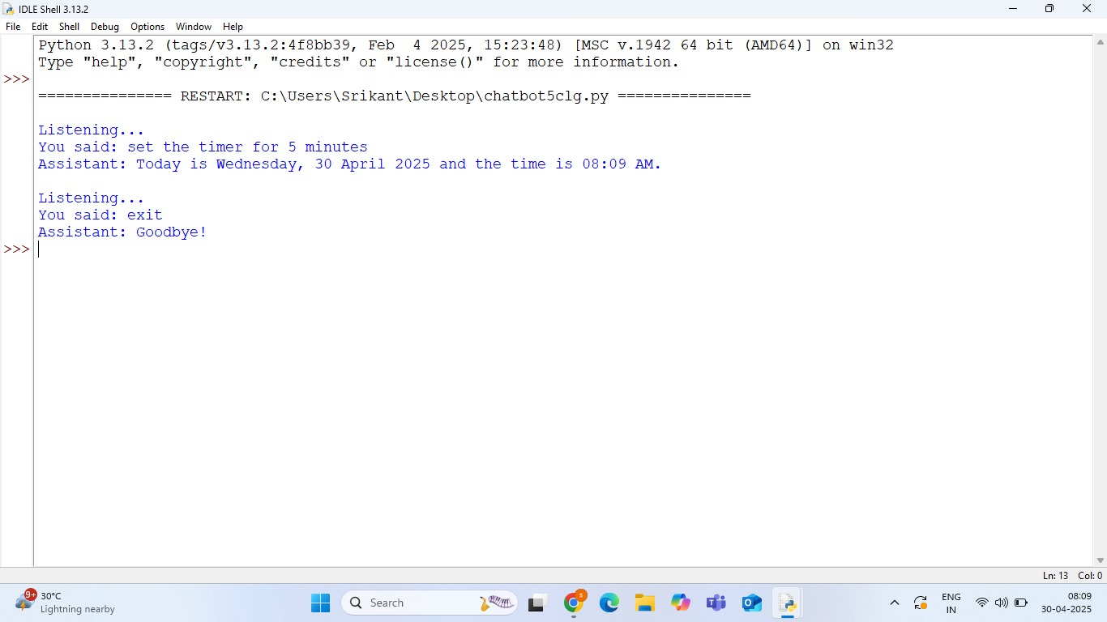
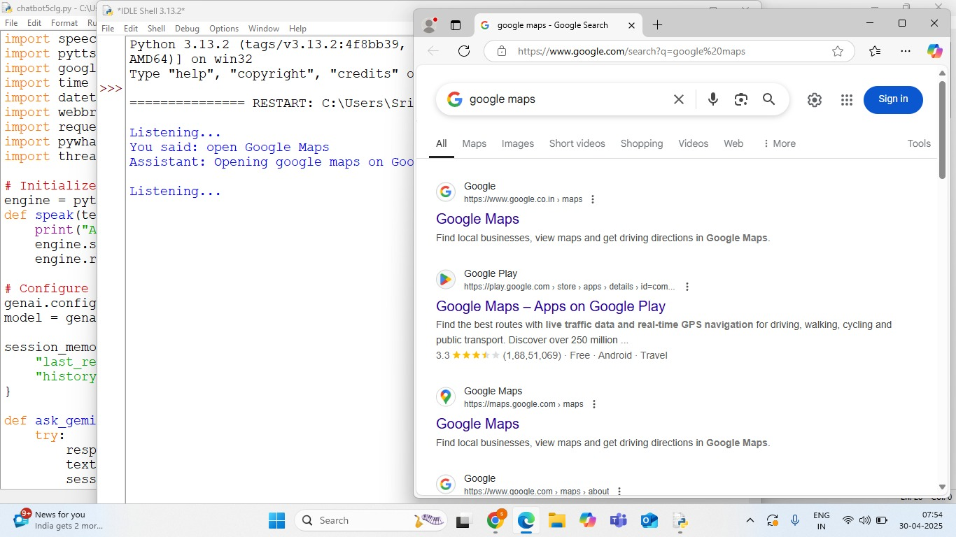
Backstreet - boys
DEMO
Sri Indu College of Engg & Tech - Cyber Club, Department of Cyber Security
Page 08

Slide 13
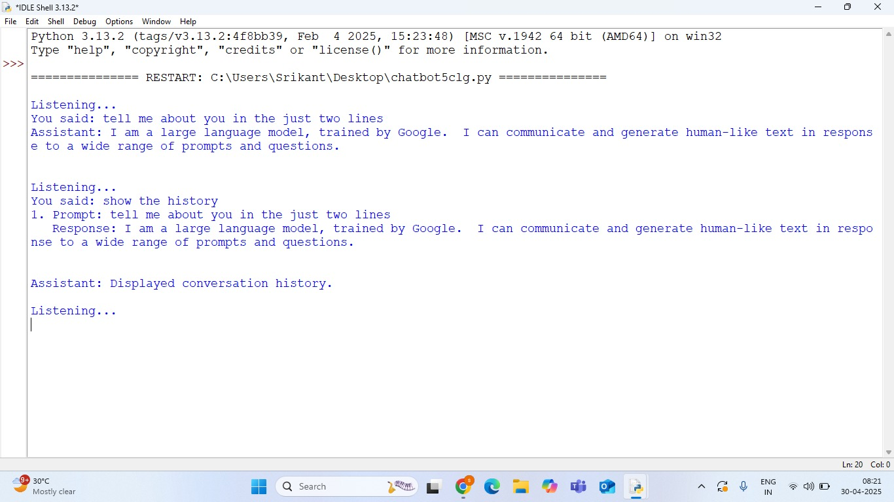
Backstreet - boys
DEMO
Sri Indu College of Engg & Tech - Cyber Club, Department of Cyber Security
Page 08

Slide 14
Backstreet - boys
CONCLUSION
A versatile voice assistant showcasing the power of AI when integrated thoughtfully into real-life use cases.
Thank you to Sri Indu College, mentors, and organizers for this opportunity.
Sri Indu College of Engg & Tech - Cyber Club, Department of Cyber Security
Page 09

Slide 15
Backstreet - boys
THANK YOU: ☺
Thank you for your time and attention. We greatly appreciate your interest in our work.
Should you have any questions or need further assistance, please don't hesitate to contact us.“shivayadav@gmail.com”
Stay connected with us through
[https://www.linkedin.com/in/shiva-kumar-durgam-0a89762b5]
[https://www.linkedin.com/in/srikanth-dosu-1189782b5/]
[https://www.linkedin.com/in/pranay-kumar-reddy-93397a2b5/]
Sri Indu College of Engg & Tech - Cyber Club, Department of Cyber Security
Page 09

