Slide 1
CSE 276: ARTIFICIAL INTELLIGENCE FOUNDATIONS
Material Code Harmonisation
Across Public Enterprises
AI-Driven Precision Entity Resolution & Duplicate Detection for Public Procurement
Section: K3P25LH | Group: G6 | Academic Year: 2026 | Course Code: CSE 276
Team Members (Draft / Allocation Record):
• Sindhant Dadwal – Reg No: 12509119 (Roll No: 43) [Official List spelling: 'Sindhant Dhadwal']
• Sabuj Mondal – Reg No: 12509118 (Roll No: 32) [Official List Reg No: 12504433]
Problem Source: Smart India Hackathon (SIH 2026) | Problem ID: SIH26099 | Ministry of Petroleum & Natural Gas
Notes:
Presenter: TBC (Sabuj Mondal / Sindhant Dhadwal)
Slide Duration: ~45 seconds
Key Talking Points:
- Welcome evaluators. We present our CSE 276 CA-1 project on Material Code Harmonisation Across Public Enterprises.
- Our group is G6 in Section K3P25LH. The project is inspired by SIH26099 from the Ministry of Petroleum and Natural Gas.
- Note: On this title slide, we present the registration numbers from our report draft while noting the discrepancies in the official allocation spreadsheet for evaluator transparency.

Slide 2
PROBLEM CONTEXT
Industrial Problem & Beneficiaries
The Industrial Procurement Problem
• Independent Siloed Codification: CPSEs (IOCL, OIL, NTPC) operate isolated ERP databases. IOCL uses 10-digit SAP numbers; OIL uses 7-digit alphanumeric codes.
• Duplicate Spare Purchasing: Identical industrial equipment (e.g., API 6D pipeline ball valves, IS:7098 power cables) is procured independently at disparate pricing.
• Inventory Lockup & Redundancy: Lack of cross-enterprise visibility forces each plant to hold redundant safety buffer stock, locking up capital.
• Why Simple Text Match Fails: Descriptions have severe abbreviations (SS-304 vs AISI 304), inverted word order (PUMP CENTRIFUGAL vs CENTRIFUGAL PUMP), and critical 1-parameter differences (250MM vs 300MM).
Target Beneficiaries & Economic Impact
• Public Sector Enterprises (CPSEs): IOCL, OIL, and NTPC procurement managers gain real-time visibility into identical cross-enterprise inventory.
• Central Procurement Teams: Enables aggregated bulk purchasing, standardized rate contracts, and massive volume discounts across ministries.
• Plant Maintenance Engineers: Emergency spare parts can be requisitioned from neighboring PSU refineries during breakdown crises.
• National Public Exchequer: Eliminates hundreds of crores in redundant procurement expenditure and dead inventory carrying costs.
Notes:
Presenter: TBC
Slide Duration: ~45 seconds
Key Talking Points:
- Large Indian public sector enterprises manage billions in procurement but operate isolated ERP systems.
- When IOCL and OIL buy the exact same pipeline ball valve, they assign completely different material codes.
- Simple string matching fails because small text differences can mean identical items (synonyms) or completely different specs (250mm vs 300mm).
- Our solution targets CPSE procurement and inventory teams to aggregate volume and reduce duplicate stock.

Slide 3
PROJECT FOUNDATION
National Hackathon Origin & Syllabus Alignment
Smart India Hackathon (SIH 2026)
Problem Statement ID: SIH26099
Official Title: AI-Driven Standardization and Harmonization of Material Codes Across CPSEs
Nodal Ministry: Ministry of Petroleum & Natural Gas (MoPNG)
Portal Link: https://sih.gov.in/sih2026PS
Dataset Access: Student-sourced public tender & material catalog corpus (Hugging Face Prasenjeet25/sih26099-cpse-material-codes, CC BY 4.0)
CSE 276 Syllabus Topics Addressed
• Unit V: Natural Language Processing: Regex-based entity attribute parsing, text canonicalization, character/word TF-IDF n-grams, and Dense Transformer Embeddings (MiniLM-L6-v2).
• Unit VI: Unsupervised Clustering: Conflict-aware connected component clustering; graph partitioning enforcing transitive conflict safety.
• Unit V: Evaluation of Matching: Pairwise precision, recall, F1-score, ROC-AUC, PR-AUC, and cluster purity / inverse purity against exact-match baseline.
• Optional Advanced Extension: Active learning uncertainty sampling (|p - 0.5|) to route the most ambiguous pairs to reviewers first.
Notes:
Presenter: TBC
Slide Duration: ~45 seconds
Key Talking Points:
- This problem originates from the Smart India Hackathon 2026 under the Ministry of Petroleum and Natural Gas.
- We rigorously align with our CSE 276 syllabus: NLP text normalization and transformer embeddings from Unit 5; clustering and graph purity from Unit 6; and precision/recall evaluation from Unit 5.
- We also implemented the optional active learning extension suggested in the course guidelines.

Slide 4
CORE DELIVERABLES
Project Objectives (Verbatim Course Allocation)
Objective 1: Harmonised Matching System
"Build a matching system that groups functionally equivalent material records and proposes one harmonised code with evidence."
Status: Delivered: Hybrid classifier + conflict-aware clustering grouping 819 real records into 374 harmonised clusters with representative descriptions and audit trails.
Objective 2: Pairwise Entity Resolution Model
"Produce an entity resolution model with pairwise precision/recall over a labelled sample."
Status: Delivered: Serialized model (models/hybrid_er_model.joblib) evaluated on 1,508 held-out test pairs, a 150-pair review set, and a 100-pair AI-assisted Batch-2 tier.
Objective 3: Baseline Comparison & Reviewer UI
"Report pairwise precision/recall/F1, cluster purity. Baseline: exact string match. Deliver Reviewer UI showing proposed merges with evidence."
Status: Delivered: Comparison vs exact match (+0.829 F1 gain), cluster purity report (0.999 vs 1.000 / 0.995 vs 0.545 completeness), and zero-dependency web reviewer app.
Notes:
Presenter: TBC
Slide Duration: ~45 seconds
Key Talking Points:
- Here are the three project objectives taken verbatim from the university allocation spreadsheet.
- Objective 1: Deliver harmonised code generation with evidence.
- Objective 2: Train a pairwise ER model reporting precision and recall.
- Objective 3: Compare against exact string match, measure cluster purity, and build the interactive Reviewer UI.
- All three objectives have been fully satisfied with verifiable code and metrics.

Slide 5
DATASET & PREPROCESSING
Data Pipeline & Candidate Filtering
Dataset Overview
Source Corpus: Hugging Face sih26099-cpse-material-codes (CC BY 4.0)
Raw Records: 21,513 industrial descriptions across 3 enterprises
Preprocessed Candidate Pool: 6,634 valid structured records
Enterprise Distribution: • IOCL: 2,746 (41.4%)
• NTPC: 2,126 (32.0%)
• OIL: 1,762 (26.6%)
Search Space: 22,001,661 all-pairs combinations
4-Stage Preprocessing & Candidate Generation
1. Canonical Text Normalisation: Case-folding, punctuation strip, unit standardization ('10 MM' -> '10MM', '1.1 KV' -> '1100V', 'CLASS 150' -> '150#'), SAP noun-first ordering.
2. Engineering Specification Extraction: Unit-aware regex parser extracts voltage, power, size, pressure rating, material grade (SS304/SS316), and valve/pump descriptor groups.
3. TF-IDF Candidate Blocking: Bi-gram TF-IDF index (min_df=2, similarity >= 0.35) filters 22.0 million pairs down to exactly 22,464 candidate pairs (99.9% reduction).
4. Cross-Enterprise Indexing: Captures cross-PSU pairs while filtering out obvious cross-commodity noise (e.g. submersible pump vs copper cable).
Notes:
Presenter: TBC
Slide Duration: ~45 seconds
Key Talking Points:
- We use real public CPSE procurement data containing 21,513 raw descriptions from IOCL, OIL, and NTPC.
- Preprocessing yields 6,634 candidate pool records across balanced enterprise shares.
- Evaluating all pairs would mean 22 million comparisons. Our TF-IDF candidate generation prunes this down to 22,464 candidate pairs without losing plausible matches.
- Our canonical unit parser equates 1.1 kV to 1100V and Class 150 to 150-pound.

Slide 6
METHODOLOGY
Self-Supervised Learning by Construction
How to Train When Human Labels Are Scarce (Without Fabricating Labels)
Only 19 binary review labels exist. Training on AI guesses would violate academic integrity. Instead, we use self-supervised learning with labels known by construction (Ditto / Sudowoodo paradigm):
• 1. Synthetic Positives (Label = 1, n = 6,599): Real catalog record vs a format-only rewrite of itself (boilerplate prefixes, quantity suffixes, noun reordering, abbreviations, typos, plurals). The physical entity is guaranteed identical.
• 2. Synthetic Hard Negatives (Label = 0, n = 1,812): Real catalog record vs a copy with exactly one specification mutated (250MM -> 300MM, SS304 -> SS316, Class 150 -> 300, Ball -> Gate valve). Different spec guarantees non-equivalence.
• 3. Real Spec-Conflict Negatives (Label = 0, n = 807): Real candidate pairs whose canonical unit specifications are completely disjoint (e.g., 1400MM vs 1800MM conveyor belts).
• 4. Random Cross-Commodity Negatives (Label = 0, n = 1,344): Pairs drawn from different commodity classes (pumps vs cables). Total training corpus: 10,562 pairs.
• 5. Zero-Leakage Guarantee: Train/val/test splits (7,546 / 1,508 / 1,508) partitioned by near-duplicate graph components (TF-IDF >= 0.8). Zero record overlap. All 173 review records completely excluded from training.
Notes:
Presenter: TBC
Slide Duration: ~50 seconds
Key Talking Points:
- A fundamental challenge in entity resolution is label scarcity. We only have 19 binary review-set labels.
- Rather than fitting models on noisy AI guesses, we adopt state-of-the-art self-supervised pair generation by construction.
- A format-only rewrite is guaranteed positive; changing one specification creates a guaranteed hard negative.
- Crucially, splits are group-disjoint, and all 173 human review records are strictly excluded from training, guaranteeing zero test leakage.

Slide 7
IMPLEMENTATION
Hybrid Feature Pipeline & Precision Policy
34 Hybrid Features & ML Models
• Semantic Embeddings: MiniLM-L6-v2 384-dimensional cosine similarity.
• Lexical & Character Features: Word & character TF-IDF cosine, Jaccard containment, 4 RapidFuzz string ratios.
• Canonical Specification Matchers: Unit-aware match flags, spec conflict counts, descriptor family comparisons.
• Candidate Classifiers Compared: Logistic Regression, Random Forest, Histogram Gradient Boosting. Selected: HistGradientBoosting on validation PR-AUC (0.9999).
Precision-First 3-Way Policy & App
• EQUIVALENT (Auto-Merge): p >= 0.85 AND shared identity specs. Zero auto-merges with conflicting specs.
• NOT_EQUIVALENT (Auto-Reject): p <= 0.25 OR explicit canonical specification conflict.
• NEEDS_REVIEW (Human Gate): Generic titles ('AIR COMPRESSOR'), asymmetric specs (spec on 1 record only), or ambiguous probabilities.
• Conflict-Aware Clustering: Graph clustering with transitive conflict detection blocking erroneous multi-hop cluster chains.
• Zero-Dependency Reviewer UI: Streamlit app with source provenance, conflict banners, non-auto-advancing labels, and explicit 'Save & Next'.
Notes:
Presenter: TBC
Slide Duration: ~50 seconds
Key Talking Points:
- Our model feeds 34 hybrid features into a Histogram Gradient Boosting classifier.
- For industrial procurement, precision is paramount: merging incompatible items causes physical installation failures.
- We deploy a 3-way decision policy: auto-merge only when probability >= 0.85 with matching specs; auto-reject on spec conflict; and route ambiguous or generic records to human reviewers.
- Our reviewer web app enforces explicit Save & Next to guarantee annotation integrity.

Slide 8
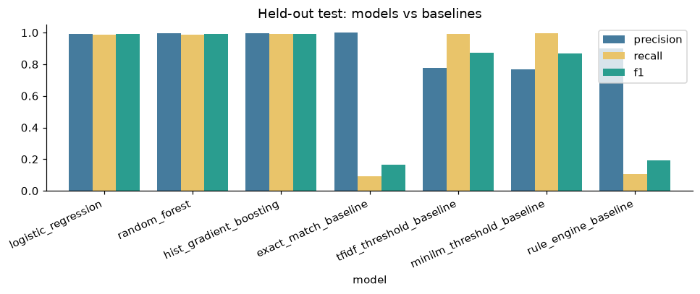
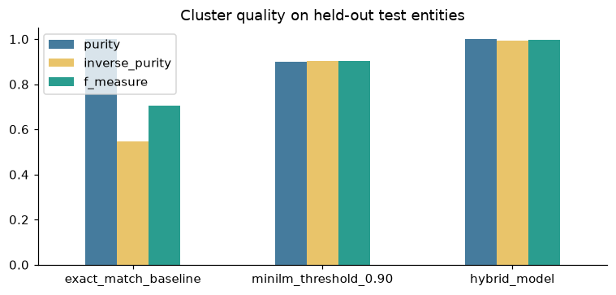
EXPERIMENTAL EVALUATION
Quantitative Results vs Baseline
Performance Metrics (Source: er_model_metrics.json)
Held-Out Synthetic Test (n = 1,508)
• Precision: Exact Match: 1.000 | Hybrid ER: 0.998
• Recall: Exact Match: 0.090 | Hybrid ER: 0.989 (+0.900)
• F1-Score: Exact Match: 0.165 | Hybrid ER: 0.994 (+0.829)
• PR-AUC: Exact Match: 0.7024 | Hybrid ER: 0.9998
Cluster Purity / Inverse Purity: Exact Match: 1.000 / 0.545 | Hybrid: 0.999 / 0.995
Review-Set Binary Labels (n = 19): TP: 2 | FP: 0 | TN: 17 | FN: 0 (Acc: 100%, 95% CI: [0.83, 1.00])
AI-Assisted Batch-2 Tier (n = 25): TP: 8 | FP: 3 | TN: 14 | FN: 0 (Acc: 88.0%)
Deployed Policy Auto-Merge Precision: Held-out: 99.5% | Review Set: 100.0% | Batch-2: 100.0%
Uncertain Pairs Auto-Merged (Safety Check): Review Set: 1 / 31 | Batch 2: 1 / 75
Notes:
Presenter: TBC
Slide Duration: ~55 seconds
Key Talking Points:
- All numbers on this slide come directly from our automated metrics JSON file.
- Against the exact-match baseline, our model improves F1 from 0.165 to 0.994—a massive jump in recall from 9.0% to 98.9% while keeping precision at 99.8%.
- On cluster completeness (inverse purity), exact match achieves only 54.5% because it splits variants into isolated clusters, whereas our model achieves 99.5%.
- In the review set and Batch 2 tier, our deployed policy achieves 100% precision on auto-merges.

Slide 9
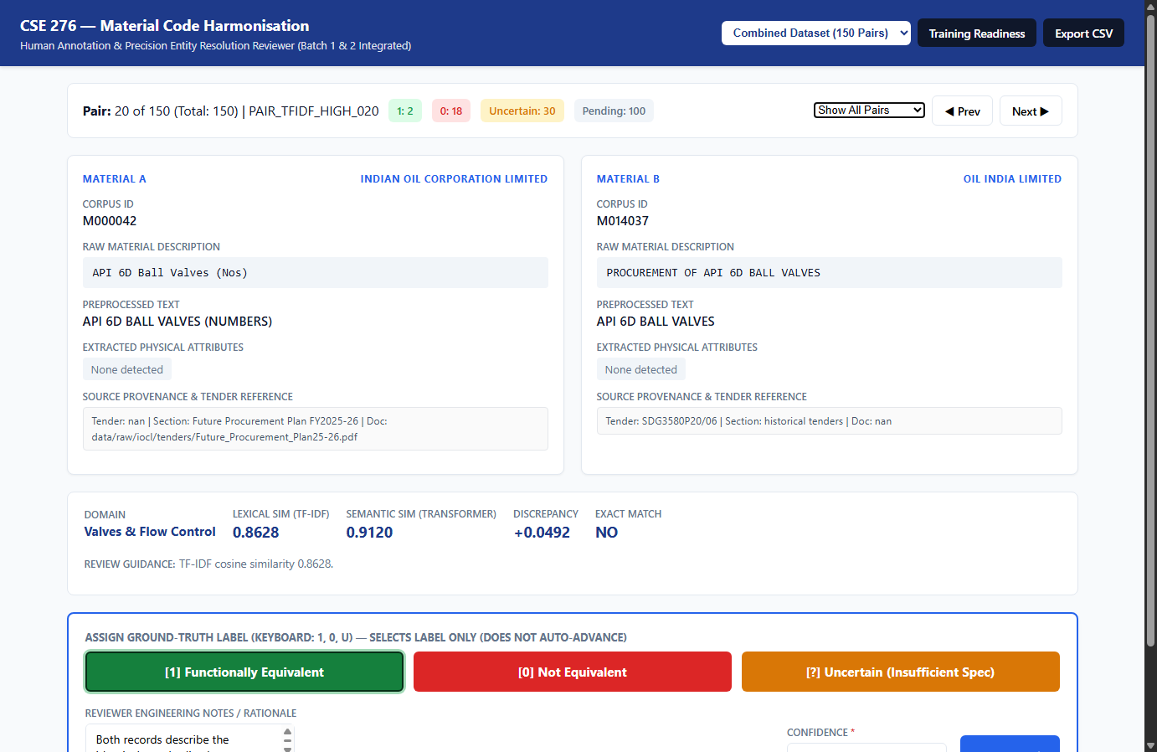
DEMO & AUDIT EVIDENCE
System Demonstration & Software Verification
Interactive Reviewer App & Live API
• Reviewer Interface Workflow: Reviewers inspect candidate pairs side by side, view extracted engineering attributes, and verify source tender documents.
• Real-Time Conflict Banners: Visual warnings alert reviewers when specification conflicts (voltage, pressure rating, material) are detected.
• Non-Auto-Advancing Navigation: Clicking labels only selects them; pairs navigate only upon explicit 'Save & Next' validation.
• Live Python Matching API: from src.er_pipeline import match_descriptions
• match('CENTRIFUGAL PUMP 60 M3/HR', 'PUMP-CENTRIFUGAL 60 M3/HR') -> EQUIVALENT (p=0.99)
• match('VALVE SS304', 'VALVE SS316') -> NOT_EQUIVALENT (Conflict: SS304 vs SS316)
Comprehensive Automated Test Suite
• 197 automated tests passed across 11 modules (pytest -v)
• 28 tests dedicated to ML model features, policy gates & serialization
• Verified zero data leakage, zero synthetic contamination & 100% test isolation
Notes:
Presenter: TBC
Slide Duration: ~50 seconds
Key Talking Points:
- Here we demonstrate our live reviewer application and API.
- The interface displays full source provenance, extracted attributes, and real-time conflict warnings.
- In our live API, reordering descriptions produces a high match probability, while changing a material grade immediately triggers an explicit conflict rejection.
- All 197 automated test cases pass with zero regressions.

Slide 10
CONCLUSIONS & EXTENSIONS
Honest Limitations & Active Learning Roadmap
Known Limitations (Reported Transparently)
• Upper Bound on Held-Out Scores: Held-out test pairs are constructed from real records. Real-world cross-enterprise variation is noisier, making held-out scores an upper bound.
• Few Human Binary Labels: Only 19 binary review labels currently exist. Wilson 95% confidence intervals are reported honestly.
• Regex Parsing Scope: Canonical extraction relies on regex rules; unusual units or uncatalogued industry standards rely on lexical and embedding signals.
• Domain Context Limits: Descriptions lacking technical specs (e.g. 'AIR COMPRESSOR') cannot be safely resolved without human procurement review.
Active Learning & Harmonised Catalog
• Active Learning Extension: Uncertainty sampling prioritizes pending candidate pairs closest to the decision boundary (|p - 0.5|). Output: batch2_review_priority.csv.
• Reviewer Efficiency: Engineers resolve high-ambiguity pairs first, maximizing information gain and model improvement per reviewer hour.
• Harmonised Master Catalog: Model grouped 22,464 candidate pairs into 374 proposed multi-record clusters covering 913 records (results/matching/harmonised_master_model.csv).
• Enterprise Deployment: Ready for ERP integration to unify SAP Material Masters across Indian public enterprises.
Notes:
Presenter: TBC
Slide Duration: ~45 seconds
Key Talking Points:
- In academic integrity, we report limitations transparently: constructed test pairs represent an upper bound, and real human labels remain small in volume.
- To overcome this, we implemented the optional active learning extension: ranking pending pairs by model uncertainty.
- We scored all 22,464 real candidate pairs and proposed 374 multi-record harmonised clusters covering 819 records with 0 transitive conflicts.
- Thank you for your time. We now welcome questions from the evaluators.

