Slide 1
what happens when you type a URL in the address bar in the browser ?

Slide 2
When you type URL into your browser the first thing that happens is a Domain Name Server (DNS) matches URL to an IP address. Then the browser sends an HTTP request to the server and the server sends back an HTTP response. The browser begins rendering the HTML on the page while also requesting any additional resources such as CSS, JavaScript, images, etc. Each subsequent request completes a request/response cycle and is rendered in turn by the browser. Then once the page is loaded some sites (though not mine) will make further asynchronous requests.

Slide 3
If I were asked to explain further I might start talking about how the server and browser connect via TCP. And we could discuss encryption via https, too.
But fundamentally, it’s only 7 steps. I hope this clears up any confusion for readers.

Slide 4
This is how I would explain it :
You enter a URL into a web browser
The browser looks up the IP address for the domain name via DNS
The browser sends a HTTP request to the server
The server sends back a HTTP response
The browser begins rendering the HTML
The browser sends requests for additional objects embedded in HTML (images, css, JavaScript) and repeats steps 3-5.
Once the page is loaded, the browser sends further async requests as needed.

Slide 5
Difference between HTTP1.1 vs HTTP2.0 :
There are many advancement and the new feature was implemented in HTTP 2.0 , since HTTP 1.1 "practically" only allows one outstanding request per TCP connection. But with HTTP 2.0 we can have multiple request at a time.

Slide 6
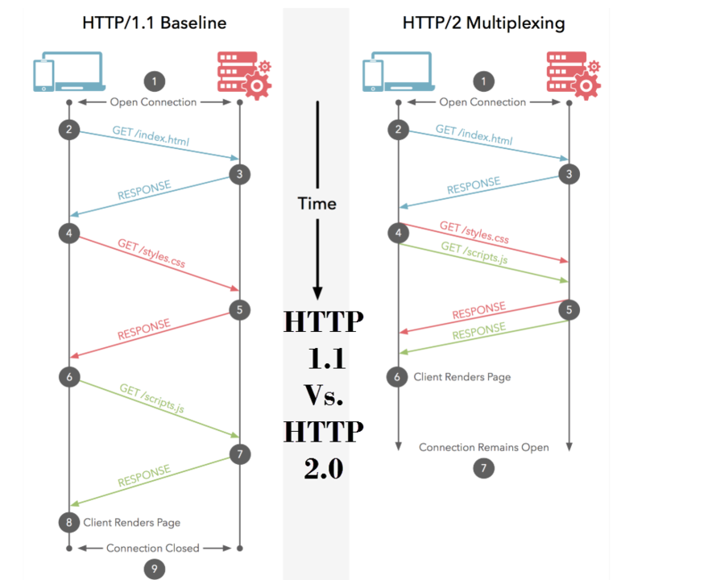

Slide 7
When we use http 1.1 version, if you request web page at a one time only 1 file is getting loaded on your UI, but with HTTP 2.0 both file will get loaded.
This is Multiplexing multiple requests over a single TCP connection an advantage out of many advantages in HTTP 2.0 together with HTTP headers compression, priority and more intelligent packet streaming management. This results in reduced latency and accelerates content download on modern web pages.

Slide 8
Browser JS(JavaScript) VS Node JS
S.no | Browser JS | Node JS
1 | Javascript is a programming language that is used for writing scripts on the websites | NodeJS is a Javascript runtime environment.
2 | Javascript can only be run in the browsers, And it is basically used on the Client – Side. | NodeJS code can be run outside the browser, And it is mostly used on the Server = Side.
3 | Javascript can run in any browser engine as like JS core in Safari and Spidermonkey in Firefox. | NodeJS can only run in V8 engine of Google chorme.
4 | Some of the Javascript Frameworks are RamdaJS, TypedJS etc., | NodeJS modules are Lodash, ExpressJS etc.These modules are to be imported from npm.
5 | Javascript is used in Frontend development. | NodeJS is used in Server-Side development.

Slide 9
EVOLUTION OF HTTP
HTTP/0.9 - The One-Line Protocol
HTTP/1.0 – Building Extensibility
HTTP/1.1 – The Standardized Protocol
HTTP/3 – HTTP Over QUIC

Slide 10
  HTTP/0.9-The One-Line Protocol (1991)
  Initial version of HTTP is a simple client to server protocol. And the request type of this version is single line method, it support GET request method only. The default method to request resources from the server called as the GET Method.
HTTP/1.0-Building Extensibility (1996)
This version is Browser-friendly protocol, It provided with header fields including rich metadata about both request and response And it supports GET, HEAD and POST Methods.

Slide 11
HTTP/1.1-The Standardized Protocol (1997)
  We using this version currently for common use. It introduced critical performance optimizations and feature enhancements, chunked transfers, virtual hosting (a server with a single IP Address hosting multiple domains), faster response and great bandwidth savings by adding cache support, etc. For more than 15 years we using this version and most of the applications works on the HTTP1.1. It supports GET, HEAD, POST, PUT, DELETE, TRACE, OPTIONS Methods.

Slide 12
HTTP/3-HTTP Over QUIC
HTTP/3 is the third and upcoming major version of the Hypertext Transfer Protocol used to exchange information on the World Wide Web. It uses QUIC, a transport layer network protocol developed initially by Google where user space congestion control is used over the User Datagram Protocol (UDP). The switch to QUIC aims to fix a major problem of HTTP/2 called "head-of-line blocking", because the parallel nature of HTTP/2's multiplexing is not visible to TCP's loss recovery mechanisms, a lost or reordered packet causes all active transactions to experience a stall regardless of whether that transaction was impacted by the lost packet. Because QUIC provides native multiplexing, lost packets only impact the streams where data has been lost.

