Slide 1
HOW TO COPY BY VALUE A COMPOSITE DATATYPE
There are 3 ways to copy by value for composite data types.
Using the spread (...) operator.
Using the Object.assign() method.
Using the JSON.stringfiy() and JSON.parse() methods.

Slide 2
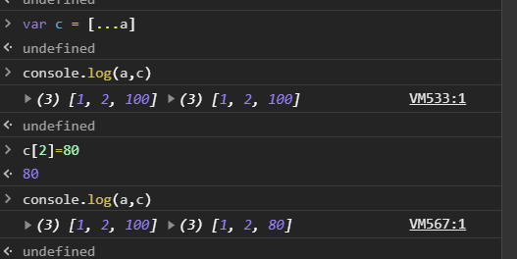
1. Using Spread method :
Spread operator allows an iterable to expand in places where 0+ arguments are expected. It is mostly used in the variable array where there is more than 1 values are expected. It allows us the privilege to obtain a list of parameters from an array.Using spread will clone your object. Note this will be a shallow copy.
In the above example when copied variable value is changed but original variable value remain same.

Slide 3
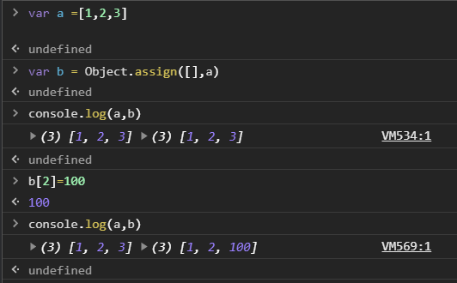
2. Using Object.assign() :
The Object.assign() method copies all enumerable own properties from one or more source objects to a target object. It returns the target object. Note this will be a shallow copy.
Note the empty [] as the first argument, this will ensure you don't mutate the original object.

Slide 4
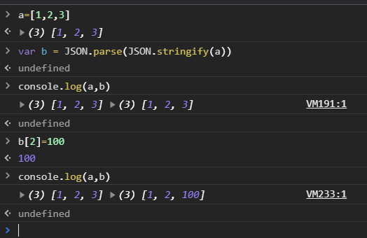
3. Using JSON.parse() and JSON.stringify():
The JSON object, available in all modern browsers, has two useful methods to deal with JSON-formatted content: parse and stringify. JSON.parse() takes a JSON string and transforms it into a JavaScript object. JSON.stringify() takes a JavaScript object and transforms it into a JSON string.Using JSON.parse() and JSON.stringify() for copy performs deep copy .
The deep copy is a true copy for nested objects. Shallow copy copies only reference in case of nested objects.

Slide 5
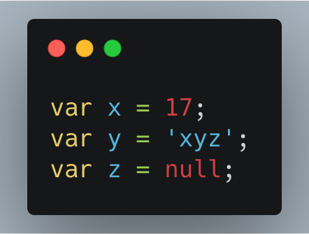
Copy-by-value Vs Copy-by-reference :
Copy-by-value :
In a primitive data-type when a variable is assigned a value we can imagine that a box is created in the memory. This box has a sticker attached to it i.e. the variable name. Inside the box the value assigned to the variable is stored.
In this figure : ‘x’ contain 17 , ‘y’ contain ‘xyz’ , z contain ‘null’

Slide 6
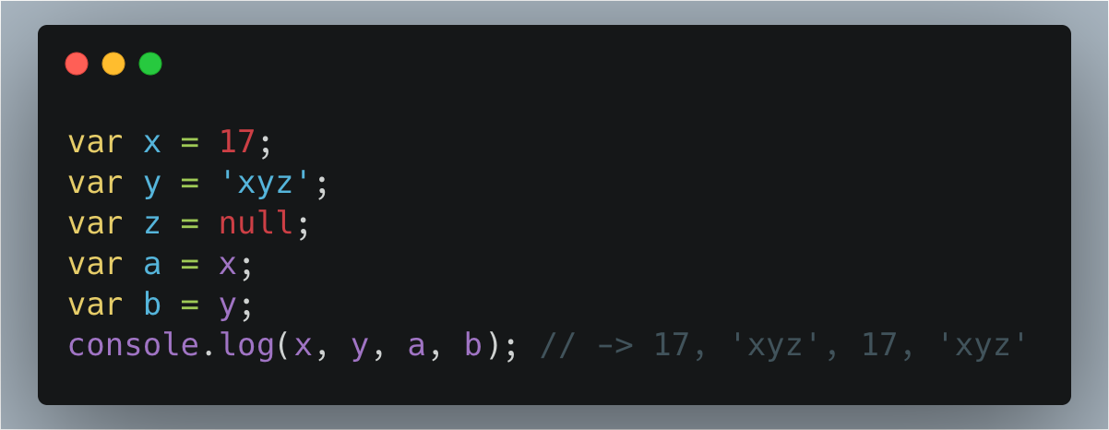
In the Figure 2; the values in the boxes ‘x’ and ‘y’ are copied into the variables ‘a’ and ‘b’.

Slide 7
At this point of time both ‘x’ and ‘a’ contains the value 17. Both ‘y’ and ‘b’ contains the value ‘xyz’. However, an important thing to understand here is that even though ‘x’ and ‘a’ as well as ‘y’ and ‘b’ contains the same value they are not connected to each other. It is so because the values are directly copied into the new variables.
Changes taking palace in one does not affect the other.

Slide 8
Copy - by - reference :
In case of a non-primitive data-type the values are not directly copied. When a non-primitive data-type is assigned a value a box is created with a sticker of the name of the data-type. However, the values it is assigned is not stored directly in the box. The language itself assigns a different memory location to store the data. The address of this memory location is stored in the box created.

Slide 9
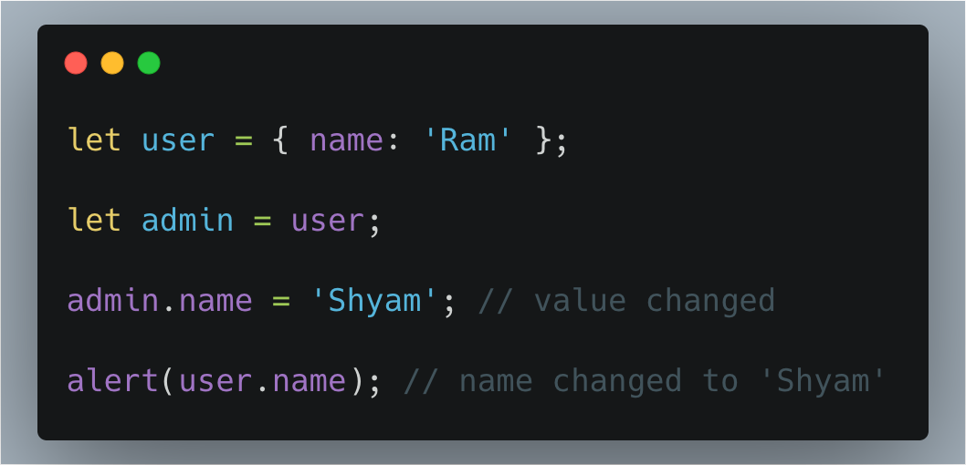
In this Figure 3, when the value of admin is changed it automatically changes the value of user as well.

Slide 10
This happens because both ‘user’ and ‘admin’ are storing the address of the memory location. And when one changes the values in the allocated memory it is reflected in the other as well.
We can further elaborate it we can say that; copy by reference is like having two keys of the same room shared between ‘admin’ and ‘user’. I one of them alters the arrangement of the room the other would experience it ads well.

