Slide 1

Notes:
Welcome. MediDispense is our final year IoT project: a low-cost system that takes a doctor’s prescription to the right hospital bed automatically. Over the next slides I will show why we built it, how we approached the design, what components we used and how the whole system fits together. Please fill in the names, guide and department on this slide before presenting.

Slide 2
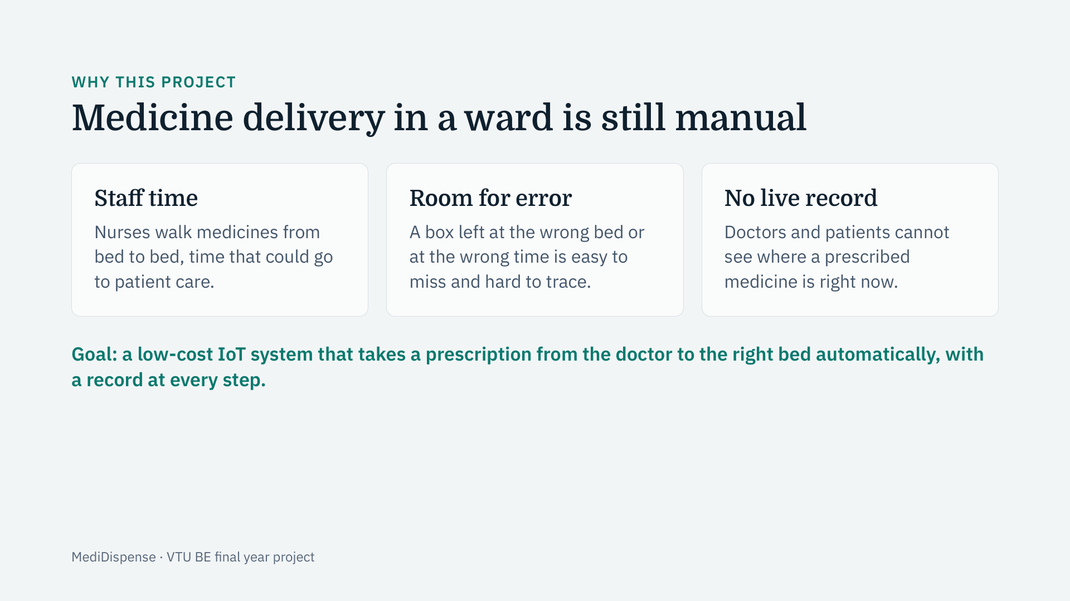
Notes:
Start with the problem. In a ward, delivering medicine is done by hand: it costs nurses time, it can go to the wrong bed, and nobody except the person carrying it knows where it is. Our goal was a low-cost IoT system that handles the delivery automatically and keeps a record at every step. We did not set out to replace nurses, only to remove the walking and the guesswork.

Slide 3
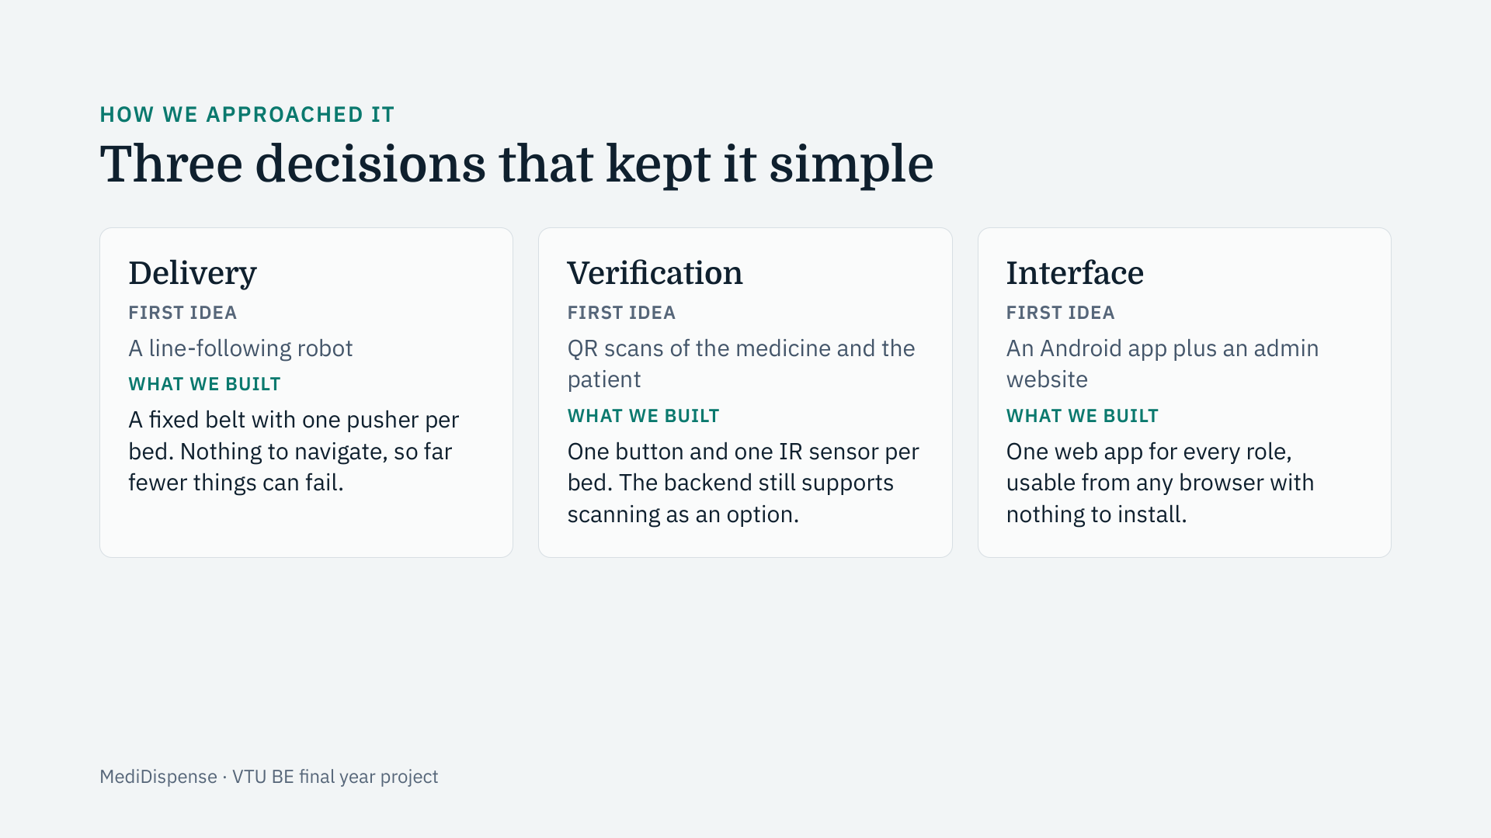
Notes:
This is how our thinking changed. We began with a line-following robot, QR scanning and an Android app. Each of those added parts that could fail and made the demonstration harder to repeat. We moved to a short fixed belt with a pusher at each bed, a single button and a sensor per bed instead of scanning, and one web application for all roles instead of separate apps. The result is cheaper, simpler and more reliable, while still showing the full idea.

Slide 4
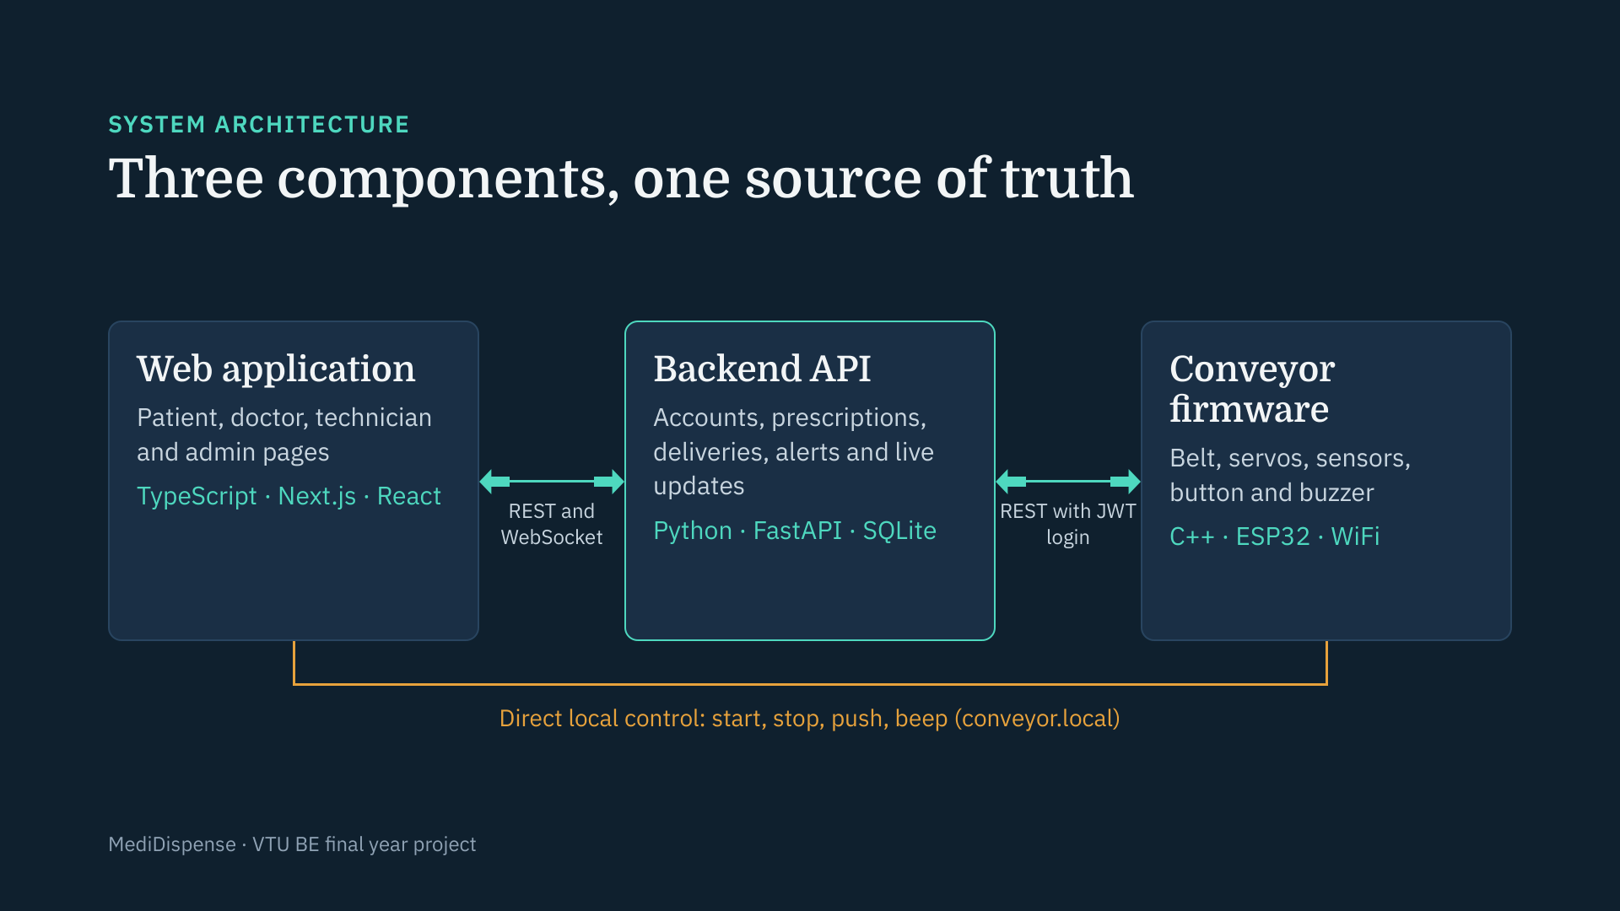
Notes:
Our architecture has three independent components. The backend is the single source of truth: it stores every account, prescription and delivery. The web application is how every person uses the system, and it receives live updates over a WebSocket. The conveyor firmware runs on the ESP32; it logs in to the backend, asks for the next job and reports back. The orange path is the one exception to going through the backend: a technician’s browser can command the conveyor directly on the local network for testing and commissioning, and those commands do not create or change delivery records.

Slide 5
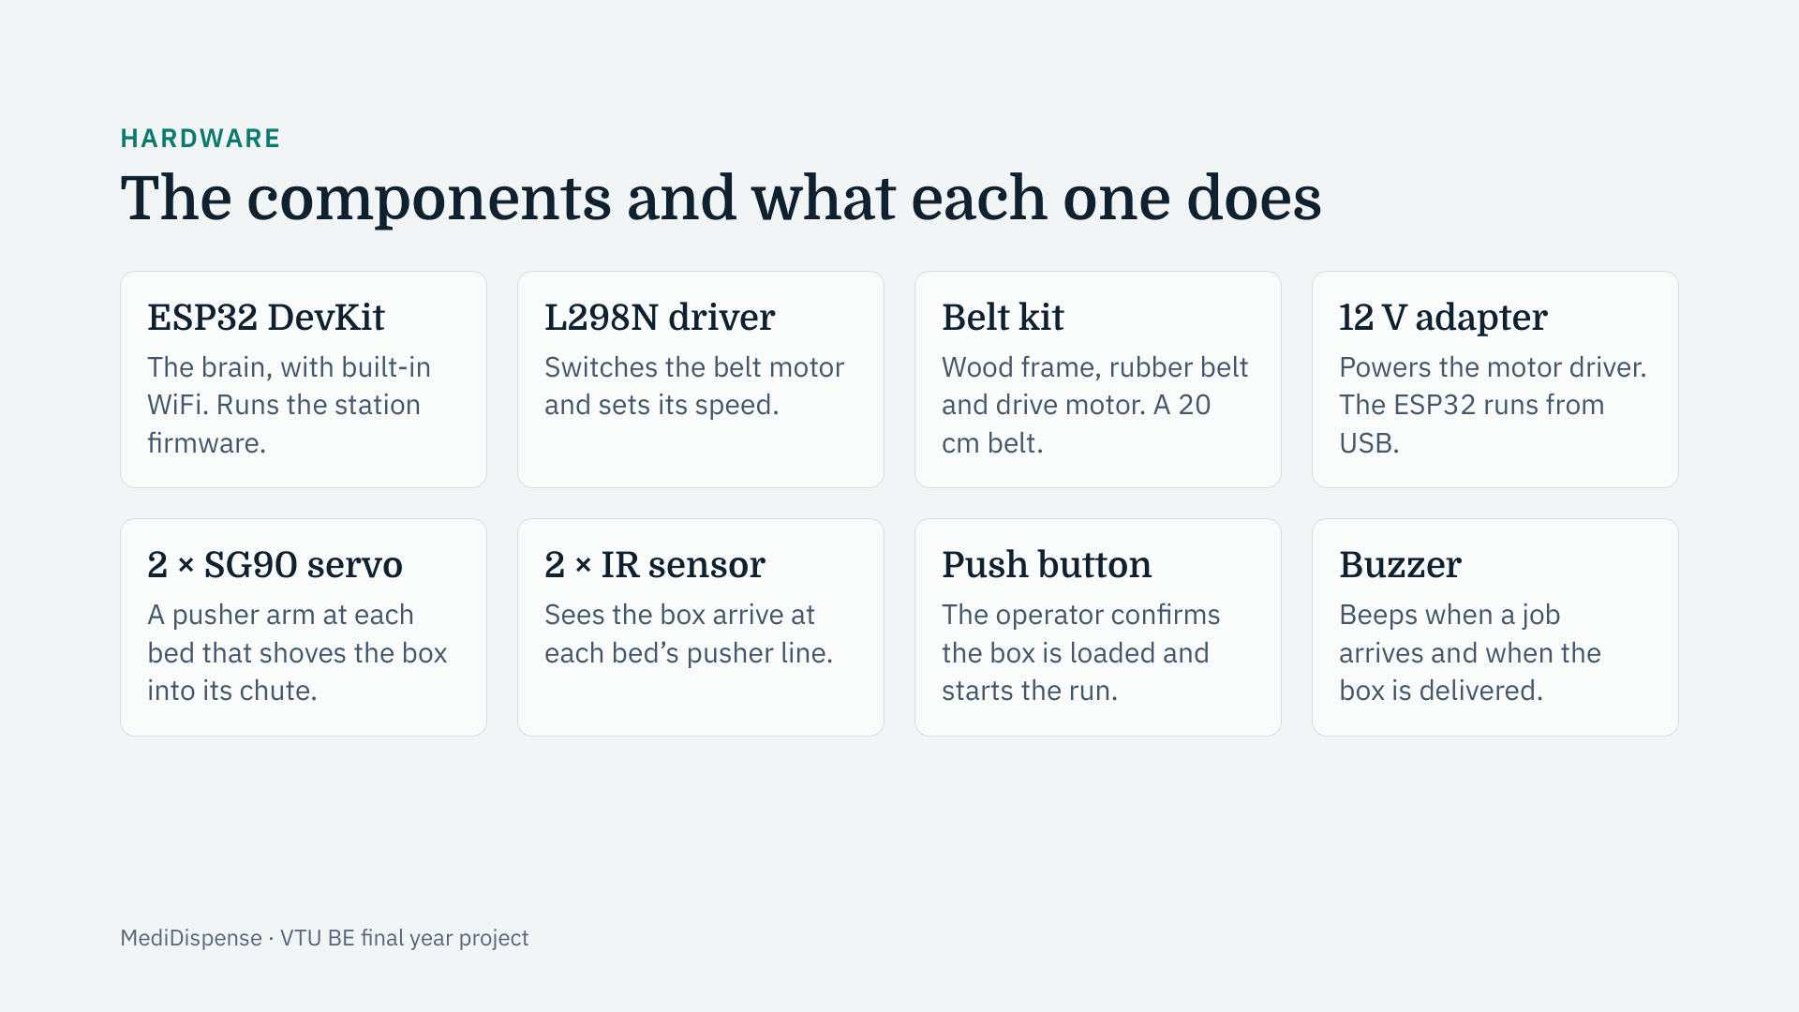
Notes:
These are the eight building blocks. The ESP32 is the brain and talks to the backend over WiFi. The L298N is a motor driver, because the ESP32 cannot power a motor directly. The belt kit gives us a real frame, belt and motor, so we did not have to build the mechanics from scratch. Two servos act as pushers, one per bed, and two infrared sensors tell the firmware when the box has reached each bed. The button and the buzzer are the operator’s interface. Only the motor driver needs the 12 volt adapter; the ESP32 runs from USB.

Slide 6
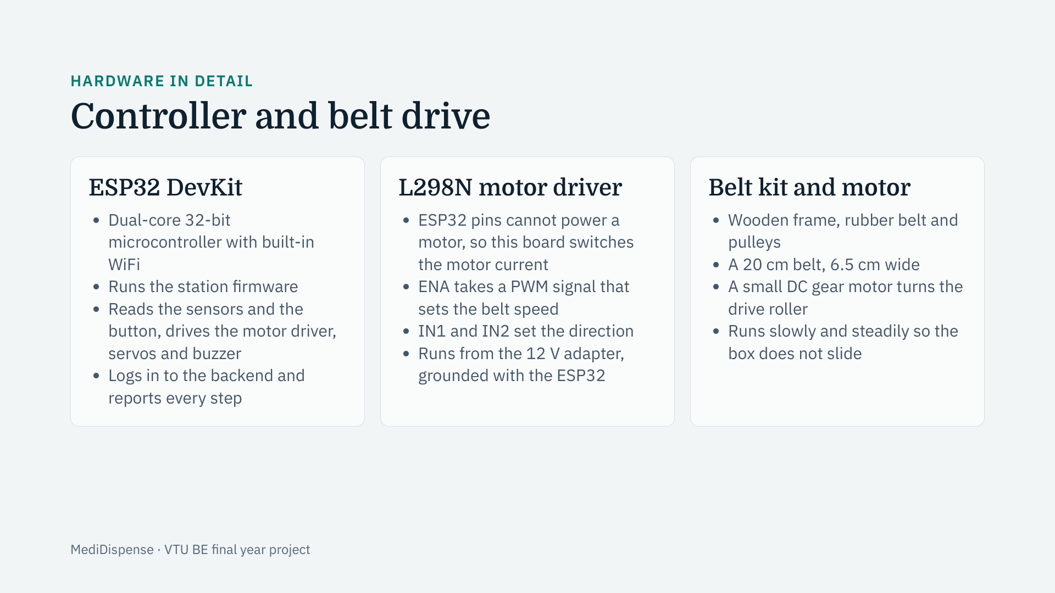
Notes:
The ESP32 is the controller. It has WiFi on the chip, so it can talk to the backend without a cable to a computer, and it reads every input and drives every output. It cannot power a motor itself, so the L298N sits between them: the ESP32 sends it small control signals, and the driver switches the larger motor current from the 12 volt supply. One signal sets the speed using PWM, and two signals set the direction. The belt kit supplies the mechanics: a wooden frame, a real rubber belt and a small geared DC motor. We run the belt slowly so the medicine box rides steadily instead of sliding.

Slide 7
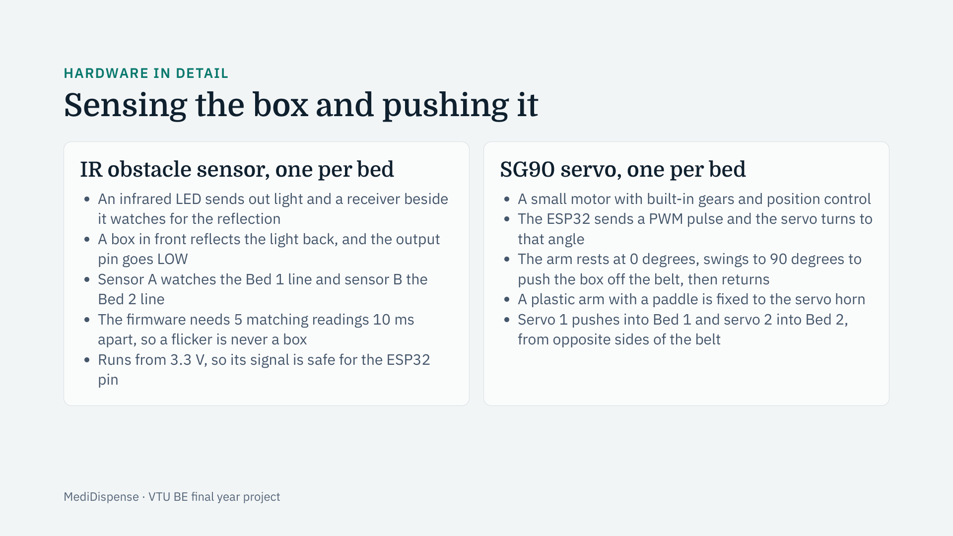
Notes:
These two parts do the sensing and the moving. Each infrared sensor sends out invisible light and watches for it to bounce back. When the box passes in front of it, the reflection appears and the sensor’s output goes low; the firmware only accepts that after five matching readings, so electrical noise cannot fake a box. Using one sensor per bed means the firmware does not have to guess the box’s position from belt timing. The servos are the pushers: the ESP32 sends a pulse whose width sets the angle, the arm swings across the belt and shoves the box into the chute. The rest and push angles are set in the firmware settings, zero and ninety degrees by default, and are calibrated on the mounted arm.

Slide 8
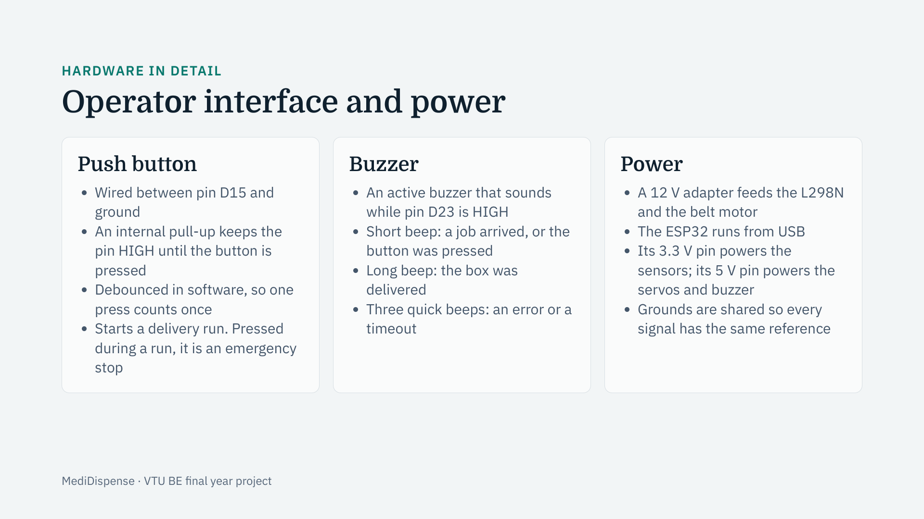
Notes:
The button and the buzzer are how a person talks to the machine. The button needs no power wire: one leg goes to a pin and the other to ground, and the chip’s own pull-up resistor holds the pin high until it is pressed. A press starts the run, and a press during a run is an emergency stop. The buzzer tells the operator what is happening: a short beep for a job or a button press, a long beep for a delivery, and three quick beeps for an error. For power, the motor has its own 12 volt supply, while the ESP32 runs from USB and powers the sensors and servos from its own pins, with the grounds tied together.

Slide 9
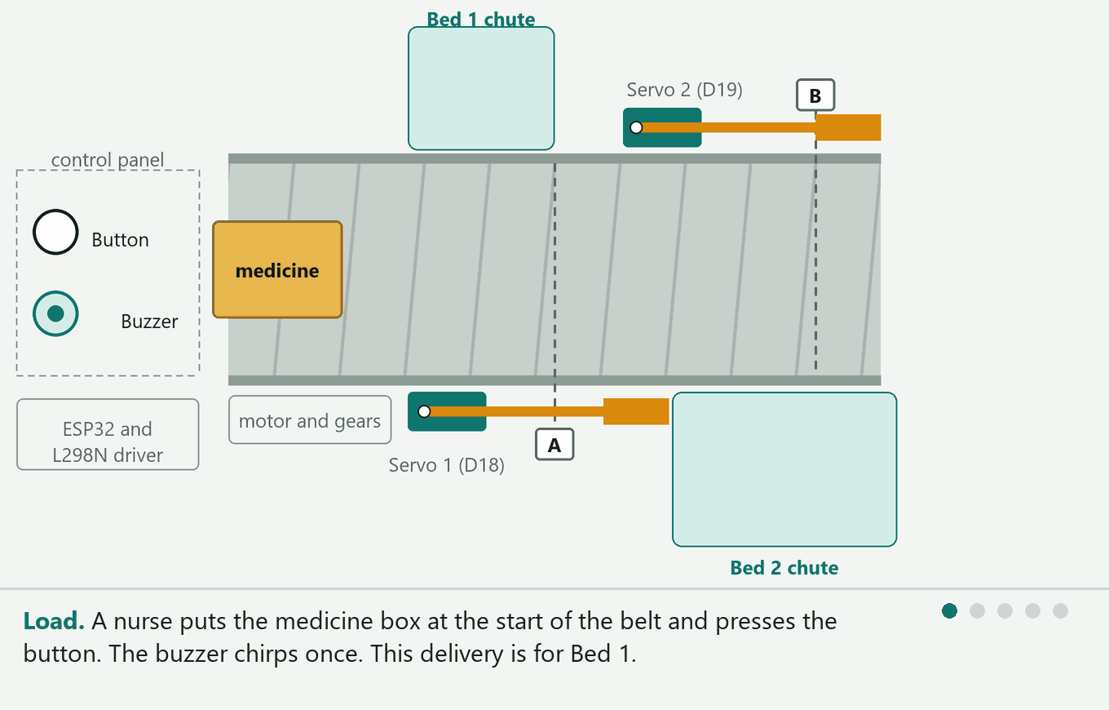
HARDWARE IN ACTION
How the servos and sensors deliver the box
Animation plays in Slide Show mode (F5). MediDispense · VTU BE final year project
Notes:
This animation shows one delivery to Bed 1 and then one to Bed 2. The nurse presses the button, the belt carries the box, and the sensor at the right bed stops it. Servo 1, on the near side, swings its arm across the belt into the Bed 1 chute. Servo 2, on the opposite side, pushes the other way into the Bed 2 chute. The red dashed line is the sensor seeing the box. Play it in Slide Show mode; it loops by itself. The same animation also runs live in the web version of the deck.

Slide 10
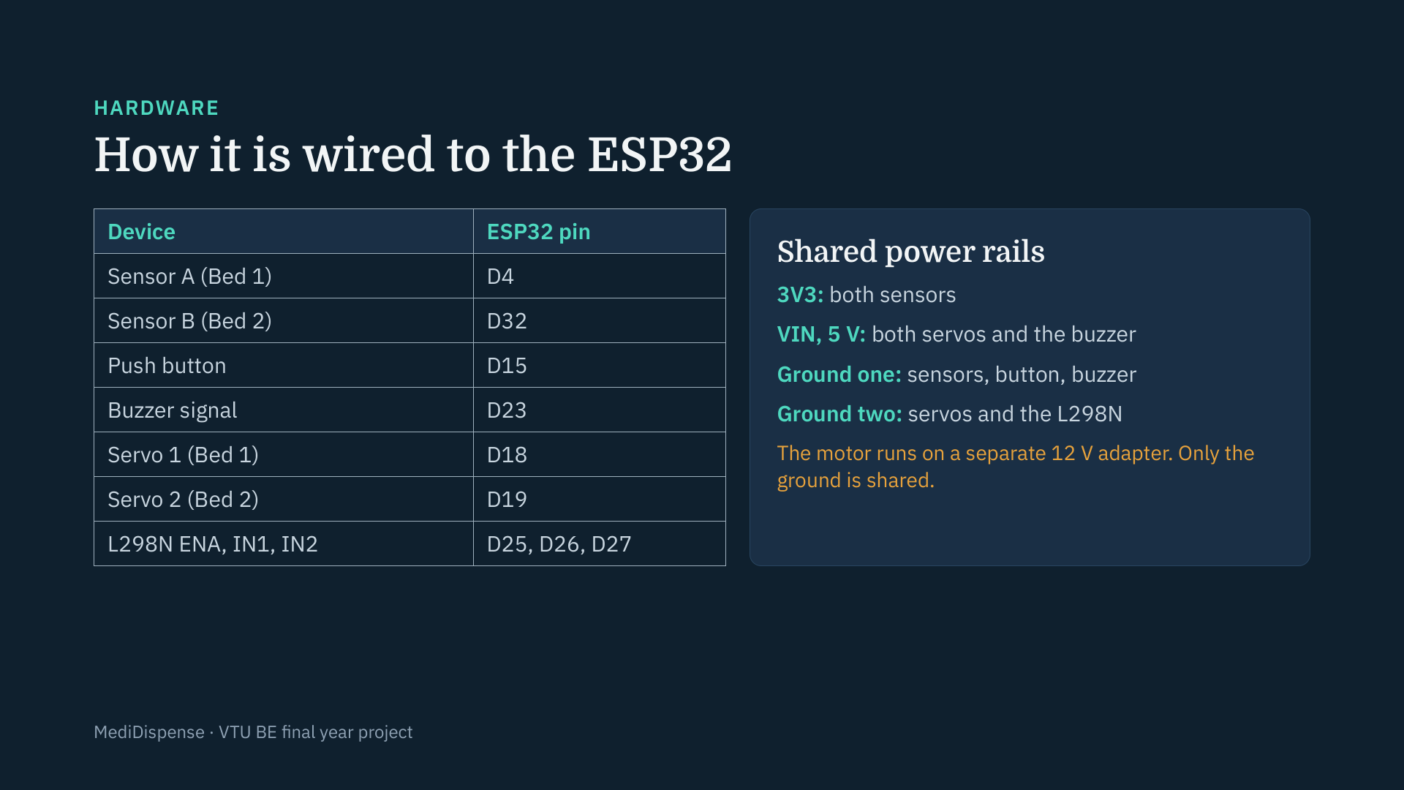
Notes:
This is the complete pin map. Each sensor, the button, the buzzer, the servos and the three motor-driver inputs have their own GPIO pin. The ESP32 has only two ground pins, one 5 volt pin and one 3.3 volt pin, so the power wires are joined into four shared rails: one for 3.3 volts, one for 5 volts, and two grounds, split so the noisy servos and motor driver do not share a ground with the sensitive sensors. The sensors run on 3.3 volts because their signal goes straight into an ESP32 pin. The motor has its own 12 volt supply and only the ground is common.

Slide 11
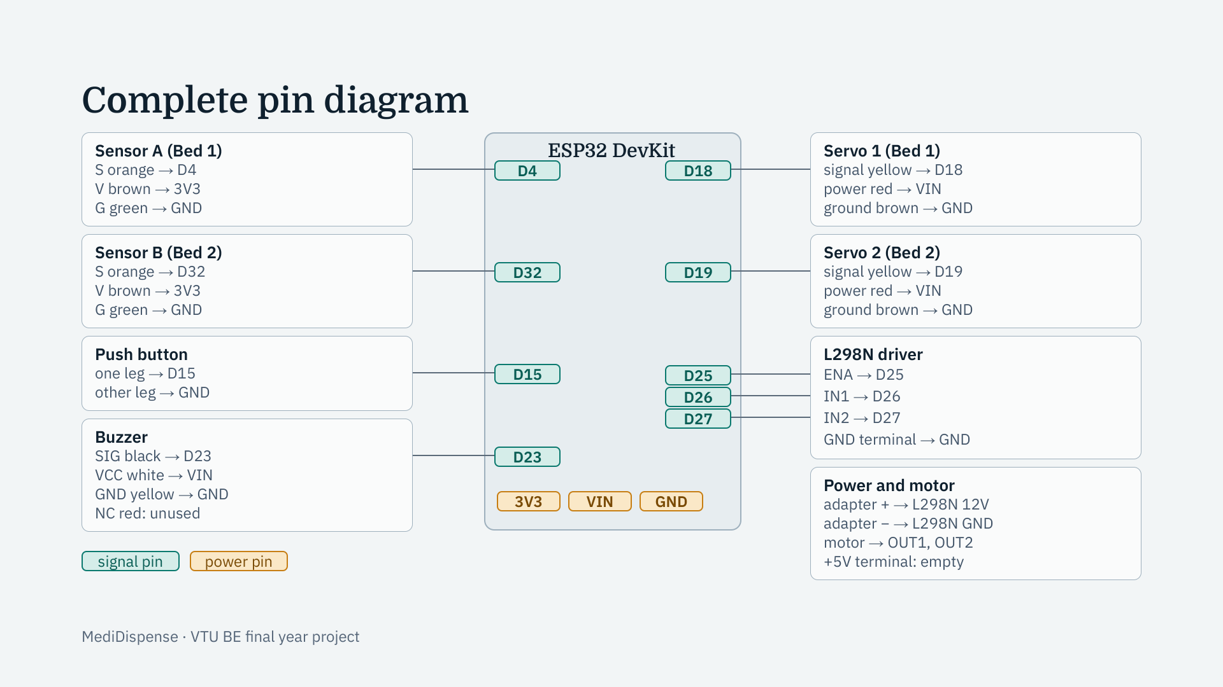
Notes:
This is the complete wiring in one picture. Each device on the left and right lists its own wires and the ESP32 pin each one goes to. The teal pins in the middle carry signals; the amber 3V3, VIN and GND pins carry power and ground and are shared: both sensors take 3.3 volts, the servos and the buzzer take 5 volts from VIN, and the grounds are joined. The motor and its 12 volt adapter connect only to the L298N, with a common ground back to the ESP32.

Slide 12
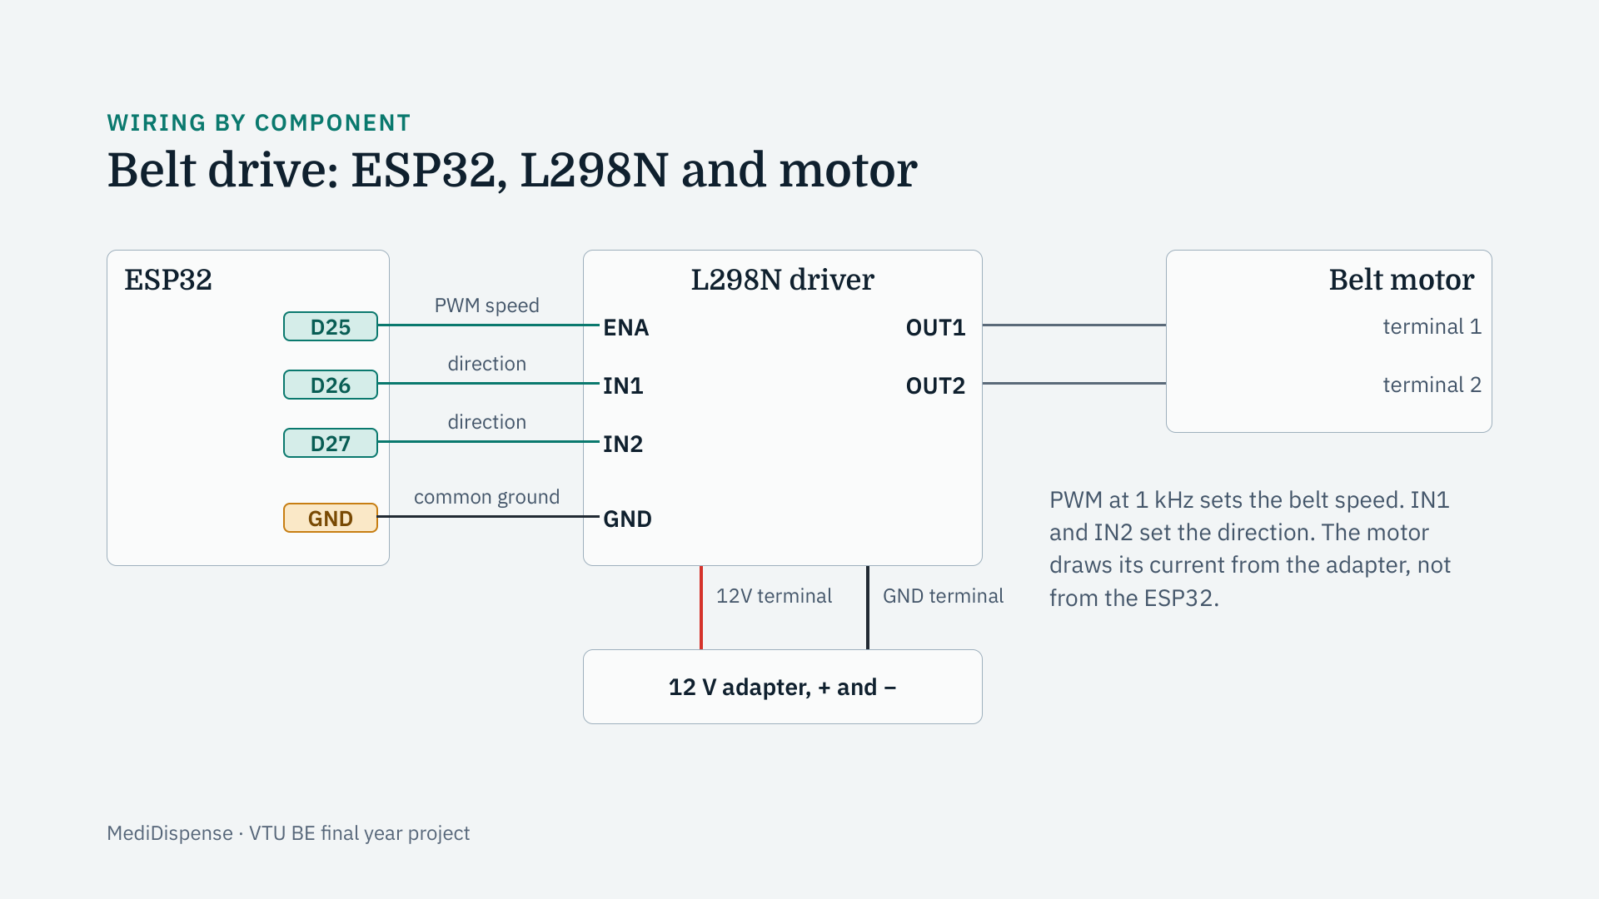
Notes:
This is the belt drive. The ESP32 cannot power a motor, so three of its pins control the L298N: ENA carries a PWM signal that sets the speed, and IN1 and IN2 set the direction. The motor connects to the driver’s OUT1 and OUT2 terminals. The driver gets its power from a separate 12 volt adapter on its 12V and GND terminals. The ESP32’s ground is joined to the driver’s ground so the control signals have a common reference.

Slide 13
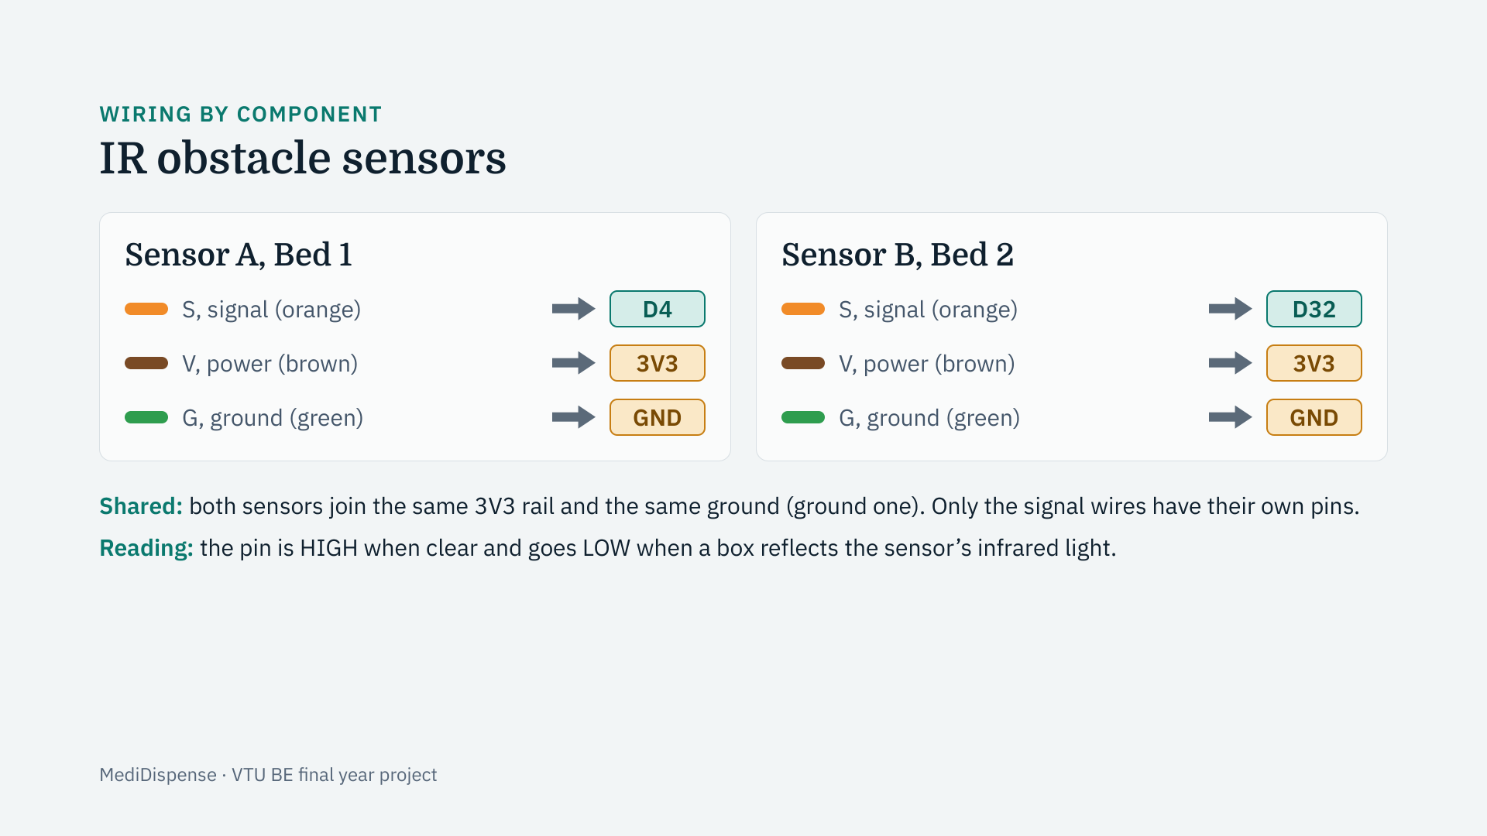
Notes:
Each IR sensor has three wires. The orange signal wire goes to its own ESP32 pin: D4 for sensor A at Bed 1 and D32 for sensor B at Bed 2. The brown power wires from both sensors are joined and go to the 3.3 volt pin, and the green ground wires are joined and go to one of the ESP32 ground pins. The sensors run on 3.3 volts so their signal is safe for the ESP32. The signal is high when nothing is in front of the sensor and drops low when the box reflects the infrared light.

Slide 14
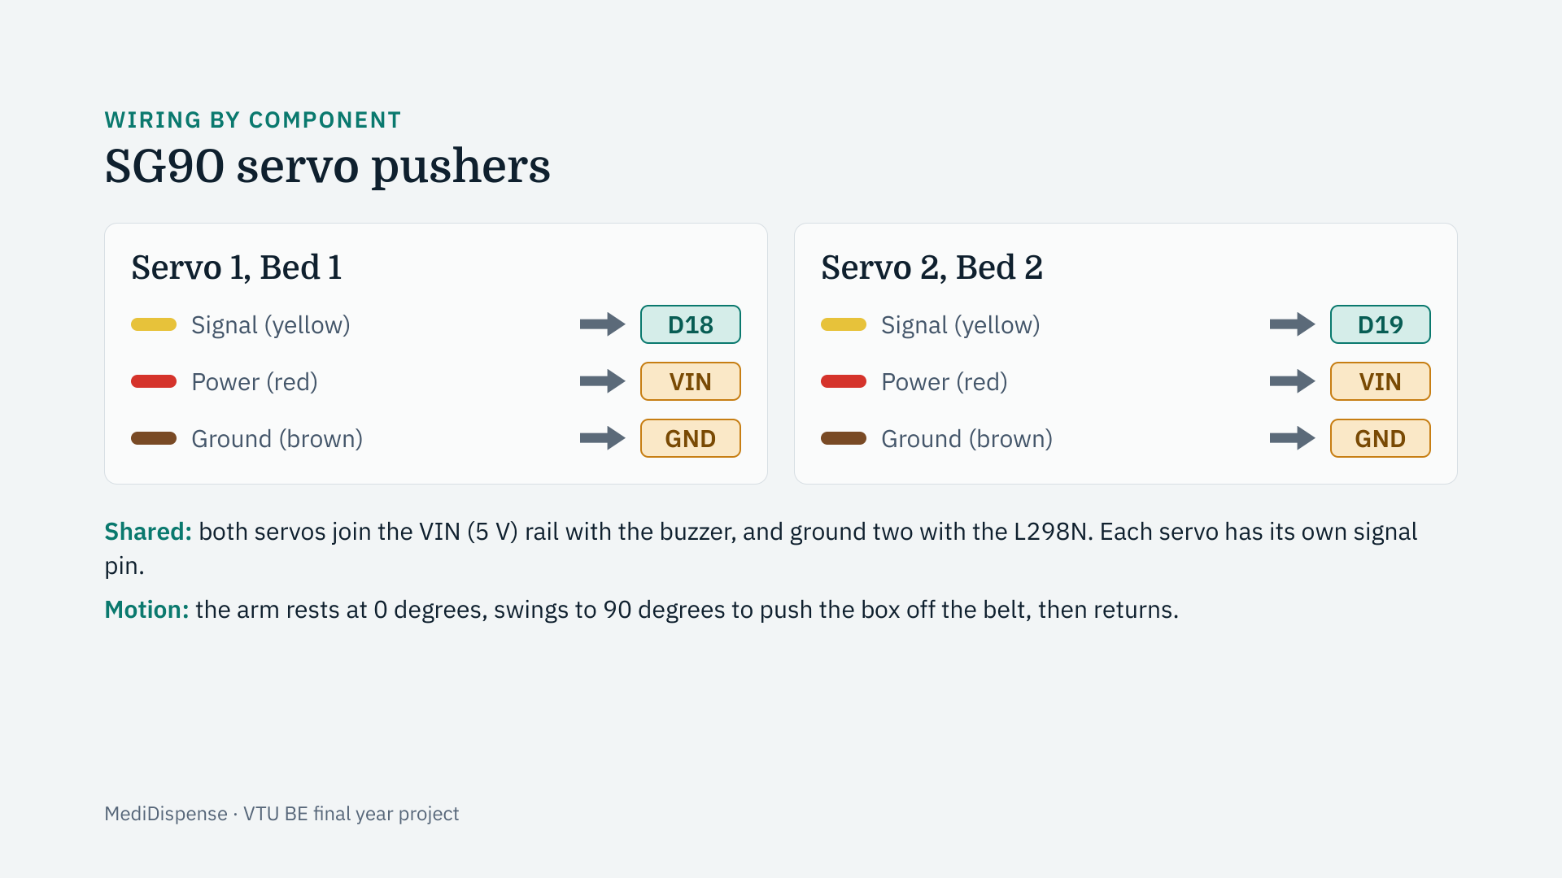
Notes:
Each SG90 servo also has three wires. The yellow signal wire carries the PWM pulse that sets the angle, to D18 for servo 1 and D19 for servo 2. The red wires of both servos join the 5 volt VIN pin along with the buzzer. The brown ground wires of both servos join the second ground, which also carries the L298N’s ground. The servos are kept off the sensors’ ground so their current pulses do not disturb the sensors.

Slide 15
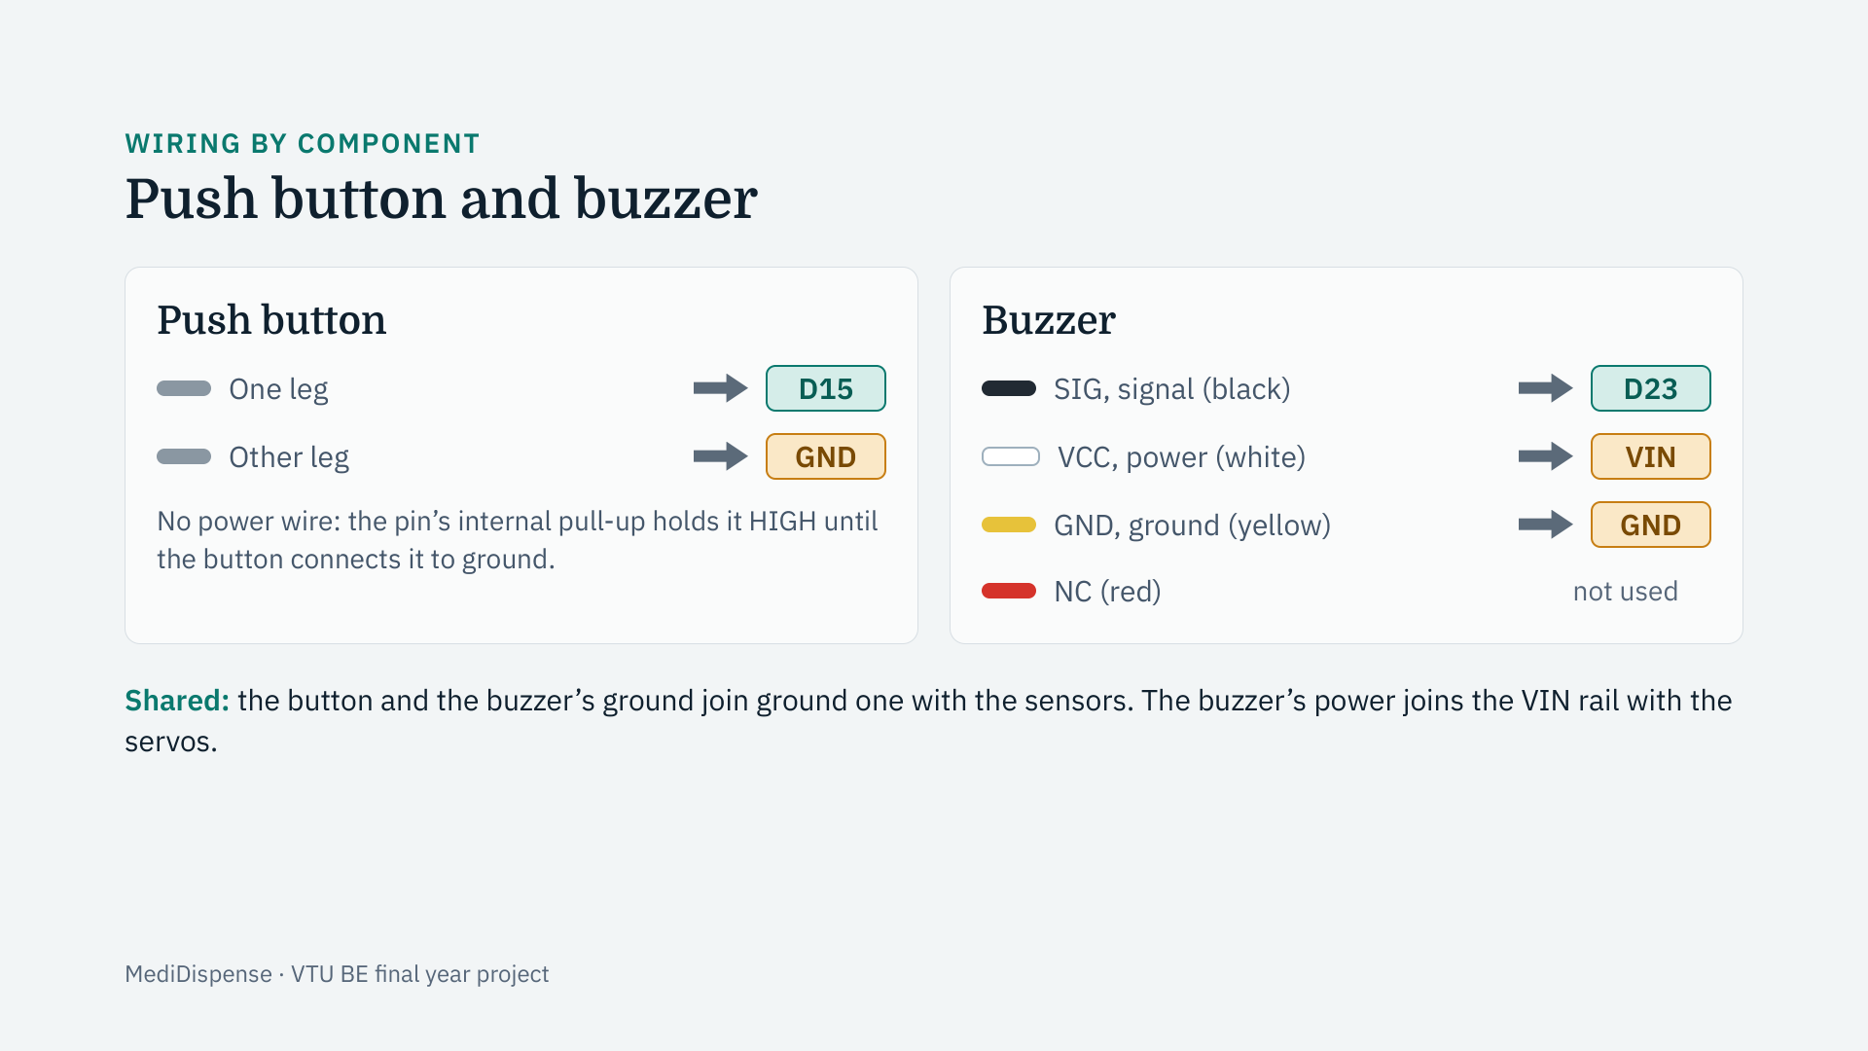
Notes:
The button is wired between pin D15 and ground; the chip’s internal pull-up keeps the pin high until the button is pressed. The buzzer module has four wires. The black signal wire goes to D23, the white power wire to the 5 volt VIN pin, and the yellow ground wire to ground one. The red NC wire is not connected inside the module and is left unused. The colours follow the labels printed on the buzzer board, not the usual convention.

Slide 16
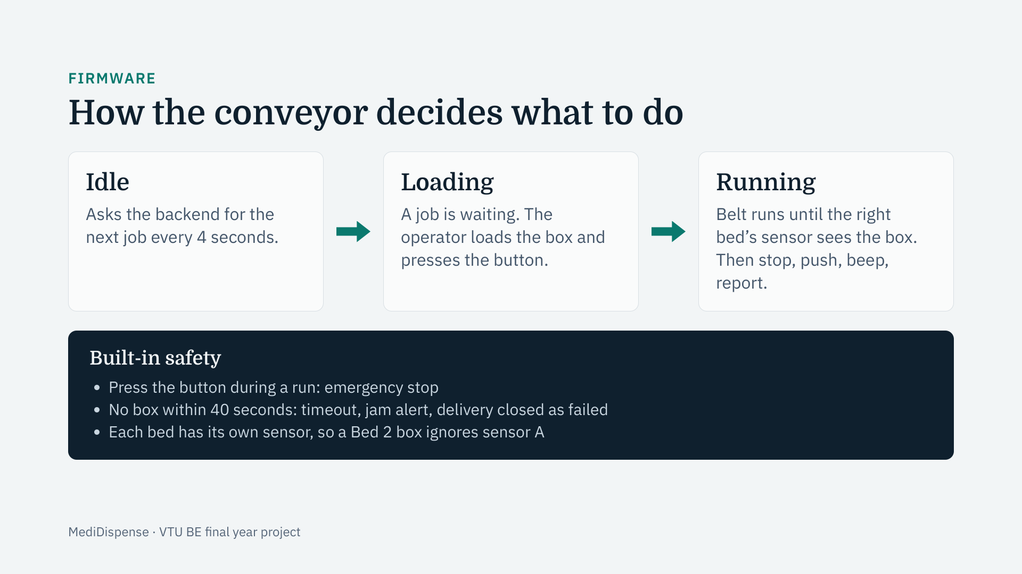
Notes:
The firmware is a small state machine with three states. In Idle it logs in to the backend and asks for the next waiting job every four seconds. When one arrives it beeps and waits in Loading until the operator has put the box on the belt and pressed the button; that press tells the backend the run has started. In Running the belt moves until the sensor at the job’s own bed sees the box, then it stops the belt, pushes with that bed’s servo, beeps and reports the arrival to the backend. Safety matters in a hospital, so a second button press is an emergency stop, and a run that never reaches its sensor times out after forty seconds and raises an alert. Note: this complete firmware is written and compiles; the first full flash and run on the machine is the remaining step.

Slide 17
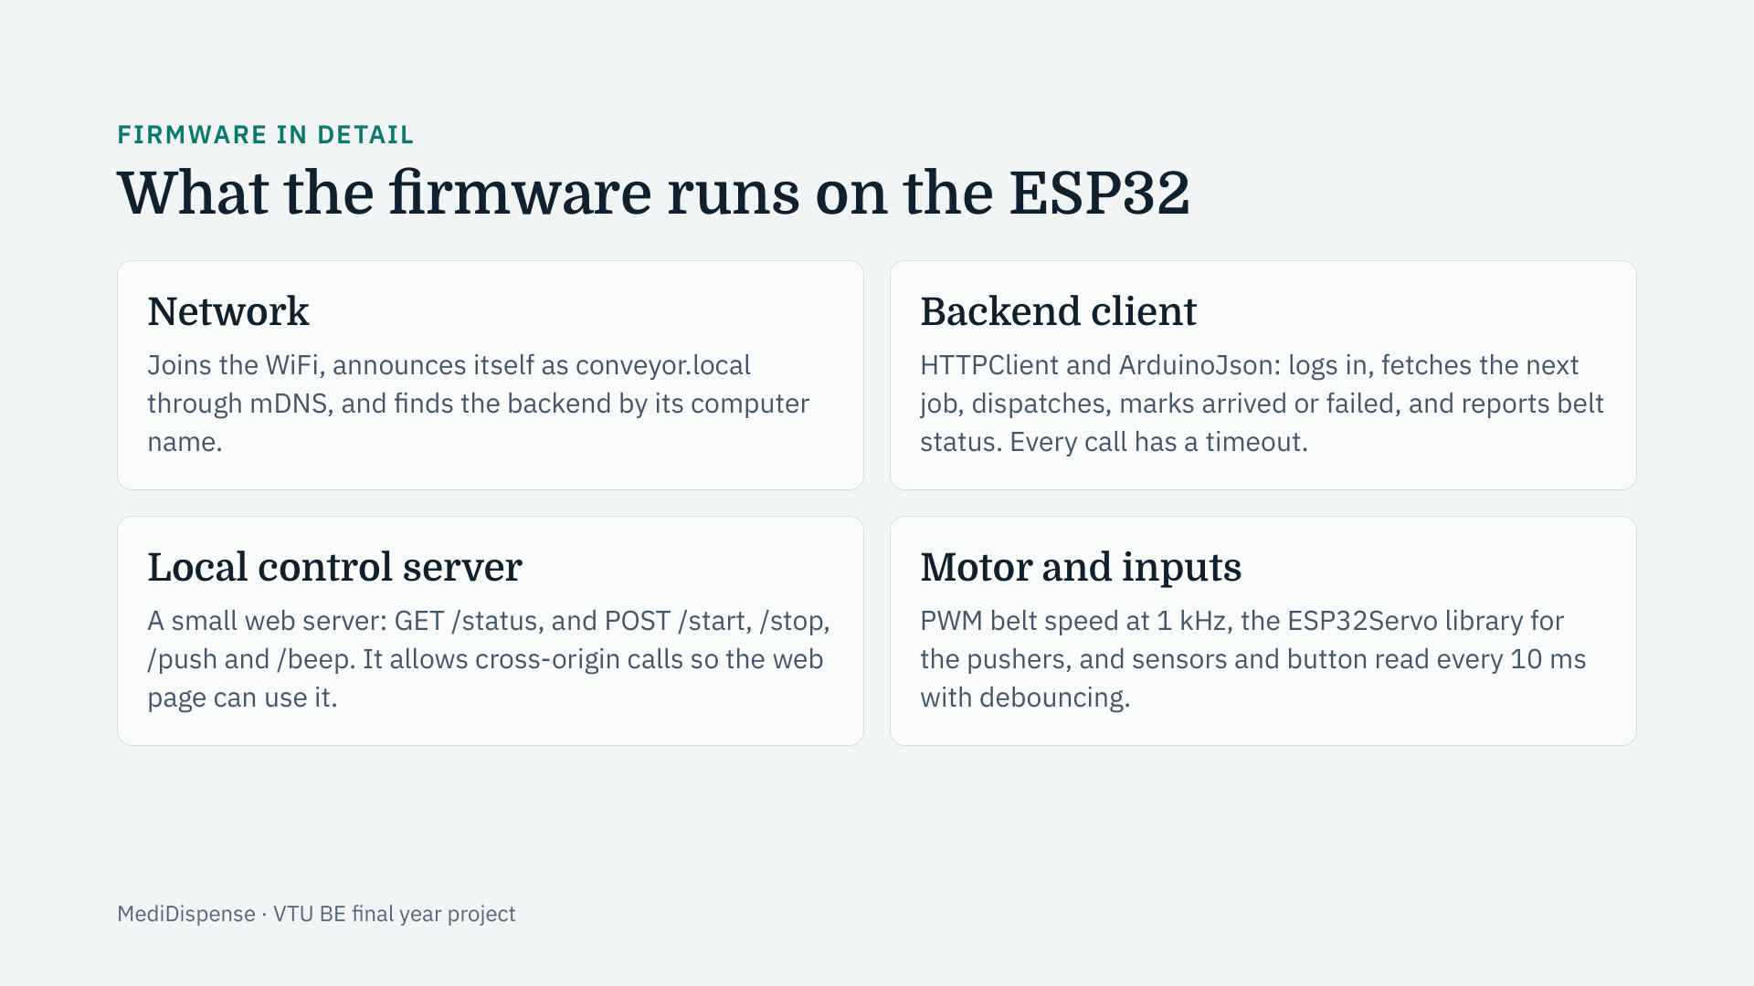
Notes:
The firmware is four services in one program. The network service joins the WiFi and uses mDNS so the machine can be found as conveyor.local and can find the backend by name, which matters because the router keeps changing addresses. The backend client logs in with the machine’s own technician account and calls the same API the web app uses. The local control server lets the technician’s browser start, stop and push directly on the local network, using small HTTP routes. And the motor and input code runs the belt with PWM, moves the servos and reads the sensors and button with debouncing so noise cannot trigger a delivery.

Slide 18
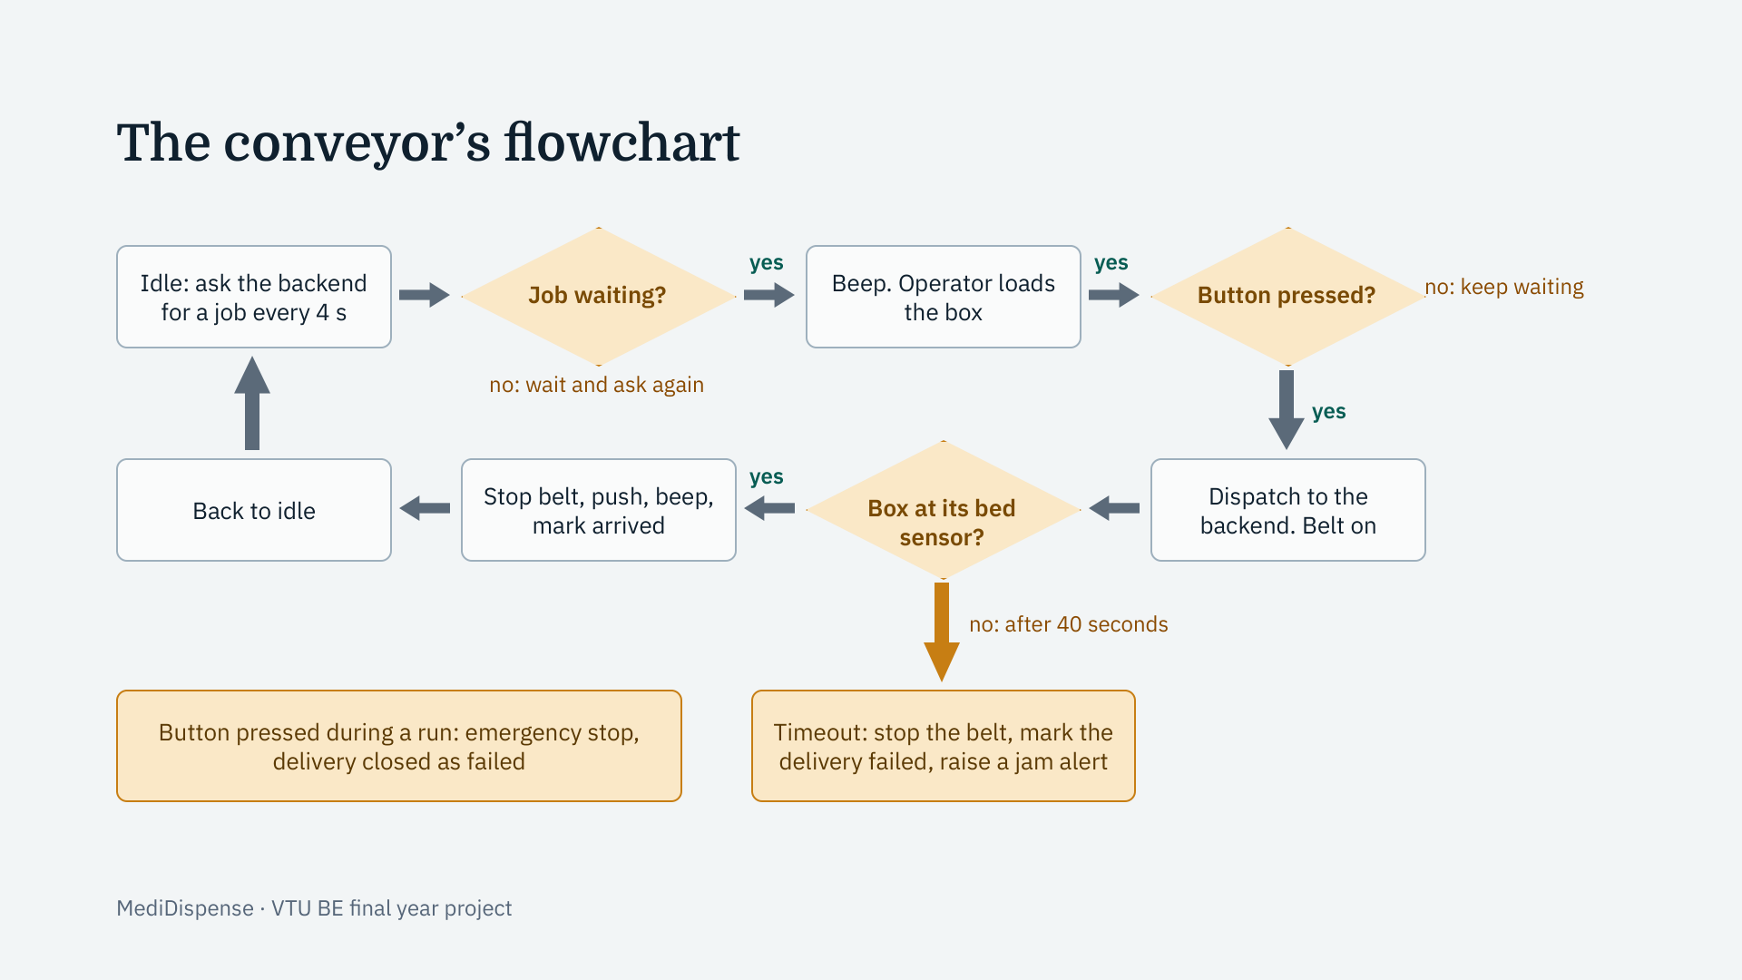
Notes:
This is the conveyor’s decision logic as a flowchart. At the top, it idles and asks the backend for a job every four seconds. When a job is waiting it beeps, and the operator loads the box and presses the button. Pressing the button dispatches the delivery in the backend and starts the belt. The belt runs until the sensor at that job’s own bed sees the box; then the firmware stops the belt, pushes with the servo, beeps and marks the delivery arrived, and goes back to idle. The two amber boxes at the bottom are the safety paths: if no box reaches its sensor within forty seconds, or if the button is pressed during a run, the belt stops and the delivery is closed as failed.

Slide 19
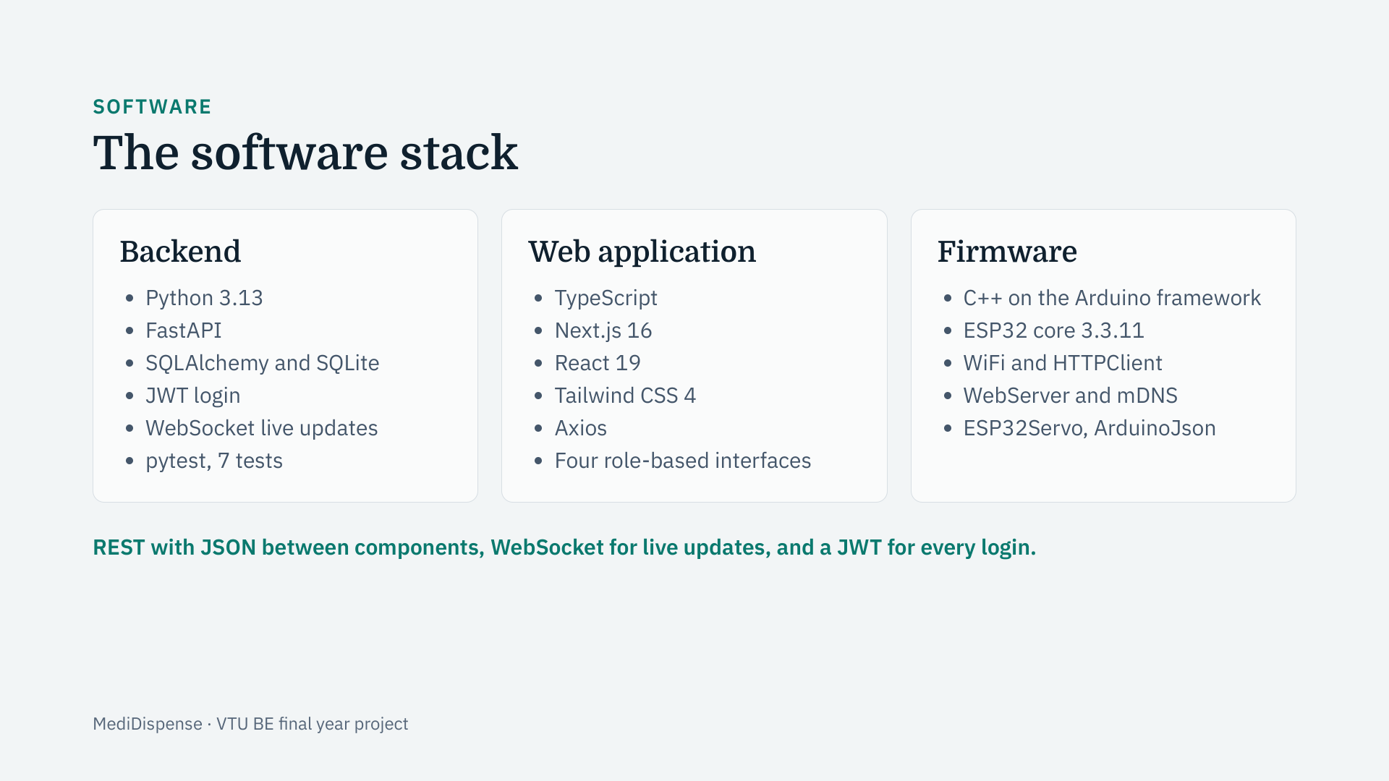
Notes:
Each component uses the tool that suits it. The backend is Python with FastAPI, which validates every request automatically and supports WebSockets; data is stored with SQLAlchemy, on SQLite for development with a path to MySQL. The web application is TypeScript on Next.js and React. The firmware is C++ on the Arduino framework, using the ESP32’s own WiFi and a small web server so it can also be controlled directly on the local network. The same token-based login serves both the browser and the microcontroller.

Slide 20
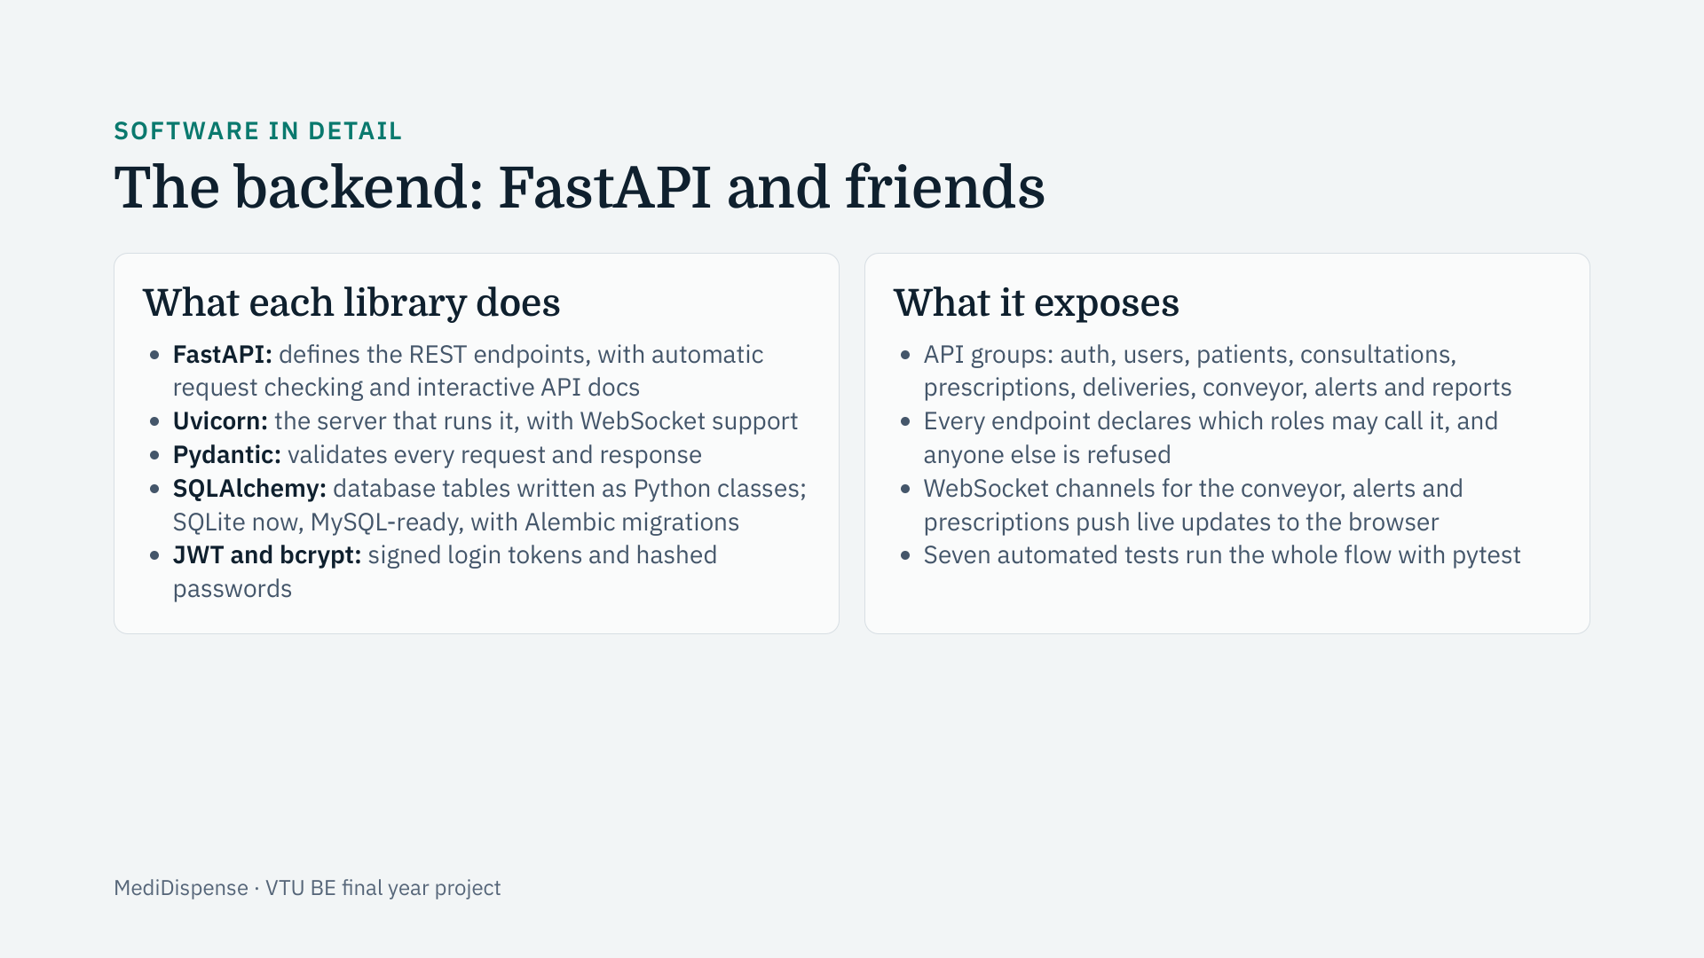
Notes:
The backend is written in Python with FastAPI. FastAPI defines each endpoint as a normal function and uses Pydantic to check that every request and response has the right shape, and it generates interactive documentation for free. Uvicorn runs the application and handles WebSockets. SQLAlchemy lets us declare the database tables as Python classes, so we develop on SQLite and can move to MySQL by changing a connection string, with Alembic tracking schema changes. Logins use signed JWT tokens and bcrypt-hashed passwords. Each endpoint says which roles may call it, so a patient cannot reach staff functions. WebSocket channels push live updates, and seven pytest tests run the whole workflow.

Slide 21
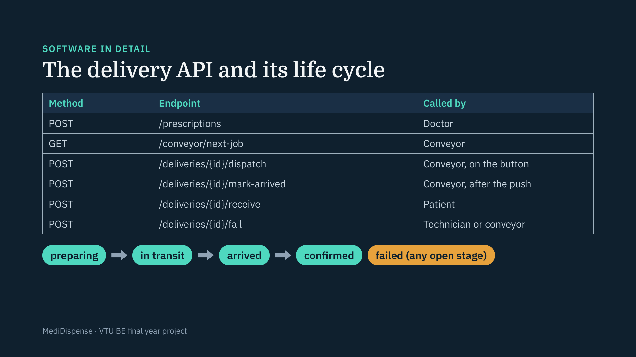
Notes:
This is the part of the API that connects everyone. A doctor’s prescription creates a delivery in the preparing state. The conveyor asks for the next waiting job, and when the operator presses the button it calls dispatch, which moves the delivery to in transit. After the servo pushes the box, the conveyor calls mark-arrived. The patient then taps I received it, which calls receive and confirms the delivery. If a run is stopped or never completes, a technician or the machine itself can call fail to close it, so a delivery never stays stuck. Each step is checked, for example you cannot dispatch the same delivery twice.

Slide 22
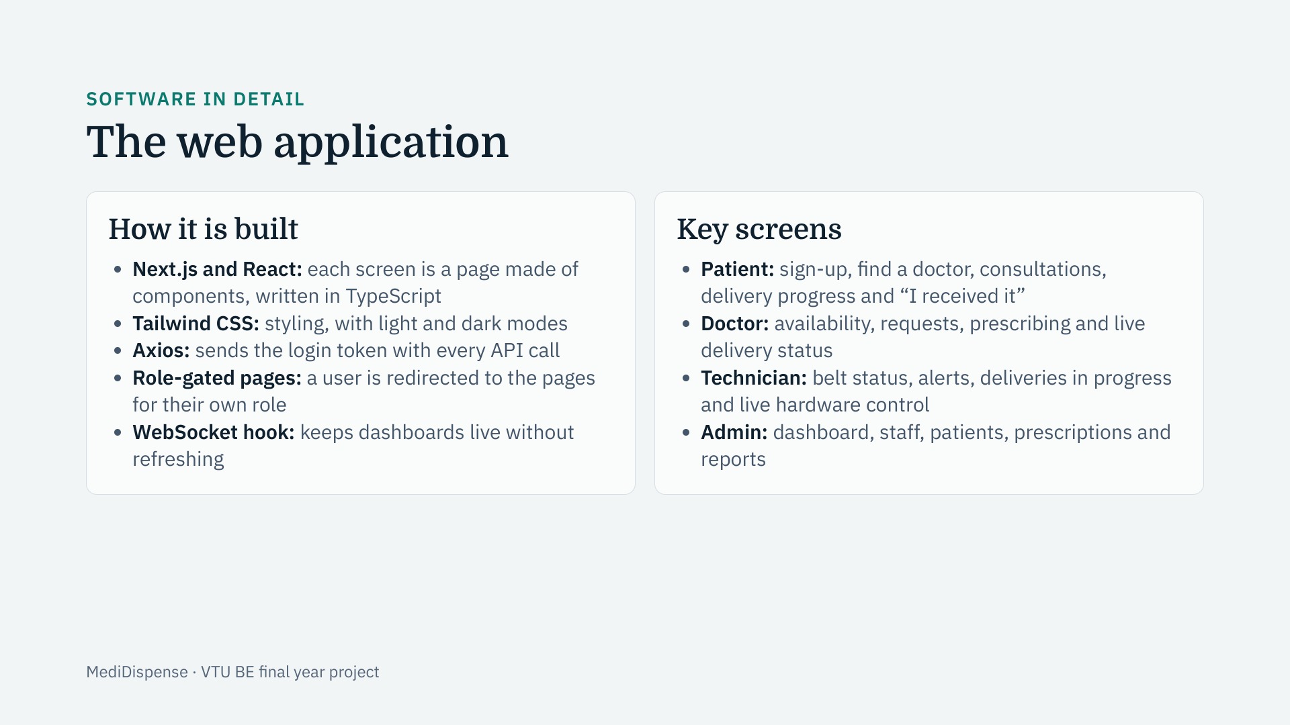
Notes:
The web application is built with Next.js and React in TypeScript, so the compiler catches many mistakes before they reach the browser. Each screen is a page made of reusable components, styled with Tailwind. The login token is attached to every API call by Axios, and each page checks the user’s role and redirects them to the right place, so a patient never sees staff screens. A WebSocket hook listens to the backend’s live channels, so statuses update on screen without refreshing. The technician’s hardware panel is a component that calls the conveyor directly over the local network.

Slide 23
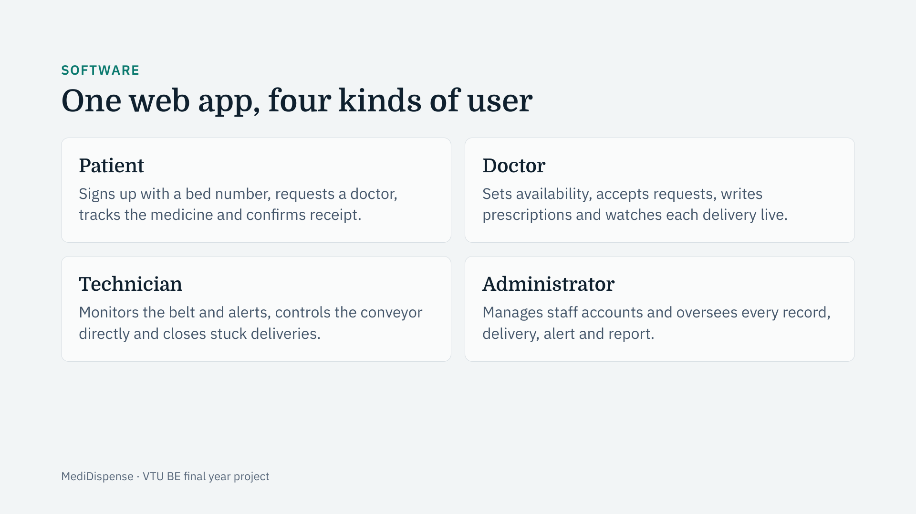
Notes:
After logging in, each user is taken to the pages for their own role, and pages that belong to other roles cannot be opened. A patient registers themselves; staff accounts are created by the administrator. Replacing the Android app with one web application means every role runs on any device with a browser and nothing needs installing.

Slide 24
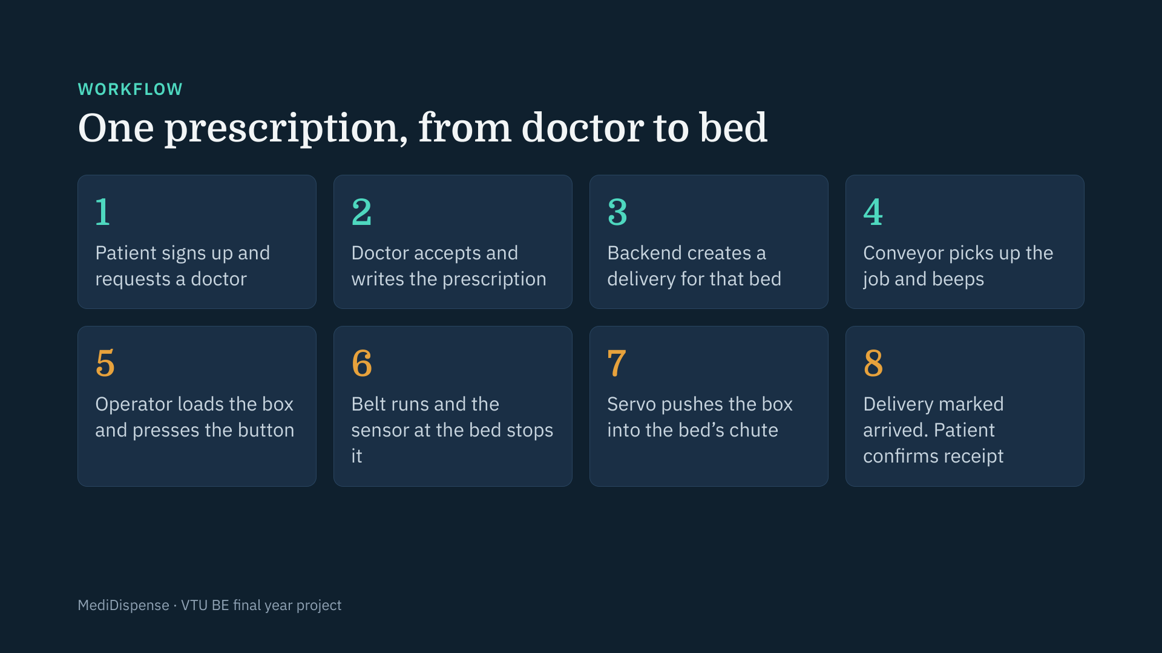
Notes:
This is the complete journey of one prescription. Steps one to three are software: the patient requests a doctor, the doctor prescribes, and the backend creates a delivery for the patient’s bed. Steps four to seven, in orange, are the physical machine: it picks up the job, the operator loads the box and presses the button, the belt carries it to the right bed and the servo pushes it into the chute. In step eight the delivery is marked as arrived and the patient closes the loop from their own page. Every step is recorded, and doctors and patients see the status update live.

Slide 25
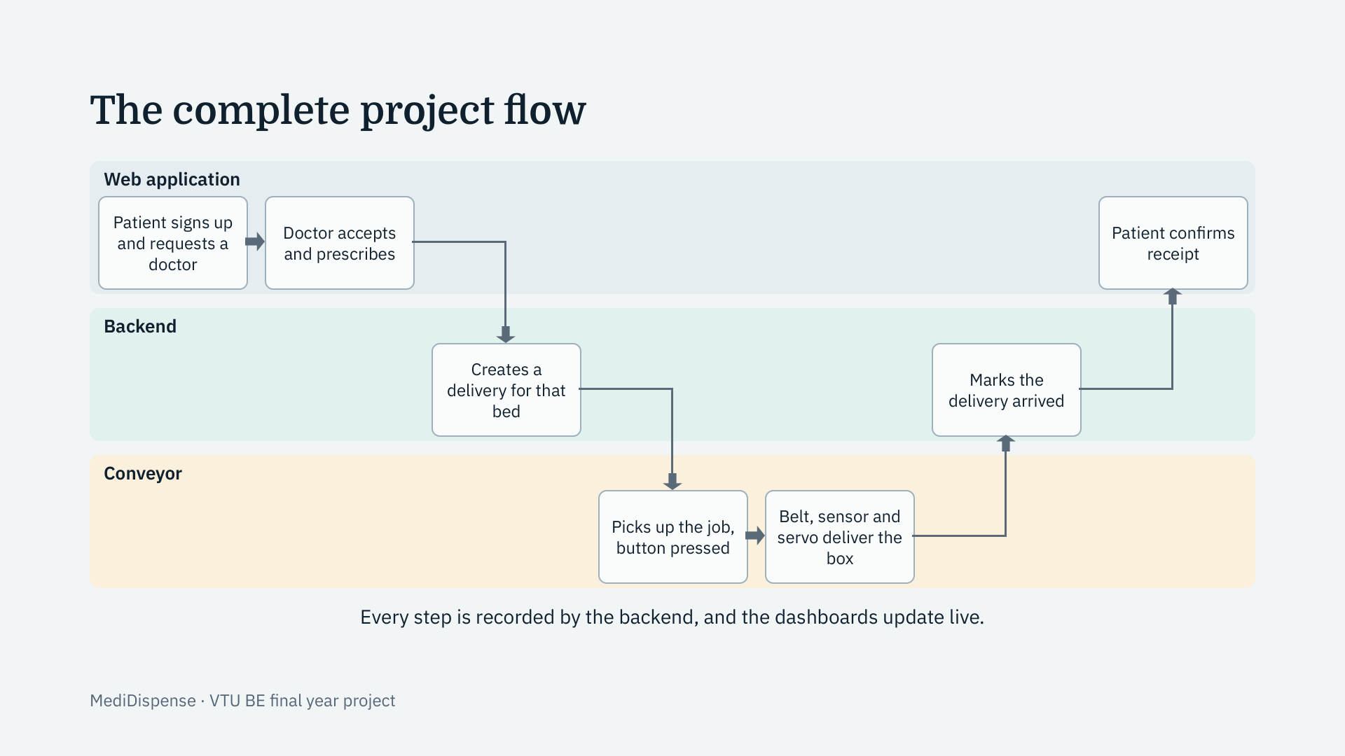
Notes:
This is the whole project in one picture, in three lanes. In the blue lane, the patient signs up and requests a doctor, and the doctor accepts and prescribes. The backend, in the green lane, creates a delivery for that patient’s bed. The conveyor, in the orange lane, picks up the job, the operator presses the button, and the belt, sensor and servo deliver the box. The backend then marks the delivery arrived, and the patient confirms receipt from their own page. Every step is recorded in the backend and shown live on the dashboards.

