Slide 1
Connection to database using JSP
Name : Shiva kumar
Section: cse-c
Roll No: 227r1a05j3

Slide 2

Introduction to JSP
What is JSP:
A technology that helps software developers
create dynamically generated web pages based
on HTML, XML, or other document types.
JSP is part of the Java development platform.

Slide 3

Importance of Database Connectivity
Why Connect to a Database?
Store and manage data efficiently.
Retrieve data dynamically.
Enhance user interactivity.

Slide 4

JDBC Overview
What is JDBC?
Java Database Connectivity (JDBC) is
an API for connecting and executing queries in a database.
It provides methods to query and update data in a database.

Slide 5
Steps to Connect to a Database Using JSP
1.Load the jdbc driver
2.Create a connection
3.Create a statement
4.Execute the query
5.process the result
6.close the connection

Slide 6
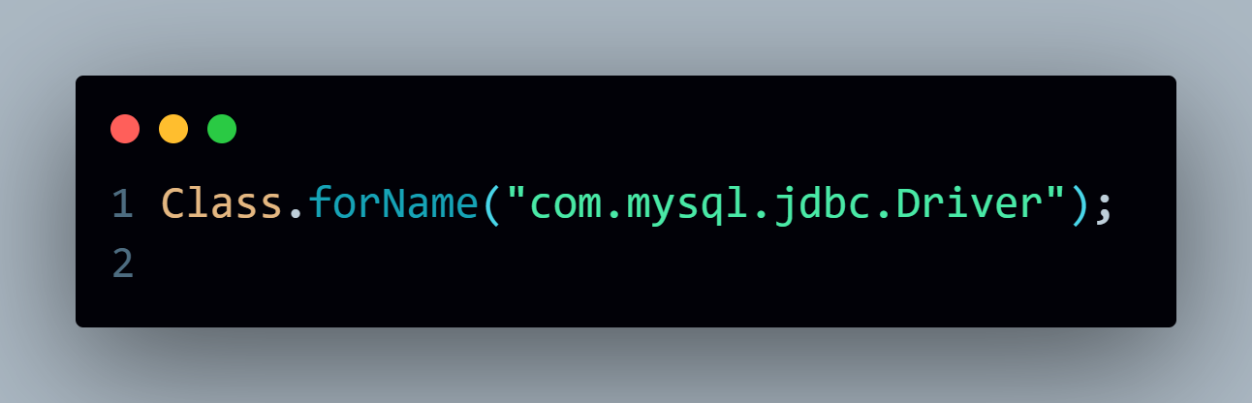
1.Load the jdbc driver
Example:

Slide 7
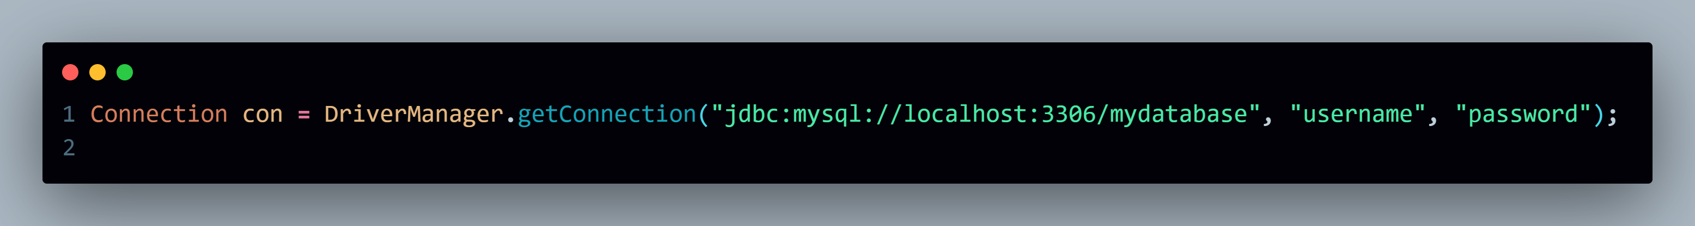
2.Creating a Connection
Example:

Slide 8
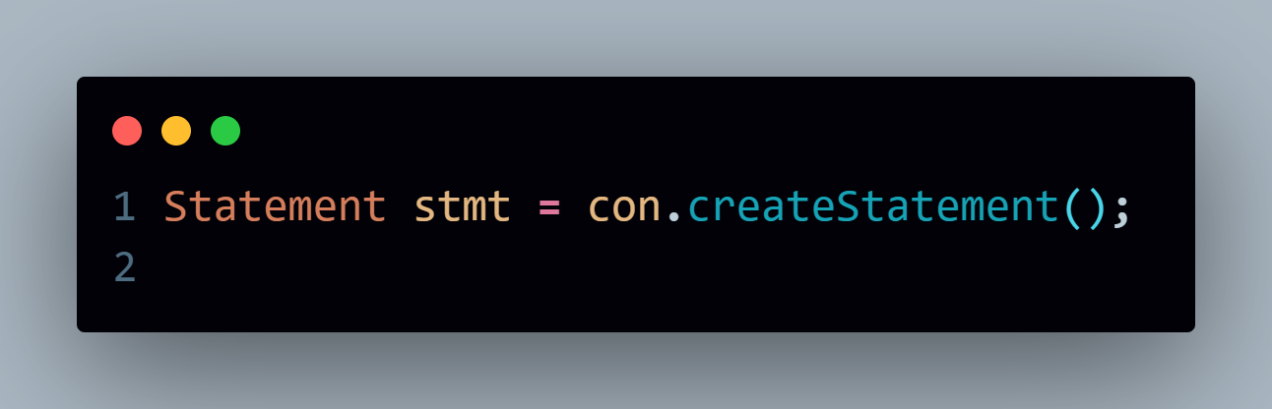
3. Creating a Statement
Example:

Slide 9
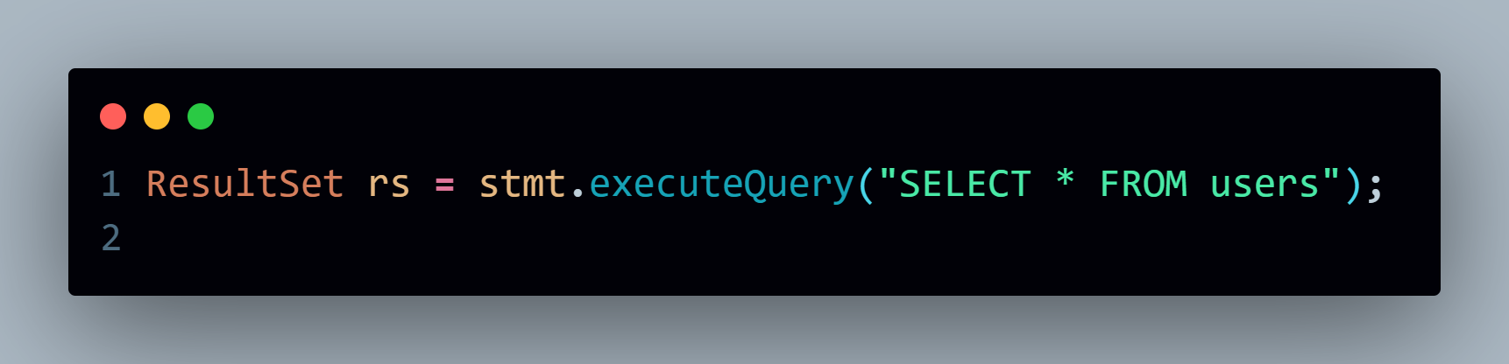
4. Executing the Query
Example:

Slide 10
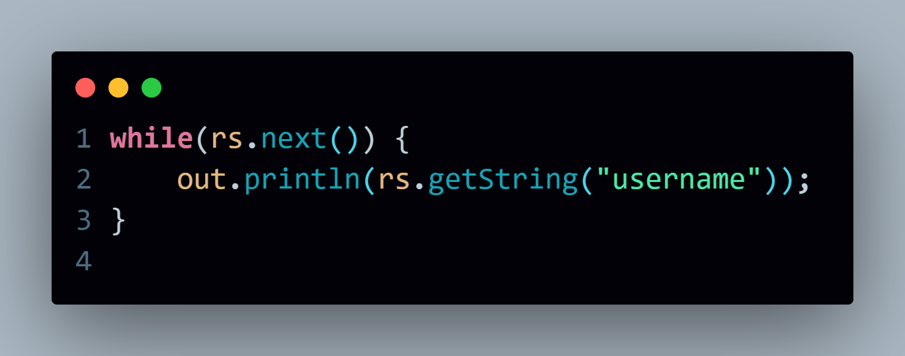
5. Processing the Results
Example:

Slide 11
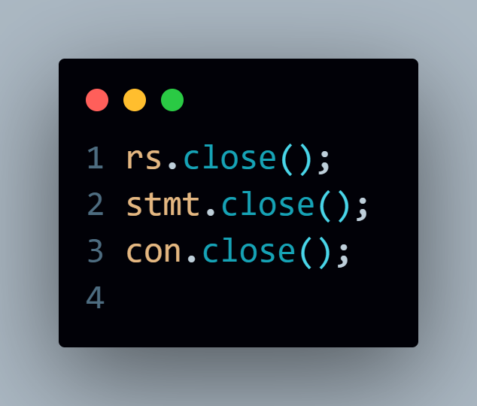
6. Closing the Connection
Example:

Slide 12


