Slide 1
Page Replacement and Optimal page replacement Algorithm
Presented by
Shiva kumar
Roll no:- 227r1a05j3
Section :- cse (c )

Slide 2
What is Paging
Paging is a memory management technique operating systems use operating systems to optimize computer memory usage.
The physical memory is divided into fixed-sized blocks called as frames.
The logical memory into is divided into blocks of the same size called as pages.
When a process is to be executed, its pages are loaded into any available memory frames from their source.

Slide 3
Paging

Slide 4
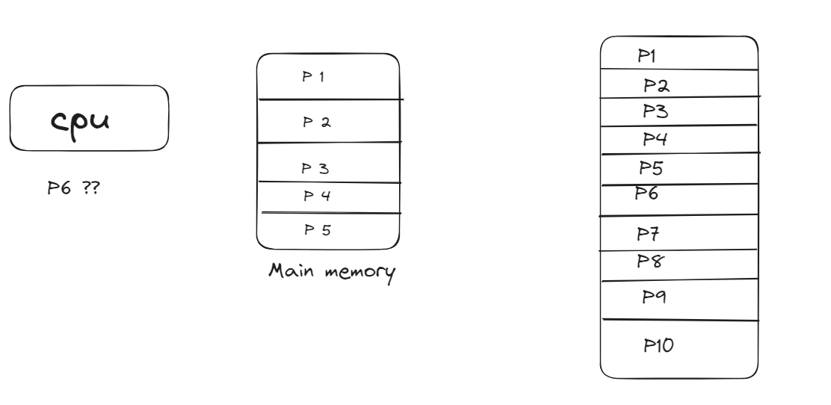
What is Page Fault
When a processor want to access a page,and that particular page is not currently present in the main memory,then page fault occurs.

Slide 5
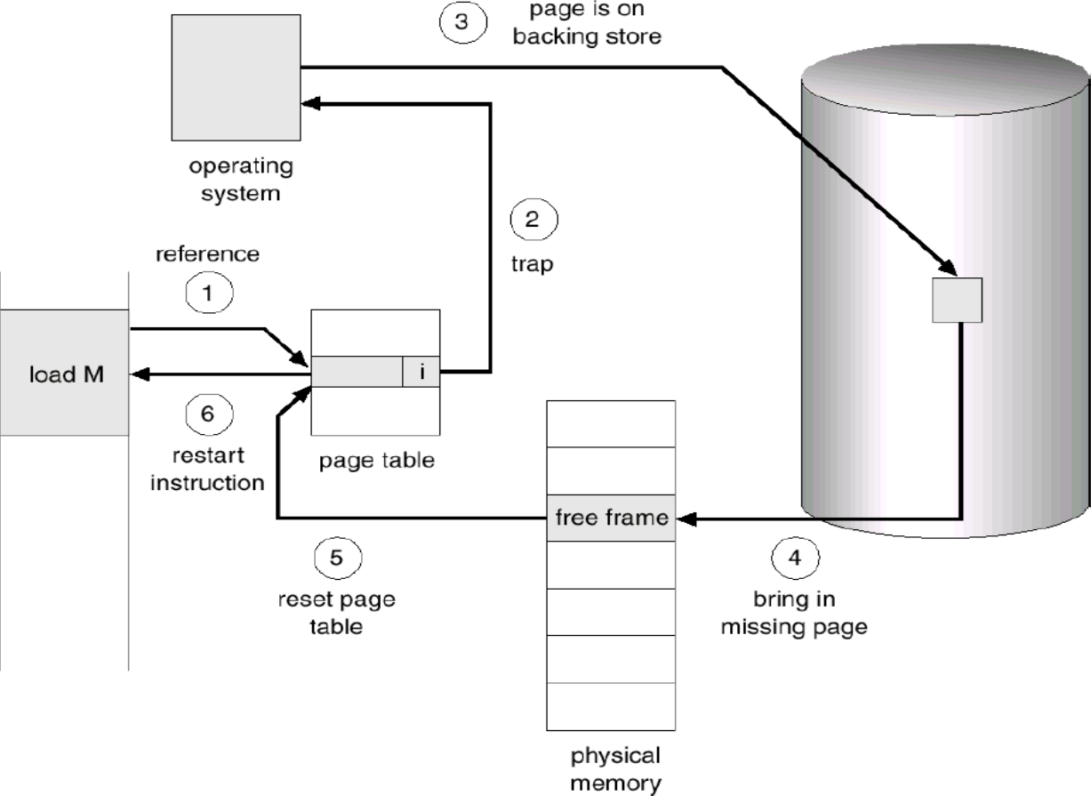

Slide 6
What is Virtual Memory
Virtual memory in an operating system is a memory management technique that creates an illusion of a large block of contiguous memory for users.
It uses both physical memory (RAM) and disk storage to provide a larger virtual memory space, allowing systems to run larger applications and handle more processes simultaneously. This helps improve system performance and multitasking efficiency

Slide 7
Introduction to Page Replacement
Page replacement algorithms are techniques used in operating systems to manage memory efficiently when the virtual memory is full.
When a new page needs to be loaded into physical memory, and there is no free space, these algorithms determine which existing page to replace.

Slide 8
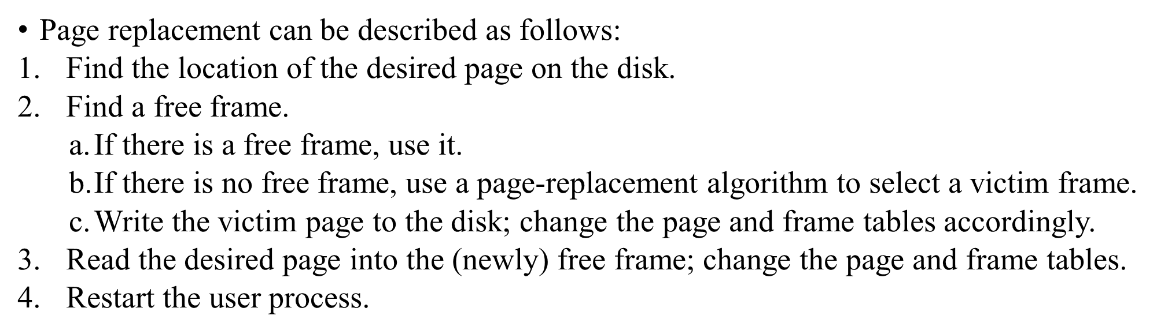
Page Replacement

Slide 9
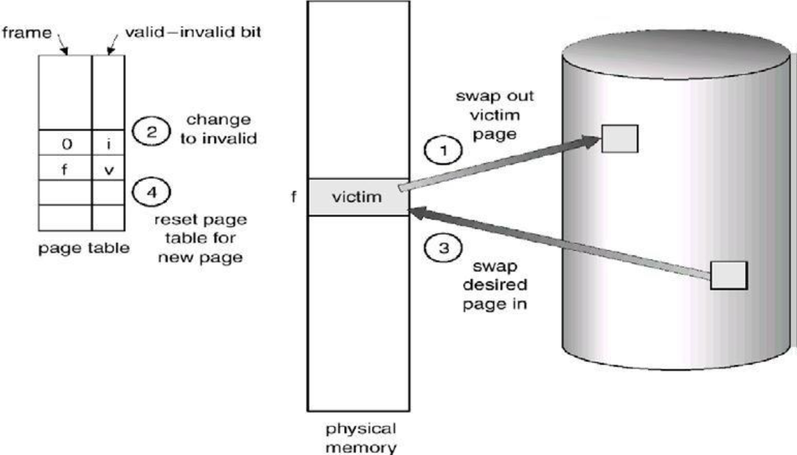
Page Replacement

Slide 10
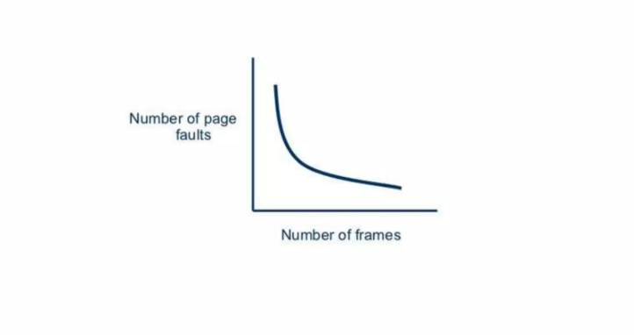
No. of page fault Vs No. of frame

Slide 11
Types of Page Replacement
1.FIFO
2.Optimal
3.LRU

Slide 12
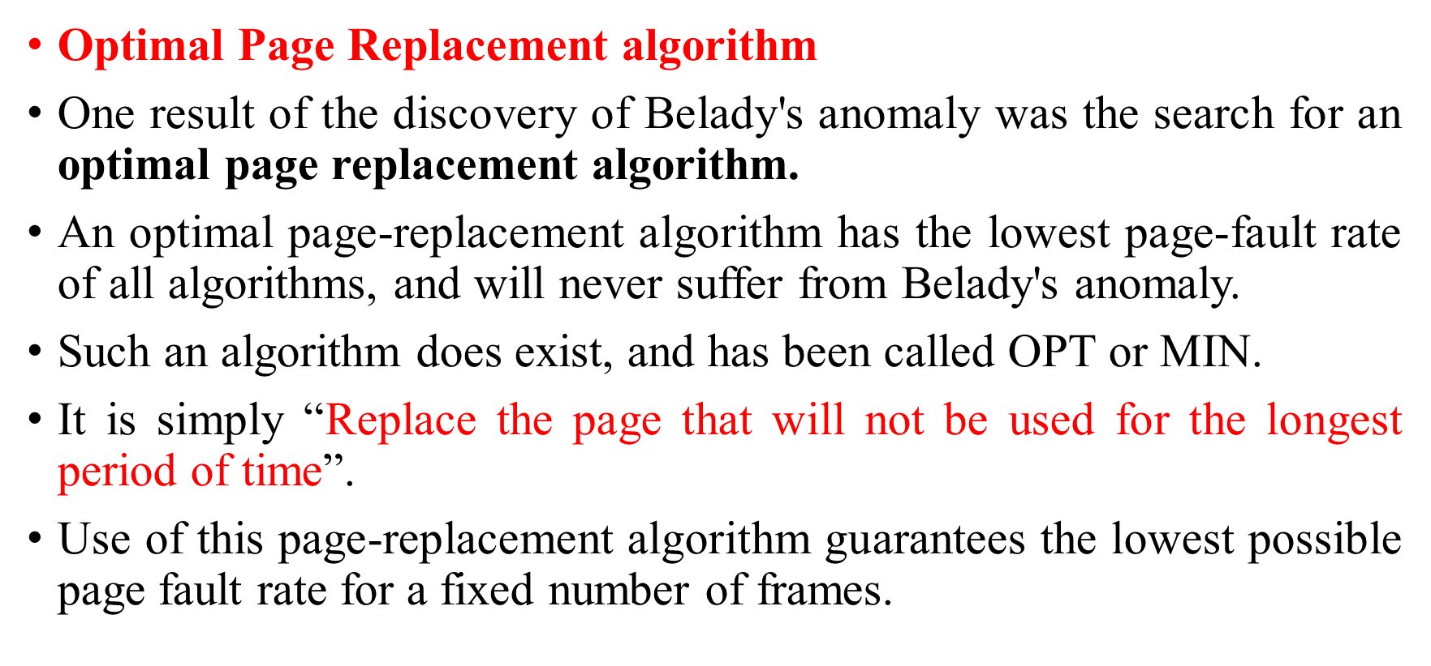
Optimal Page Replacement

Slide 13
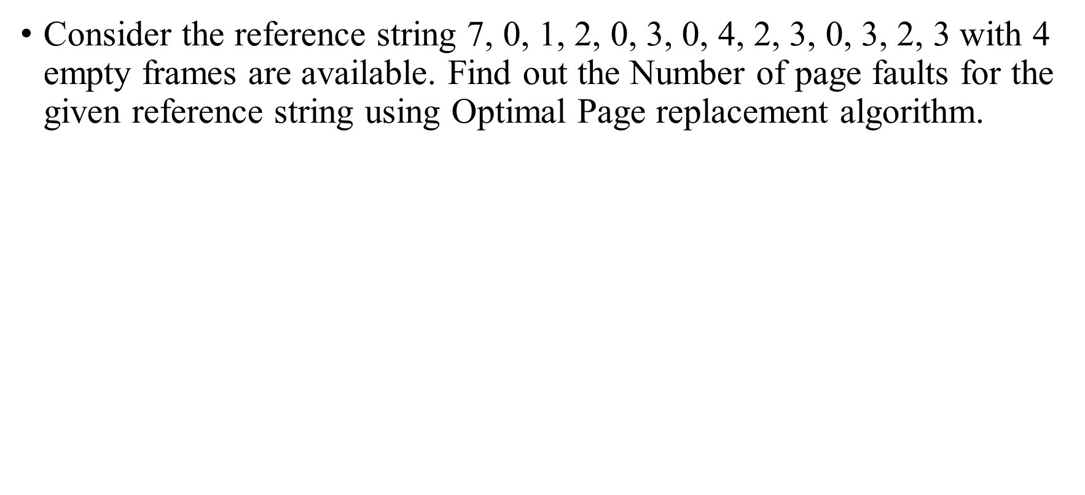
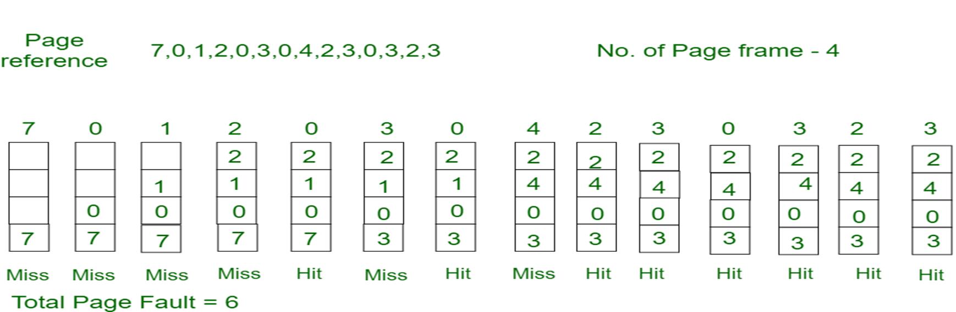

Slide 14
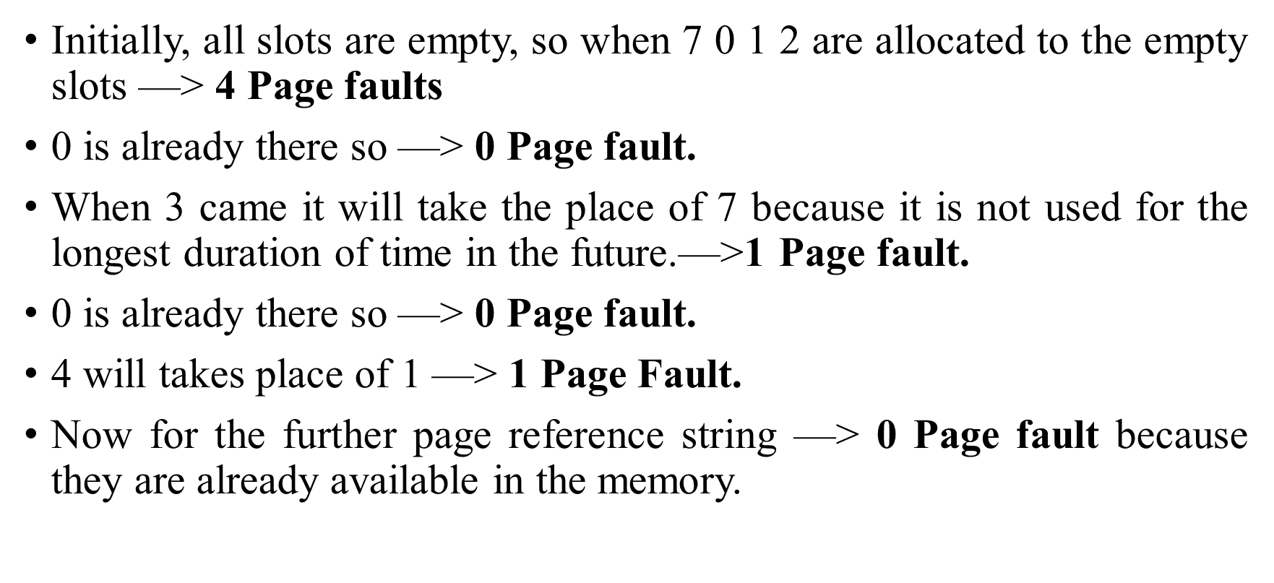

Slide 15
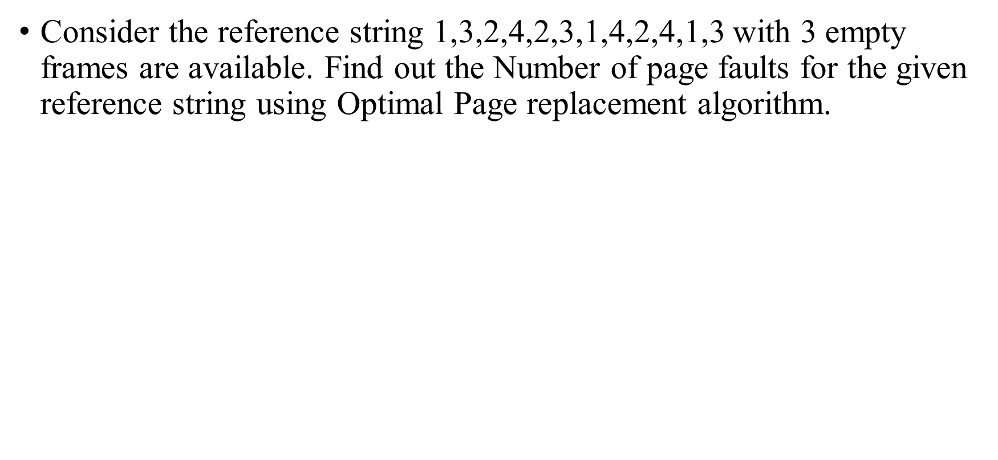
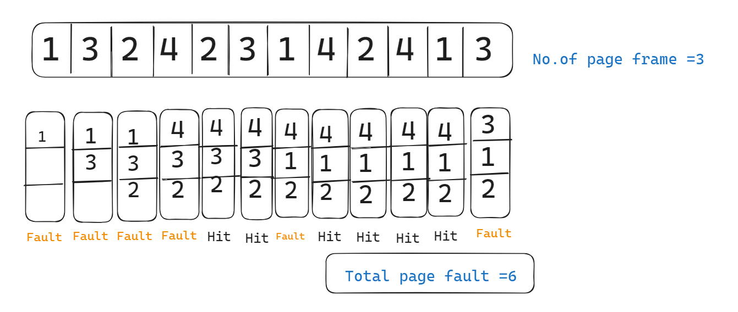

Slide 16
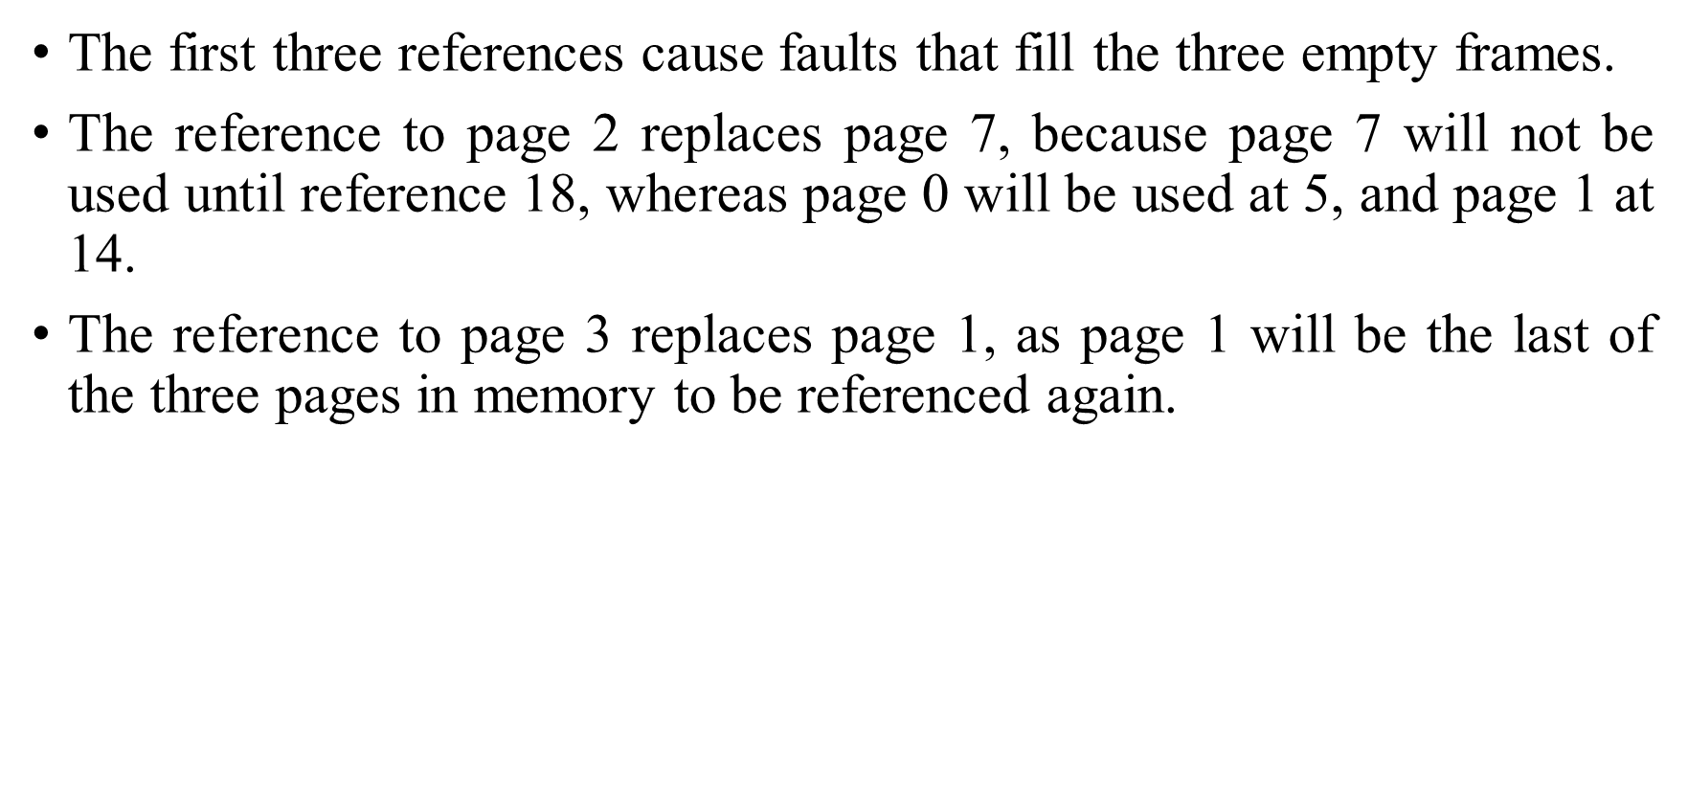

Slide 17
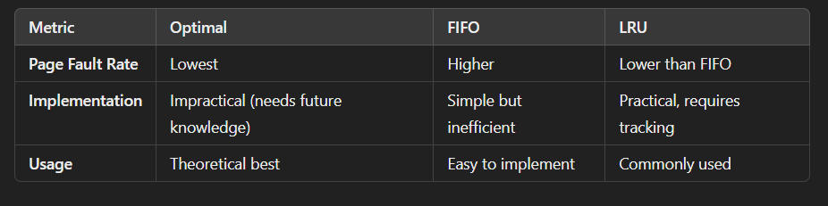
Comparison with Other Algorithms

Slide 18
Advantages of Optimal Replacement Algorithm
1.Complexity is less and easy to implement.
2.Assistance needed is low i.e Data Structure used are easy and light.
3.Optimal performance: The optimal page replacement algorithm is designed to replace the page that will not be used for the longest time in the future. It provides the best possible performance because it minimizes the number of page faults and maximizes the number of hits.
4.Efficient use of memory: Optimal page replacement leads to efficient use of memory because it replaces the page that will not be used for the longest time in the future. This means that pages that are rarely used or not important are more likely to be swapped out, freeing up memory for more critical pages.
5.No thrashing: Optimal page replacement is less susceptible to thrashing compared to FIFO or LRU because it considers the future usage of pages. It can detect which pages are being used frequently and which pages are likely to be used in the future.

Slide 19
Disadvantages of Optimal Replacement Algorithm
1.OPR is perfect, but not possible in practice as the operating system cannot know future requests.
2.Error handling is tough.

Slide 20


