Slide 1
Model for testing
Presented by:
Shiva Kumar
Roll No: 227R1A05J3
Sub: STM

Slide 2
Introduction
What is the Model for Testing?
A structured approach to guide the testing process.
Helps identify, track, and resolve issues effectively.
Testing Level
Objectve
Purpose of Testing:

Slide 3
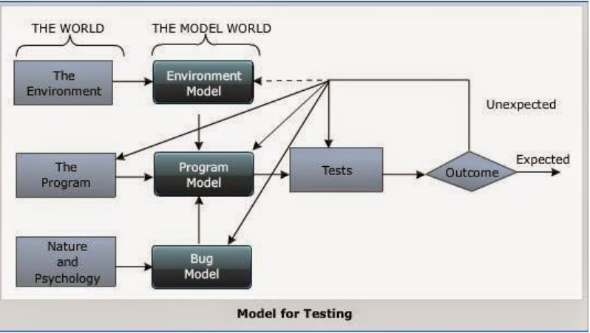
It includes three models:
1.A model of the environment,
2.A model of the program
3. model of the expected bugs

Slide 4
1.Model of the Environment
Definition: Describes the environment in which the software operates.
Details:
Includes hardware, operating systems, network conditions, databases, and other software dependencies.
Ensures that testing accounts for all external factors that may affect software performance and reliability.
Example: Testing how the software behaves under different hardware or network conditions.

Slide 5
2.Model of the program
Definition: Represents the structure and components of the software system.
Details:
This model focuses on how the program is organized, including its modules, functions, and interactions.
It ensures that the internal structure of the software aligns with the intended design.
Example: Analyzing the flow between software modules and ensuring they communicate as expected

Slide 6
2.Model of the Expected bug
Definition: Anticipates common errors or defects that may occur in the software.
Details:
This model identifies high-risk areas where bugs are more likely to be found.
It includes common defects like memory leaks, invalid inputs, or performance bottlenecks.
It helps testers to focus their efforts on areas with higher likelihoods of failure.
Example: Focusing testing on areas like user input validation or network interactions, which are prone to bugs.

Slide 7
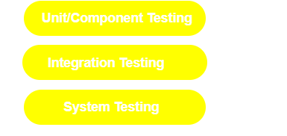
Test Procedure
Inputs must be prepared
Outcomes should be pre directed
Tests should be documented Commands need to be executed Results are to observed
All these errors are subjected to error
A typical software system goes through with following three test

Slide 8

1.Unit testing
Definition: Testing the smallest testable part of a software (unit).
Purpose: To ensure that individual components function as expected.
Details:
A unit is typically one function, module, or class.
It is usually the work of a single programmer.
Unit testing verifies that the unit satisfies its
functional specification and matches the design structure.
Goal: Ensure that each component or unit works independently.

Slide 9
1.1.component testing
Definition: Testing an integrated set of units to ensure they work as a group.
Purpose: To ensure that the component, which may consist of multiple units, behaves as intended.
Details:
->A component is an aggregation of one or more units.
->It is tested for functional correctness and design consistency.
->It verifies that components function correctly when integrated but individually tested.
Goal: Ensure that components work together as expected.

Slide 10
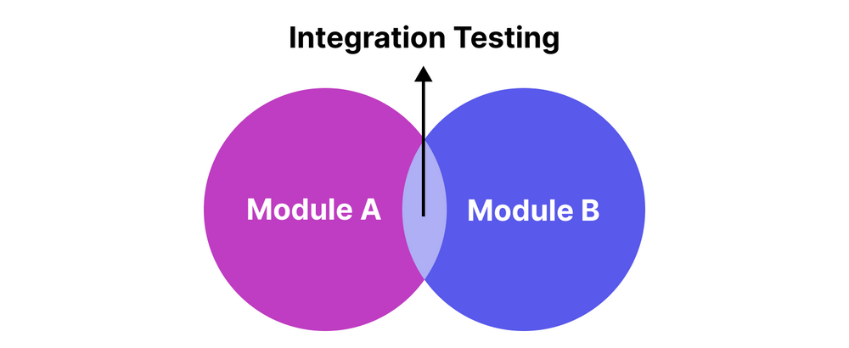
2.Integeration testing
Definition: Testing interactions between integrated components or modules.
Purpose: To identify issues arising from the combination of components.
Details:
-> Integration is the process of combining individual components into larger systems.
-> Integration testing ensures that components work
together as expected.
-> It tests for compatibility issues and data flow between modules.
Goal: Validate that integrated components function correctly as a system.

Slide 11
3.system testing
Definition: Testing the entire system as a whole to uncover errors that cannot be attributed to individual components.
Purpose: To ensure that the system meets its requirements and behaves as expected in the real world.
Details:
->Includes performance, security, recovery, and configuration testing.
->System testing validates both business requirements and the overall architecture.
->It is a comprehensive testing phase that ensures the whole system is robust and reliable.
Goal: Validate the system’s performance, security, and overall functionality.

Slide 12


