Slide 1
GUI checkpoint for single object/window
Presented by:
Shiva Kumar
Roll No: 227R1A05J3
CSE-C

Slide 2
Introduction
Behaviour of Graphical User Interface objects in an application are verified by GUI checkpoints using WinRunner tool.
A GUI checkpoint examines the behavior of an object’s properties

Slide 3
Procedure
Steps:
1. Start WinRunner and create a new test.
2 Start the Flight Reservation application and log in.
3 Start recording in Context Sensitive mode.
4 Open the Open Order dialog box from flight reservation application
5 Create a GUI checkpoint for the Order No. check box.

Slide 4
Choose Create > GUI Checkpoint >For Single Object/Window
6. Use the pointer to double-click the Order No. check box.
The Check GUI dialogbox opens and displays the available checks.
Accept the default check “State.”
This check captures the current state (off) of the check box and stores it asexpected results.
Click OK in the Check GUI dialog box to insert the checkpoint into the test script.
The checkpoint appears as an obj_check_gui statement
7. Enter “4” in the Order No. text box.
8. Click OK &amp; Stop recording
9. Save the test.

Slide 5
To Run the Test
1. Make sure the above saved test and Flight Reservation application are open.
2 In WinRunner, check that Verify mode is selected in the Standard toolbar.
3.Choose Run > Run from Top,
4. The Run Test dialog box opens. Accept the default test run name “res1.”
Run the test Click OK in the Run Test dialog box.
5. Review the results.

Slide 6
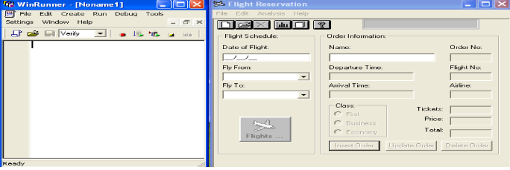
Output
> Creating GUI Checkpoint for Single Object/Window
> Open WinRunner tool > Application

Slide 7
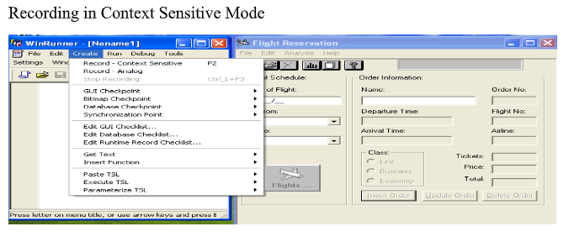
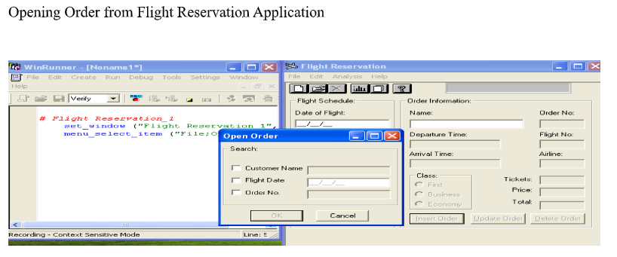

Slide 8
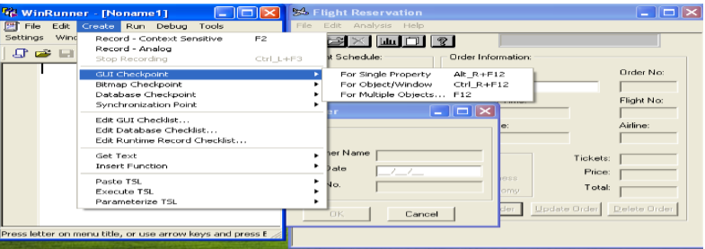
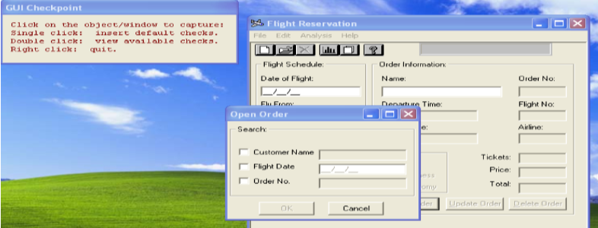
Creating a GUI Checkpoint for Object/Window for Order No checkbox object

Slide 9
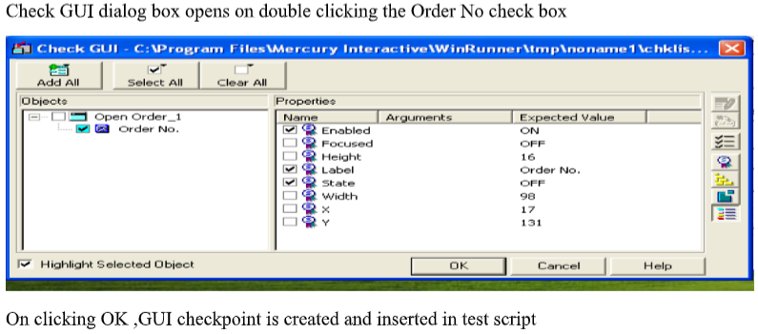
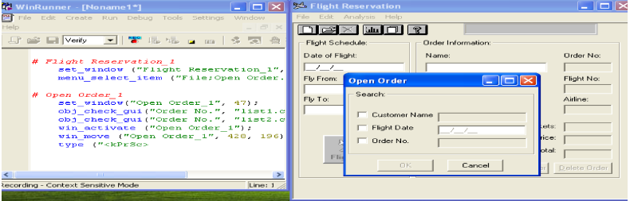

Slide 10
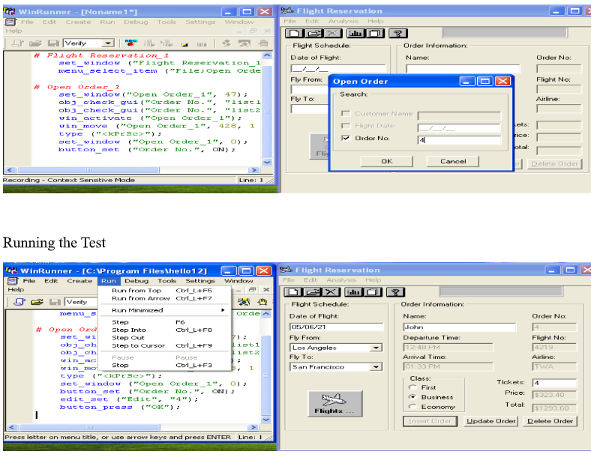

Slide 11
