Slide 1
Breadth First Search
Shiva Kumar
227R1A05J3
Section -CSE(c )

Slide 2
Introduction
Breadth First Search is a traversal technique in which we traverse all the nodes of the graph in a breadth-wise motion. In BFS, we traverse one level at a time and then jump to the next level.
In a graph, the traversal can start from any node and cover all the nodes level-wise.
The BFS algorithm makes use of the queue data structure for
implementation.

Slide 3
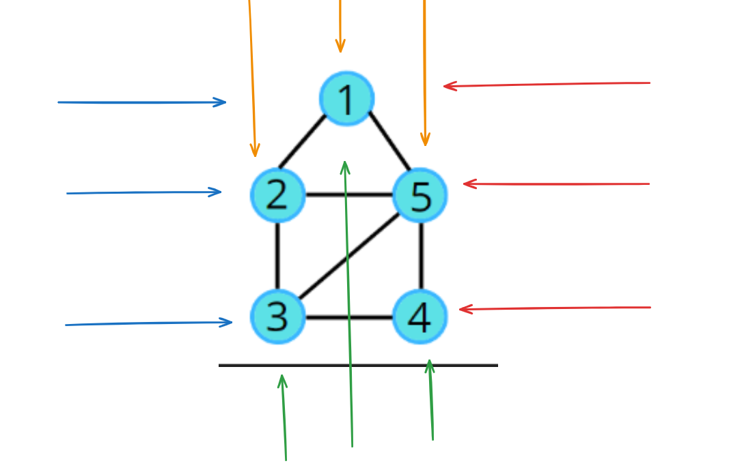
The BFS algorithm also known as Level Order Traversal

Slide 4
BFS Algorithm:
Step 1: Choose any one node randomly, to start traversing.
Step 2: Visit its adjacent unvisited node.
Step 3: Mark it as visited and display it.
Step 4: Insert the visited node into the queue.
Step 5: If there is no adjacent node, remove the first node from the queue.
Step 6: Repeat the above steps until the queue is empty.

Slide 5
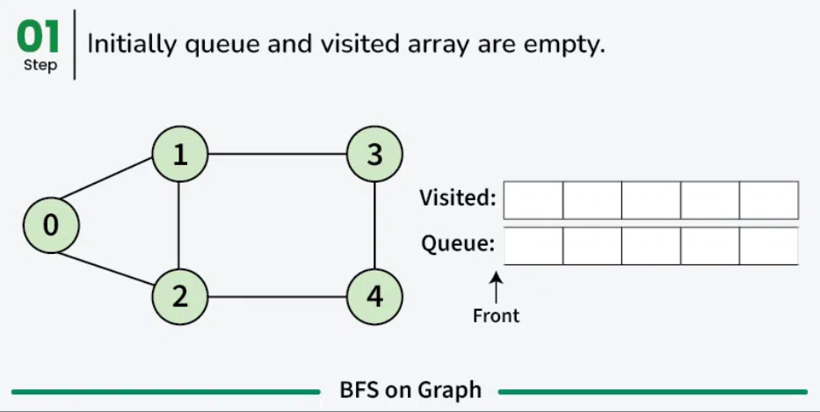
Example

Slide 6
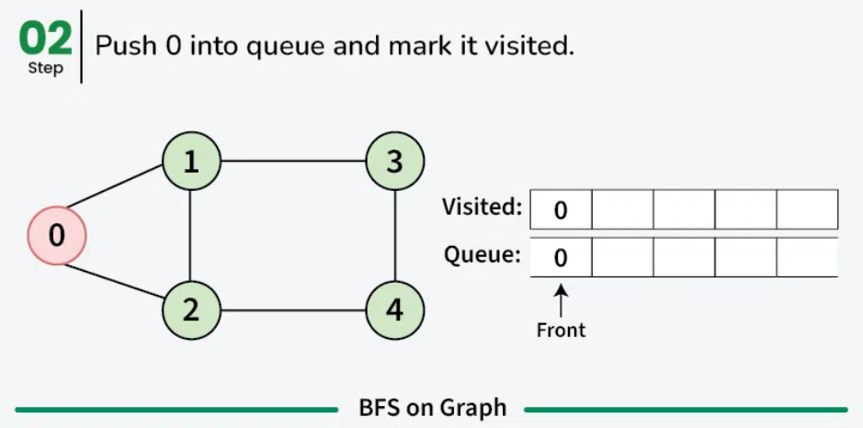

Slide 7
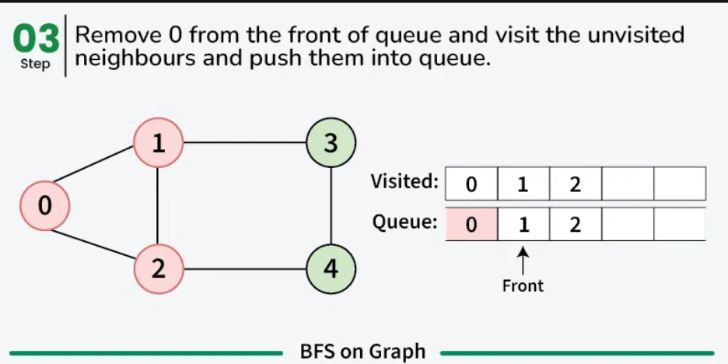

Slide 8
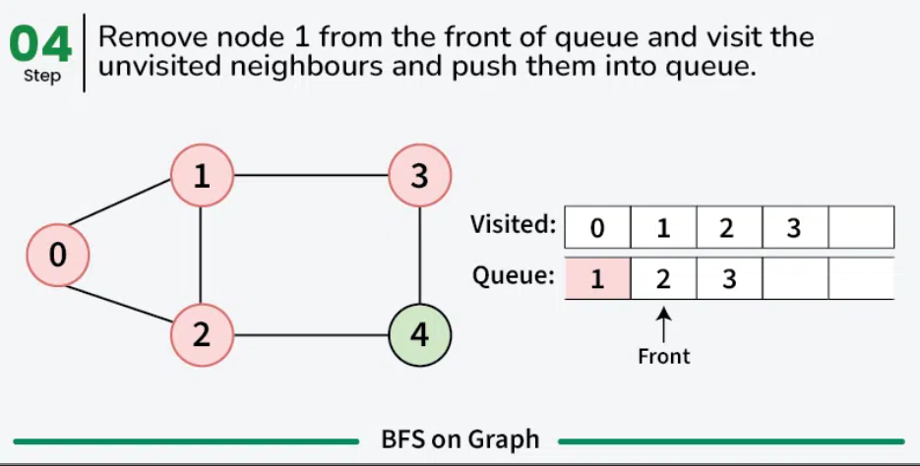

Slide 9
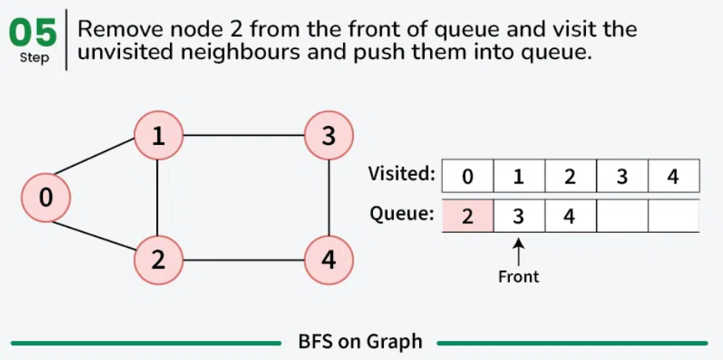

Slide 10
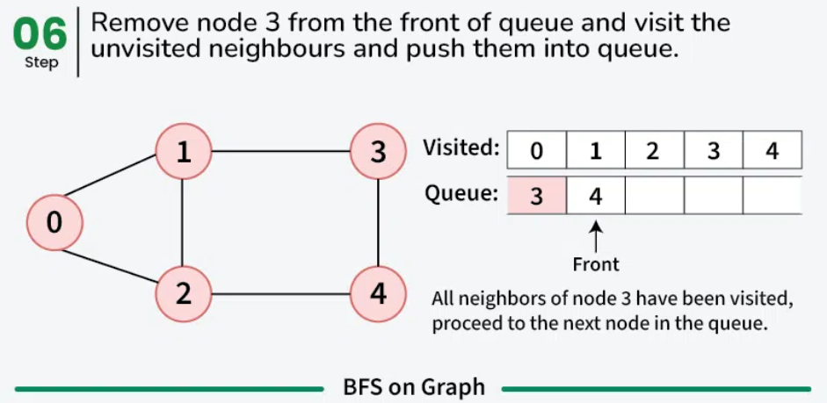

Slide 11
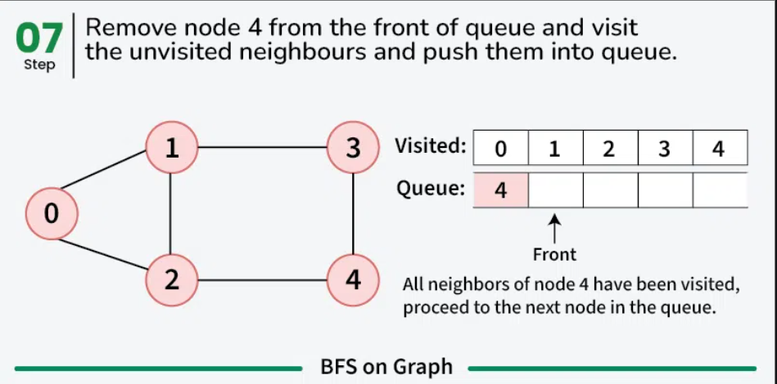

Slide 12
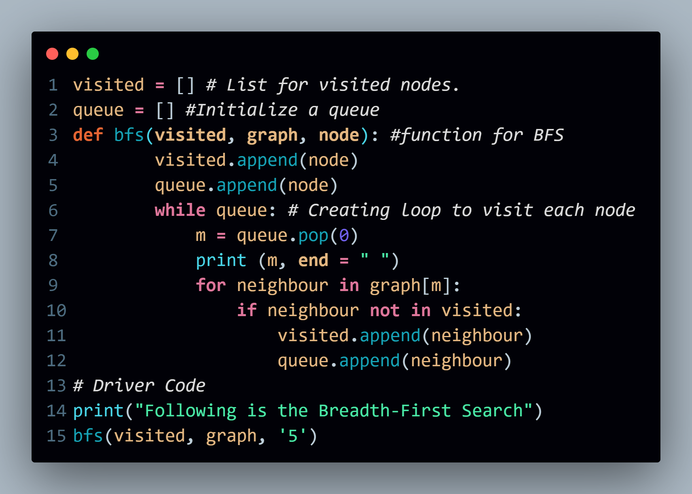

Slide 13
Application
1.Pathfinding
BFS is used to find the shortest path in unweighted graphs.
It serves as the foundation for algorithms like Dijkstra’s algorithm and A Search*.
Example: In Google Maps or GPS navigation systems, BFS helps in finding the shortest route between two locations.
2.Web Crawling
Search engines like Google, Bing use BFS to traverse the web.
It starts from a given webpage (URL) and follows all its links level by level.
3.Social Network Analysis
BFS is used to find shortest connections in a social network.
Example: LinkedIn uses BFS to suggest "People You May Know" by finding the shortest path between users.

Slide 14


