Slide 1
The Language Of Turing Machine
Presented by
Shiva Kumar
Roll No : 227R1A05J3
SECTION : CSE(C)

Slide 2
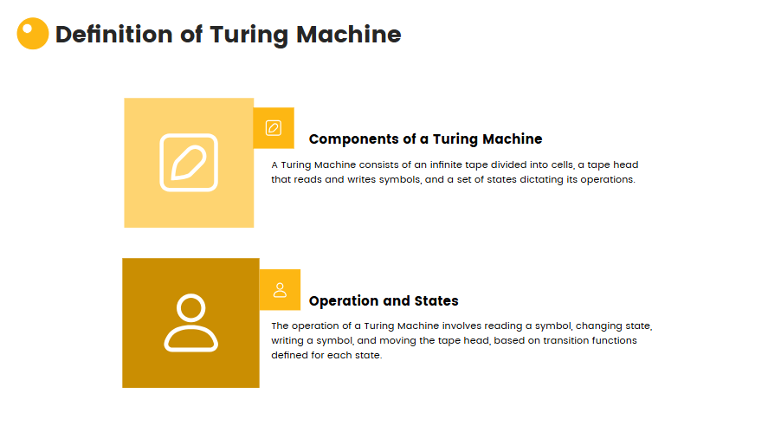

Slide 3
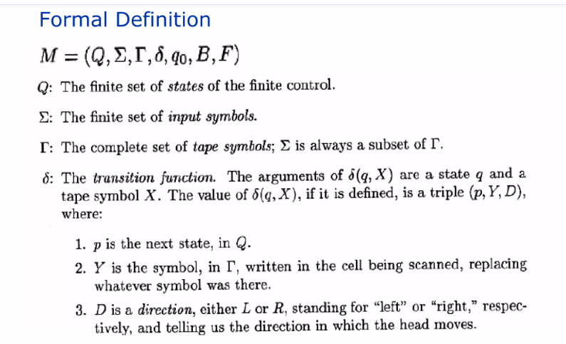

Slide 4
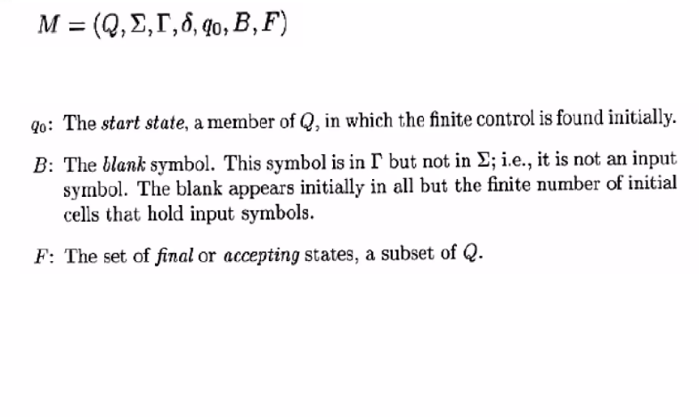

Slide 5
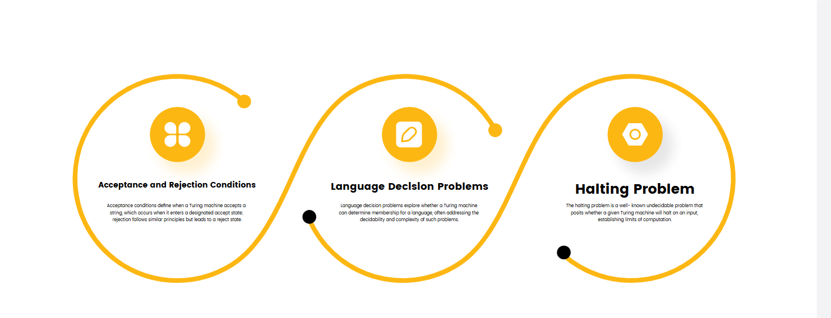

Slide 6
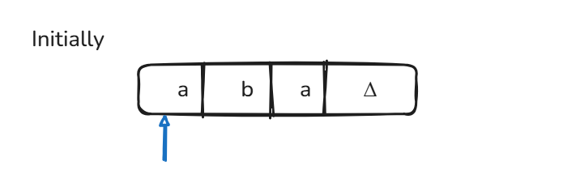
Example:
Construct a Turing Machine which accepts the language of aba Over Σ={a,b}

Slide 7
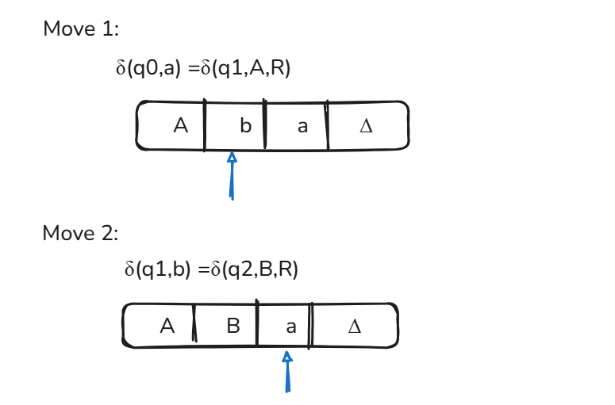
Example:

Slide 8
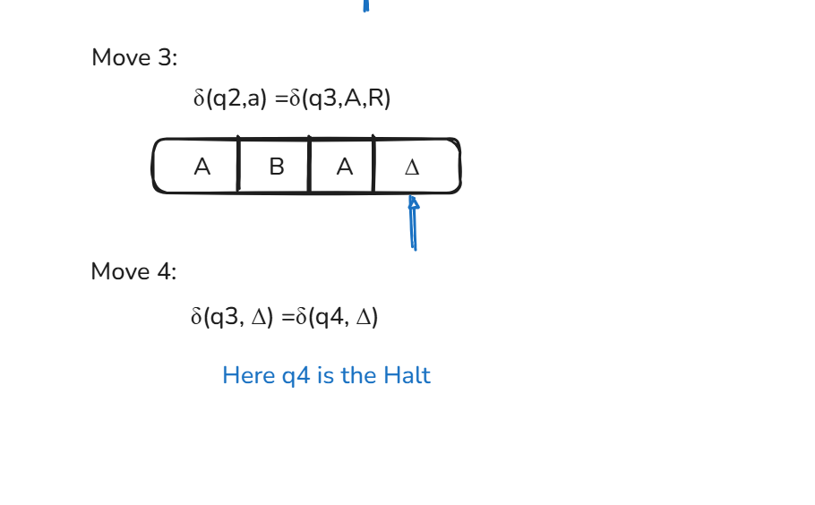
Example:

Slide 9
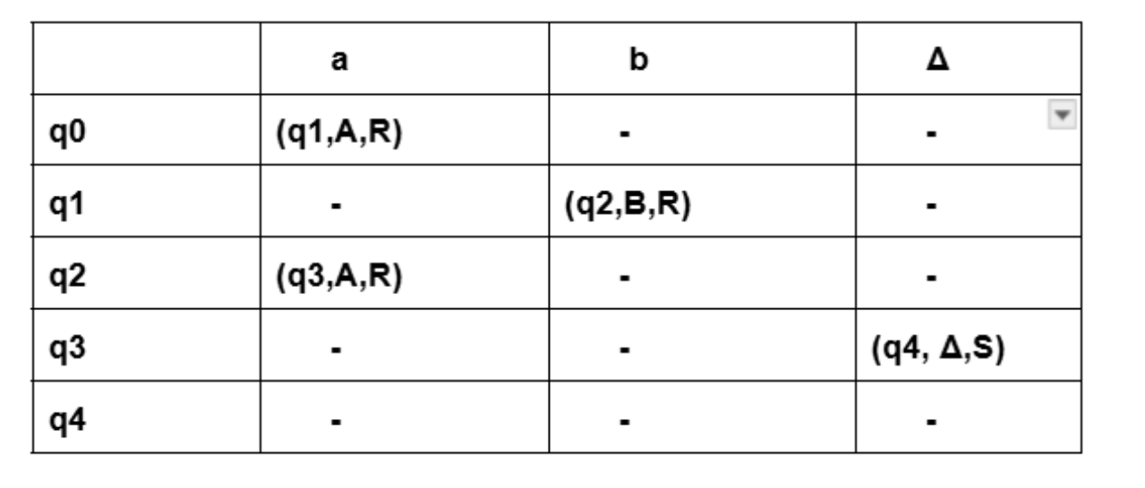
Transition Table

Slide 10
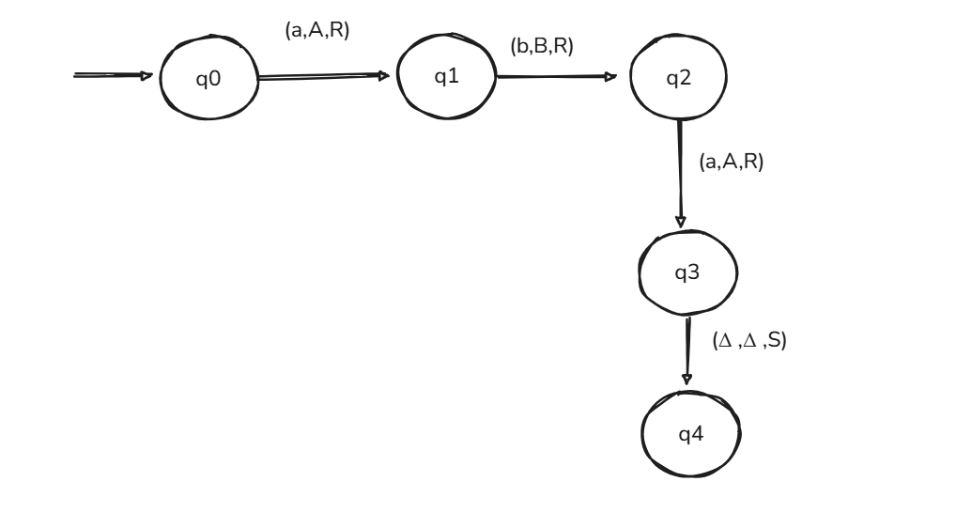
Transition Diagram

Slide 11


