Slide 1

CMR Technical Campus Department of CSE
Business Economics and Financial Analysis
Rules for maintaining Books of Accounts for Business Economics financial Analysis
Presented By:​
Shiva Kumar
227R1A05J3
CSE-C
​

Slide 2
Rule #1: Selecting the Right Accounting Standard
GAAP vs. IFRS
U.S. GAAP
IFRS
Choosing between U.S. GAAP and IFRS impacts financial statement comparability. Understand the differences in revenue recognition, lease accounting, and inventory valuation.
Generally Accepted Accounting Principles. A standard set of rules and procedures for accounting.
International Financial Reporting Standards. A principles-based set of accounting standards.
Select the standard that best suits your business needs.

Slide 3

Rule #2: Maintain Accurate & Complete Records
1
Document Everything
2
Essential Documents
Keep invoices, receipts, bank statements, and contracts organized.
Record every transaction meticulously. This includes sales, purchases, and expenses.
3
Software Solutions
Use QuickBooks, Xero, or NetSuite for efficient recordkeeping and automation.

Slide 4




Rule #3: Follow Double-Entry Bookkeeping
Assets = Liabilities + Equity
Debits and Credits
Balance is Key
Ensure the accounting equation always balances.
Grasp the basic principles of debits and credits.
Understand the fundamental accounting equation.

Slide 5



Rule #4: Adhere to the Matching Principle
Expense Recognition
2
Match expenses to related revenues.
Revenue Recognition
1
Record revenue when earned.
Net Income Impact
3
Understand the impact on net income calculation.

Slide 6

Rule #5: Implement Strong Internal Controls
Segregation of Duties
Prevent fraud and errors through separation of responsibilities.
Regular Reconciliations
Reconcile bank statements and inventory counts.
1
2
3
Authorization Limits
Implement approval processes for transactions.

Slide 7




Rule #6: Comply with Tax Regulations
Understanding Tax Laws
Stay updated on tax laws and reporting requirements.
Records for Audits
Maintain records for potential tax audits.
Consult a Professional
Seek advice from a tax professional for guidance.

Slide 8



Conclusion: Books of Accounts - A Strategic Asset
Effective Analysis
1
Ratios and trends.
Informed Decisions
2
Investment & pricing.
Proactive Management
3
Early problem ID.

Slide 9
Tax Compliance
GST Records
1
Goods and Services Tax
TDS Records
2
Tax Deducted at Source
Income Tax
3
Accurate reporting

Slide 10
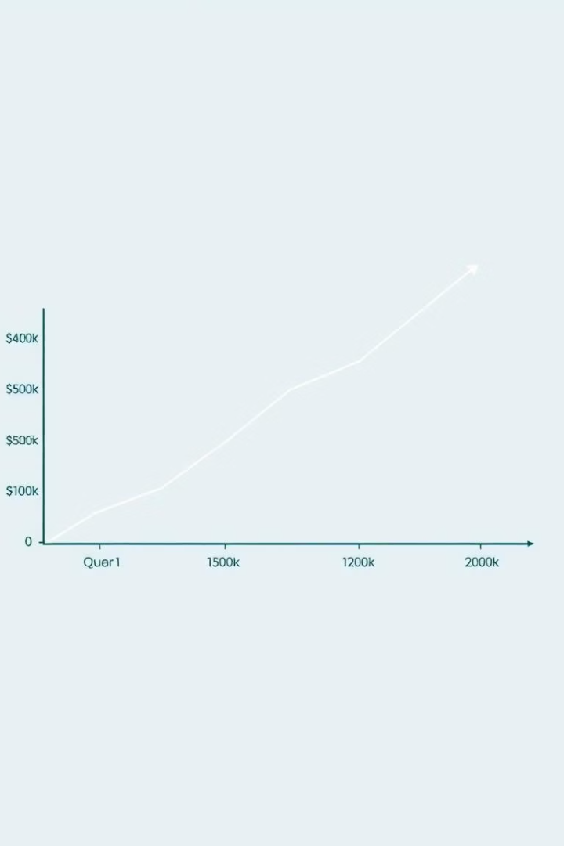
Support Financial Analysis
100%
100%
Budgeting
Forecasting
100%
Ratio Analysis
Maintaining accurate books of accounts supports financial analysis. It helps in budgeting, forecasting, and ratio analysis. It's the foundation for informed decision-making.

Slide 11


