Slide 1

Environment
Shivam Kumar SIngh
210150022
shivam.ks

Slide 2
Topics to be Analysed
Temperature
Rainfall
Air Quality
Forest

Slide 3
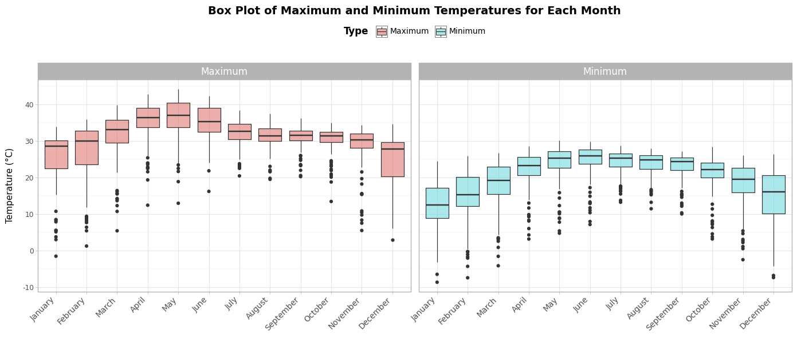
Temperature
How Temperature varied across India in 2019?
Observations ▶
Temperature varies from about -8°C to 44°C while the mean varies from about 12°C to 37°C.
Mean maximum Temperature peaked during the month of May while Minimum Temperature peaked during the month of June.
Mean maximum Temperature was the lowest in December while the Minimum Temperature was lowest in January.
Outliers exist but these outliers are observed in the lower temperatures scale.

Slide 4
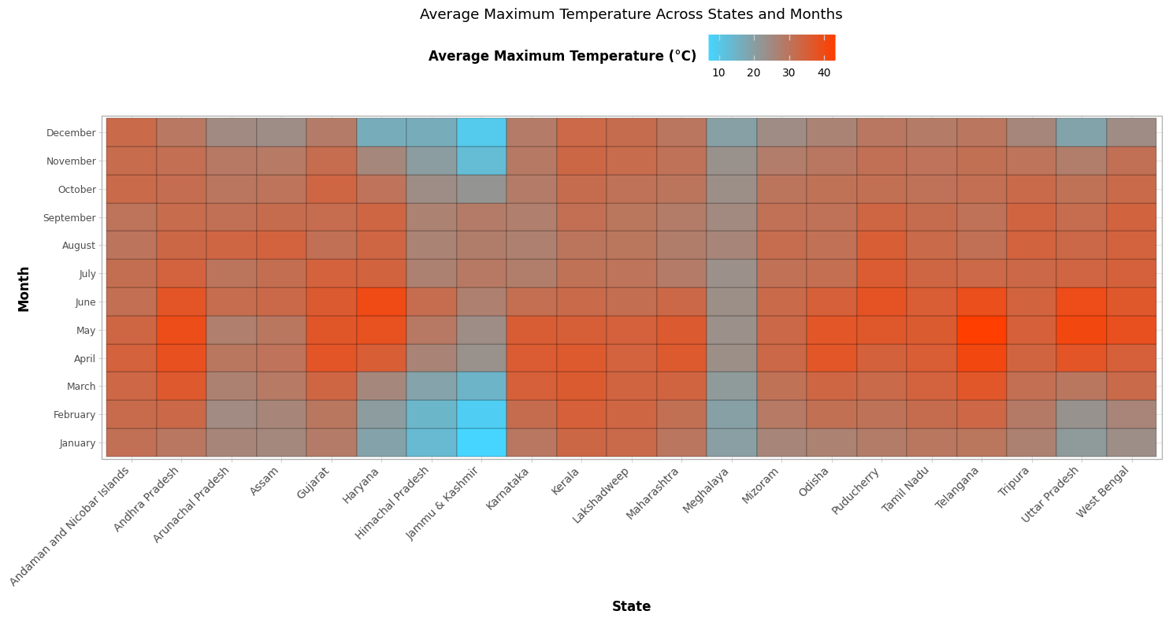
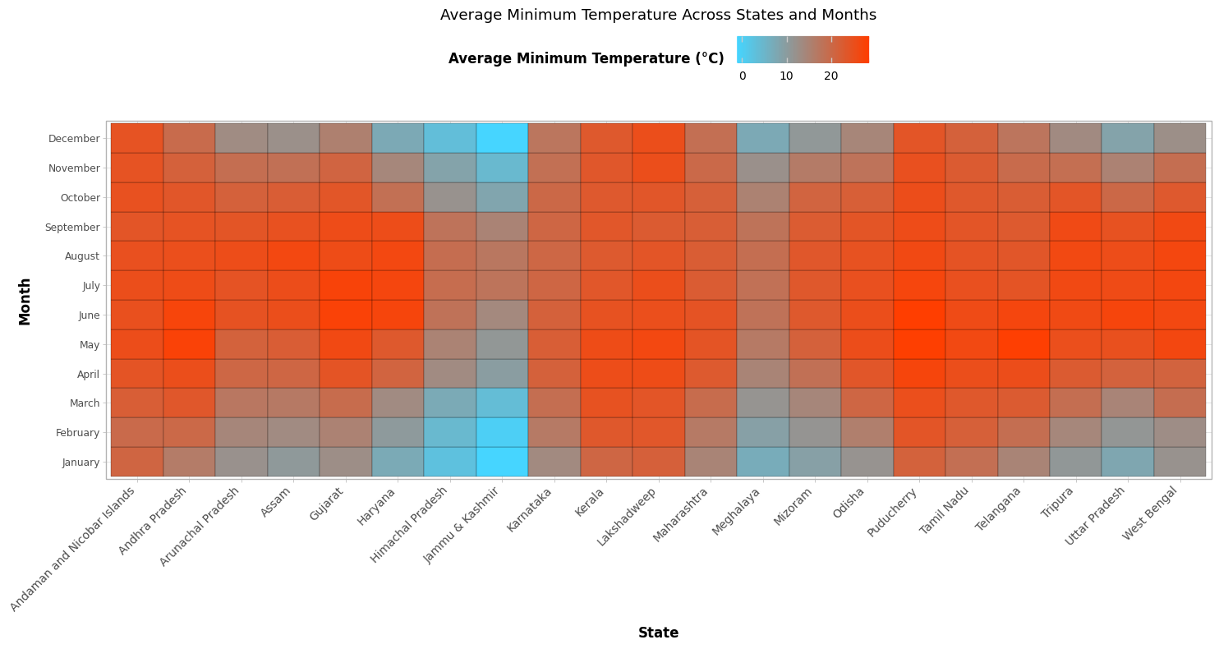
How Temperature varied across the states for every month?
Observations ▶
States/UTs like Kerala, Tamil Nadu, Lakshadweep, Puducherry & Andaman Nicobar seem to have less variation in Temperature across the year as these states/UTs are located in coastal regions in hotter range while Meghalaya has similar climate but in cooler range, maybe because of cloudy climate.
Maximum average temperature was observed in Telangana in the month of May and Haryana in June while Jammu & Kashmir was the coolest state.
States like Jammu & Kashmir, Gujarat, Haryana, Andhra Pradesh, Uttar Pradesh & Telangana have higher variation in Temperature across the year.

Slide 5
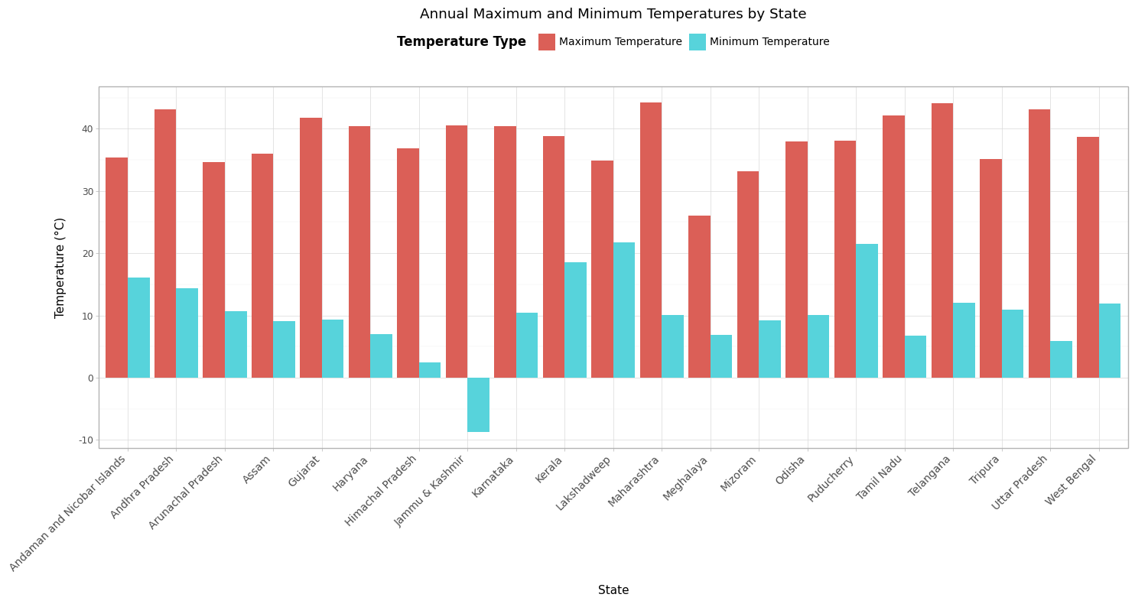
What about extreme Temperature of all the regions?
Observations ▶
Maharashtra saw the highest temperature over the year, followed by Telangana, Andhra Pradesh, Uttar Pradesh & Tamil Nadu.
Jammu & Kashmir saw the lowest temperature over the year, followed by Himachal Pradesh, Uttar Pradesh, Tamil Nadu & Meghalaya.
Jammu & Kashmir had a high range in temperatures observed during the year (from -8°C to 41°C). Further analysis of Temperature differences is difficult.

Slide 6
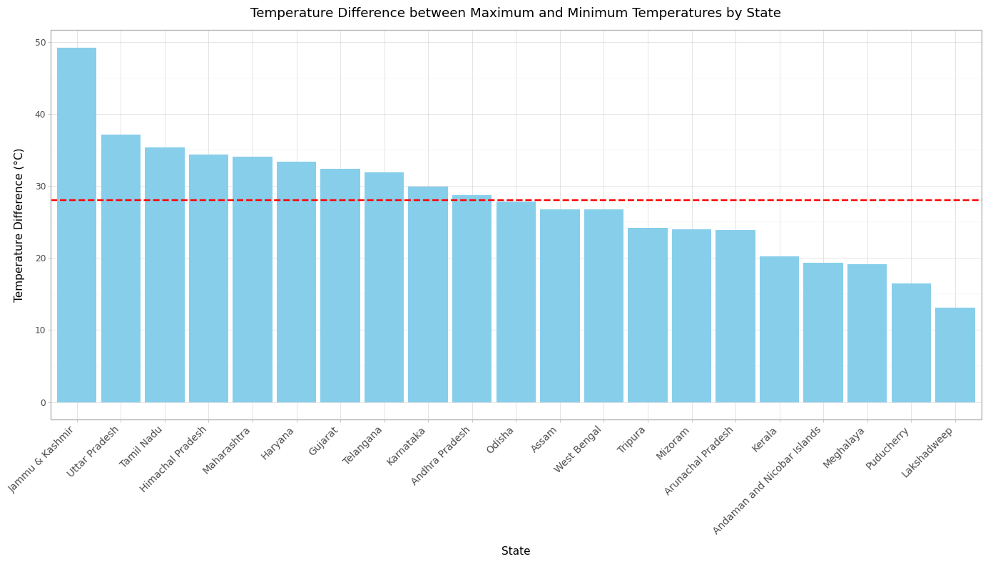
What about extreme Temperature difference of all the regions?
Observations ▶
Among the Top 7 states having high difference between maximum & minimum Temperature, 6 states are landlocked except Tamil Nadu(it could be that some stations in Tamil Nadu observed extreme temperatures due to various factors) while Tamil Nadu had lower variation in average temperature over the year as observed in heatmap earlier.
Among the Top 5 states having low difference between maximum & minimum Temperature, 4 states belong to coastal regions except Meghalaya (this might be because of cloudy climate), similar observations could be seen in heatmap.
Average extreme difference across all the states lies somewhere around 28°C which matches with that of Odisha.

Slide 7
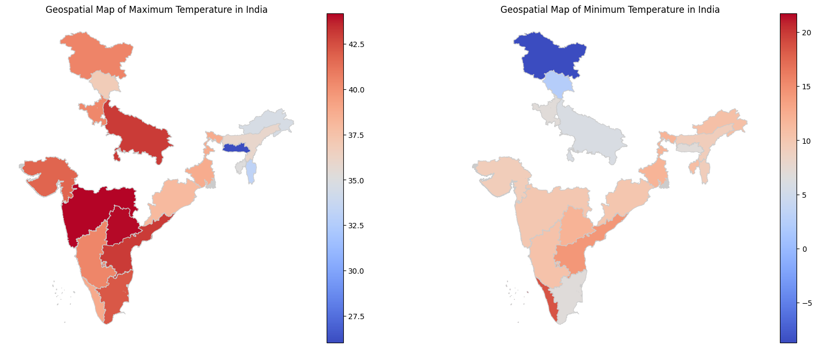
What about extreme Temperature of all the regions?
Observations ▶
Lack of sufficient data for some states (which are not visible in the plot).
In general, Northern states are cooler than Southern states due to equatorial distance.
One can be confused from the 1st plot that Meghalaya & Mizoram has lower temperature value than the coolest state Jammu & Kashmir the plot depicts least Maximum temperature, not the least Temperature (can be confirmed by the 2nd plot).

Slide 8
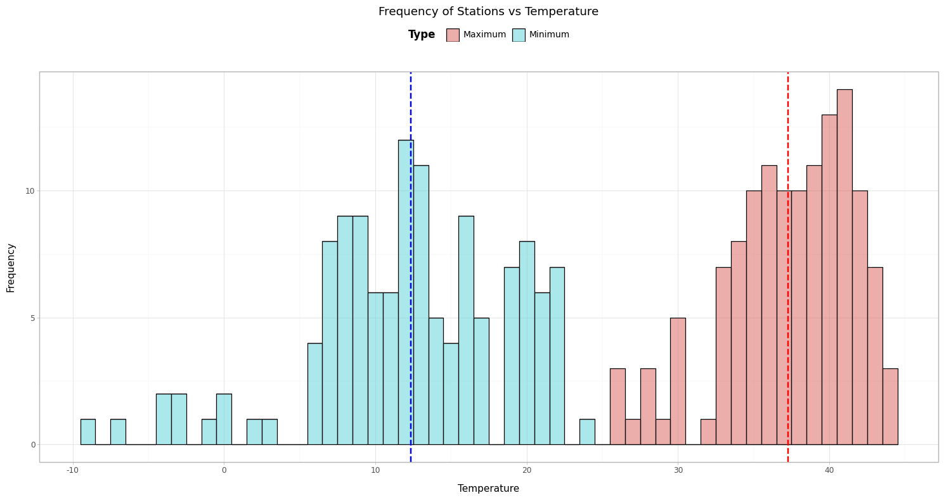
What about the distribution of stations over the extreme temperature?
Observations ▶
Mean minimum temperature over all stations is around 12°C while that of the maximum temperature is around 38°C.
Minimum temperature has higher variance in comparison to maximum temperature.

Slide 9
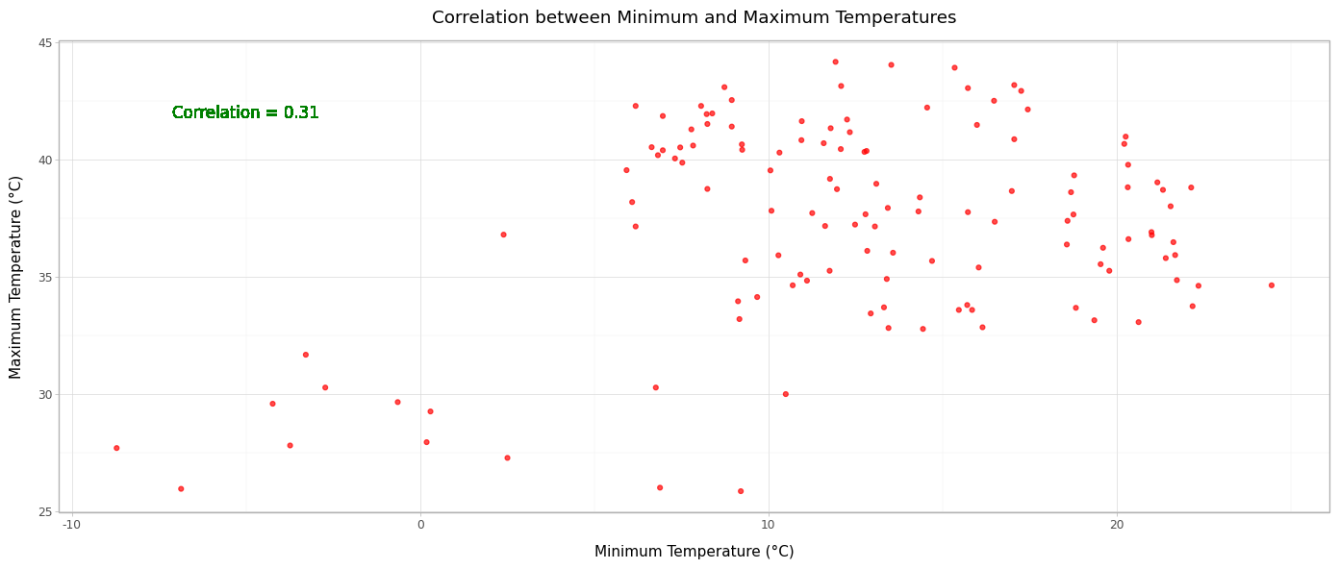
How Maximum & Minimum Temperature corelates with each other ?
Observations ▶
Minimum & Maximum Temperature are slightly positively correlated with a value of 0.31.

Slide 10
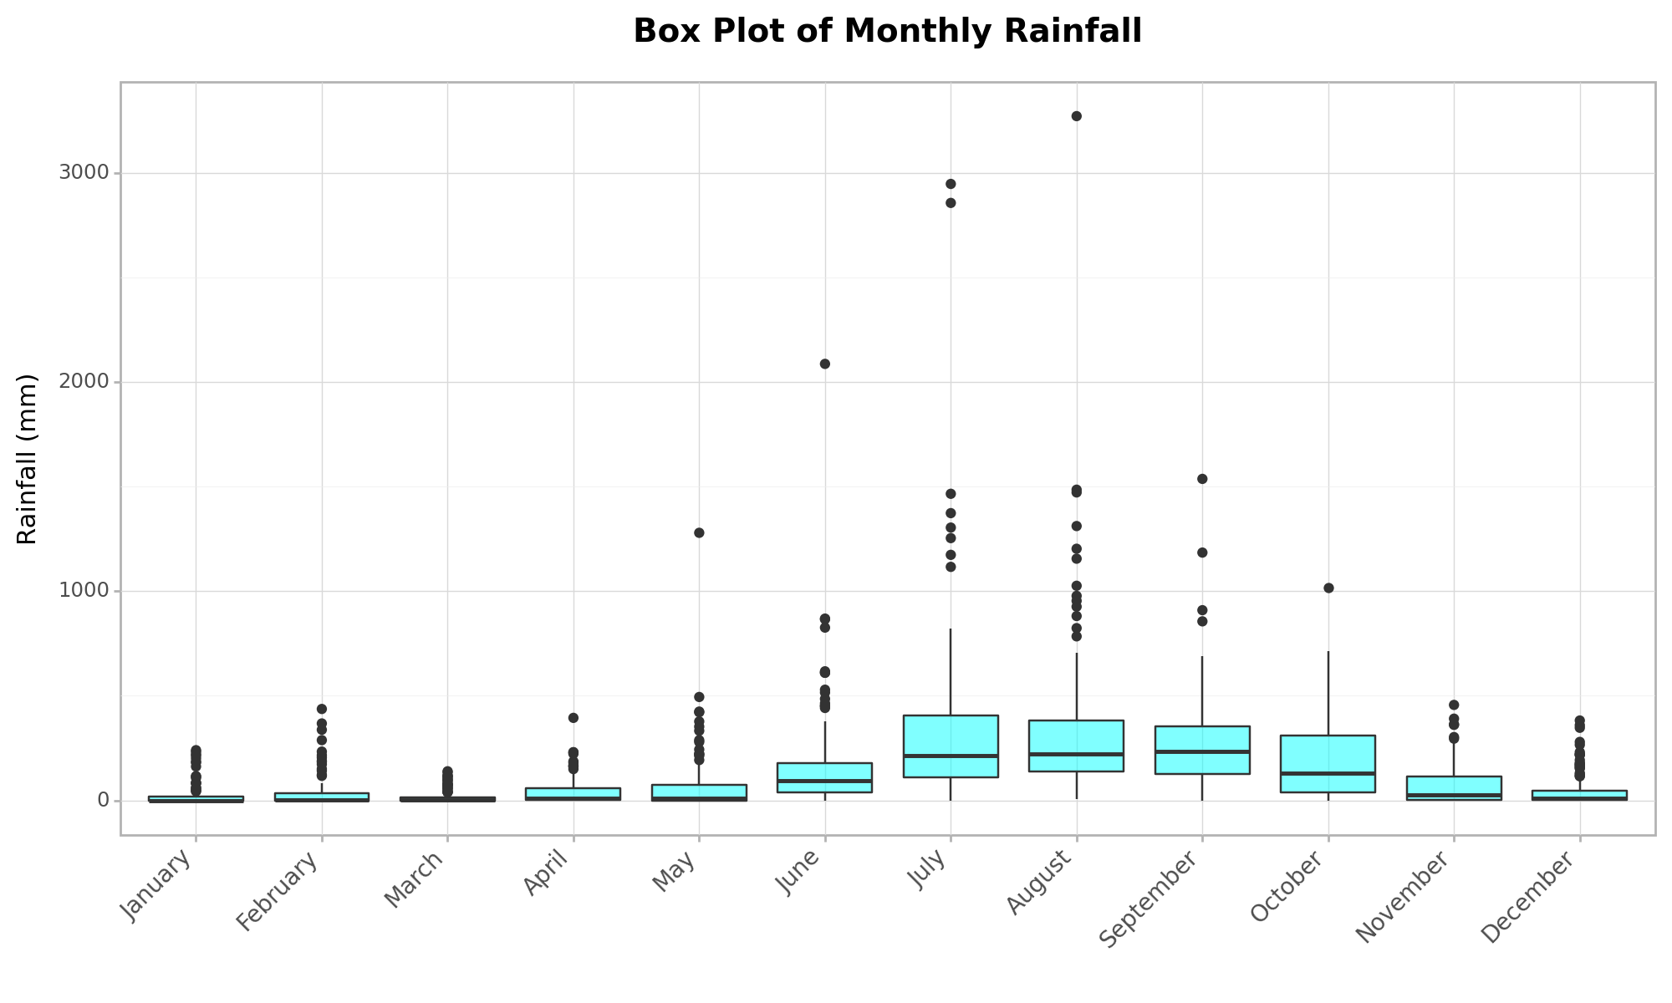
Rainfall
How Rainfall varied across India in 2019?
Observations ▶
Maximum rainfall received by any station is about 3600 mm.
Rainfall peaked in the months of July and August while minimum rainfall occurred during the month of March.
Outliers in the higher rainfall scale can be observed

Slide 11
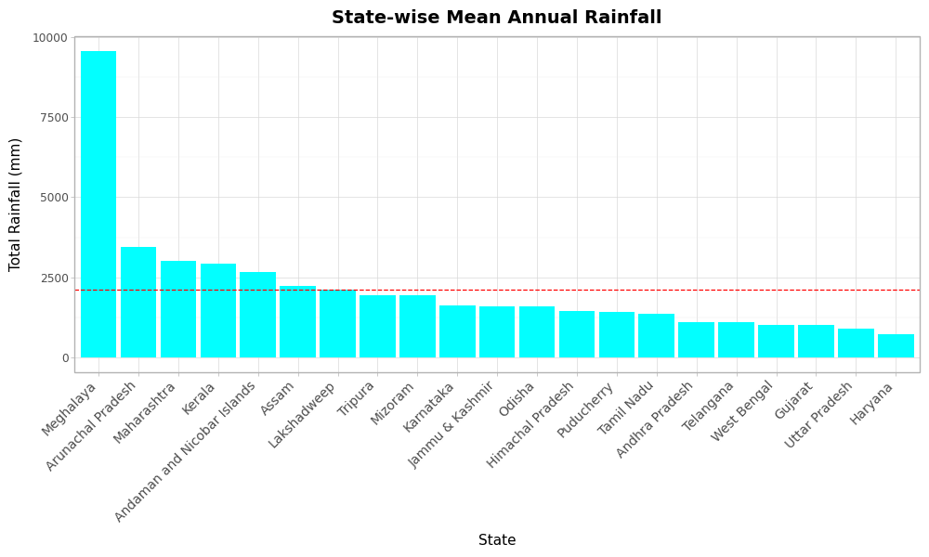
How Rainfall varied across the States/UTs?
Observations ▶
Meghalaya received almost three times more rainfall than Arunachal Pradesh which ranks in at second place.
Coastal states like Kerala, UTs like Andaman and Nicobar Island & Lakshadweep receive high rainfall because of its location (proximity to the sea) and direction of wind.
Northern-eastern states like Assam, Meghalaya, Mizoram and Tripura receive high rainfall because of forest as well as Mountain areas.

Slide 12
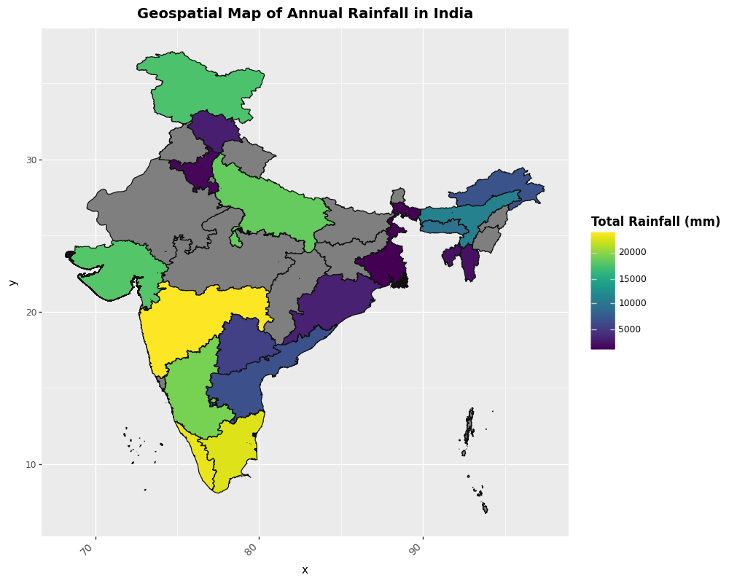
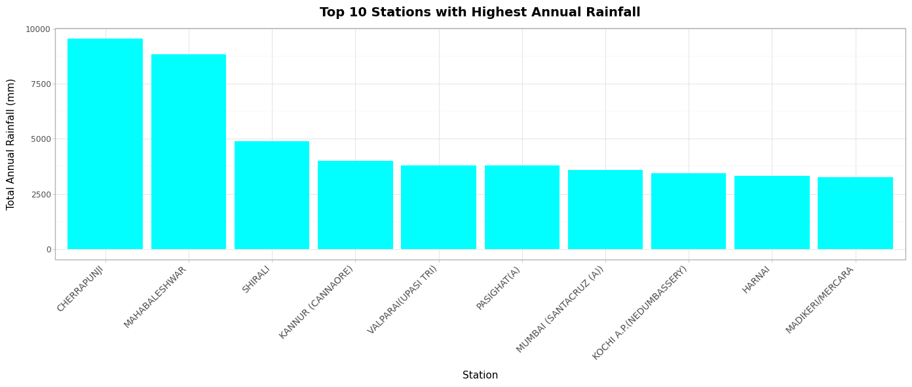
How Rainfall varied across India in 2019?
Observations ▶
Why does the Western Ghat Belt receive higher rainfall than its Eastern counterpart? ➡ The Western Ghats in India receive rainfall due to orographic rainfall, which occurs when winds from the Arabian Sea climb the slopes of the mountains and cool, causing the windward side to receive heavy rainfall. The winds rise, expand, cool, condense, and shed their moisture on the western slopes, resulting in more rainfall.

Slide 13
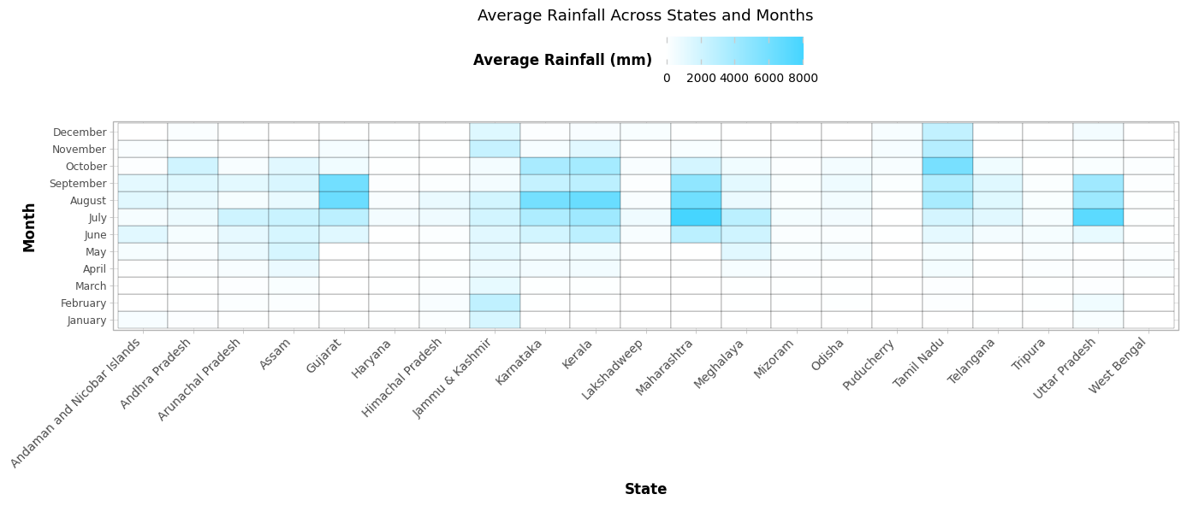
How Rainfall varies across the states for every months?
Observations ▶
Most of the states receives rainfall during the months of June to October while Tamil Nadu receives rainfall till December and Jammu & Kashmir receives rainfall almost throughout the entire year except September & October.

Slide 14
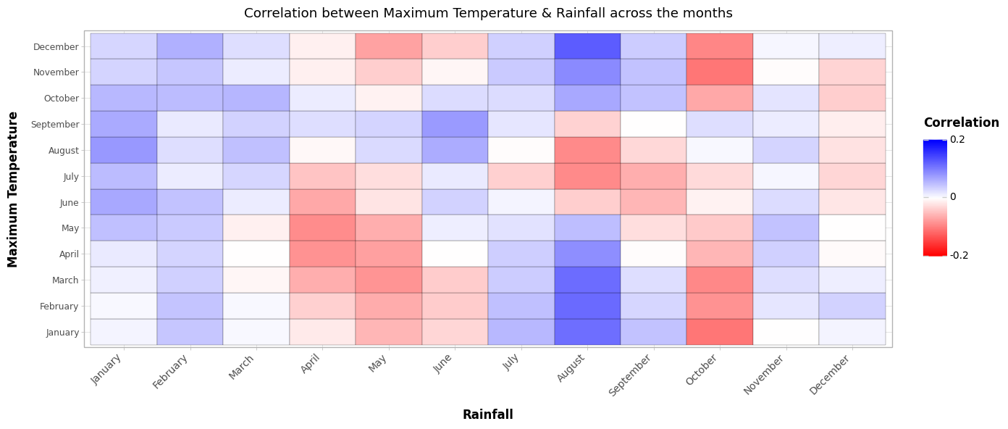
Will there be any correlation between Temperature & Rainfall?
Observations ▶
There's not much correlation which is observed but we can see an alternate pattern of blue and red combination of columns.
Average temperature data over the months may have higher correlation with rainfall, but I was unable to find such data for these many stations.

Slide 15
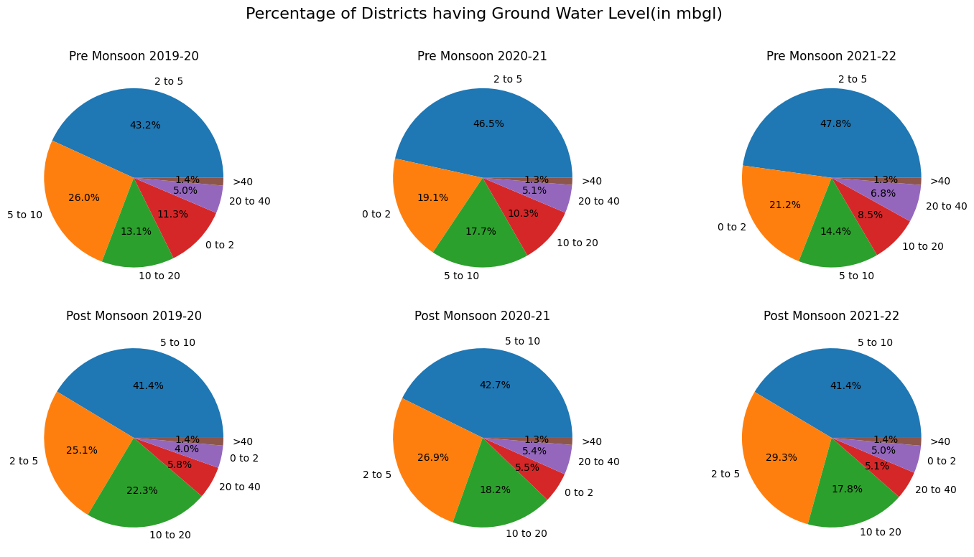
What about the changes in Ground Water Level in Pre & Post Monsoon?
Observations ▶
There's an increase in the percentage of districts having higher ground water level values and a decrease in the percentage of districts with lower water level values post monsoon as compared to pre monsoon.

Slide 16
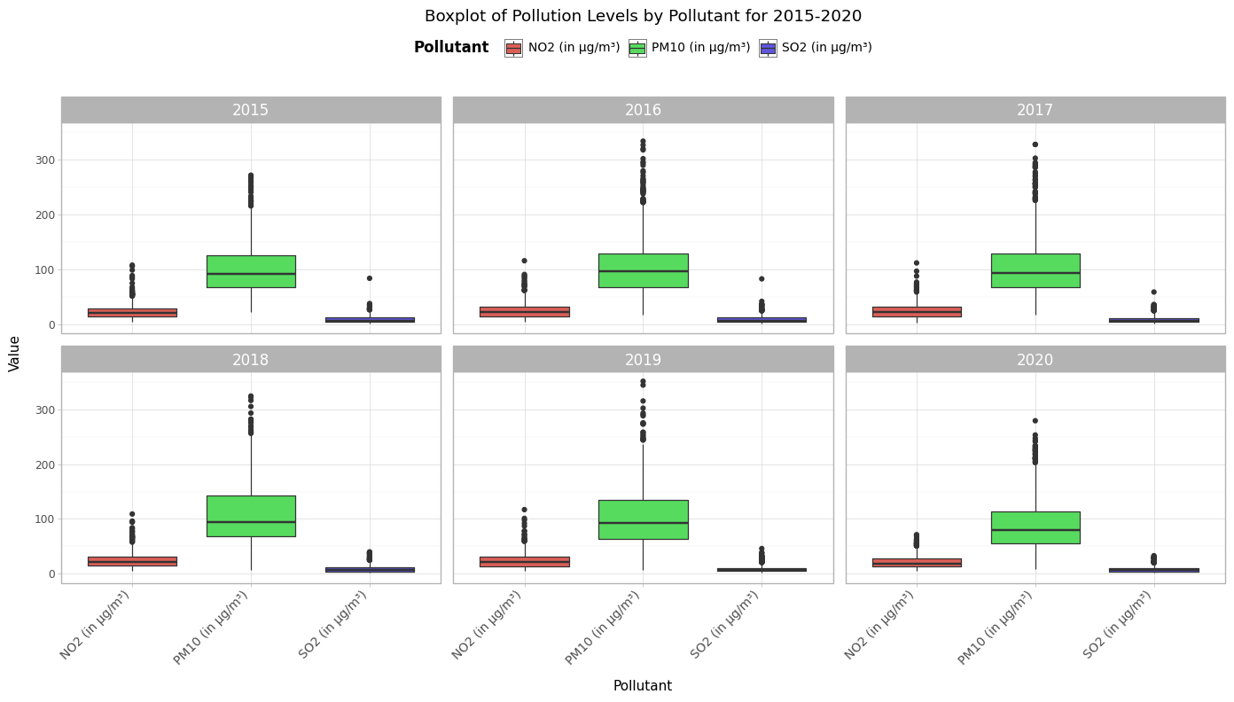
Air Quality
How Air Quality varied across India, over the past few years?
Observations ▶
There's an increase in the concentration of PM10 across the years from 2015-2019 and a sudden decrement in 2020 because of Lockdown throughout the country due to Covid.
NO2 concentration is more or less the same across the years from 2015-2019 with a slight decrease in 2020.
SO2 concentration decreases slightly over the years from 2015-2020.

Slide 17
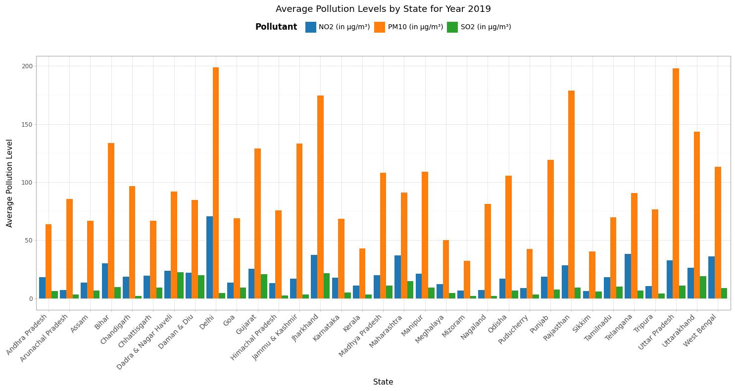
How does Pollutants concentration varies across the States/UTs?
Observations ▶
Delhi has the maximum concentration of PM10 & NO2 as the main sources of these pollutants are brush/waste burning, landfills, wildfires and agriculture (from the surrounding states) & fossil fuels consumed by cars respectively.
One thing can be observed that States having higher values of PM10, also have higher values of NO2 as compared to other states but SO2 doesn't follow similar trends.
Jharkhand has the maximum concentration of SO2 which can be attributed to the fact that Industrial gaseous waste is the major source of SO2.
Mizoram has the least concentration of all the pollutants.

Slide 18
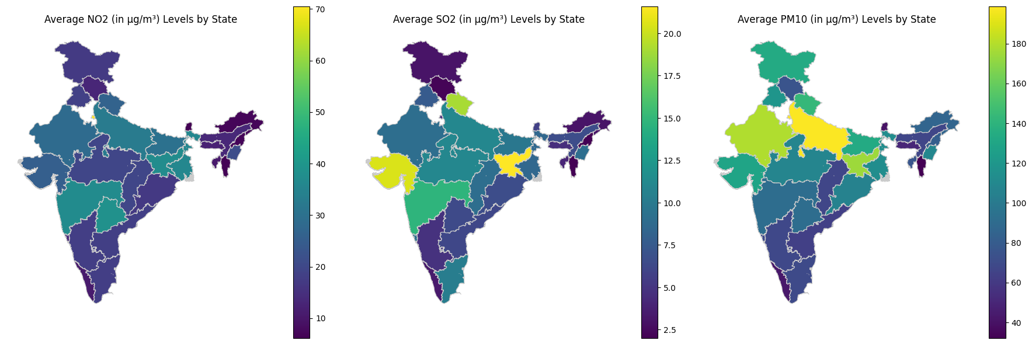
Visualization on Indian Map
Observations ▶
Southern, North-Eastern & Extreme Northern states have low concentration of all Pollutants.
Delhi has much higher concentration of NO2 as compared to other states.

Slide 19
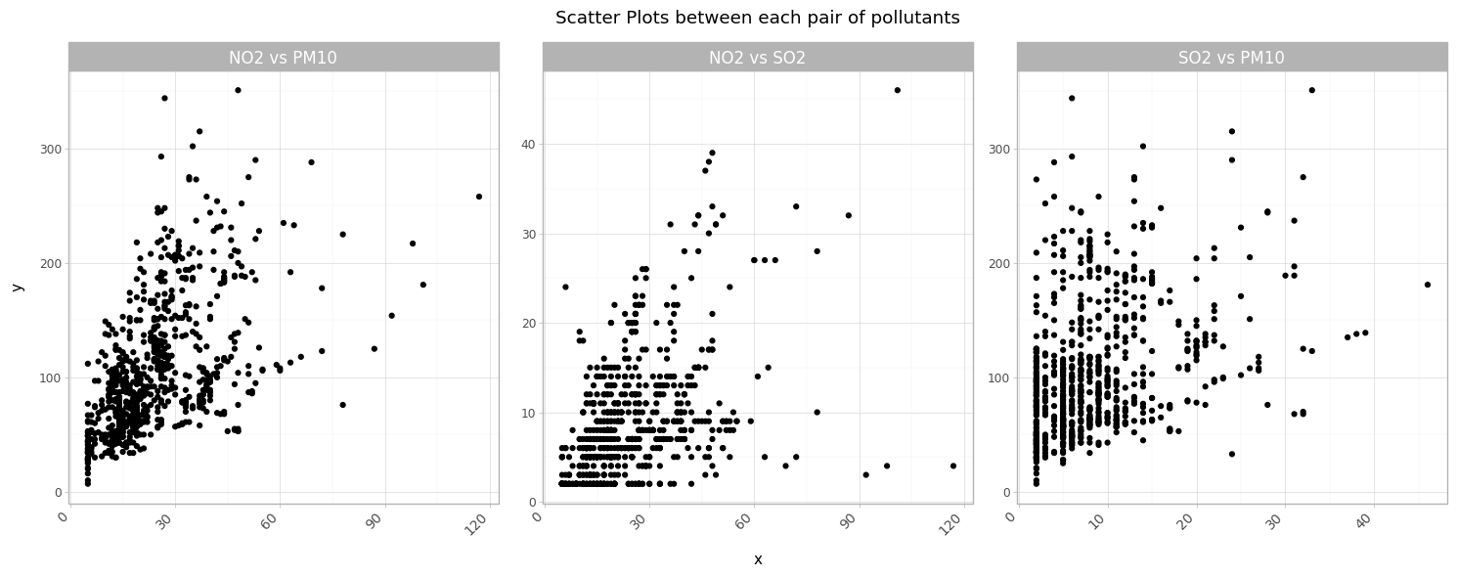
What about the correlation among concentration of the pollutants?
Observations ▶
NO2 and PM10 are more correlated, followed by NO2 and SO2
More correlation may conclude that they have same major source.

Slide 20
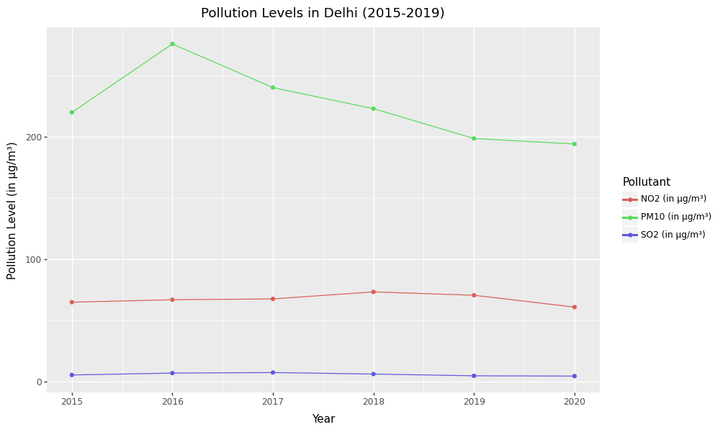
What about the most infamous city for Pollution i.e. Delhi?
Observations ▶
PM10 concentration peaked in 2016 and started decreasing after that.
NO2 concentration is almost constant but hiked in 2018.
Similarly with SO2, concentration was at its peak in the year of 2017.

Slide 21
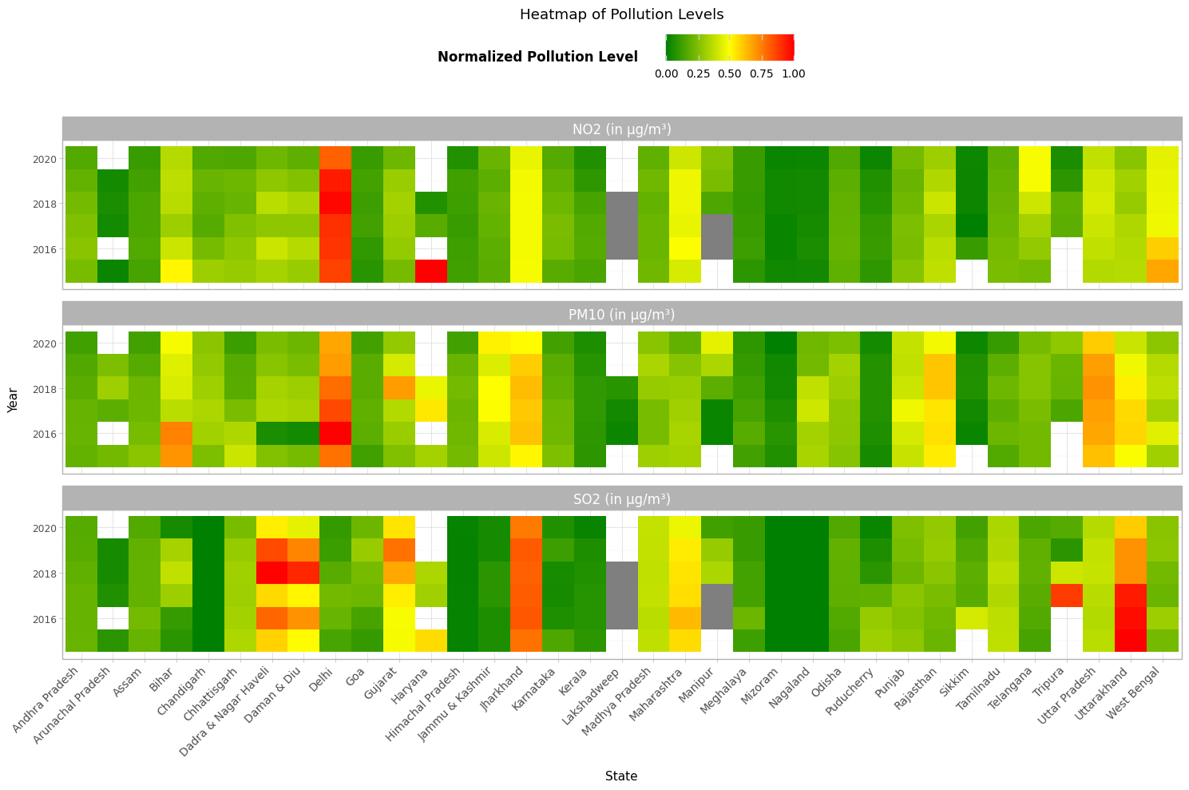
What about the Statewise Pollutant Concentration over the year?
Observations ▶
States/UTs like Uttarakhand, Jharkhand, Dadra Nagar Haveli & Daman Diu have high concentrations of SO2 but lower concentrations of the other 2 pollutants opposite to the case of Delhi.
Normalization of pollutants could help us conclude the above, which was hard to do in the case of Bar-Plot visualization.
Lack of data of few states for few years.

Slide 22
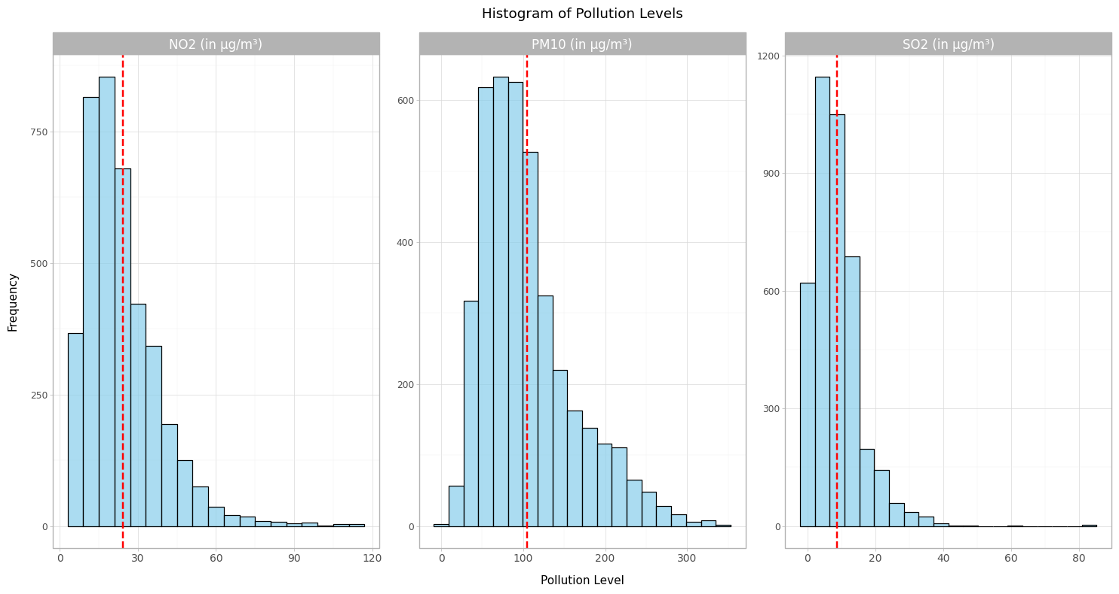
What about the distribution of stations over the concentration of Pollutants?
Observations ▶
Mean values of each pollutants for all stations over the years are :- NO2 ~ 20 μg/m³ PM10 ~ 105 μg/m³ SO2 ~ 8 μg/m³

Slide 23
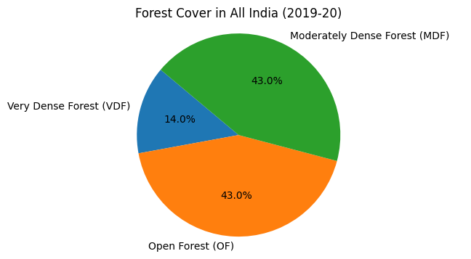
Forest
How Forest are grouped based upon the canopy density?
There are 3 types of Forest :-
Very dense forest (VDF): A canopy density of 70% or higher
Moderately dense forest (MDF): A canopy density of 40% to more than 70% but less than 70%
Open forest (OF): A canopy density of 10% or higher but less than 40%

Slide 24
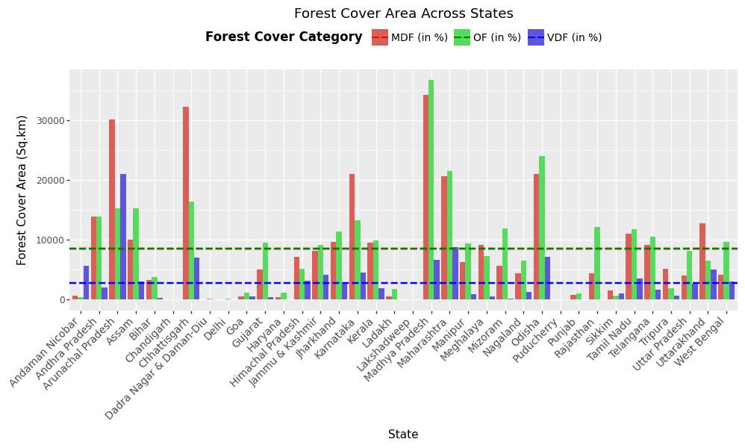
How Forest cover area varies across the states?
Observations ▶
Madhya Pradesh has the maximum area of MDF & OF, followed by Chhattisgarh and Arunachal Pradesh in MDF & Odisha, Maharashtra, Chhattisgarh and Arunachal Pradesh in OF
Arunachal Pradesh has the maximum area of VDF, with no other state close to it.
Despite of being smaller in area but highly rich in Forest Area that means it'll have highest percentage of Forest Land as compared to Total Land.

Slide 25
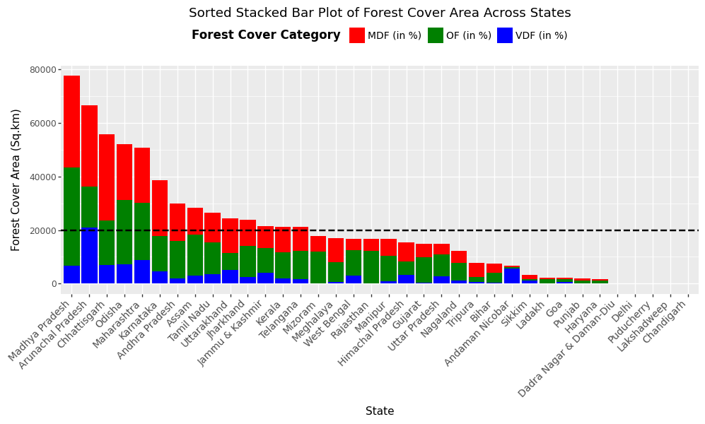
How total Forest cover area varies across the states?
Observations ▶
Madhya Pradesh has the maximum combined Forest Area, followed by Arunachal Pradesh, Chhatisgarh, Odisha & Maharashtra.
14 states have higher Forest area than the country average.

Slide 26
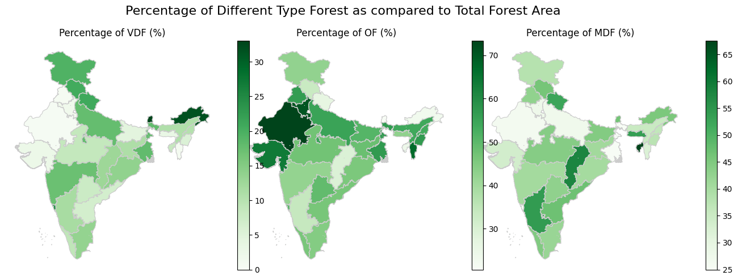
Visualization on Indian Map for each type of Forest distribution
Observations ▶
North-western states have higher percentage of Open Forest.
Arunachal Pradesh having highest percentage of Forest Area, even in that most of the area covered by Very Dense Forest only.

Slide 27
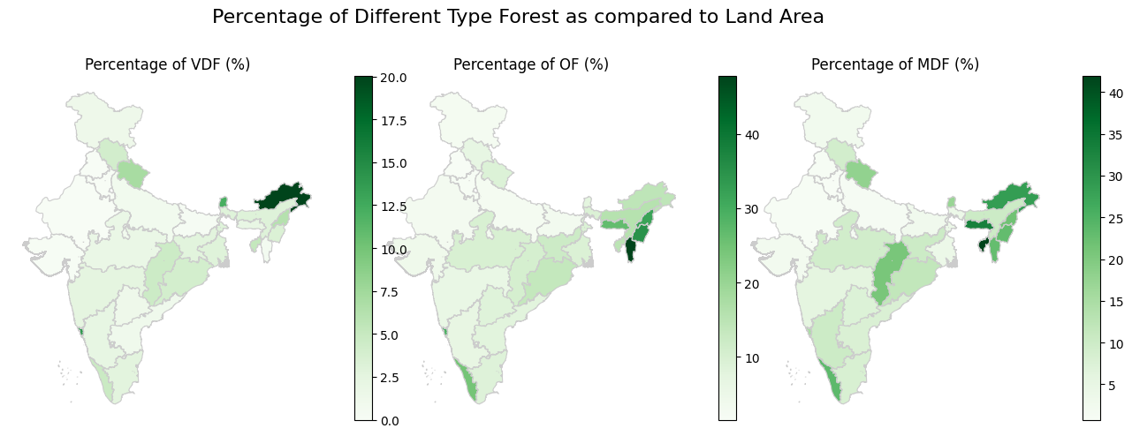
Visualization on Indian Map for each type of Forest distribution
Observations ▶
North-western states have a higher percentage of Open Forest.
Arunachal Pradesh has the highest percentage of Forest Area, with most of its area being covered by Very Dense Forests.

Slide 28
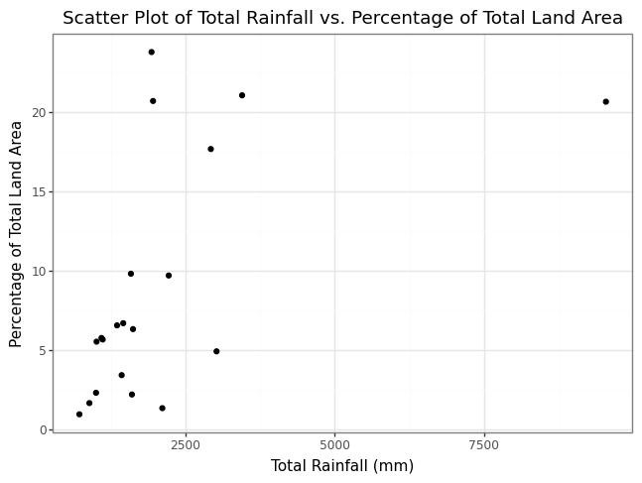
Will Forest and Rainfall be correlated?
Observations ▶
The correlation is around 0.55 which could be due to Transpiration (a process in which trees and vegetation absorb water through their roots and cool surroundings by releasing water vapor into the air through their leaves).
Meghalaya is an outlier, because of high Hilly areas.

Slide 29
Thank You
The Earth is what we all have in common
—Wendell Berry

