Slide 1

RISC 5 BASED SOC DESIGN -UART​
TEAM 8​
TEAM DETAILS​
SL.NO | NAME | USN
01 | PRABODH KULAKARNI | 01FE21BEC049
02 | SURESH G KINI | 01FE21BEC255
03 | SHIVANANDA BIRADARA | 01FE21BEC272
04 | SOUBHAGYA A BHOVI | 01FE21BEC302
Under the guidance of: Dr. Saroja V Siddamal

Slide 2
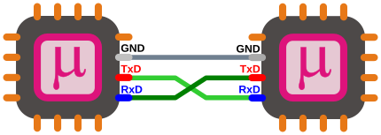
Introduction to UART Protocol
UART (Universal Asynchronous Receiver-Transmitter) is a protocol used for serial communication between two devices. It is a simple and widely used communication protocol that allows data to be transmitted and received between devices asynchronously.
UART Architecture
•Transmitter
•Receiver
•Baud Rate Generator
The UART architecture consists of a transmitter, a receiver, and a baud rate generator. The transmitter and receiver communicate through a common set of data lines, and the baud rate generator sets the speed at which data is transmitted and received.

Slide 3
UART ARCHITECTURE
The UART architecture consists of two main components: the transmitter and the receiver.
Transmitter
The transmitter is responsible for converting parallel data into serial data and transmitting it through the communication channel. The transmitter consists of the following components:
Data Register: Stores the data to be transmitted.
Baud Rate Generator: Generates the clock signal for the transmitter and receiver to synchronize the data transmission.
Control Register: Configures the transmitter settings such as the number of data bits, parity, and stop bits.
Receiver
The receiver is responsible for receiving serial data from the communication channel and converting it into parallel data. The receiver consists of the following components:
Data Register: Stores the received data.
Baud Rate Generator: Generates the clock signal for the transmitter and receiver to synchronize the data transmission.
Control Register: Configures the receiver settings such as the number of data bits, parity, and stop bits.

Slide 4
UART Working
•Start Bit
•Data Bits
•Parity Bit
•Stop Bit
UART uses a start bit, data bits, parity bit, and stop bit to transmit and receive data. The start bit indicates the beginning of a byte, followed by the data bits, which contain the actual data being transmitted. The parity bit is used for error checking, and the stop bit indicates the end of a byte.

Slide 5
Start Bit
The transmission of data begins with a start bit, which is always a logic low (0).
Data Bits
The data bits are transmitted LSB first, followed by the MSB. The number of data bits can be configured to be 5, 6, 7, or 8 bits.
Parity Bit
The parity bit is optional and can be used for error detection. It can be configured to be even, odd, or none .
Stop Bit
The transmission of data ends with a stop bit, which is always a logic high (1).

Slide 6
Data Transfer
UART transfers data in serial format, one bit at a time. It uses start and stop bits to indicate the beginning and end of a byte of data.
Data is transmitted LSB (Least Significant Bit) first, Data is received LSB first
Baud Rate
The baud rate is the number of bits per second that are transmitted.
It is important to ensure that the transmitting and receiving devices have the same baud rate to ensure accurate data transfer.

Slide 7
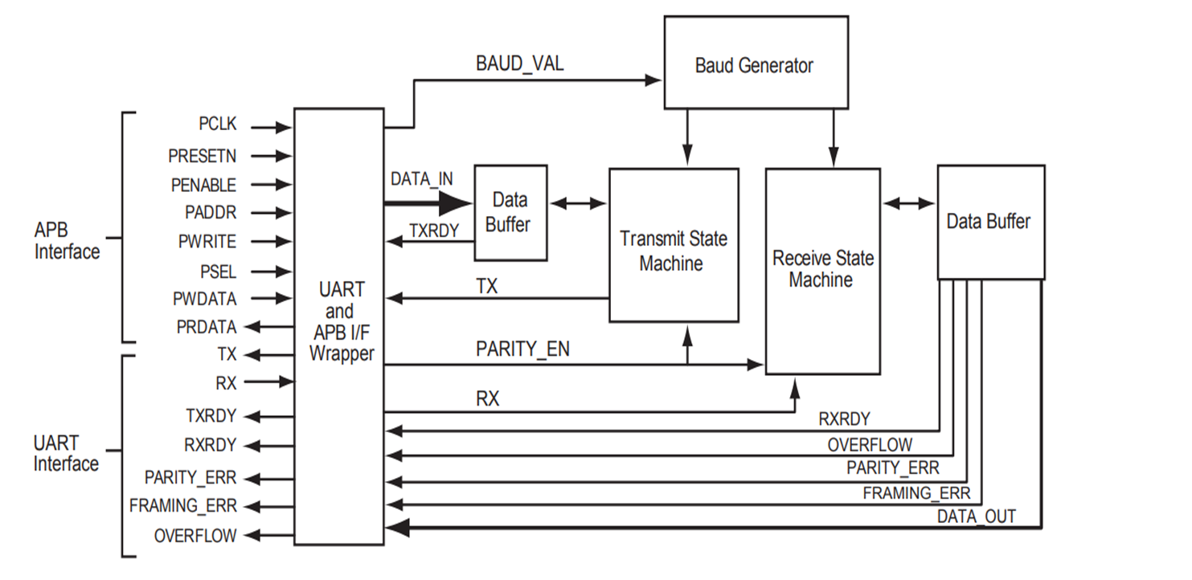
FUNCTIONAL BLOCK DIAGRAM

Slide 8
TRANSMIT BLOCK DIAGRAM
Baud_val
Baud generator
PCLK
wrapper
Data_in
Data
buffer
TSM
RSM
Data
buffer
TXRDY
Tx
TX

Slide 9
RECEIVER BLOCK DIAGRAM
Baud_val
Baud generator
PCLK
wrapper
Data
buffer
TSM
RSM
Data
buffer
Rx
Rx
RXRDY
Data_out

Slide 10
TRANSMITTER
RECIEVER
BAUD GENERATER
BAUD VALUE

Slide 11
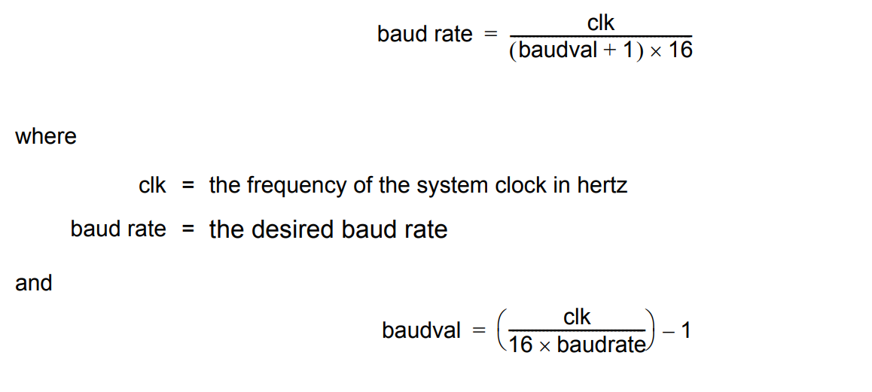
Baud Value Calculation
CLK = 30MHz
Baud rate = 9600 bits/sec
Baud value = [30/(9600*16)] -1
Baud value = ( 195.3) 194 dec(C2 hex)

Slide 12
CONTROL REGISTER - 1
0 | 1 | 2 | 3 | 4 | 5 | 6 | 7
7-0 : Baud value
Read / Write type
Bits 7:0 of 13-bit baud value

Slide 13
CONTROL REGISTER - 2
0 | 1 | 2 | 3 | 4 | 5 | 6 | 7
0 : BIT8 [Data width setting:
BIT8 = 0: 7-bit data
BIT8 = 1: 8-bit data]
1-2 : Reserved
3-7 : 12-8 bits of BAUD VALUE
All registers are of Read/Write type.

Slide 14
CONTROL REGISTER - 3
0 | 1 | 2 | 3 | 4 | 5 | 6 | 7
2-0 : BAUD_VAL_FRACTION
Register is of Read/Write type.
When Configuration is set to Programmable, this register can be used to set a fractional part for the baud value.

Slide 15
STATUS REGISTER
0 | 1 | 2 | 3 | 4 | 5 | 6 | 7
0 : TXRDY
1 : RXRDY
2-4 : Reserved
5-7 : UNUSED
All status registers are of type read only.

Slide 16
ADVANTAGES OF UART
Hardware complexity is low.
Low Power Consumption.
Simple to operate, well documented as it is a widely used method with a lot of resources online.
DISADVANTAGES OF UART
No acknowledgement from the receiver after successful or failure of data transmission.
Limited amount of input data frame.
Both devices should follow similar data transfer settings.
We can not send data to more than one device at a time.

Slide 17
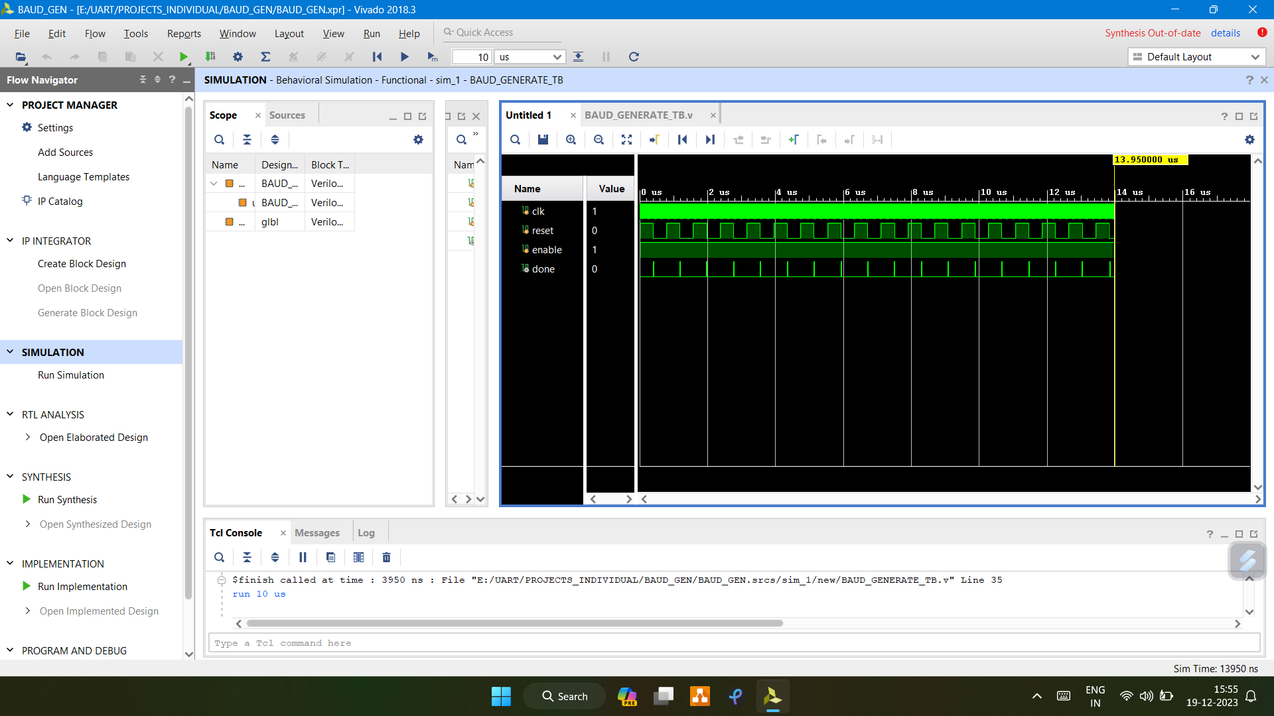
BAUD RATE GENERATE

Slide 18
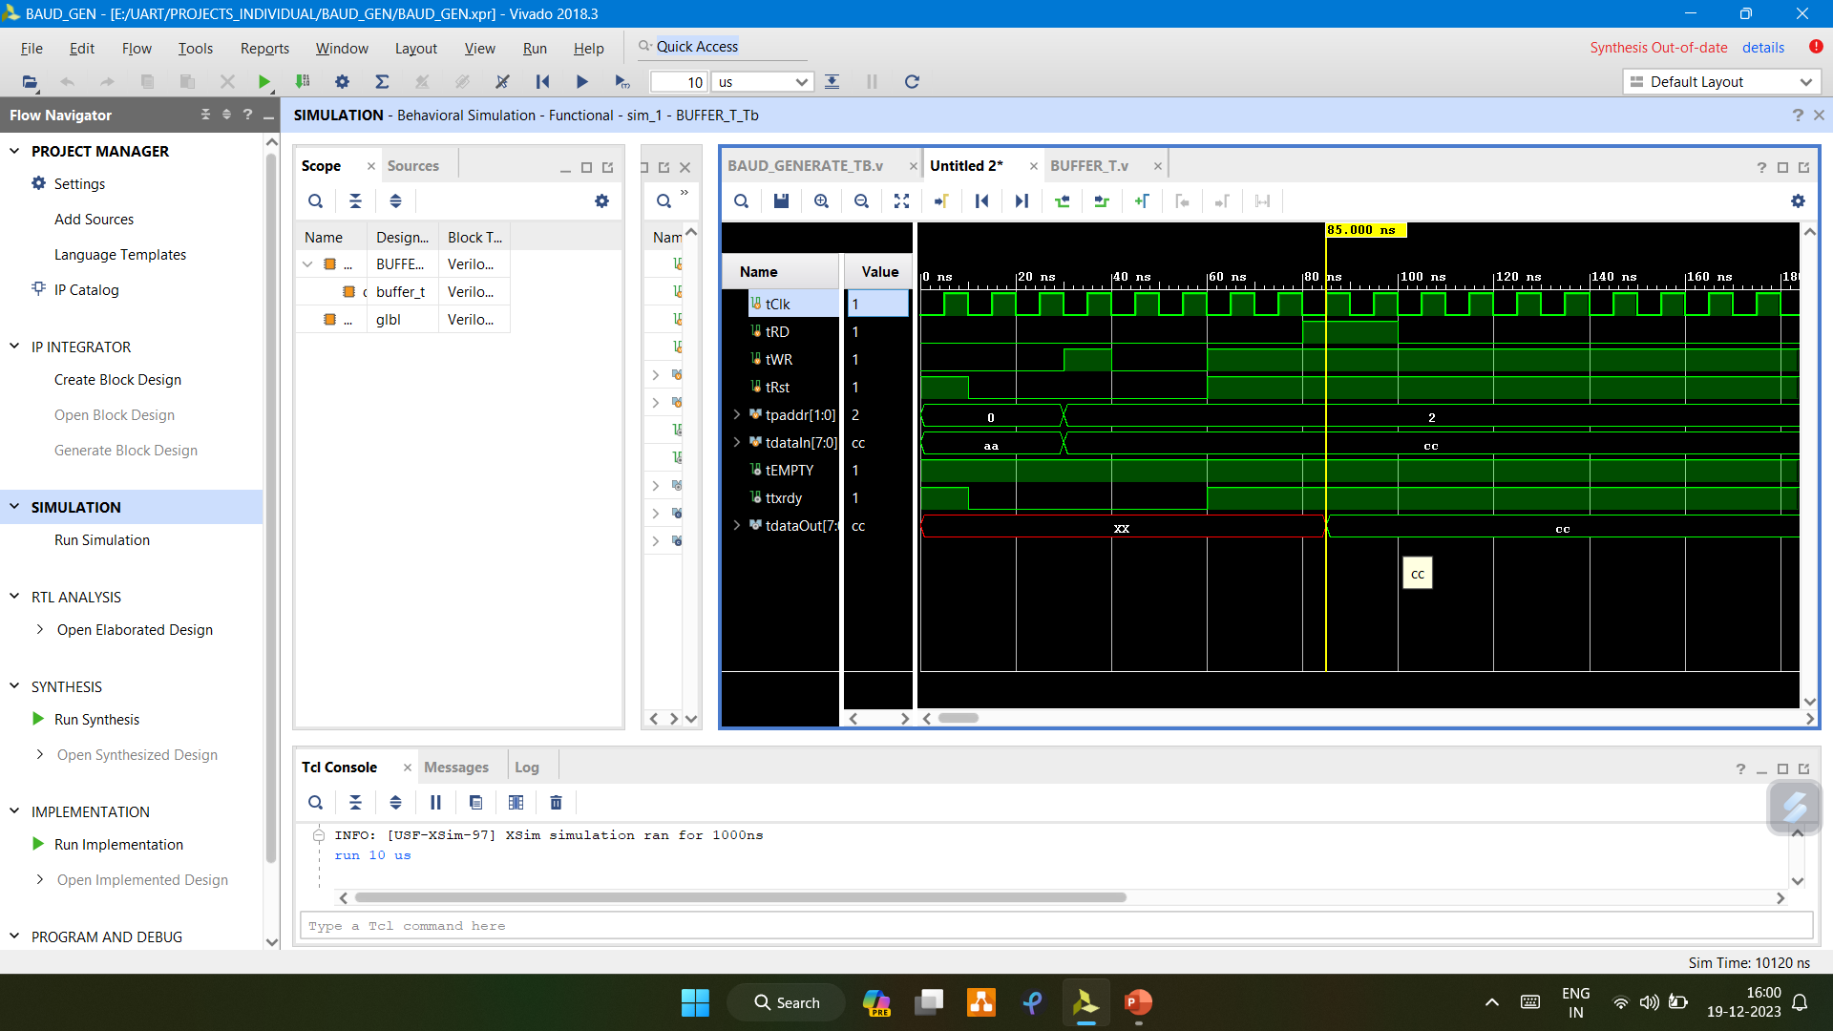
BUFFER TX

Slide 19
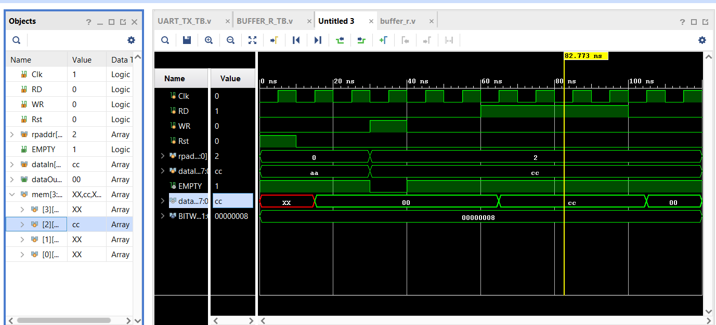
BUFFER RX

Slide 20
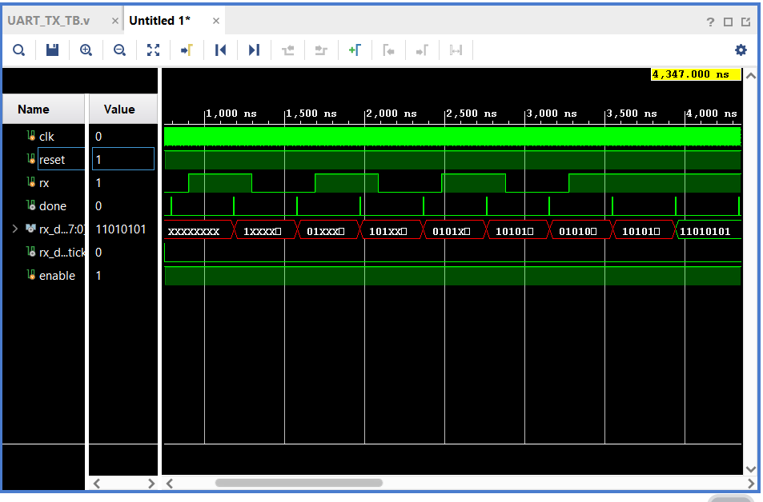
RECIEVER

Slide 21
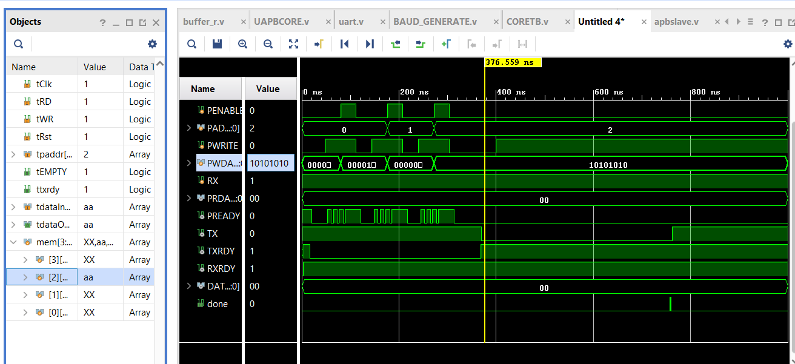
UART

Slide 22
THE BAUD GENERATER’S TICK SIGNAL SHOULD SENT TO THE S_TICK OF THE UART_RX(RECIEVER) AND
TX(TRANSMITTER).
WE SHOULD SEND RESET’ (RESET_BAR,OR ACTIVE LOW) .
THE NORMAL CLOCK SIGNAL IS SEND TO THE BUFFER REGISTERS.
W_DATA IS THE DATA WHICH IS TO BE TRANSMITTED IT WILL COME AND SIT IN TX_BUFFER.
THE DATA OUT OF THE RECEIVER SHOULD BE THE DATA IN FOR THE RECEIVE_BUFFER.

Slide 23
THANK YOU

