Slide 1


ICASSCT 2024
PAPER ID: SCT 5010​
Autocompletion of Words
Using Transformer Model
Presented by: Shivananda Biradara
Second International Conference on Advances in Smart Sensor, Signal Processing and Communication Technology (ICASSCT 2024)
22 - 23, March 2024, Goa University, Goa, India

Slide 2
Contents
Introduction
Objectives
Dataset
Methodology
Implementation
Results
Conclusion

Slide 3
Introduction
Autocompletion is a feature that suggests words or phrases as the user is typing.
The auto-completion algorithm compares inputs to these patterns and suggests the next word that is most possible.-
Transformer models are deep learning models that perform natural language processing (NLP) tasks and are suitable for auto-completion jobs because they can learn long-range dependencies in text.

Slide 4
Applications
Text Editors
Word Processors
Browsing
Search Engines
Applications
Email typing
Programming IDEs
Command line interfaces
Web Forms

Slide 5
Objectives
Perform a comprehensive literature survey towards understanding the state of the art in the direction of autocompletion of words.
Compare the LSTM-based model with the attention-based mechanism towards the auto-completion of words.

Slide 6
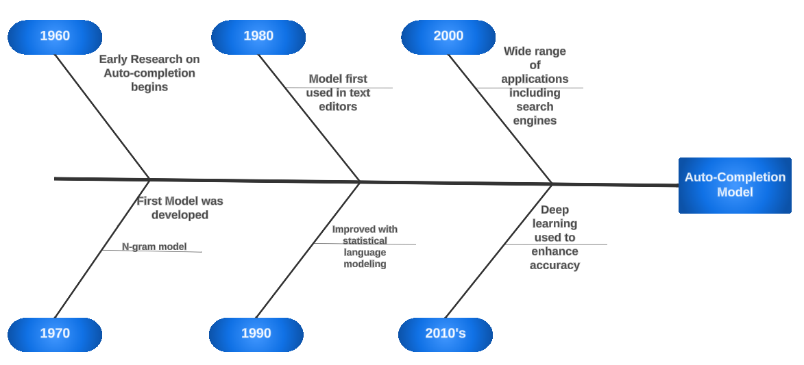
Development towards autocompletion

Slide 7
Literature Survey
SI No | Title of Paper | Year | ML/DL Method used | Performance Metrics
1. | A Machine Learning Approach to predict the Next Word in Statement | 2023 | LSTM and BiLSTM | Accuracy--> BiLSTM=85% LSTM=57%
2. | Attention is All You Need | 2017 | Transformers | Accuracy=95% BELU(E-G)=28.4% BELU(E-F)=41.8%
3. | Learning Autocompletion from Real World Datasets | 2020 | BERT | Accuracy=95%
4. | On-Device Neural Language Model Based Word Prediction | 2020 | LSTM | Key stroke saving=65.11% Word prediction rate=34.38%

Slide 8
Data set
In this project, data was collected from books from the website Project Guttenberg and some telegram channels. We have selected books including The Adventures of Sherlock Holmes, The Divine Comedy, The Harry Potter series, Books authored by Sukhbodhananda and Sudha Murthy, some books related to mythology, and a few books having conversations between people.
Data set size : 15_634_743 words
Unique words :7_78_887 words

Slide 9
METHODOLOGY
RAW DATA
Data Preprocessing
Model Building
Training
Testing
Results
DATA CLEANING
TOKENIZATION
BERT(Training)
LSTM(Training)
OUTPUT
OUTPUT

Slide 10
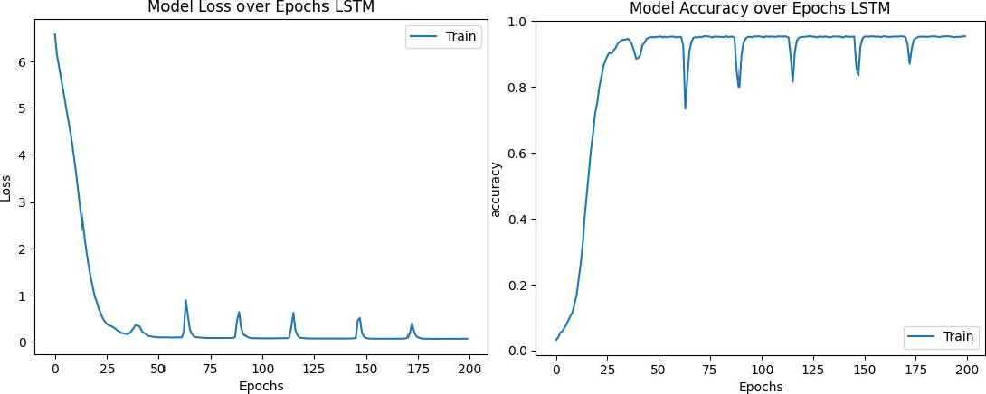
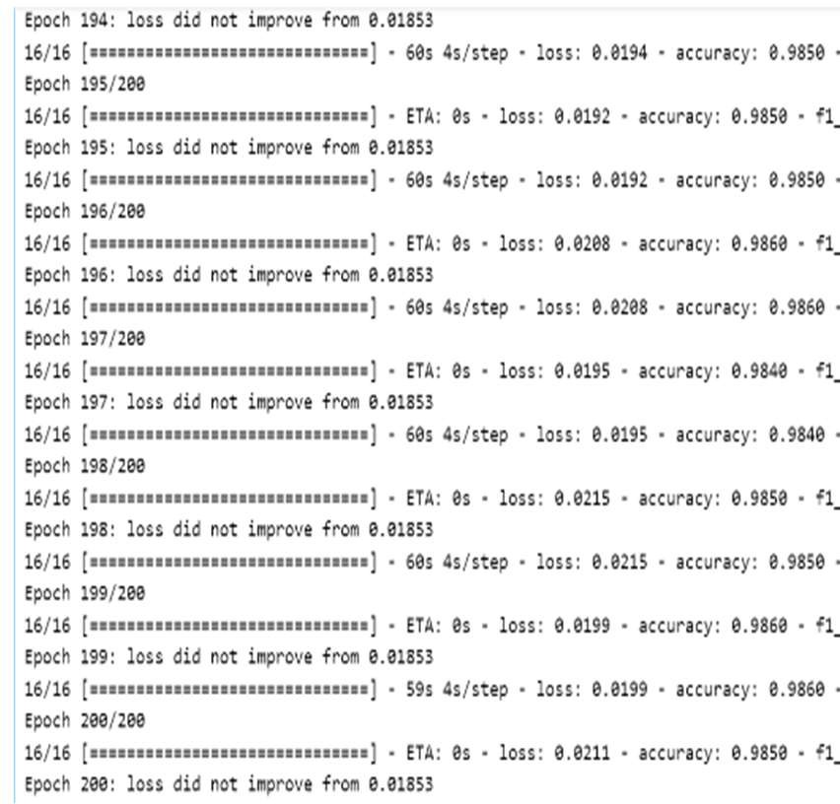
Implementation and Results
Learning rate = 0.03
Hidden Layers (LSTM) =700 Masking percentage (BERT) =15
Training the LSTM model Nvidia A6000 GPU with 128 gigabytes of RAM was used.
At the time of training 55 GB of RAM was used by the model
Bert was trained on the Google collab with 15 GB RAM
Accuracy LSTM : 98.50%
Accuracy BERT : 98.07%

Slide 11
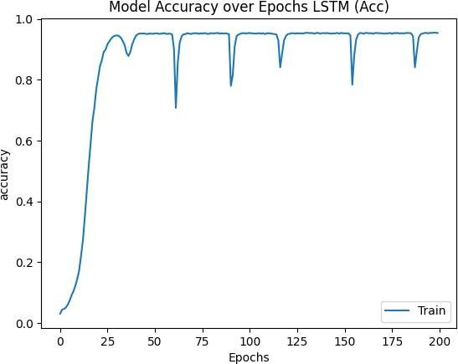
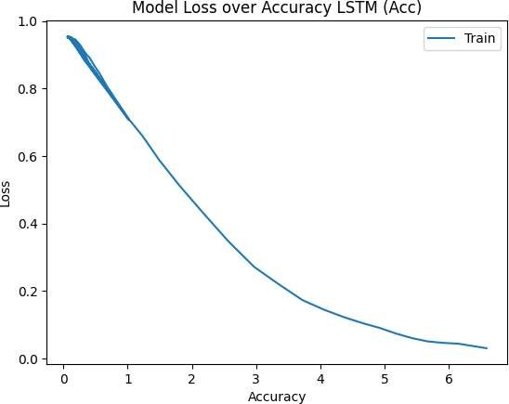
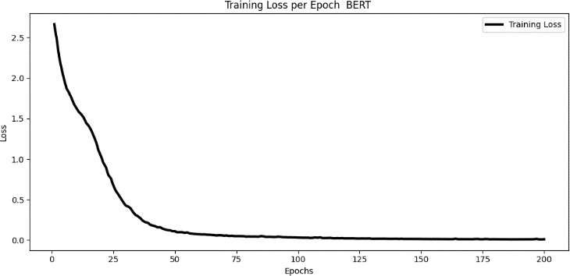
Training Loss per Epoch BERT

Slide 12
Conclusion
The training time of the BERT will be less than the LSTM for the same dataset and the same epochs.
Based on the obtained results, it could be said that the BERT model is very good at the context holding than the LSTM model
The model which is saved on the best loss will give better results than that of the models saved on the best accuracy

Slide 13
References
Vishal Rathee and Sakshi Yede. A machine learning approach to predict the next word in a statement. In 2023, 4th International Conference on Electronics and Sustainable Communication Systems (ICESC), pages 1604–1607. IEEE, 2023.
Ashish Vaswani, Noam Shazeer, Niki Parmar, Jakob Uszkoreit, Llion Jones, Aidan N Gomez,Łukasz Kaiser, and Illia Polosukhin. Attention is all you need. Advances in neural information processing systems, 30, 2017.
Gareth Ari Aye, Seohyun Kim, and Hongyu Li. Learning autocompletion from real-world datasets. In 2021 IEEE/ACM 43rd International Conference on Software Engineering: Soft- ware Engineering in Practice (ICSE-SEIP), pages 131–139. IEEE, 2021.
Seunghak Yu, Nilesh Kulkarni, Haejun Lee, and Jihie Kim. On-device neural language model based word prediction. In Proceedings of the 27th International Conference on Com- putational Linguistics: System Demonstrations, pages 128–131, 2018.

Slide 14
THANK YOU

Slide 15
Q & A

