Slide 1

SMART INDIA HACKATHON 2026
Problem Statement ID – 26195
Problem Statement Title- Solutions could be in the form of waste segregation, disposal, and improve sanitization system.
Theme - Clean and Green technology
PS Category- Software
Team ID - SIH26-A0H-T504
Team Name - SthapatyaX

Slide 2
Smart construction waste segregation & sustainable disposal system
STHAPATYAX
PROBLEM
India generates 25–30 million tonnes of C&D waste annually. Valuable materials such as steel, bricks, timber and glass are often lost during demolition due to poor identification and segregation, making reuse, recycling and responsible disposal difficult.
PROPOSED IDEA
A web-based platform that converts a building’s information model (BIM) into a digital Material Passport, using AI to identify, classify and organize construction materials before demolition. The platform helps stakeholders determine what can be reused, recycled or safely disposed, reducing construction and demolition waste.
DETAILED SOLUTION
STAGE 1 : UPLOAD
STAGE 2 :
AI DETECTION
STAGE 3 :MATERIAL PASSPORT
User uploads the building’s Building information model to the website.
AI analyses the BIM model and identifies materials, components and their properties.
The system generates a digital passport containing:
Material type, Location in building ,Dimensions , Manufacturer, Material properties, Installation information, Reusability,
Recycling potential ,Disposal requirements
REUSE
Materials/components that can be directly reused.
RECYCLE
Materials that cannot be directly reused but have recoverable material value.
DISPOSE
Materials that cannot be reused or recycled safely/economically.
STAGE 4 : AI SEGREGATION
→ Listed on the platform
→ Buyers can view details
→ Buyers can bid/purchase reusable materials
→ Platform identifies appropriate recycling pathway
→ Materials can be directed to registered recycling facilities
Platform provides information on authorized disposal facilities / government-designated locations.

Slide 3
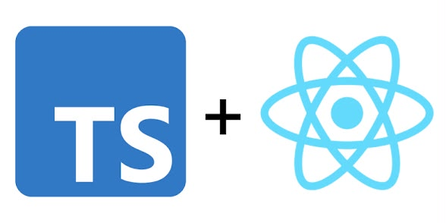




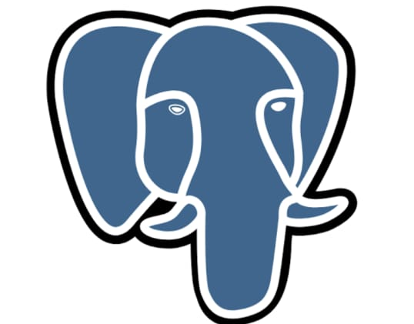


TECHNICAL APPROACH
STHAPATYAX
REACT + TYPESCRIPT
Builds the website where users upload BIM models and view material information.
IFC + WEB-IFC
Reads the Building information model and extracts details such as walls, doors, steel, concrete, glass, quantity.
THREE.JS
Displays the BIM building in 3D, allowing users to select individual components.
AI + RULE ENGINE:
Analyses the extracted material data and decides whether each material is suitable for Reuse, Recycle, or Dispose.
SUPABASE + postgreSQL
Stores the material passports, building data, users, marketplace listings, and bids.
MARKETPLACE:
Allows buyers to find reusable materials and place bids.
MAPS API:
Shows suitable recycling and authorized disposal facilities.
VERCEL + SUPABASE:
Used to host and deploy the website.

Slide 4
FEASIBILITY AND VIABILITY
STHAPATYAX
PROBLEMS:
SOLUTIONS:
VIABILITY:
The platform is highly viable as it converts BIM data into actionable material intelligence, enabling
pre-demolition planning, waste segregation and material recovery. By connecting reusable materials with potential buyers and directing recyclable/disposable materials to appropriate facilities, it can reduce construction waste while creating economic value from recovered resources .
BIM DATA AVAILABILITY:
Older buildings may lack complete BIM models, accurate material specifications and updated building information, limiting automated material identification.
• MATERIAL CONDITION & AI ACCURACY:
Correct segregation depends not only on material type but also on condition, damage, contamination and recoverability, creating challenges for AI-based classification.
• ECOSYSTEM & INTEROPERABILITY:
Connecting buyers, demolition teams, recyclers and authorized disposal facilities while supporting different BIM formats requires standardized and interoperable systems.
• STANDARDIZED MATERIAL PASSPORT:
IFC-compatible BIM data and standardized fields will generate a digital passport containing material type, quantity, location, condition and recovery potential
AI + HUMAN VALIDATION:
AI will classify materials into REUSE, RECYCLE and DISPOSE using material and condition data, with confidence scoring and expert verification for uncertain cases.
CIRCULAR MATERIAL NETWORK:
A verified marketplace will allow buyers to bid for reusable components, while recyclable and disposable materials are routed to appropriate authorized facilities.
SOLUTIONS
• PC – based VR deployment with a centralized experiential centre for cost – efficient scalability.

Slide 5




IMPACT AND BENEFITS
STHAPATYAX
Circular & Environmental Impact:
Digital & Data Impact:
Economic & Market Impact:
Industry & Social Impact:
Promotes material reuse, reduces construction waste, minimizes landfill use, and lowers the need for new material extraction and embodied carbon.
Transforms demolition waste into valuable assets, creating a marketplace where owners can recover value and buyers can access affordable reclaimed materials.
Creates a digital material passport using BIM + AI, providing information about material quantity, condition, lifespan, and future reuse potential.
Connects material owners, architects, contractors, recyclers, and buyers, while encouraging design for reuse, local material networks, and a circular construction culture.
TARGET AUDIENCE:
Building owners:
Identify the value and condition of existing materials, then reuse, sell, or recover them instead of sending them directly to waste.
Buyers:
Easily discover, compare, and bid for suitable reclaimed materials based on quantity, condition, location, and suggested reuse.
Architects:
Use BIM-based material passports to track materials, understand their lifecycle, and plan for future reuse.
Recyclers:
Receive categorized materials requiring recycling or treatment, making material recovery and responsible disposal
more efficient.

Slide 6
RESEARCH AND REFERENCES
STHAPATYAX
MATERIAL PASSPORT :
https://www.linkedin.com/pulse/from-take-make-waste-circular-how-bim-powering-material-hhq3c?utm_source=share&utm_medium=member_android&utm_campaign=share_via
https://share.google/J9Q7XArKoGuaADDgz
https://share.google/3zVmtDSzNIIAUeg46
WEBSITE REASEARCH
https://share.google/wJEuTtWOXVpILQGCX
https://share.google/4dkCnX1r7R0Y0cfSn

